Slide 1
Applying the 2025 Nobel Economic Prize Insights to PHI
Joy Liu
May 2026

Slide 2
The Actuaries Institute acknowledges the traditional custodians of the lands and waters where we live and work, travel, and trade.
We pay our respect to the members of those communities, Elders past and present, and recognise and celebrate their continuing custodianship and culture.

Slide 3
This presentation reflects my own views and does not represent the views of my company

Slide 4
What does an actuary really do?

Slide 5
RISK
DATA
DECISION

Slide 6
How do systems absorb ideas?

Slide 7
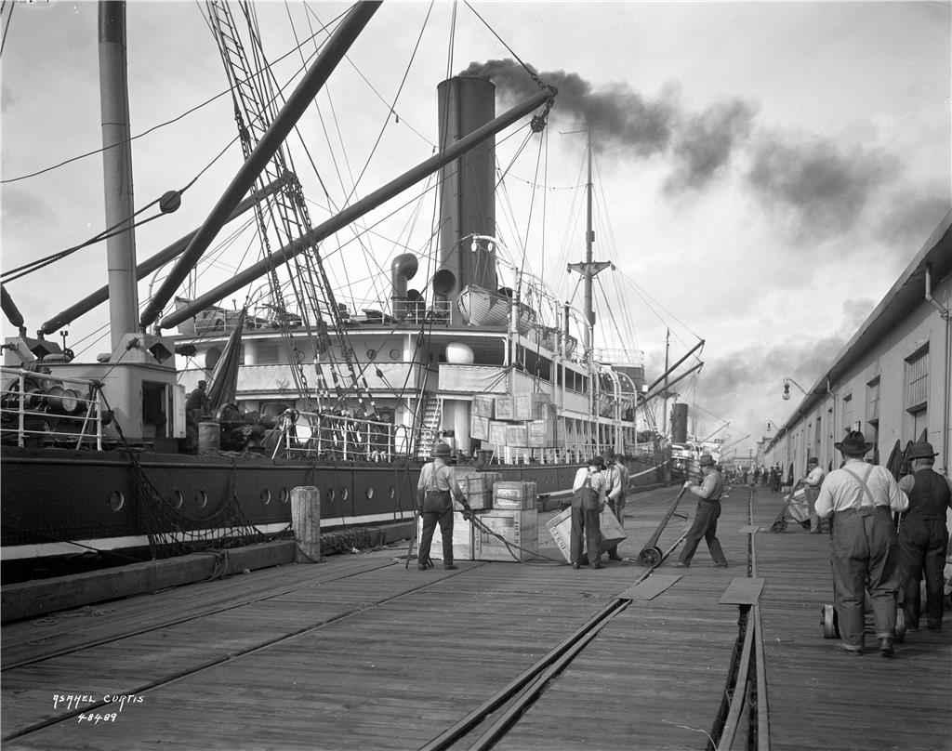
Shipping in the 1950s

Slide 8
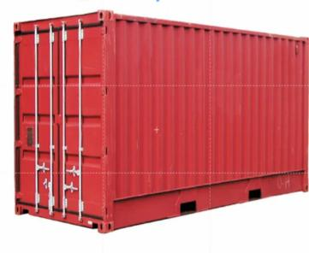
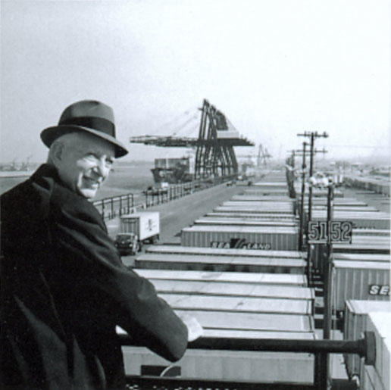
Malcolm McLean

Slide 9
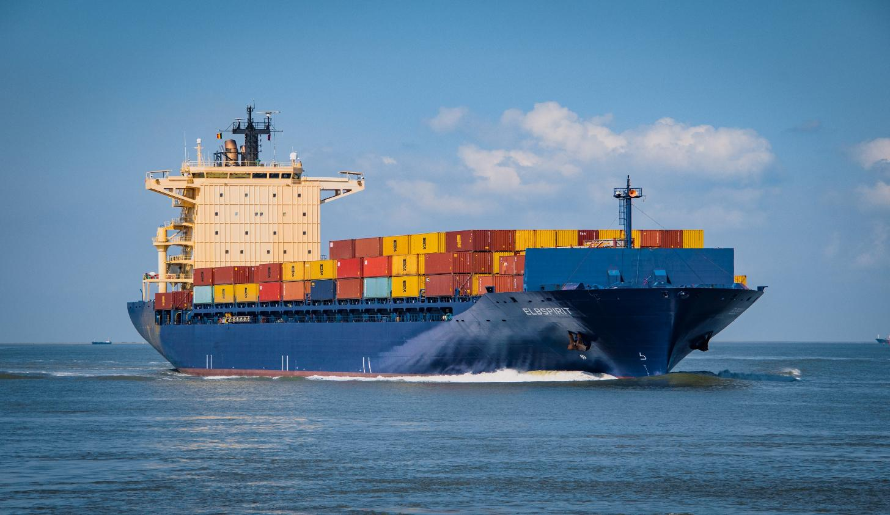
Container shipping

Slide 10
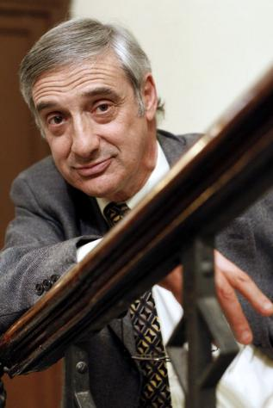
2025 Nobel Prize Winner in Economics
Joel Mokyr

Slide 11
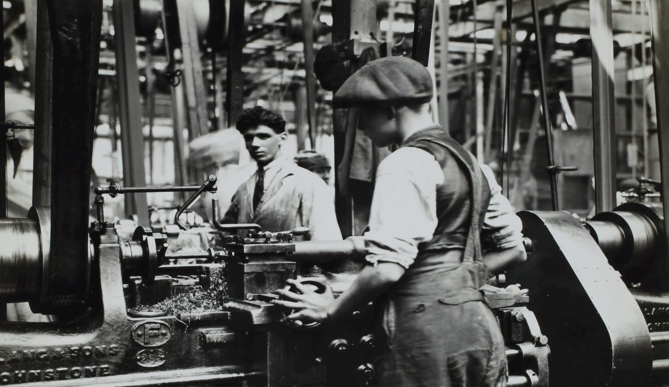
The Industrial Revolution

Slide 12
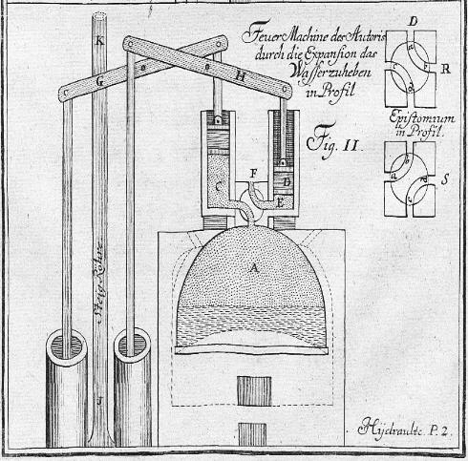
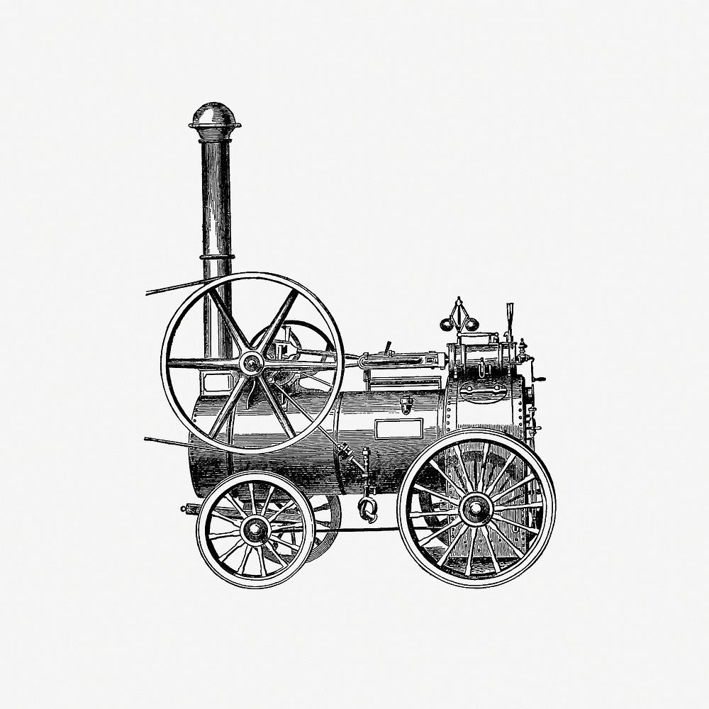
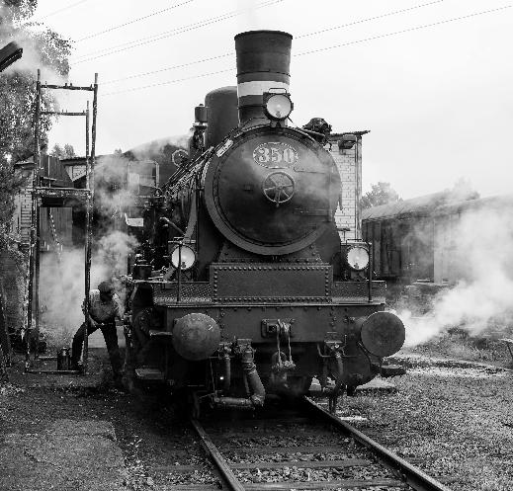
The steam engine

Slide 13
From idea to use
1. KNOWING THAT
2. KNOWING HOW
3. USED IN PRACTICE

Slide 14
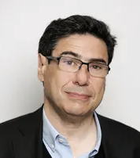
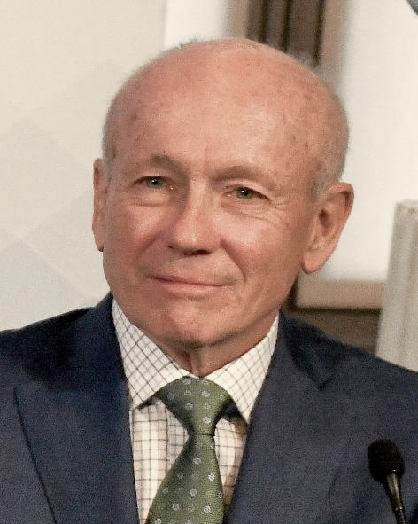
Peter Howitt
2025 Nobel Prize Winners in Economics
Phillipe Aghion

Slide 15
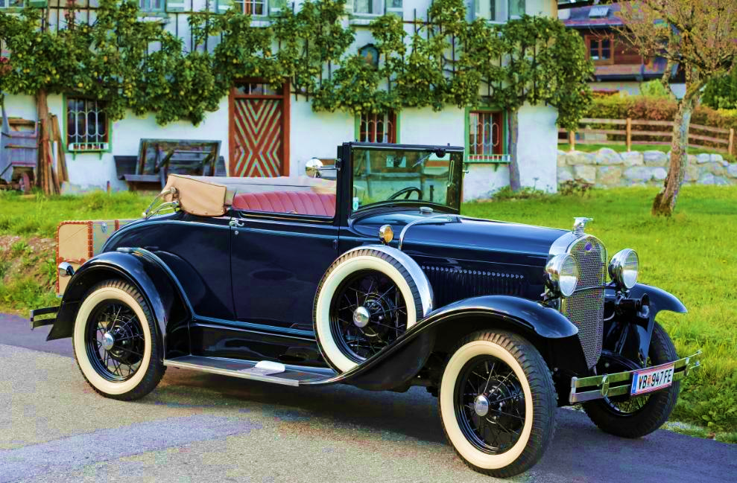
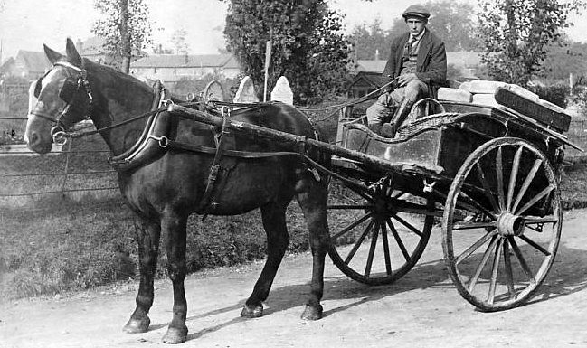
From horse to car

Slide 16

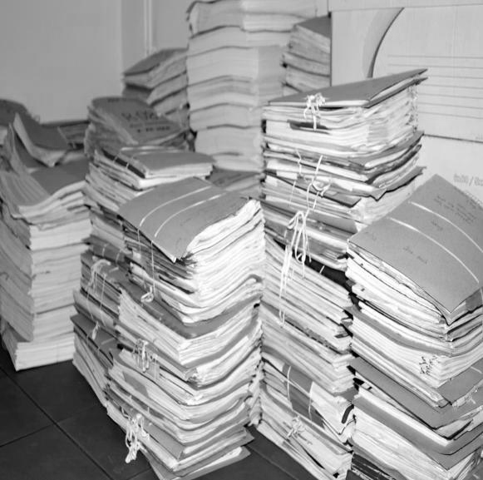
From paper to digital

Slide 17

Innovation growth cycle
1. INNOVATION
2. PRODUCTIVITY GAINS
4. REINVESTMENT
3. ECONOMIC
VALUE

Slide 18
The in-between problem

Slide 19
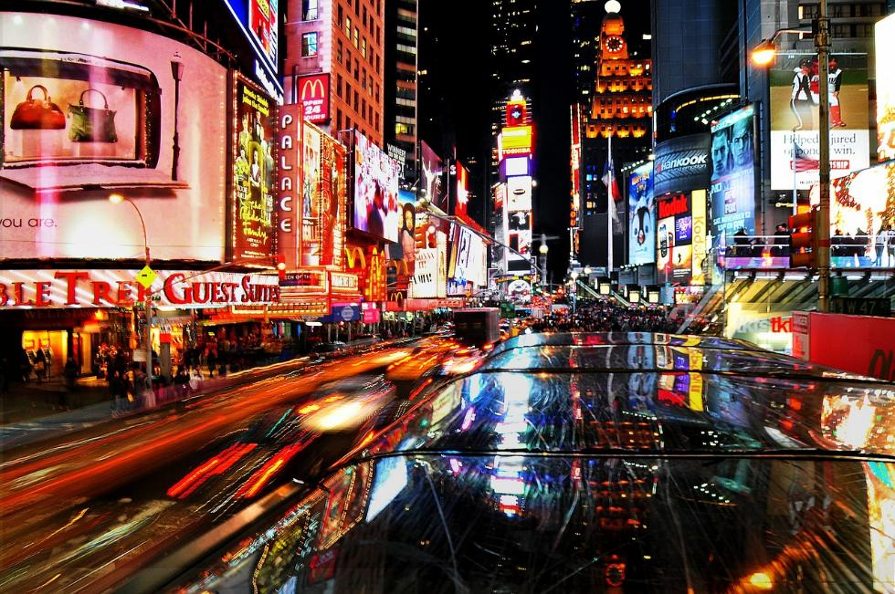
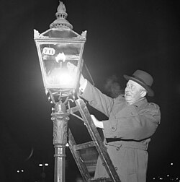
From gas to electric

Slide 20
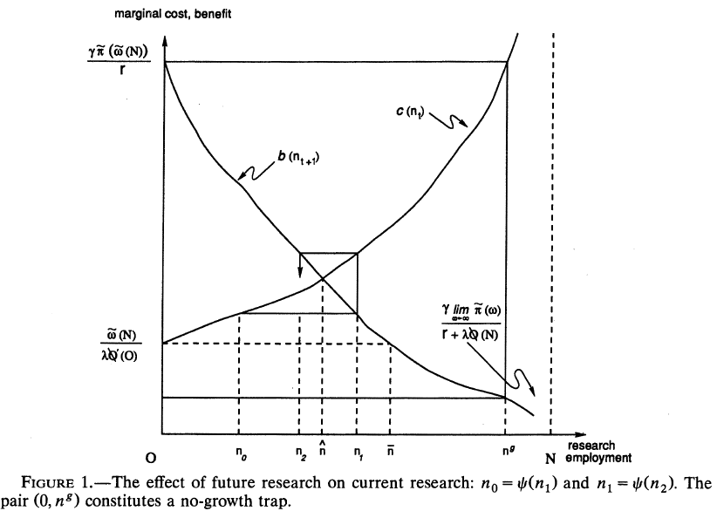
Innovation Equilibrium

Slide 21
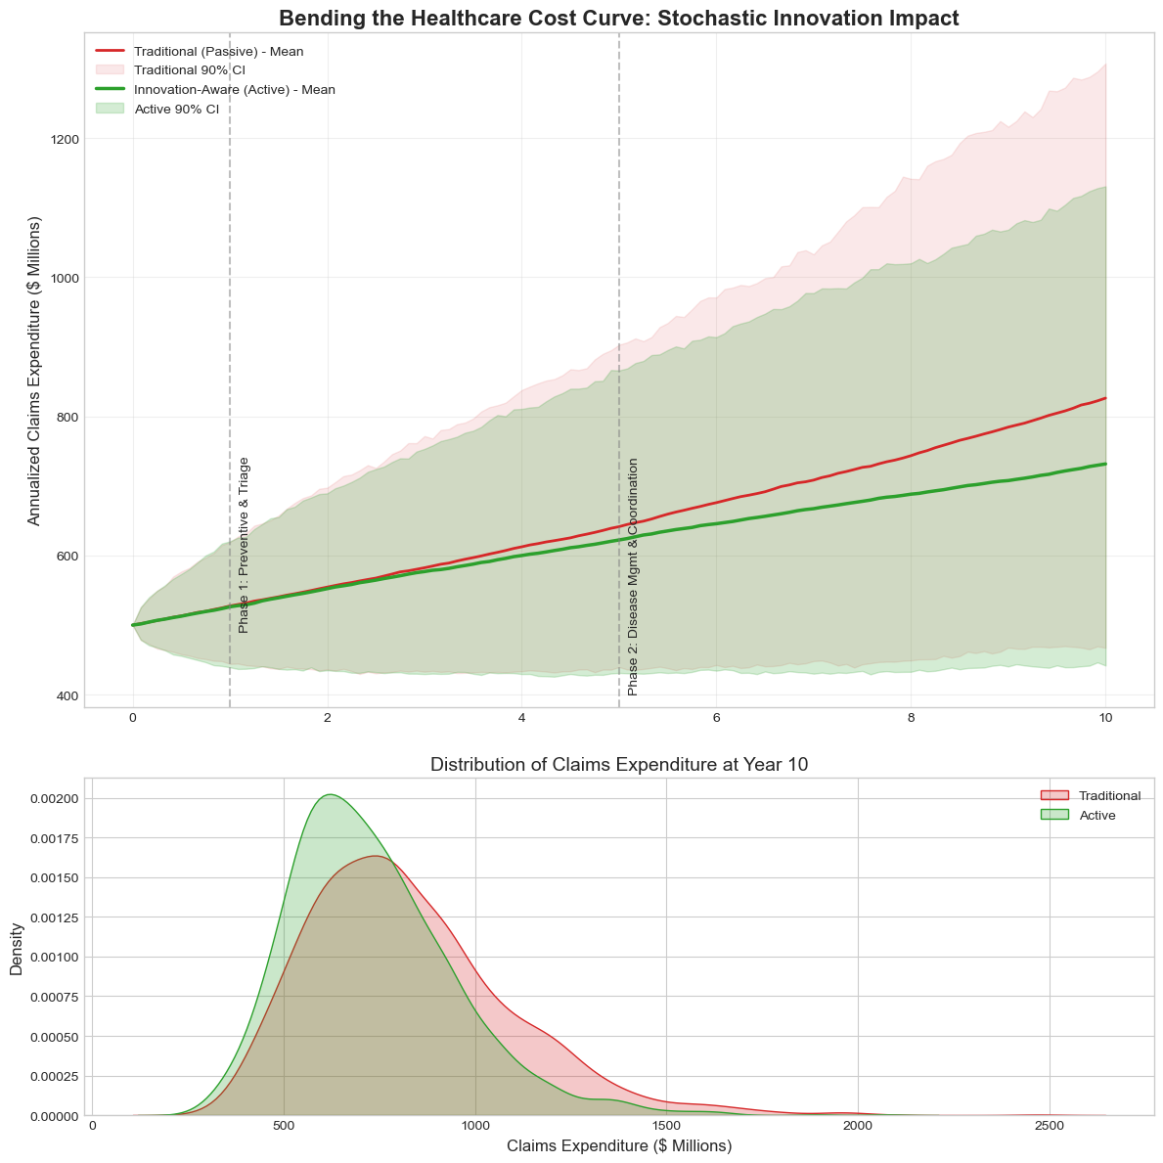
Bending the cost curve
Modelling how cost pathways evolve over time
$$C_{t+dt}=C_{t}exp\left[\left(μ\left(t\right)−\frac{1}{2}σ{\left(t\right)}^{2}\right)dt+σ\left(t\right)dW_{t}\right]$$

Slide 22
Actuaries help good ideas scale.

Slide 23
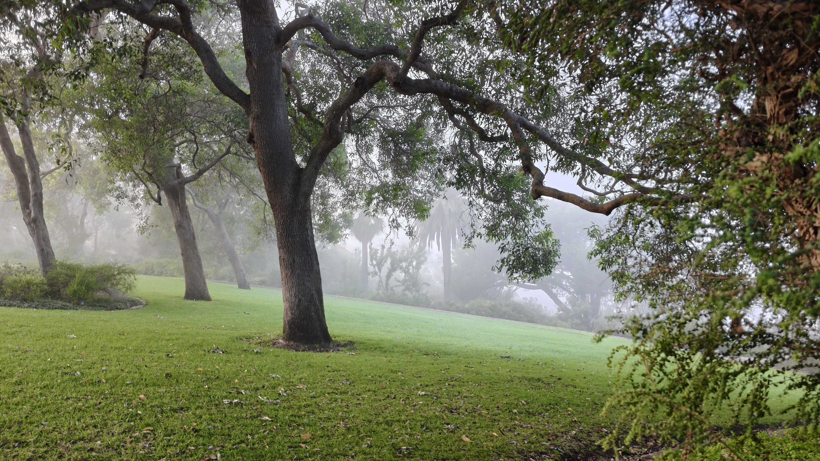
Thank you

