Slide 1
Reputation Risk as a Quantitative Actuarial Practice Area
Colin Priest
May 2026

Slide 2
Contents
Introduction 03
Case Study: Qantas 01-Sep-2023 07
New Tools: ARA and AI 13
Results 20
Ethics and Professionalism 25
Conclusion 27

Slide 3
Introduction
01

Slide 4
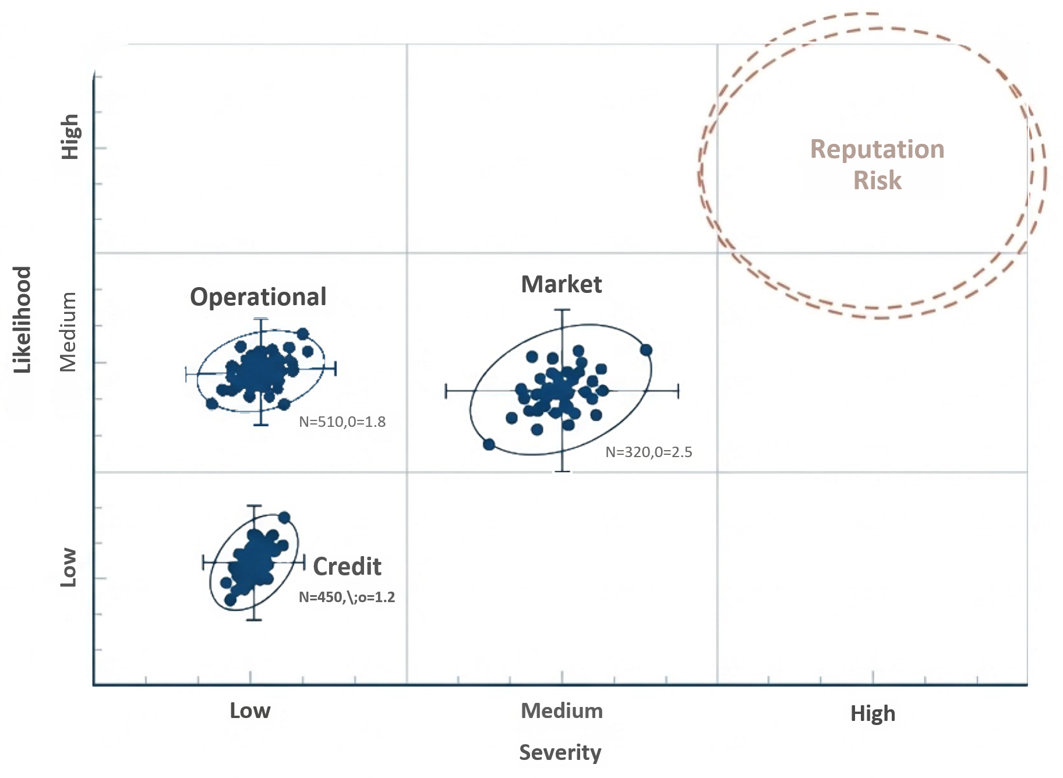
Actuaries Quantify Everything
Except Maybe This…
Reputation risk is a correlated amplifier of all other enterprise risks, yet it remains relegated to qualitative heatmaps.

Slide 5
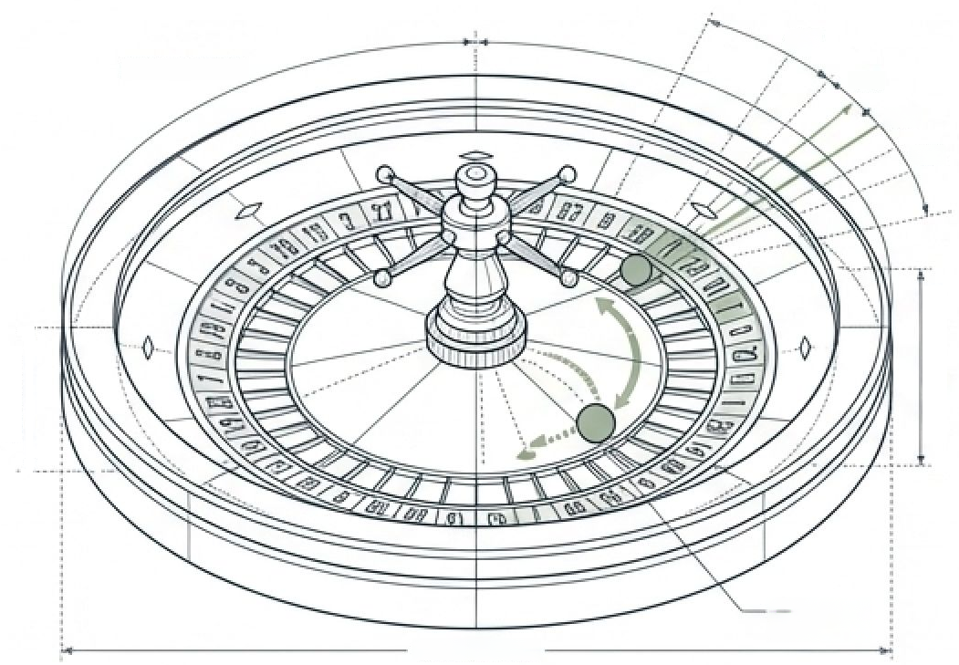
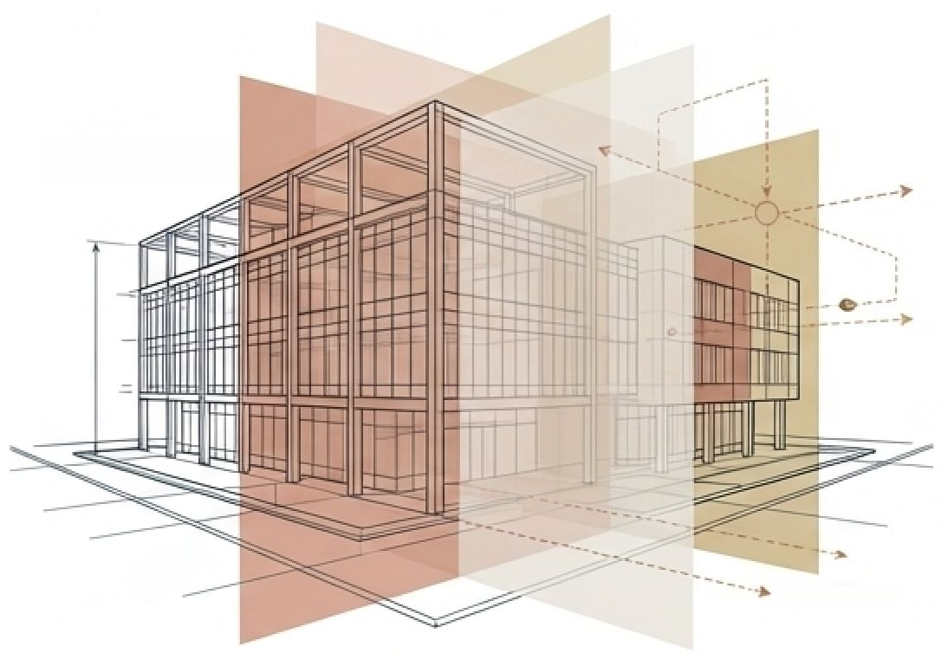

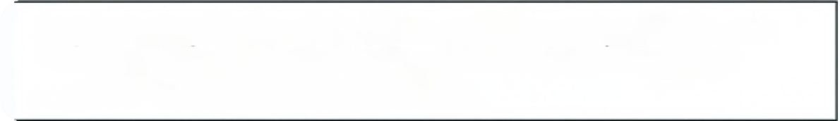
Navigating the Fog of Knightian Uncertainty
Aleatory Uncertainty
Epistemic (Knightian) Uncertainty
CIRCUMFERENCE
1/37
1/98
1/37
1/58
SHIFTING STAKEHOLDER
PERCEPTIONS
UNKNOWN
OUTCOMES
OBSCURED
VISION
PROBABILITY
FIELD
EVENT HORIZON
CIRCUMFERENCE
Traditional Insurance Risk. Outcomes are random, but the underlying
probabilities are known, observable, and strictly stable.
Corporate Reputation Risk. A realm of unknown probabilities and unknown
outcomes. Stakeholder perceptions shift abruptly in response to rare,
unobservable events.
Takeaway: Traditional risk matrices fail in the boardroom because they treat strategic, shifting human responses as static, predictable roulette spins.

Slide 6






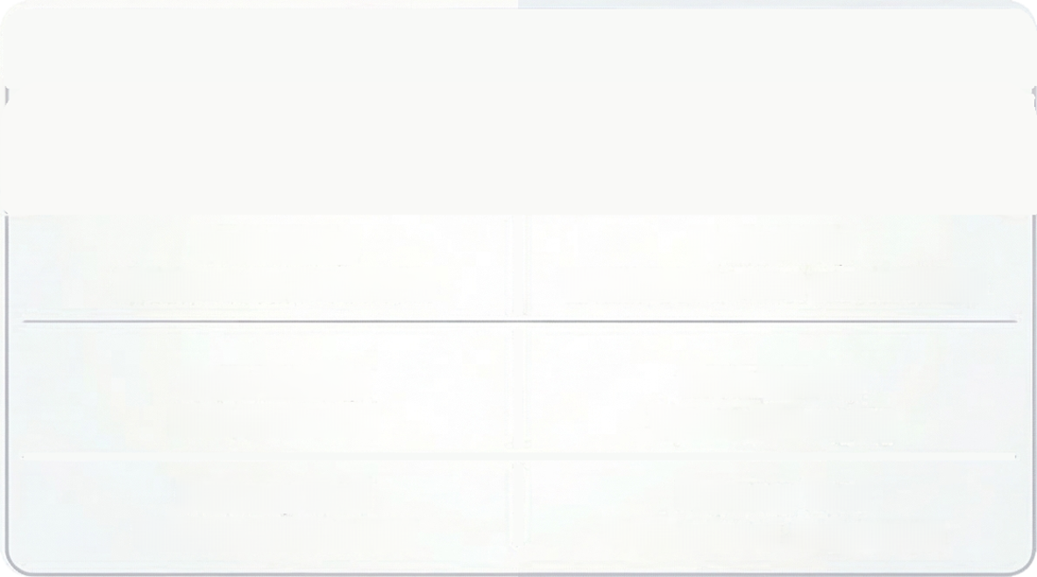










Mastering the Unknowable: Why Actuaries Lead in Knightian Uncertainty
By blending statistical rigour with professional judgment, actuaries turn "unknowable" reputational and strategic risks into actionable management frameworks.
THE ANALYTICAL POSTURE
PROFESSIONAL ACCOUNTABILITY & JUDGMENT
Operating at the
Boundary of Risk
N
Judgement Under
Deep Ambiguity
Actuaries distinguish between
what can be priced and what is
genuinely unknowable.
The Actuarial Control Cycle
manages situations where feedback
is delayed and data sparse.
S
Model Risk as a
First-Class Priority
Institutional
Accountability
for the Unknown
Actuaries are
professionally obligated
to question models when
uncertainty is irreducible.
COMPARISON: TRADITIONAL RISK VS.KNIGHTIAN UNCERTAINTY
Formal responsibility for
solvency forces intellectual
honesty about what is truly
unknown.
TRADITIONAL RISK
KNIGHTIAN
UNCERTAINTY
Probability
Probability
Measurable/Statistical
Unknowable/Non-probabilistic
Data Quality
Data Quality
Rich/Historical
Sparse/Emerging
Fluent in Non-Probabilistic
Reasoning
Primary Tool
Primary Tool
Practical Judgment
Over Inference
Statistical Inference
Professional Judgement
Tools like stress testing explore
plausible outcomes without pretending
to assign exect likelihoods.
Actuarial training prioritises the
human judgment required when
statistical systems fail.

Slide 7
Case Study: Qantas 01-Sep-2023
02

Slide 8
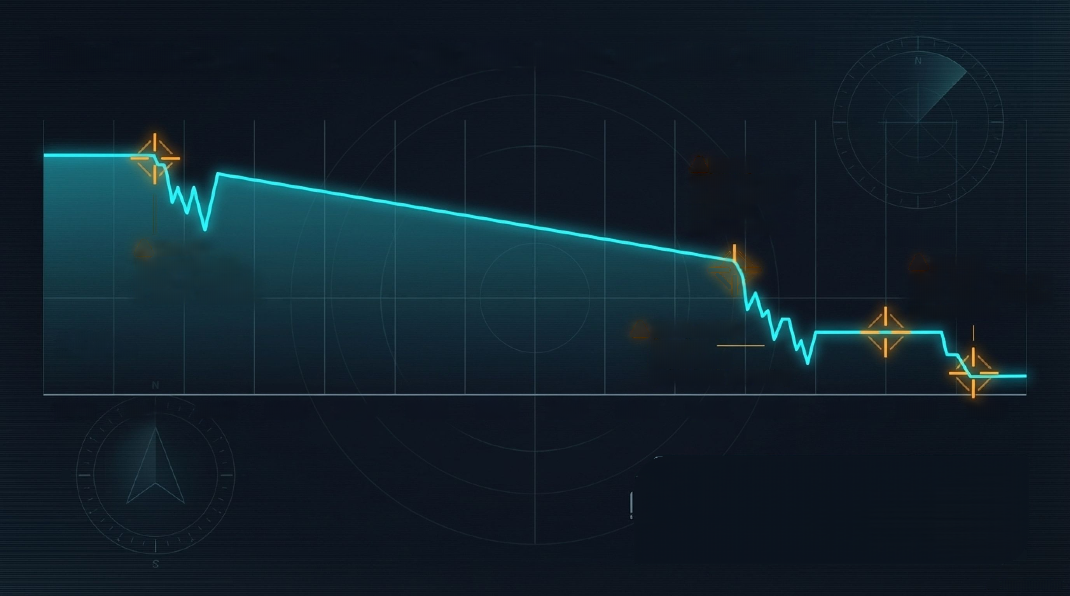





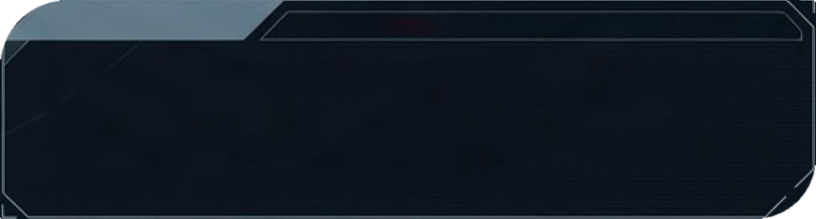



N
Qantas: The perfect Australian stress test
W
W
E
E
[2020]:
COVID-19mass
stand-downs &
unlawful
outsourcing
S
5
ALT:58.000FT
D4IAINTEGRITY:$9.6
6
[2011]:
Unprecedented
fleet grounding &
labour conflict
[2023]:
High Court loss &
ACCC Ghost Flights
prosecution
ALT:55.608 FT
VELOCITY:4DB HTS
DATA INTEGRITYS0.BS
[2022-2023]:
Service
failures &
N
political
scrutiny
2010
2011
2012
2013
2014
2015
2016
2017
2018
2019
2020
2021
2022
2023
E
AVIATION DASHBOARD
BATA EXTESRITT:
GATTECN.
ALFI:
STMTESTE REALIGOERT BEOJIRES
514r05
ENcADo
We use Qantas because the outcomes are known, the
governance stakes were highly public, and the
sequential decisions were visible. Reputation damage is
cumulative, not an isolated scandal.
8

Slide 9


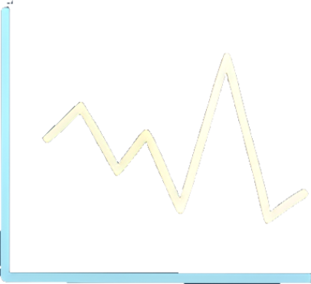


The CEO's Radar:
Why Fuel Prices
Trump Reputation Risk
FINANCIAL & OPERATIONAL
DOMINANCE
PROFIT WARNINGS
HIGH FREQUENCY (~35 EVENTS)
FUEL COSTS
Profit warnings, fuel costs, and
market volatility drive share
price drops.
HIGH FREQUENCY (~30 EVENTS)
Tangible costs have immediate,
measurable impacts.
MARKET
VOLATILITY
REGULATORY
ISSUES
REPUTATION DAMAGE
THE AVIATION EXECUTIVE'S CALCULUS
VERY LOW FREQUENCY (<5 EVENTS)
Reputation damage and regulatory
issues account for only a tiny
fraction of downtums.
OLIGOPOLY
INSULATION
SHORT-TERM
MARKET RESPONSE
High market concentration
limits dissatisfied customers
switching, protecting
revenue.
High-profile repulation
crises are poor predictors
of short-term share price
movements compared to
cost spikes.
CEO PRIORITY
CEOs focus on fuel due to direct,
data-rich impact, unlike the indirect
pathways of reputation.
9

Slide 10

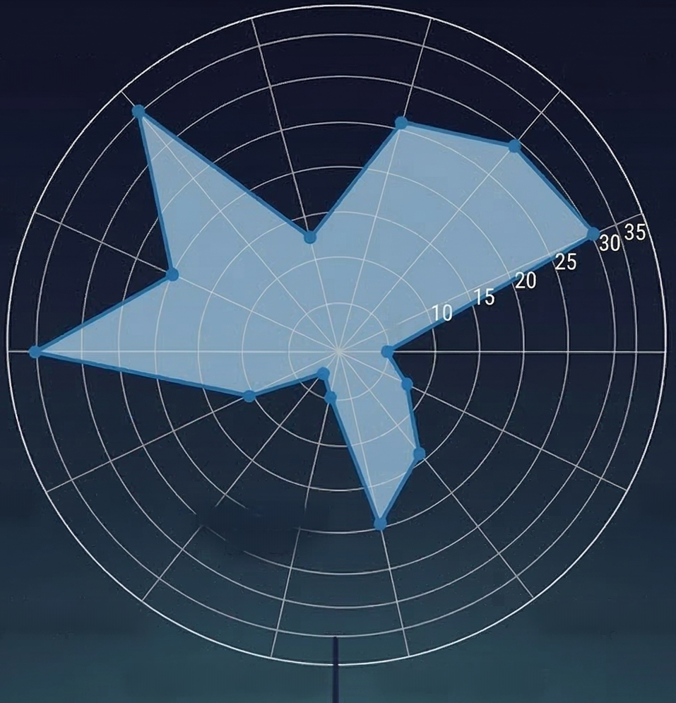

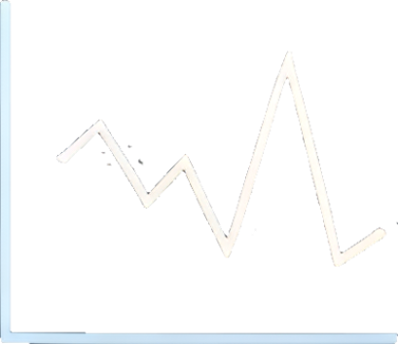



The CEO's Radar:
FUEL COSTS
Why Fuel Prices Trump
Reputation Risk
Industrial action
Fuel costs
(30 EVENTS)
Market volatility
Competition
PROFIT WARNINGS
HIGH FREQUENCY(~35EVENTS)
FUEL COSTS
Operational
disruptions
COVID-19
Profit warnings, fuel costs, and
market volatility drive share
price drops.
HIGH FREQUENCY (~30 EVENTS)
Tangible costs have immediate,
measurable impacts.
5
Profit warnings
Analyst downgrades
Profit-taking
REGULATORY
ISSUES
Technical adjustment
REPUTATION DAM
THE AVIATION EXECUTIVE'S CALCULUS
VERY LOW FREQUENCY (<3 EVENTS)
Reputation damage and regulatory
issues account for only a tiny
fraction of downtums.
Regulatory issues
Strategic changes
Reputation damage
Safety incidents
OLIGOPOLY
INSULATION
SHORT-TERM
MARKET RESPONSE
High market concentration
limits dissatisfied customers
switching, protecting
revenue.
High-profile repulation
crises are poor predictors
of short-term share price
movements compated to
cost spikes.
CEO PRIORITY
CEOs focus on fuel due to direct,
data-rich impact, unlike the indirect
pathways of reputation.
10

Slide 11


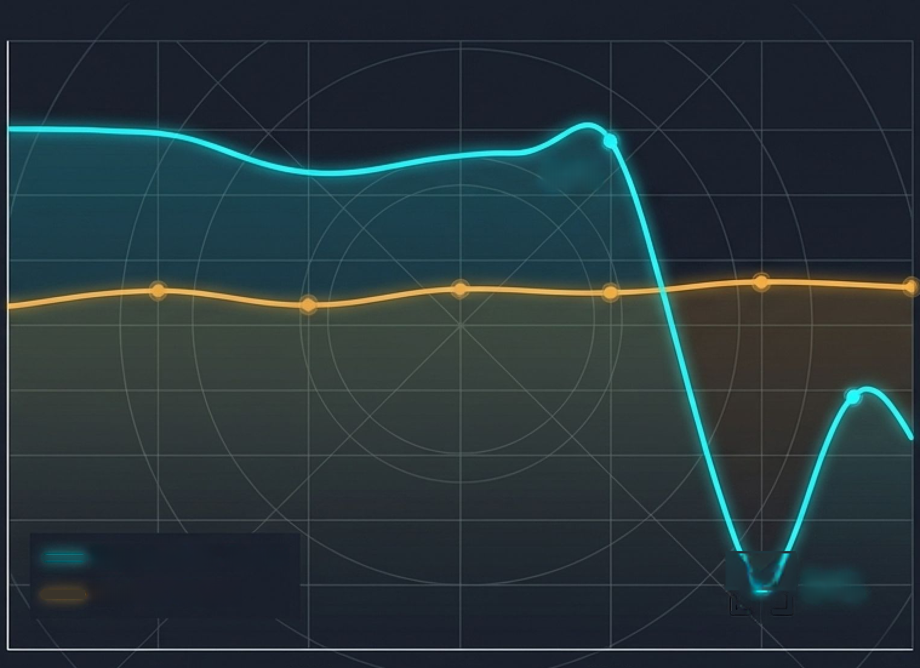







The Oligopoly Shield: Why customers aren’t the primary strategic actors
108%
108%
OBSERVATIONS
81%
85%
Customer trust fell sharply,
but in an oligopoly with
fixed supply, passengers
couldn't easily switch.
81%
75%
70%
70%
65%
Naive models assume
reputation damage flows
cleanly into immediate
revenue loss. They are
wrong. Customer anger is
a background force, not
the direct threat.
60%
60%
65%
64%
60%
53%
75%
50%
Reputation Score
60%
Market Share
51%
51%
65%
51%
2010
2012
2015
2017
2020
2023
2025
AVIATION
ALT:35.600FT
Roboto Mono
DASHBOARD
VELOCITY:4BO NTS
CRITICAL
DATA INTEGRITY:
11

Slide 12
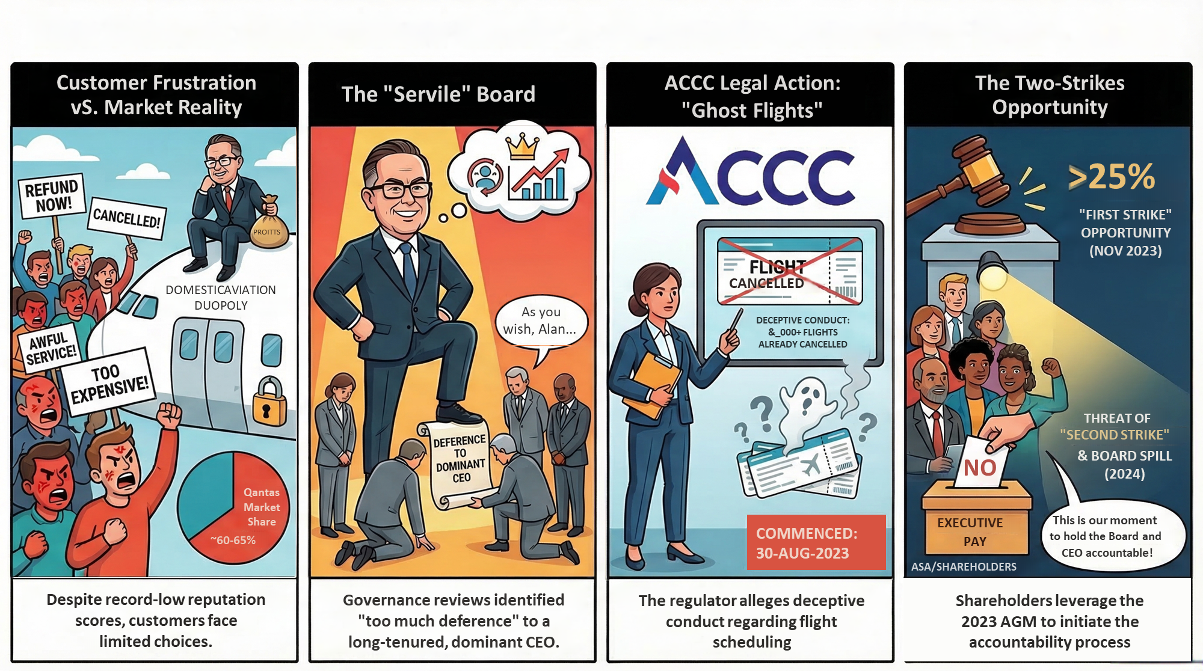
The Qantas Governance Crisis: A Strategic Crossroads (Sept 2023)

Slide 13
New Tools: Adversarial Risk Analysis and AI
03

Slide 14
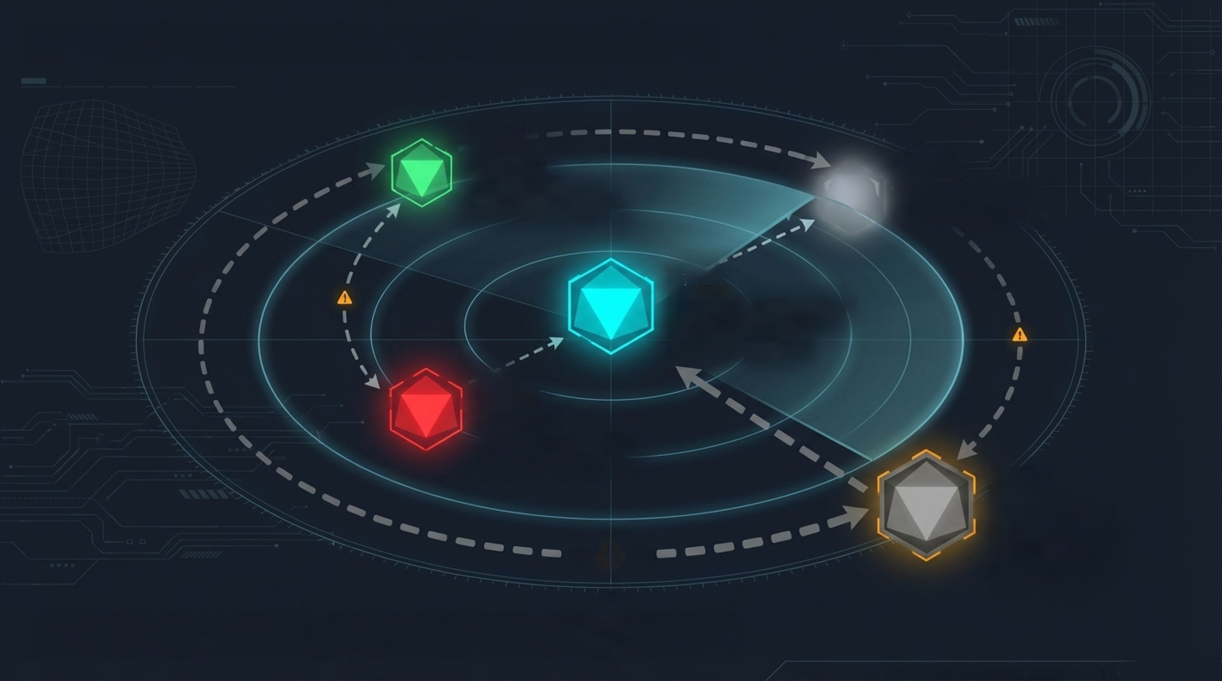




This is a multi-actor strategic system
200 1t
VEL4S0 ETG
ALT:95.688FT
STRTOS:
ERITICAL
TOUSUEOCE:1IOON
VEL:4502T8
ALT:95.600FT
JKFLUENCE:HIG
H
The ASA
Governance activists
coordinating retail vote
Shareholders
The final voting block
YEI
S8E ATS
55.AMRFT
ALE
STATUS!
CRITIEAL
The Qantas Board
280D
(Focal decision-maker;
fears liability & spill)
1000s
260 18
500 0.
SOD
VEL:450UTS ALT
SERCGYT
STSTOS-CIOTICAL
INFLUENCE.HIGH
The CEO
Dominant, resistant to
external accountability
VELND ETS
AIT-SCRHFT
STBTUS-ERICAL
PNFLUENCEIHGH
Regulators
(ACCC/FWO)
Heavy
background
gravitational pull
5000
Reputation management is not the company vs. the public. It is a delicate sequence
of moves and countermoves among strategic actors with conflicting utilities
14
AVIATION DASHBOARD
ALT.
S6,000FT
VELOGITT
510 RTS
STATUS.
ENGAGED
BA

Slide 15


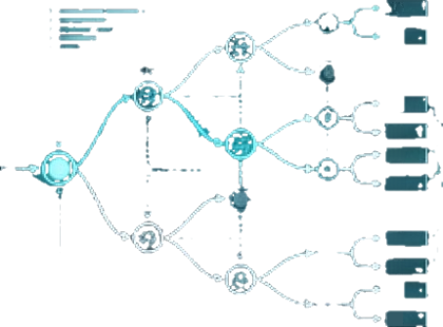













N
Adversarial Risk Analysis (ARA): Modeling
opponents you don't fully understand
03
COL
OEd
GDt
CME
01:02
po
but not
Trert
10
C6I
ODP
P12
DooT
CME
DAE
The image is too blurry to recognize any text content.
L
DHZ
DSA
reo
911
D.ES
Traditional Heatmaps
Standard Game Theory
Adversarial Risk Analysis (ARA)
Verdict:Too simple.Ignores
strategic responses entirely.
Verdict: Assumes too much.
Requires common knowledge
(everyone perfectly knows what
everyone else wants).
Verdict:
Just right. A Bayesian
framework that lets you model
sequential decisions when
opponents have hidden motives,
constraints, and resources.
15
AVIATION DASHBOARD
DATA INTEGRITY:CRITICAL
ALTITUDE:DECISION POINT
STATUS:ENGAGED

Slide 16















十
Some risks fight back.
Traditional Risk
(Credit or
Mortality)
Strategic Risk (Activist shareholder,
angry CEO, regulator)
十
SSHA
500
LOCY-ON
nutarai
FOC10
on
DNNO
DAEY
OIA
LOON
LECK.ON
HEAF-SONR
The image is too blurry to recognize any text content. SETEa
OATA
MEAT
SEO
0O9 NOOS
000
BOES
GroGe
LDCA-CH
rima
DIORNT
EE
It doesn't read the
newspaper. It acts blindly.
You cannot model reputation risk as a
static probability. It reacts dynamically to
your defensive maneuvers.
+
AVIATION DASHBOARD
I
RESKTRAJECTORY:DYNANIC
ALTITUDE:CRITICAL
DECISION POINT
STATUS:ENGAGED
16

Slide 17
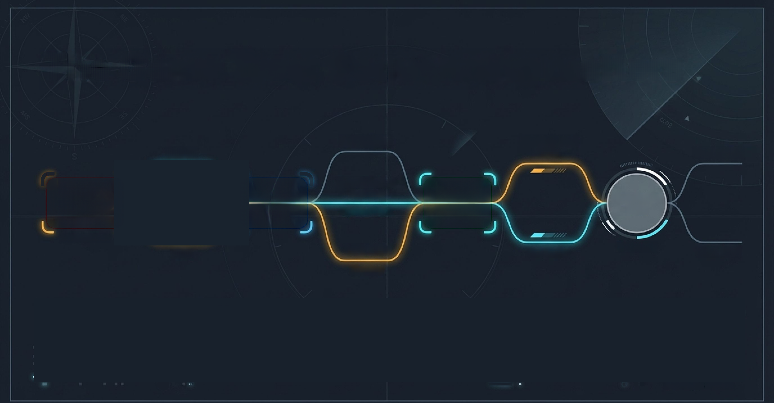
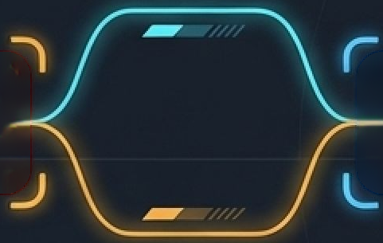
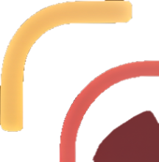












The Game Tree: Sequencing matters
Do Nothing
Recommend
Strike
Resign
Under 25%
Commission
Review
CEO
Move
Board
Move
ASA
Shareholder
Optimal Path
Move
Vote
Roboto Mono
Telemetry
Stay
Sack CEO
No Strike
Over 25%
Warning
Every move changes the next player's incentives. We map the crisis as a turn-based
sequence to calculate expected utilities at the end of every possible timeline.
Inter Light
Roboto
AVIATION DASHBOARD
DATA INTEGRITY:
CRITICAL
ALTITUDE:
DECISION POINT
STATUS:
ENGAGED
17

Slide 18



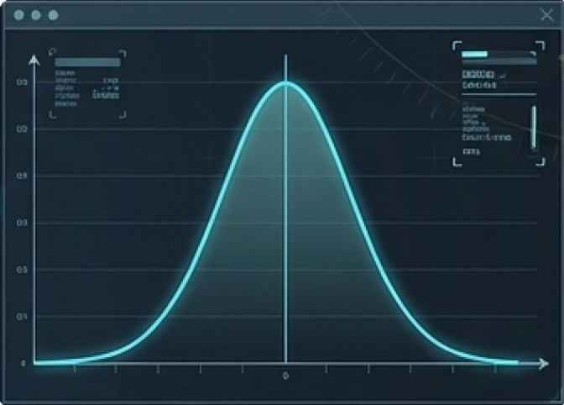

240
Modelling people when data are thin
News
Legal
Charters
DVI DHODOT
DENS OCLT
DOFCEXNI
14TOGe
088
Biographies
Historical
base rates
GenAl Digital Twin
Elicitation (LLM
Prompt Engine)
Unstructured
Evidence
Structured Outputs
(Bayesian Priors)
Instead, we use LLMs and Temperature
Sampling across hundreds of
counterfactual scenarios to generate
structured priors.
These simulated priors are strictly
constrained by empirical base
rates. The LLM is an instrument,
not an oracle.
We cannot interview the
Qantas Board, ARA, or CEO.
18
AVIATION
DASHBOARD
DIGITAL
TWIN
ELICITATION
ALTITUDE:STRATEGIC OVERSIGHT
STATUS:OPERATIONAL

Slide 19
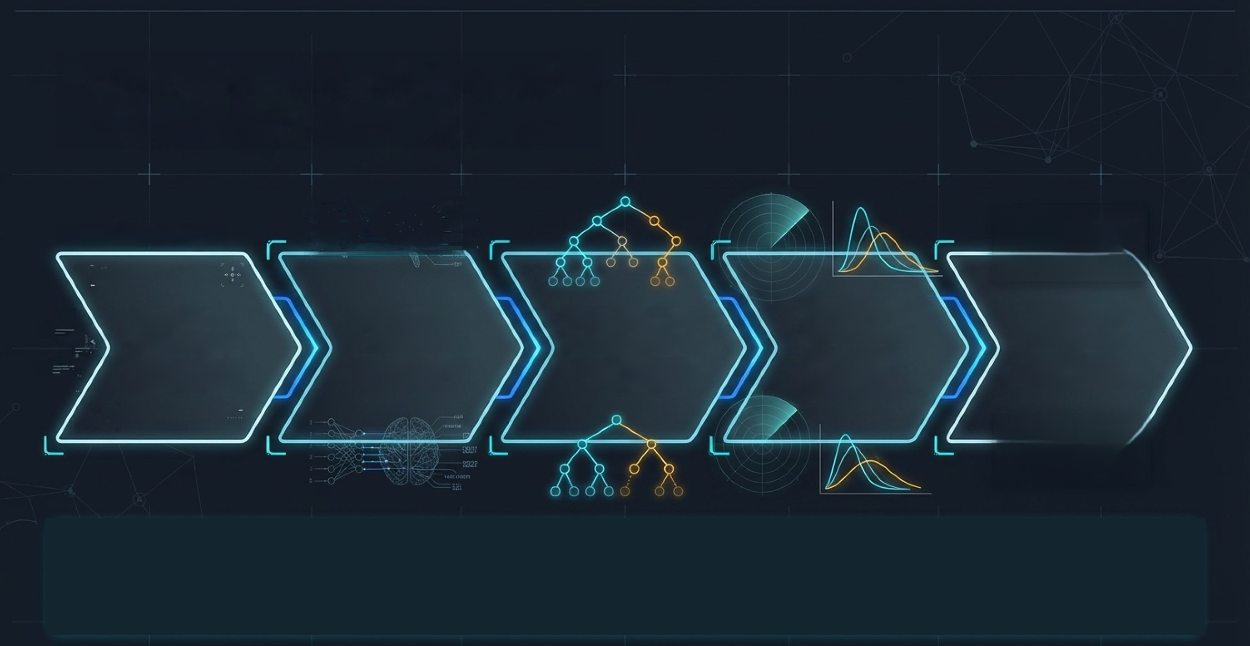

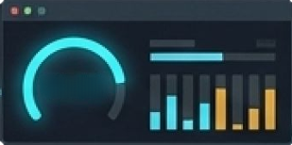







From qualitative beliefs to
probability distributions
Actuarial Engine
V4.89
DATA:VOTES_RESTA_SENT
Evidence
Gathering
Digital Twin
Priors
Scenario Tree
Construction
Simulated
Outcomes
Expected
Utilities
(Historical voting,
media sentiment)
(GenAl scenario
elicitation)
(The Sequential
Game Tree)
(Monte Carlo
integration,
Dirichlet noise)
(Argmax-count
decision probabilities)
BATA:VOTES_HLDIA.SEHT
No science fiction. Just
rigorous actuarial work.
We transform unstructured
crisis narratives into
mathematically coherent
predictive distributions.
19
AVIATION DASHBOARD
DATA INTEGRITY:
CRITICAL
ALTITUDE:
ANALYTICAL
FLIGHT PATH
STATUS:
OPERATIONAL

Slide 20
Results
04

Slide 21
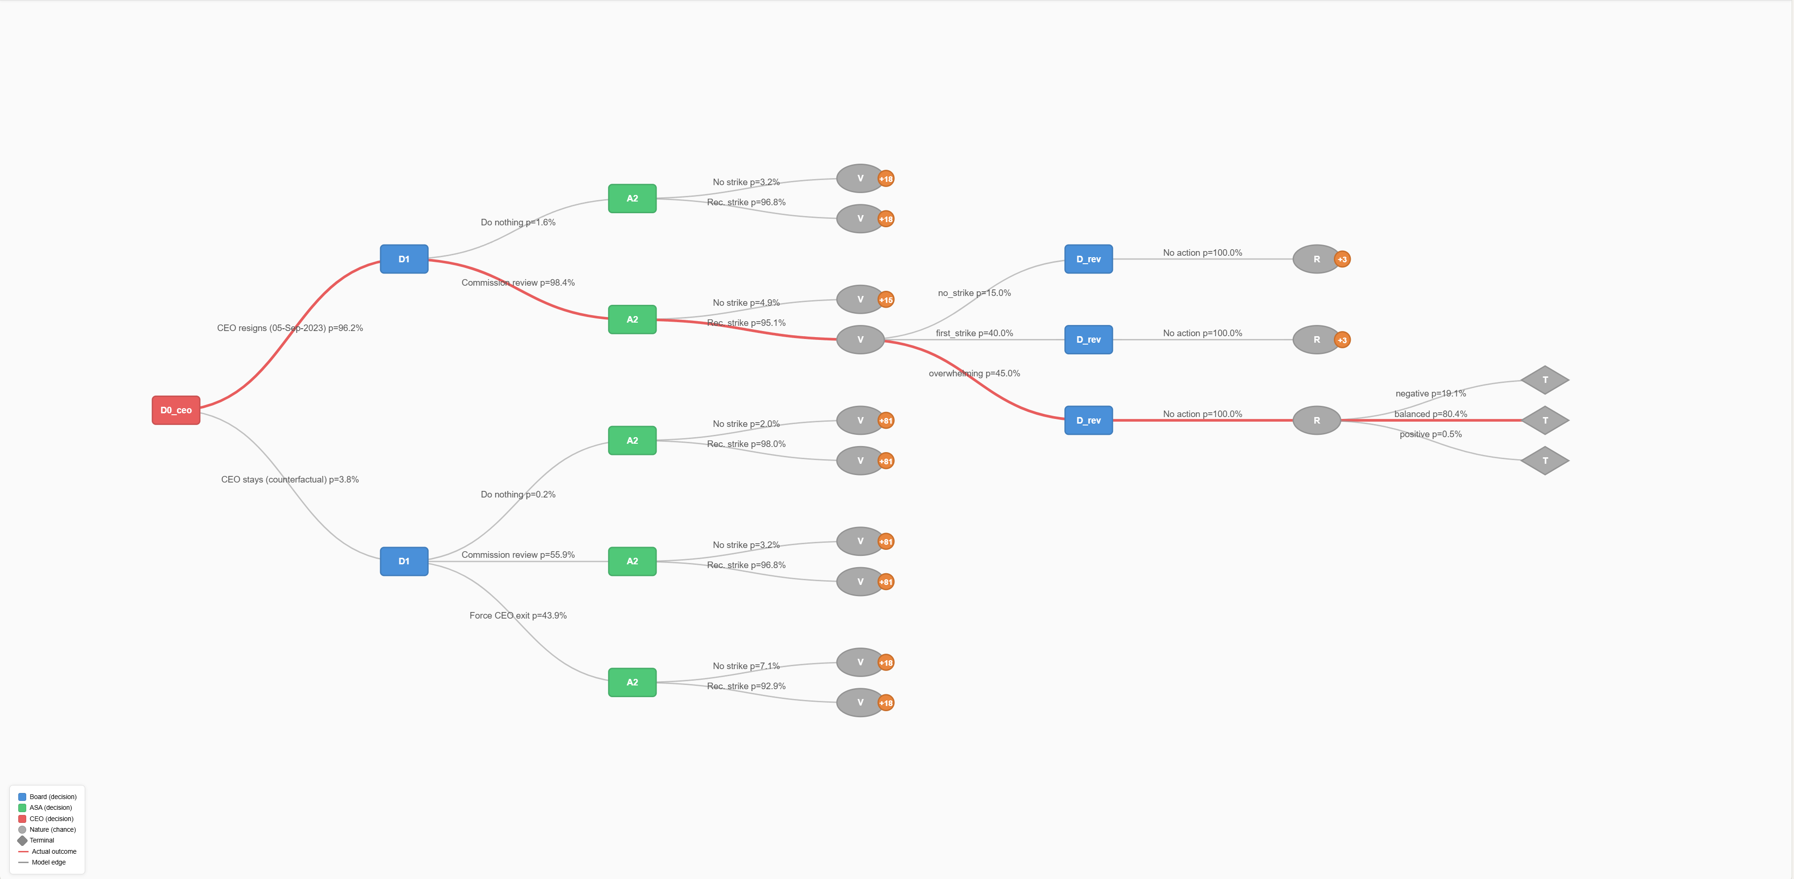
Game Tree
Stochastic

Slide 22
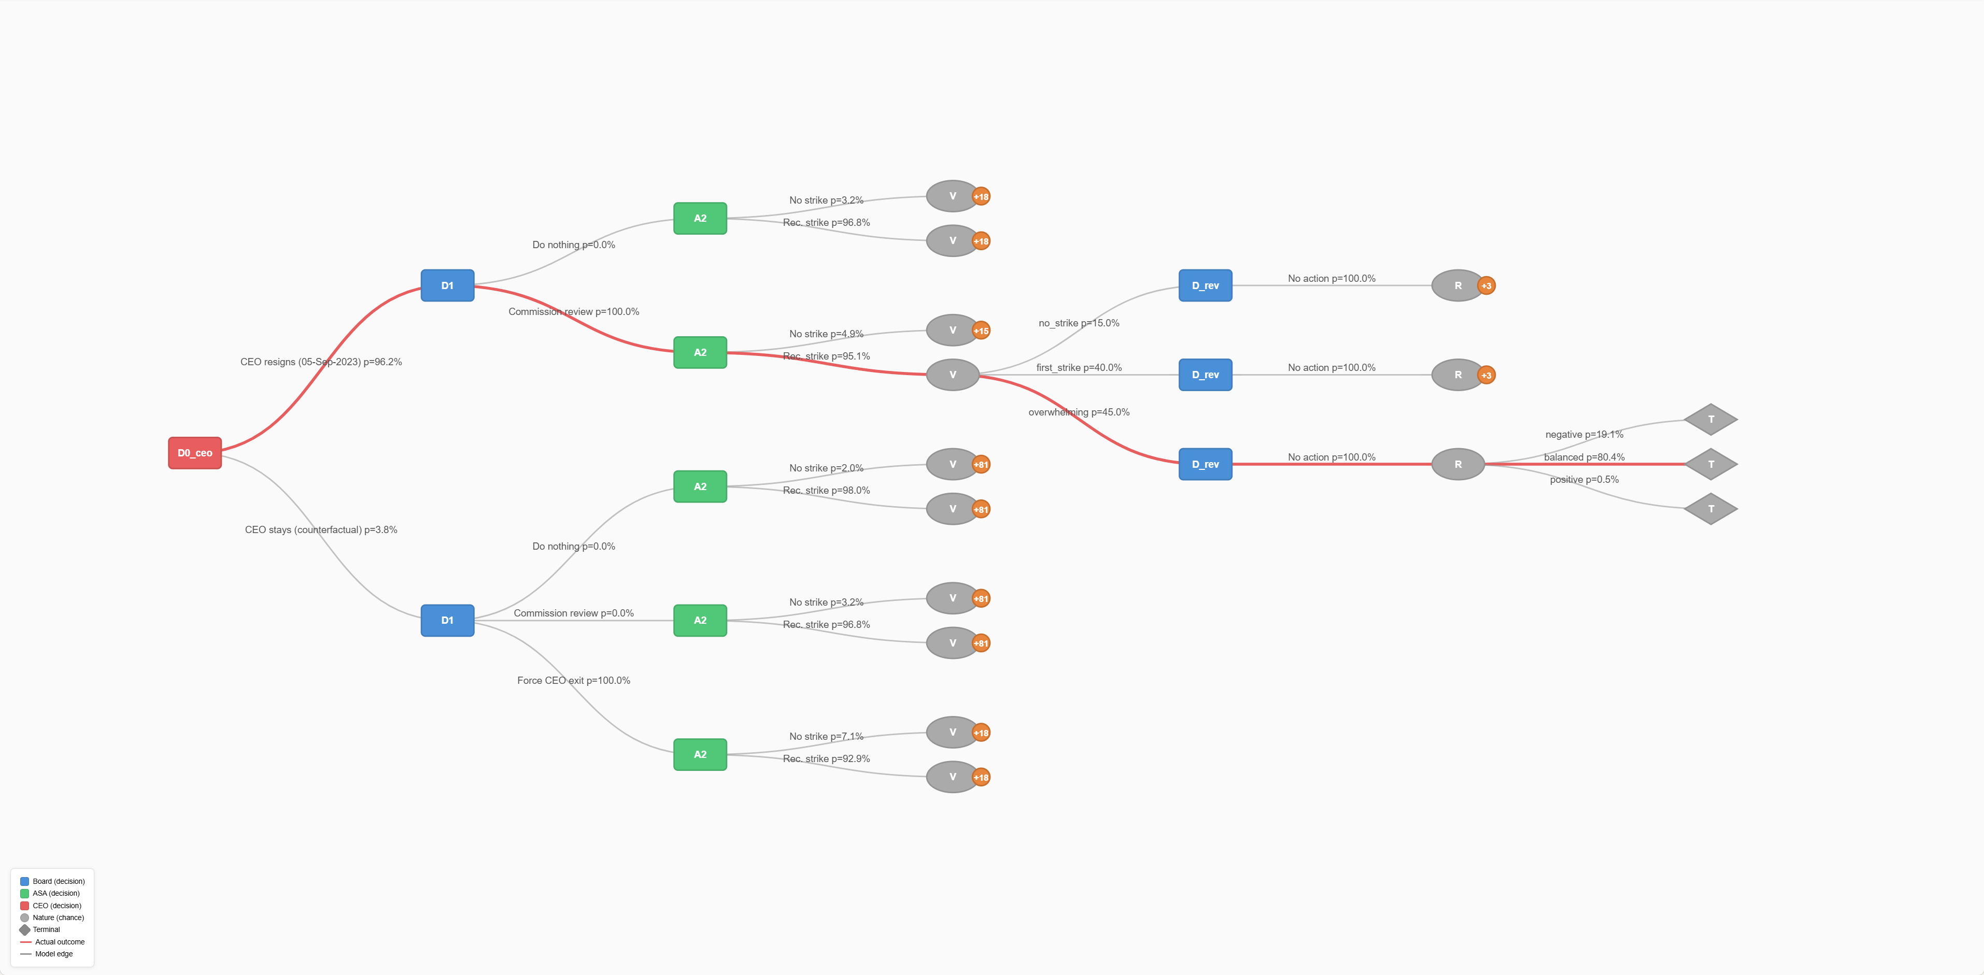
Game Tree
Board-Focussed Strategic

Slide 23
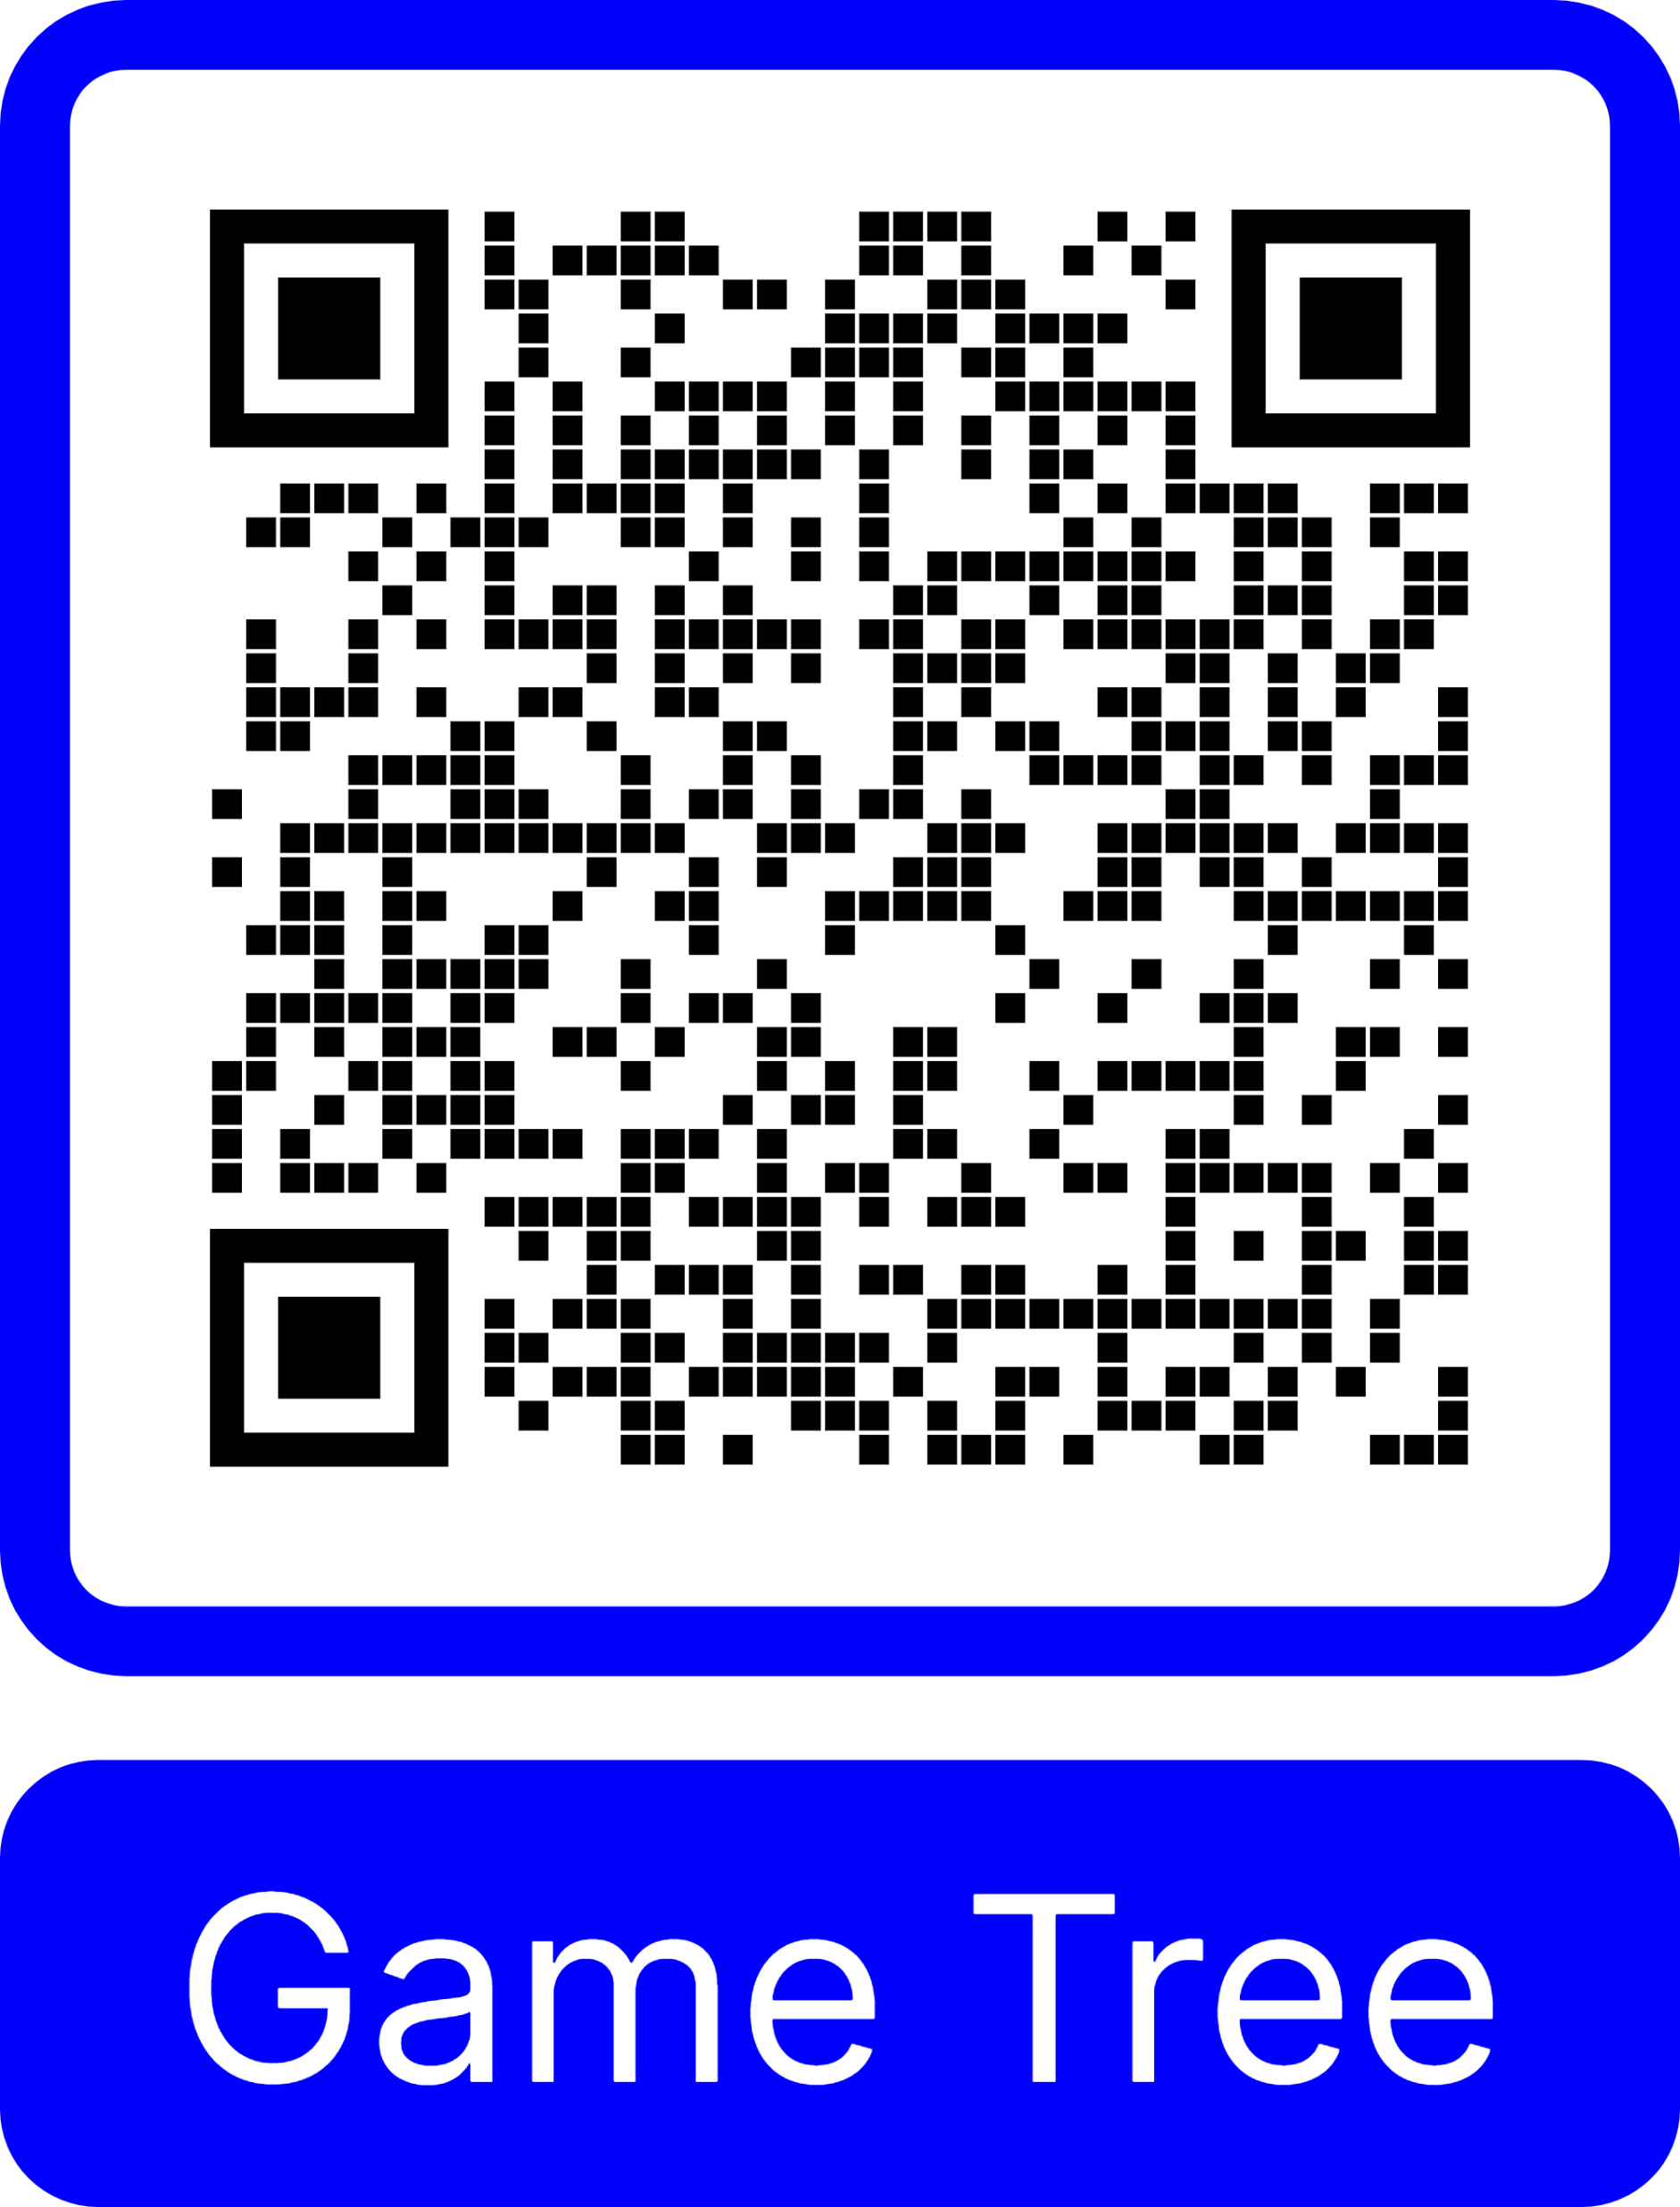
Game Tree

Slide 24

The Value of Information: Stop waiting for the smoke to clear
N
Action-Dominant
Core Insight:
The Value of Information (Vol) for waiting to
see what the ASA or Shareholders would
do was mathematically calculated at zero
(0.019 EU difference).
Execute
& Refine
!
Qantas Crisis
Speed Required (Low to High)
Strategic Takeaway:
The Qantas event was an
Action-Dominant
Monitor
& Wait
Information
- Dominant
crisis.
Early decisive action (commissioning
a review) dominated delayed action
across all downstream states. In these
regimes, the
Board's priority must be
speed of response
, not
intelligence
Information Clarity (Low to High)
gathering.
24

Slide 25
Ethics and Professionalism
04

Slide 26
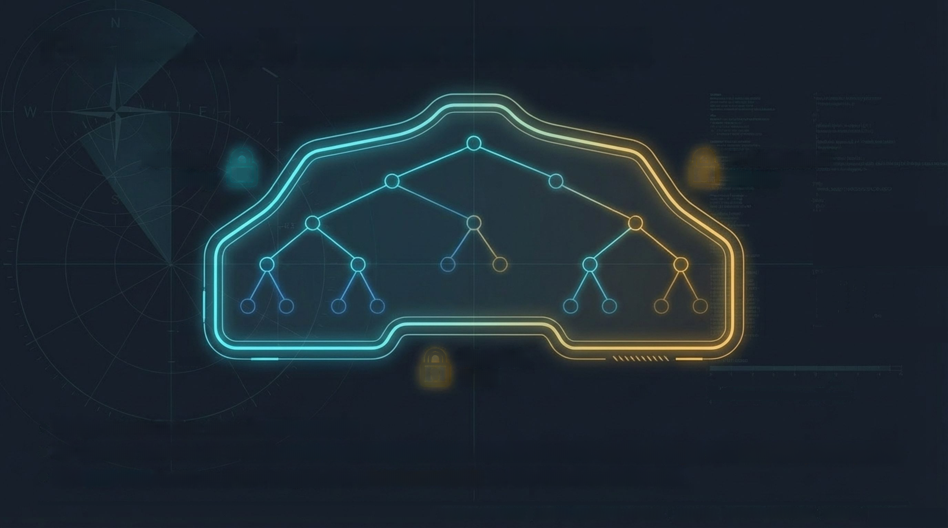



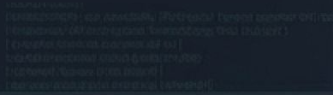








The Actuary is
not just a strategist
+1000
Fiduciary
Professional
Duty
P
Ethics
3800
2800
The Pub
Test
Utility maximisation alone is
not enough.
An actuary advises on what is
mathematically optimal
only within what is
ethical, legal,
and
societally acceptable.
The
pub test
is not an afterthought; it is a
hard constraint
on the feasible action set.
26
AVIATION DASHBOARD
ETHICAL
INTEGRITY:
CRITICAL
ALTITUDE:
STRATEGIC OVERSIGHT
STATUS:
AC

Slide 27
Conclusion
05

Slide 28

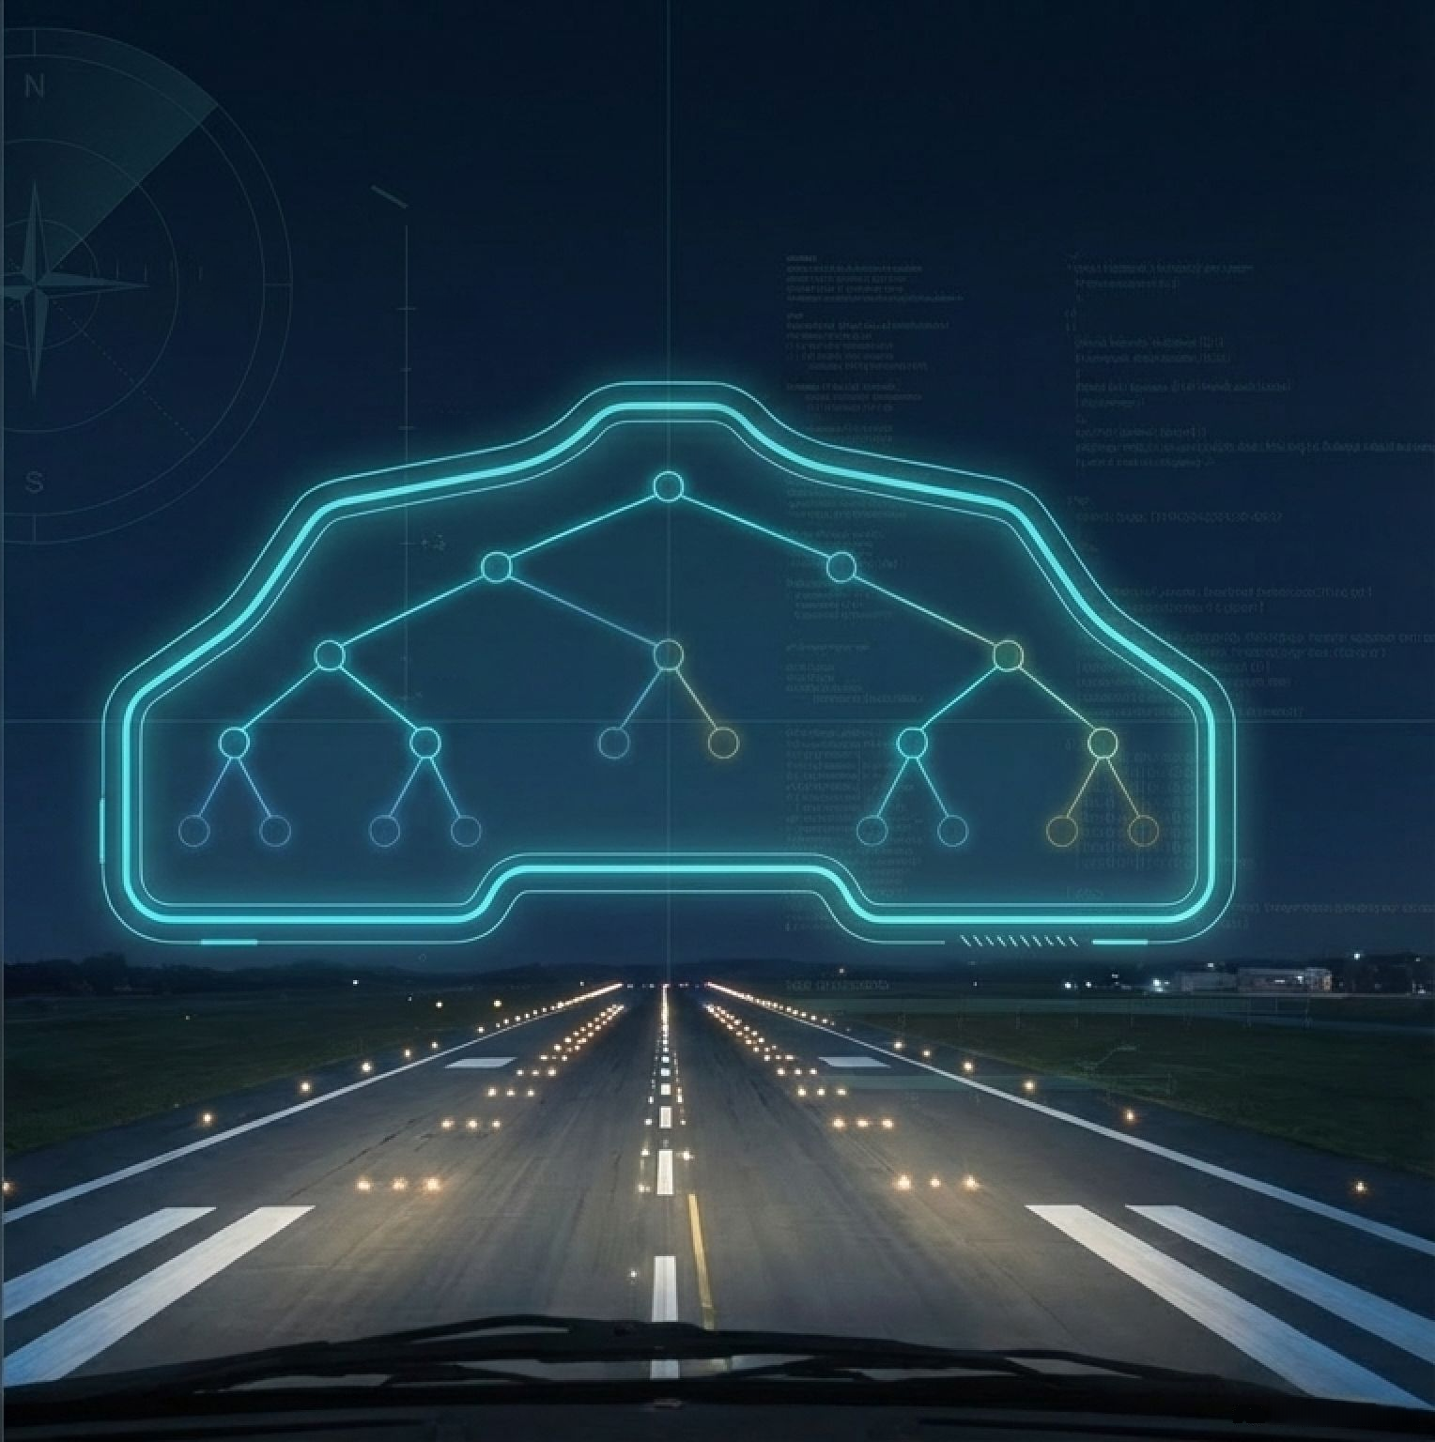



A new quantitative
actuarial practice area
E
+1000
Reputation risk is not beyond
quantification.
000
It is a data-poor, strategically
interactive risk.
TOOO
That is exactly why actuaries
are the top professionals
equipped to lead it.
From heatmaps
to game trees.
28

Slide 29

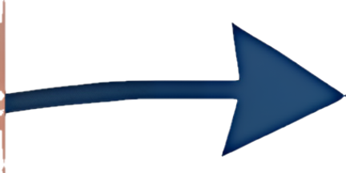


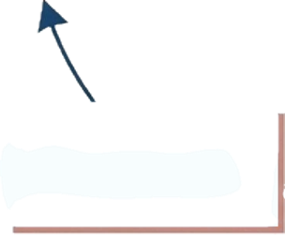


The Replication Blueprint
N
1. Define: Map stakeholders & power levers
2. Inject: Build GenAI prompt packs from public evidence
6. Optimise: Extract expected utilities and optimal paths
3. Anchor: Calibrate to empirical behavioural / voting / market data
5. Compute: Run sequential ARA game tree
4. Elicit: Generate distributions via repeated LLM sampling
29

Slide 30
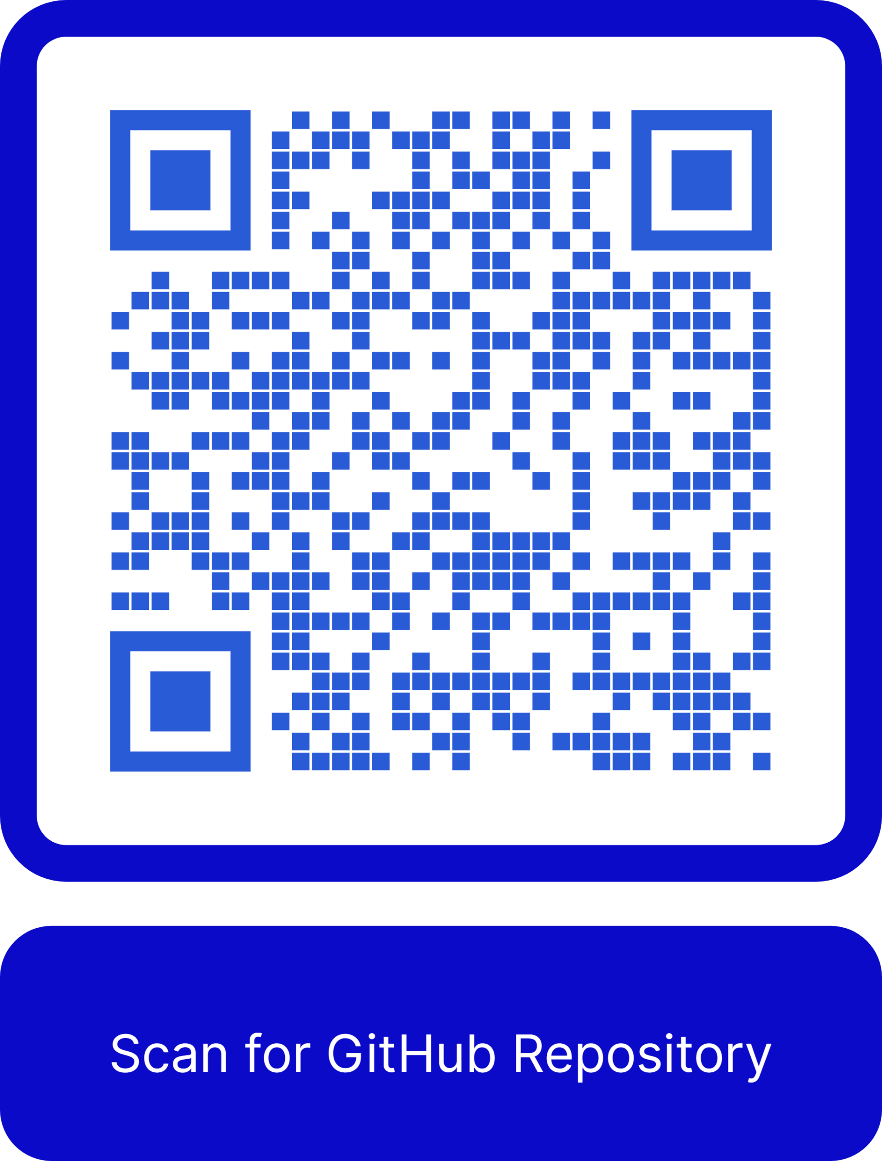
The Replication Blueprint
N
https://github.com/colinpriest/qantas-adversarial-risk-analysis
Presented at the 2026 All Actuaries Summit
30

Slide 31
Thank you
Actuaries Institute
actuaries.asn.au

