Slide 1
Group TPD - Powering Sustainability
Presenter:
Michael Lin – TAL
Richard Land - AustralianSuper
Chair: Joyce Wang - Cbus
May 2026
Notes:
Joyce to intro

Slide 2
Contents
Context – The Environment
The Great Recalibration – Is NOW a catalyst for change
A Claimant Case Study
The challenge for change
Looking Ahead – Let’s Recalibrate
Notes:
Michael
Thank you Joyce.
Good afternoon everyone, and thank you for being here — particularly on Day 3, right after lunch. We really appreciate you spending your last session of the Summit with us.
Before we get into the substance — I want to spend thirty seconds on why this topic belongs at this Summit.
There are about 65 sessions this week. If you look across the program, three themes keep surfacing regardless of practice area: the role of AI and data in reshaping how we work, sustainability across every product and system, and what it means to serve the community fairly.
Group TPD touches on all three of these themes. It could be one of the most consequential product sustainability questions in the insurance industry.
I also want to acknowledge upfront — this is not a new conversation. TPD challenges have been discussed for some time. But the value of today's session is that we are now twelve to eighteen months into this latest episode. There is real data and progress. What Richard and I want to do is bring the full picture together in one place — because not everyone has had sight of every data point, the luxury of time in watching this unfold.
One important note: everything Richard and I say today reflects our personal views, not the positions of AustralianSuper or TAL.
Here is how the session will run.
I will start by establishing the context and the challenge.
Richard will then offer his perspective on why this moment feels different from previous cycles, and share a case study that brings the human dimension of TPD into the room. We will then examine the structural challenges together. And I will close with what the market is already doing — and what we think are the opportunities ahead of us.

Slide 3
The Context
01
Notes:
Michael
Let’s start with the positive.

Slide 4
Group Insurance continues to deliver value to members and plays an important role in the community.
The Environment
Value for Money
30%
<1%
79%- 90%
90.2%
Improving decision times
Will experience at least one insurance event
(J. Humphreys K. Lau, 2025)
Affordability at less than 1% of Salary and less than 4% of retirement Income (J.Humphreys K. Lau, 2025)
Claims Ratio (ASIC REP 675, APRA Life Insurance statistics)
TPD Claims Acceptance Rate 96.1% for income protection
(Moneysmart.com.au, 30 December 2025)
3 months for TPD
1 months for IP and Death
(APRA Claims and Dispute Statistics December 2025)
Societal Impact
>9m
>50,000
42%
35%
$8.3b
Insured Lives
(APRA Claims and Dispute Statistics June 2025)
Death, TPD and IP claims admitted 12 months to 30 June 2025
(APRA Claims and Dispute Statistics December 2025)
Of TAL’s TPD claims is represented by members in disadvantaged postcode, compared to 27% of its TAL’s membership
(GAP INTERGENERATIONAL SUMMIT,2025)
Of Mental Health TPD Claims are represented by individual living in regional Australia despite comprising of 25% of the membership.
(GAP INTERGENERATIONAL SUMMIT,2025)
in income support (from life insurers) to Australians living with work disability in 2023/24. Represents 11% of the total national income support
(Cross Sector Project Update, 2026)
Notes:
Michael
Group insurance in superannuation continues to deliver genuine value — and it is important to anchor this conversation in that fact before we talk about what might be going wrong.
More than nine million lives are currently insured through superannuation, with more than 50,000 claims paid last year.
The Insurance in Super working represented by Jeff Humphreys and Karen Lau presented some compelling data at this Summit last year.
One in three Australians will experience at least one insurable event in their working life.
And the cost of that default cover sits at less than one percent of salary — less than four percent of retirement income.
The claims ratio sits between 80 and 90 percent – probably much higher than that in recent times. That is an extraordinary value proposition by any measure.
The TPD claims acceptance rate is above 90 percent. Decision times have also improved, with TPD decisions now averaging around three months.
A new data point worth highlighting — from the Cross Sector Project Update published in April 2026 by CALI. — life insurers collectively provided $8.3 billion in income support to Australians living with work disability in 2023/24. That represents 11 percent of total national income support. This is a significant social contribution that often goes unrecognised in the sustainability conversation.
Two data points from TAL's own portfolio speak directly to the equity dimension.
Forty-two percent of TPD claims come from members in economically disadvantaged postcodes — who represent just 27 percent of the insured membership.
And 35 percent of mental health TPD claims come from regional Australia, which accounts for only 25 percent of the membership.
Group insurance is not just a financial product. It is a core pillar of social protection — disproportionately supporting the Australians who need it most. That is what makes getting this right so important.

Slide 5
The Environment
LIFE INSURANCE PROFITABILITY
Group Lump Sum (Super) financial results of -$120m in 2025
(APRA Life Insurance Statistics to Dec 2025)
REINSURANCE CAPACITY REDUCING
Swiss Re Life & Health Australia Limited (Swiss Re) have paused new business activities in Australia since October 2025
Headwinds faced by the Industry are structural
POPULATION MENTAL HEALTH CHALLENGES
730% increase in mental health TPD claims between 2013 to 2022 in the age group 30-40 (Australia’s Mental Health Check UP, CALI & KPMG, 2025)
1 In 5 Australians aged 16-85 experienced a mental disorder. (Australian Insitute of Health and Welfare)
SIGNIFICANT PREMIUM INCREASES across various super funds.
Retail TPD premium increase of 15%-40%
Insurance Cover not keeping pace of cost of living and insurance needs
IMPACT BEYOND LIFE INSURANCE
+131% increase in Worker’s comp psychological injury claims (2017 – 2024)
Mental Health Claim eligibility strengthening in all states.
8.5 million Australians now access income support when unable to work due to injury or illness, up from 6.5 million in 2015/16. (Cross Sector Update Report 2026, CALI, Super Friend, Monash University Healthy Working Lives)
Notes:
Michael
And yet — the headwinds faced by the industry are structural.
According to The APRA statistics Group lump sum insurance in superannuation recorded a loss of $120 million in 2025.
On the reinsurance side, Swiss Re — one of the world's largest reinsurers — formally paused new business activities in Australia from October 2025.
The mental health dimension is well known to this audience, but the numbers remain striking. Mental health TPD claims in the 30 to 40 age group increased by 730 percent between 2013 and 2022. One in five Australians aged 16 to 85 experienced a mental disorder in any given twelve-month period. This is a societal challenge that insurance is being asked to absorb.
As a result of these challenges, we are starting to see premium increases both in Group insurance but also double digit increases in the Retail life industry
There is also a quiet erosion of value that receives less attention — and Karen and Jeff touched on this last year in their presentation. Cover levels across many funds have been largely static for over a decade, while inflation has run above three percent per year. Coverage has not kept pace with the cost of living or with members' actual insurance needs.
Lastly the pressure extends well beyond life insurance. Workers' compensation psychological injury claims increased by 131 percent between 2017 and 2024, with every state now tightening mental health eligibility criteria. The Cross Sector Update Report from CALI shows 8.5 million Australians now access income support when unable to work due to injury or illness — up from 6.5 million in 2015/16. The entire disability support ecosystem is under simultaneous pressure.
It is fair to say that what we are seeing is structural, not cyclical. On that note, I will hand to Richard.

Slide 6
A Case study
02
Notes:
Richard
Thanks Michael. As Joyce mentioned my name is Richard Land. I've worked in Group insurance now for over 10 years and led the Group Insurance workstream of the Actuaries Institute Disability Insurance Taskforce, which I’ll touch on very briefly. I’ve become a little jaded and slightly less optimistic about TPD sustainability and have steered away from panel discussions on the topic in the past few years. It’s all too easy to have a common view and call to action in an industry forum. But I do think with the CALI study and press release on mental illness and TPD, the increase in claims, and the innovation in the retail market, that change may now come to group insurance.
I’ll now present a modern-day case study because it gets to the heart of the complexity, and the difficulty and angst for the member, the insurer and the fund in assessing modern-day claims.

Slide 7
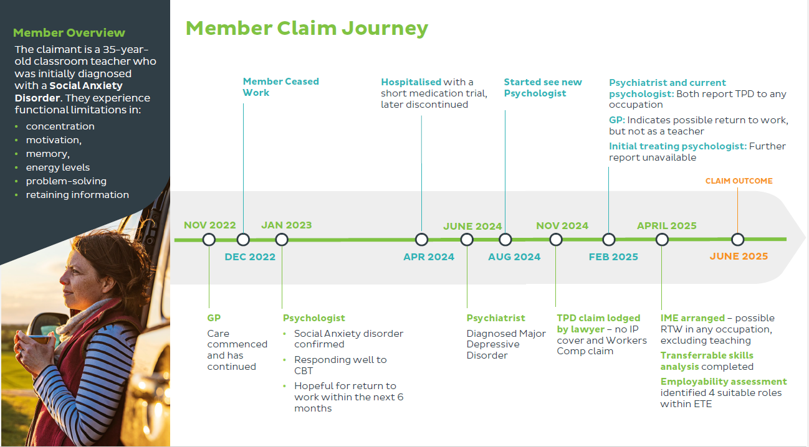
Notes:
Richard
Jody

Slide 8
Claiming a TPD benefit payment
You will be considered permanently disabled if:
At the end of the three months in a row, as well as when the insurer makes a decision, your injury or illness means that you’re incapable of every working in any job that you’re reasonably suited to based on your previous education, training or experience, or any job that you may reasonably become suited to with further education, training or experience within a reasonable period.
The Insurer will consider things such as:
What re-skilling, retraining or voluntary work you’ve already done
Any retraining or re-skilling you reasonably could be expected to do; and
Any rehabilitation you’ve done already or any rehabilitation you reasonably could be expected to do.
Notes:
Richard

Slide 9

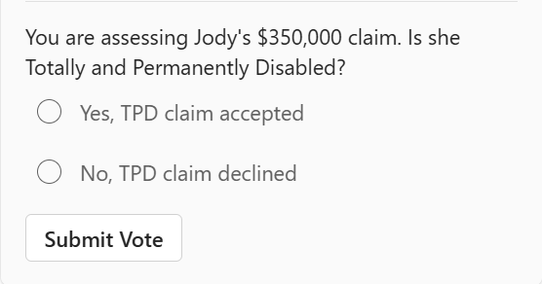
What’s your decision?
Notes:
Richard
So Jodi’s claim was accepted.
Which raises a few things to think about
Do you think it should have been accepted? What if it was your sister?
Why was it accepted? Strict legal interpretation of the policy definition? Limited access to medical evidence and tight LICOP timeframes? Modern community attitudes on mental illness? Lawyer involvement? Reputational risks for the insurer and fund and a desire to avoid dispute and complaint?

Slide 10
Let’s Recalibrate
03

Slide 11

Disability Insurance Taskforce 2024 - Group Insurance
Problems
Lump sum
Recommendations
SIS Act refocused on TPD or income stream benefits
Underwriting for above default cover
TPD work definitions
Notes:
Richard
The DITF found what a lot of life actuaries know about lump sum TPD, and what I’d be telling Jodi if she was my sister…
− There’s a financial incentive here to prove the permanence of disability;
− There’s a disincentive to rehabilitate until the claim is admitted; however
− The need to prove permanence of disability to achieve financial compensation can result in secondary mental harm.
The DITF recommended that
− SIS Act be refocused on TPD or income protection benefits, rather than just permanent incapacity.
− Underwriting should generally be used for voluntary cover, and there should be relatively limited opportunity to increase cover without underwriting.
− TPD definitions consider a member’s capacity to perform a job suited by reasonable rehabilitation, retraining and reskilling.

Slide 12

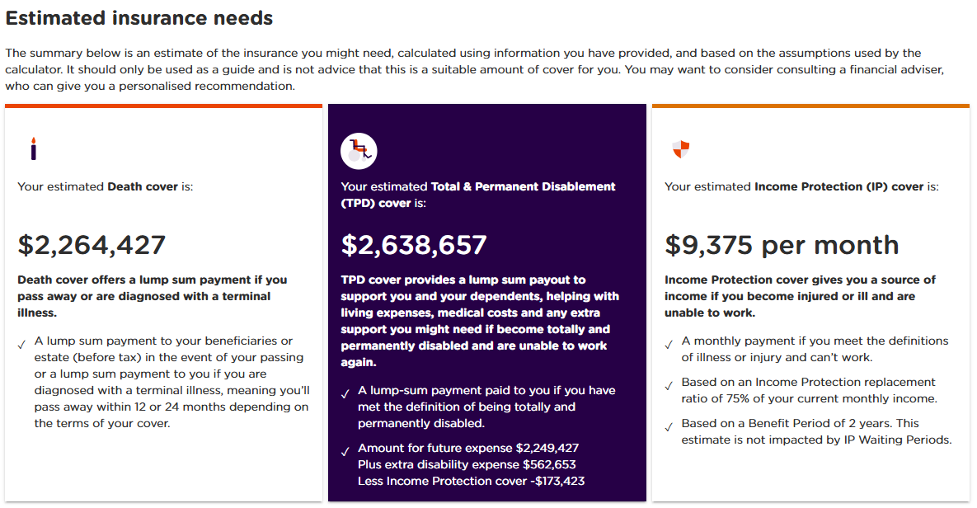
Options for consideration
Re-focus on income stream and rehabilitation
  For default?
  For voluntary?
Underwriting
TPD definitions
Two-tier options
Notes:
Richard
Let’s focus on some of these recommendations
Income streams, rehabilitation and underwriting. Focus on income protection and rehabilitation. My employer is AustralianSuper, and my predecessor, Richard Weatherhead, one of my actuarial heroes, left a legacy of default income protection and modest default TPD cover (max $61,000 at age 30). Together with our insurer TAL, the Fund’s rehabilitation includes: Triage questionnaires at claim time, condition-focused support (for cancer, pain, fatigue, mental health), carer support, and recovery support (career coaching and retraining, and exercise and work conditioning). Other Funds, including Rest, Hesta and Australian Retirement Trust, also focus on income stream in their default insurance benefits, in one way or another.
But an outworking of offering modest default TPD is that up to 80% of the TPD portfolio, by premium, can be voluntary. Industry-wide, members can typically be underwritten for up to $3m of TPD, including over 20 x salary for younger low-income members, and these are the type of covers and claims that are leading to increases in claims rates. On a typical fund insurance needs calculator, huge TPD lump sum cover is recommended for a married member with two young kids and a pretty average $1.3m mortgage. Advisors registered with funds work for AFSLs whose advice guidelines are for lump sum TPD cover to clear all debts. Perhaps it is time to extend Richard Weatherhead’s default sustainability principles to voluntary cover? Does income protection, together with modest TPD lump sums provide adequate and affordable insurance cover for voluntary cover? Should we restrict these via revamped insurance needs calculators and reduced cover limits or underwriting? Should we be more rigorous in short-form financial underwriting such as evidence of salary and debt being covered? Perhaps the way forward is to recommend or restrict TPD cover to a lower limit or multiple of salary?
2) TPD definitions:
Let’s consider two real life pieces of evidence relating to definitions:
2013 group insurance crisis: Many funds switched to TPD definitions which allowed for future rehabilitation, retraining and reskilling. Some funds also switched to a greater emphasis on “activities of daily living” TPD benefits. What is the outcome? Did it make a difference? Evidence would suggest no. In APRA statistics, funds with the so-called more restrictive benefits don’t have lower claims acceptance rates. ASIC was concerned with restrictive ADL definitions and was very active in its supervision, and the pendulum has well and truly swung back the other way.
Workers compensation reforms in Victoria and NSW. Key elements: (1) Significant mental impairment must be diagnosed in accordance with DSM (Diagnostic and Statistical Manual of Mental Disorders), with employment being the predominant cause (2) work stress or burnout excluded, and (3) significant Whole Person Impairment definitions. What was the outcome? Anecdotally mental illness decline rates in Victoria have moved from 40% decline rates pre-reform to 80% post reform. Would this work in the superannuation environment, and is this the right thing for trustees to do?
3) Two-tier options are appearing in individual (retail) insurance, and Michael will cover these later on.

Slide 13

Sustainability Considerations for Super Funds
MySuper and member and community expectations
Reputation, regulators
Members Best Financial Interests and Trustee duties
  For default?
  For voluntary?
Member needs (advisers, member insurance needs calculators)
No surprises at claim time
Notes:
Richard
Insurers and actuaries often think of sustainability per the Actuaries Institute Disability Insurance Taskforce, focusing on affordability and long term viability (and perhaps stable insurer profitability). Sustainability is seen as sound insurance principles such as: Clear insurable interest; Objective claims management with definable and measurable disability definitions; and loss minimization incentives for insured members.
But Super Funds often look through a slightly different lens. For insurance to be sustainable as a compulsory legislated part of MySuper, it’s important to meet member and community expectations, including:
1. It must meet the legal requirements of the SIS Act, i.e. offer to permanent incapacity insurance.
2. It must pass the pub test, and I’ve seen member research that absolutely expects mental disability to be treated no differently from physical disability
3. Must be affordable and not erode retirement savings
4. Members must have confidence that claims will be admitted; i.e. no surprises at claim time. Members might not understand terms and conditions but they expect them to be fair and reasonable when it comes to claim
Reputation and regulators play important roles in insurance in super. We’ve seen the impact of the Royal Commission with adverse outcomes for the retail superannuation sector, and industry funds benefitting. We’ve seen ASIC’s view on TPD definitions which involved Activities of Daily living. I’m guessing if super funds introduced workers compensation-style sustainability reforms, with 80% mental illness decline rates, the outcome would be a lot different than for workers compensation and may significantly threaten a super fund’s credibility and perhaps viability. Workers compensation are monopoly government insurers with a key aim of providing affordable premiums for employers. They’ve appeared on 4 Corners in the past but continue to make stringent reforms to contain premium costs. Insurance in super is a much different environment, and we can’t define and exclude our way to sustainable premium costs.
Members Best Financial Interests play a role. Super Funds have a very high legal burden of proof – they are assumed to be not acting in members best financial interests unless they have documented decision-making evidence to prove they are, and it may prove difficult to introduce restrictive definitions without a tangible up-front premium benefit.
Thinking about Members Best Financial Interests, some funds have a single premium rate table for default and voluntary cover, others have separate rate tables. Arguably the trustee may have a greater fiduciary duty for sustainable premium costs for default members, as these members have not made an insurance election. Members with voluntary cover have all made a decision. Arguably, if you separate default and voluntary premium rates to avoid any cross-subsidy, then fidicury obligations to members with default cover become easier – they can make their own best financial interest choice about whether they take up extra default premium and how much.
Member needs as advised by advisors and member insurance needs calculators. I’ve already spoken about the current advice that members receive here, with large lump sum TPD cover recommended. Many funds have registered advisers, perhaps 25% of all advisers in Australia, so the advisers can provide advice to members and deduct fees from the members’ accounts. There is a reluctance to introduce measures which may disenfranchise advisers (although the adviser leverage is much less than for retail life insurance, with only X% of insured members having an adviser.
Over to you Michael.

Slide 14
A Thought experiment – 2028 Looking Back
It is 2028. We gather again. Here is what we see.
Half of Funds made product changes – TPD volumes stabilized but remain elevated
Affordability at 1.3% of salary – no meaningful increase in coverage
Prices rose across the economy. Cover did not keep pace
Community still asking: What does TPD cover? Is it worth it.
Question we are left with
What went wrong?
What were the early warning signs?
What could we have done differently – together?
Notes:
Michael
Thank you Richard. You posed quite a few questions in your presentation……. Unfortunately I won’t be talking about the answers in today’s session.
What I will do is to share what the market is already doing and how effective they have been in addressing the sustainability challenge. Before I do that I want to use a thought experiment to frame why it matters.
It is 2028. We are back in this room. Half the funds made product changes — TPD volumes stabilised, but remain elevated. Premiums kept rising as rate guarantees expired. Affordability reached 1.3 percent of salary, with no meaningful increase in coverage. And the community is still asking: what does group TPD cover? Is it worth it?
The question to this hypothetical scenarios are: What went wrong? Did we move too slowly? Or did we simply have the data, the diagnosis, and the platform — and not do anything differently when we left the room?
The question is not whether TPD needs to evolve. The question is whether we use this moment — or look back from 2028 wishing we had.
It is abit dramatic – but if I could ask everyone to Keep that in mind as I walk through what the market is already doing.

Slide 15
TPD challenges and opportunities
TAL Observed TPD problem statement¹
Current sustainability pressures highlight limitations in existing TPD product structures and create an opportunity to rethink and evolve the design of TPD.
Opportunities
Trade offs
Benefit Misalignment
Reduce the amount of TPD cover
Instalment / Income structure
Pay TPD benefit only after a period of rehab
No longer call it TPD
Value and Adequacy of Cover
Community Expectation
Risk of being viewed as discriminatory to certain conditions
Frictional cost of instalment based and income based benefits
Financial incentive to claim
Late stage intervention ineffective.
The term TPD is at odds with recovery pathways.
Definition Challenges
Adjust design structure or definition that differentiate :
Conditions that prevent any future work
Conditions which would permit work following retraining in new role.
Does not reflect modern mobility of work.
Lack objective diagnostic tests creating uncertainty of permanency assessments.
Definitions have been narrowed by lawyers.
Claims Challenges
Adjust design structure to provide assessors more time to consider claims
Simplify or tailor definitions to enable easier application to specific conditions and reflect modern workplace patterns.
Limited timeframes and evidence upon which assessments can be made.
Presented at the 2026 All Actuaries Summit
Notes:
Michael
Drawing on the case study Richard shared, and on everything we have covered, the structural challenges in TPD can be organised into three categories — each with corresponding opportunities, and each with its own trade-offs.
The first is benefit misalignment. Large lump sum benefits can create financial incentives to claim and discourage engagement with rehabilitation. Intervention comes far too late in the claims journey to be effective. And the term "total and permanent disability" is increasingly at odds with recovery pathways — particularly for mental health conditions.
The opportunity are:
redesign the benefit structure:
lower cover amounts,
instalment or income-based payments, and conditional benefits on rehab participation.
The second challenge is definitional.
The ETE framework was designed for a world where people held one job for life. It does not reflect modern mobility of work.
Mental health conditions lack the objective diagnostic tests that create certainty in permanency assessments.
And ETE definitions have been progressively narrowed through legal interpretation.
The opportunity is to differentiate more clearly between conditions that permanently prevent any future work and those where recovery and retraining are realistic pathways.
The third challenge is claims assessment. Regulatory requirements currently limit both the timeframes and the evidence base available to assessors.
The opportunity is to extend assessment windows through
longer qualifying periods,
instalment structures —
and to simplify definitions to enable more consistent application.
The trade off for each of the opportunities needs to be considered carefully.
Any redesign has to grapple with the adequacy and value of cover for members who need it most.
Community expectations are high — members believe mental health conditions should be treated the same as physical ones. There is a risk that differentiated designs could be perceived as discriminatory toward certain conditions.
And lastly instalment or income-based structures carry frictional costs in claims administration.
These tradeoffs shouldn’t be arguments against change — but they are the constraints within which change should or could happen.

Slide 16
Differentiated default designs – Group insurance examples
Funds are already moving towards income based/instalment-based designs with some level of success
 | AustralianSuper | HESTA | ART (SuperSavings)
Default Disability Benefit | TPD: Lump Sum, capped at $61,000 IP: capped at $3,100 per month, 2-year benefit period | IP: $1,000 per month , 5-year benefit period Permanent Incapacity Support Benefit (PISB): fixed $10,200. | TPD Assist: up to 6 instalments over 5 years (250,000 age 30).
Disability definition differentiation | Incapable of ever working in any job within ETE Consideration of potential future rehabilitation | IP has a switch to stricter definition at 2-year mark. PISB can only be paid after 2 years of IP payments. | Zero waiting period for first instalment Unable ever to be gainfully employed within ETE + may require compulsory occupational rehabilitation
Challenges | Value of cover constrained | Value of cover very low Lump sum benefit limited | Material claims assessment cost. Member friction at claim time.
Moderated financial incentives via lower lump sum benefits Income stream benefits to support members return to health | Effectiveness in addressing sustainability to date | TPD Definition constrained & have not kept pace with modern work patterns.
Notes:
Michael
Richard briefly touched on the fact that funds like AustralianSuper, Hesta Rest and ART have already looked to address the challenges with The income-based and instalment designs
It is worth examining what they have achieved and where the opportunity remain.
I wont talk too much about AustralianSuper.
HESTA has taken a pretty radical approach, effectively removing a traditional TPD benefit from its default design. Members receive a Permanent Incapacity Support Benefit of $10,200 — payable only after two years of IP payments — alongside a five-year IP benefit at $1,000 per month. It is worth noting that HESTA deliberately avoids the term "TPD" for its default benefit, using PISB instead — which aligns with the point about language being a barrier. The sequencing of IP before PISB creates a genuine intervention window. The trade-offs are a very low absolute cover value and member friction at claim time.
ART has retained a lump sum structure but paid in up to six instalments over five years, capped at $250,000 at age 30. The definition requires the member to be unable ever to be gainfully employed within ETE, with compulsory occupational rehabilitation in some cases. ART advertises a zero waiting period for the first instalment — though in practice claims assessment still takes time. The instalment structure moderates the lump sum incentive effect, but the ETE definition constraint remains.
What these three designs share is a genuine attempt to moderate financial incentives and support recovery. What none of them has yet resolved is the definition challenge.
Richard also raised a question - what do we do about voluntary cover? Up to 80 percent of a fund's TPD portfolio by premium can be voluntary. The moderated incentive logic of a $61,000 default cap or income stream products doesn't carry through when members can be underwritten for up to $3 million on top of that.
SO there is a bit of unfinished business. And it is why the retail examples on the next slide matter.

Slide 17
Differentiated designs – Retail Life Insurance
Options alongside traditional TPD to manage affordability.
Feature | Zurich Continuous Care | Acenda TPD Severity | TAL TPD Support Option
Launched | >> Oct 2024 | Sept 2025 | Dec 2025
Design focus | Need for ongoing, long term intensive care | Degree of medical impairment | Recovery‑focused, staged TPD for some conditions
Severity Definition requirements | Required continuous care for at least 3 consecutive months Need Avg 6 hours of care per day Certain conditions requires 60% WPI or 47% PIRS or other criteria | 30% WPI (Physical conditions) or 30% PIRS (mental health conditions) | Not applicable
Payment structure | Lump sum | Lump sum | Lump sum except Mental Health & Fatigue related conditions – 5 x 20% payments
Notes:
The retail market is also moving with new TPD options that complements the traditional lump sum ETE offerings. While these are individually underwritten products through a different distribution channel the design thinking is relevant to the group conversation both in thinking about default cover as well as voluntary cover.
Three products options have launched in just over a year, which is itself a signal of the pace of change.
Zurich's Continuous Care option, launched October 2024, is focused on the need for ongoing long-term intensive care — requiring continuous care for at least three consecutive months, averaging around six hours per day, with high impairment thresholds for certain conditions. Payment is a lump sum. This is a genuine severity-based definition that sets a high bar for the most acute cases while leaving standard TPD in place for others.
Acenda's TPD Severity option, launched September 2025, uses a different trigger — 30 percent whole-person impairment for physical conditions, or 30 percent on the Psychiatric Impairment Rating Scale for mental health. Also a lump sum. The focus is degree of medical impairment rather than ongoing care needs, which broadens the accessible population relative to Zurich's design.
TAL's TPD Support Option, launched December 2025, takes the most differentiated approach to payment structure. For mental health and fatigue-related conditions, benefits are paid as five instalments of 20 percent of the sum insured, assessed annually. Severe mental health conditions meeting a higher impairment threshold retain a lump sum. All other conditions are assessed under the standard any-occupation definition with a lump sum payment. The instalment structure creates annual reassessment points that support return-to-work attempts — removing the finality of a single lump sum at the point of maximum vulnerability.
The common thread across all three is acknowledging that the traditional lump sum may not be not the right structure for all conditions — and that the industry is capable of designing alternatives. None of these is a complete solution and certainly untested in the Group context. But the direction of travel is clear, and the group market will need to draw on this experience as it considers its own pathway.

Slide 18
Let’s Recalibrate. Thank you
Actuaries Institute
actuaries.asn.au
Notes:
Michael
So — to close.
We started today by asking whether the industry would use this moment. We are reasonably confident that if the actuaries in this room can't figure it out how to solve this, nobody can.
We're very much looking forward to the discussion.

