Slide 1

All Actuaries Summit
Recalibrating Insurability: Navigating the Future of Protection: The consumer perspective
Drew MacRae
Principal, Policy Development
27 May 2026
Notes:
Introduction
Thanks Ian and I’d like to acknowledge the Traditional Owners of Narrm, the Wurundjeri Woi Wurrung people of the Kulin Nation. I pay my respects to their Elders past and present, and to Elders of all First Nations communities who may be in the audience today
I’ve been asked to speak to today about the changing attitudes to disability, mental health and wellbeing and expectations about insurance coverage.
Before I do I think it would be good though to clarify what I can’t speak to first:

Slide 2
Recalibrating Insurability: The consumer perspective
Overview
What I can’t speak to:
The data on mental health claims
The data on prevalence of mental illness
Why is this occurring
Notes:
I can’t speak to the data.
I’m not here to question the data that has been put forward by various bodies going to the rising numbers of mental health claims in TPD or income protection, I won’t talk about how old it is and how hasn’t been updated
I can’t really speak to the historical trends in the prevalence of mental illness (severe or otherwise) either
I also won’t be putting forward any views on why there these trends are occurring – be it increased awareness and societal support to discuss mental health issues openly, the impact of COVID and or any views with respect to any particular generation – Z, Y, X or any other letter of the alphabet.

Slide 3
Recalibrating Insurability: The consumer perspective
Overview
What I can’t speak to:
The data on mental health claims
The data on prevalence of mental illness
Why is this occurring
What I can speak to:
The experience of clients on the Insurance Law Service
The ways they are impacted by the life insurance sector
Their current and future expectations
Notes:
What I can speak to though is the experience of clients that we hear from on Financial Rights’ Insurance Law Service and their interactions with the life insurance sector – especially with respect to its treatment of people with mental health conditions.
What I can lay out is the ways they are impacted - and disappointed by - the sector and
their current and future expectations when doing so
So let me detail one story reported in The Australian last year.

Slide 4
Recalibrating Insurability: The consumer perspective
Client experiences with life insurance and mental illness
Case study - Veronika’s story
Veronika was knocked back when applying for life insurance and income protection after she told the insurer she had ADHD.
Veroniki added the anxiety that she’d been diagnosed with 20 years ago into the mental health question. Computer said: No
There were other questions around her ADHD which she answered: Computer said: No
Her children – who have ADHD and autism - were thrown into the same basket
She found it really confronting and stigmatising
After complaining, the insurer has re-invited her to re-submit. But she has lost trust.
James Dowling, Life Insurance report finds coverage gap for disclosed mental health conditions, The Australian, 19 September 2025
Notes:
Veronika Birnkammer was knocked back when she applied for life insurance and income protection after she told the insurer she had ADHD.
“As part of the application form they asked about mental health issues; I just added the anxiety that I’d been diagnosed with 20 years ago. Then it also asked about neurodivergence. I have ADHD … and I added that, but not as a mental health issue, because it’s not”
“Then when I submitted it I got what I suspected is an automated response saying that I can’t be offered insurance based on the information I provided.
“It had other questions around: Does the ADHD impact my work? Does it impact my life? And I answered ‘no’ to all of those questions, but it didn’t seem to make a difference.”
Two of Ms Birnkammer’s children have ADHD and autism, increasing her anger that the life insurance sector seems not to have kept pace with social attitudes to destigmatise mental health.
“It’s a very blunt instrument they are using, and it’s doing nothing to dispel the myth that people who are neurodivergent aren’t contributing to society as much as anybody else,” she said.
“I found it really confronting that something that’s just inherent in a person from when we’re born – whether that’s ADHD (or being) autistic – is immediately seen as a risk.
“It’s the same for my children, and that’s what made me feel sad for them. I don’t want them growing up thinking they’re a risk to society, or a risk in general.”

Slide 5
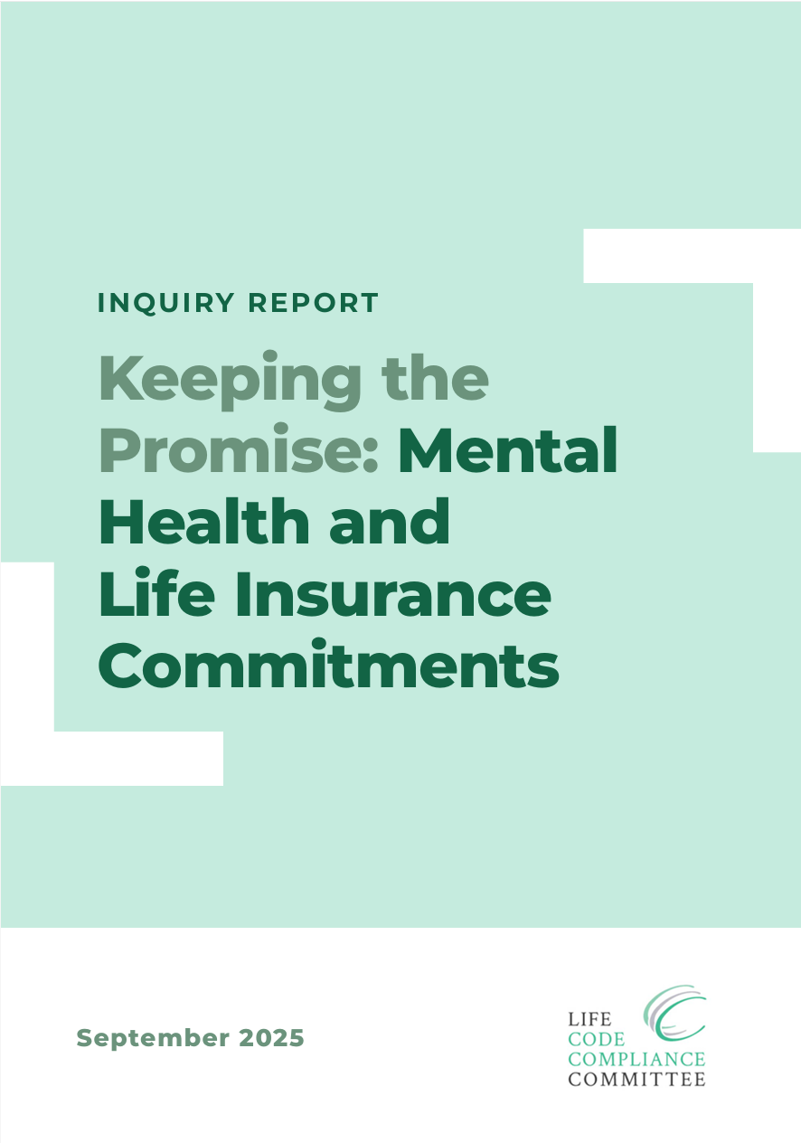
Recalibrating Insurability: The consumer perspective
Other experiences with life insurance and mental illness
LCCC’s Mental Health and Life Insurance Report
Default to exclusions
Insurers rarely consider individual circumstances
Don’t manage though alternative ways to manage risk
Limit cover and reinforce stigma
Notes:
Veronika is not alone
The Life Code Compliance Committee in its Keeping the Promise: Mental Health and Life Insurance Commitments report found that:
insurers’ underwriting processes too often default to exclusions or denials when applicants disclose a mental health condition.
The LCCC found little evidence of insurers considering the full extent of information about an individual’s circumstances
Almost all policies looked at by the LCCC relied solely on exclusions rather than exploring alternative ways to manage risk, such as higher premiums, limits, or caps and
the LCCC found that this approach can limit access to cover and may unintentionally reinforce stigma by treating all mental health disclosures in the same way.
The LCCC Chair said at the time that:
“Defaulting to exclusions means that customers are not being seen as individuals,”
“Insurers need to show that they are genuinely weighing up each applicant’s circumstances, exploring alternatives, and using professional advice where appropriate.”
“The increasing prevalence of mental health conditions only makes it more important for insurers to get underwriting right with an approach that considers individual circumstances properly”
There are also other issues our clients raise with us. These include:

Slide 6
Recalibrating Insurability: The consumer perspective
Other experiences with life insurance and mental illness
LCCC’s Mental Health and Life Insurance Report
Default to exclusions
Insurers rarely consider individual circumstances
Don’t manage though alternative ways to manage risk
Limit cover and reinforce stigma
Other issues seen
Claims denial based on disclosed or non-disclosed pre-existing conditions
Fishing expeditions
Difficulties questioning or challenging these decisions
Poor claims handling behaviour impacting mental health
Notes:
Claims denials based on previously disclosed mental health conditions and an exclusion being applied
Claims denials based on non-disclosed pre-existing conditions – many of which “feel like it” involve fishing expeditions
One example involved a client on claim for income protection who has long been providing the requested documentation. However, she was recently asked to provide information about a medical examination she had as a child 40 years ago, including all her psychological notes.
I mean come on
Other issues include
Difficulties encountered when people try to question or challenge those decisions and a reluctance to provide the underpinning data, and
Mental health impacted by poor claims handling behaviour – as my colleague on the Insurance Law Service lines says:
If a client hasn’t gotten a mental health condition before they deal with a life insurer – they will definitely have one after dealing with them

Slide 7
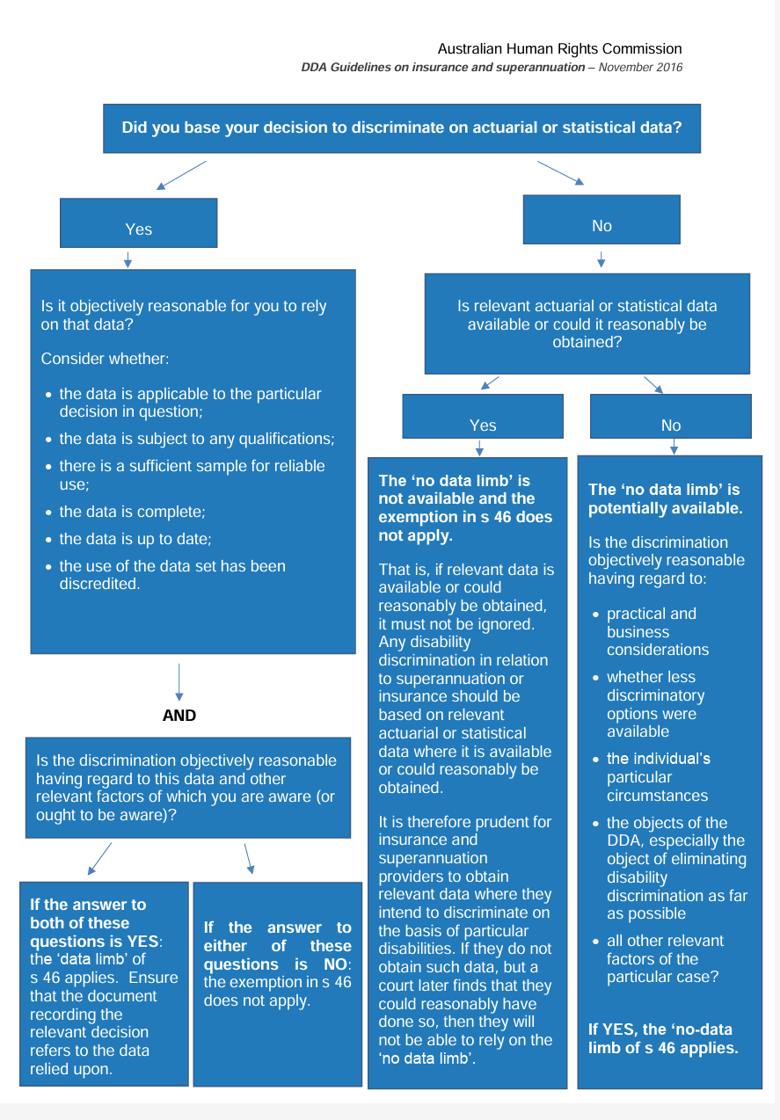
Recalibrating Insurability: The consumer perspective
The law
The Disability Discrimination Act
Section 46 partial exclusion
  actuarial or statistical data reasonable to rely, and discrimination is reasonable regarding all other relevant factors
  AND not an OR
  Factors that increase and lower risk it
  Individual’s particular circumstances are key
  Avoid formulaic, automated approaches
Section 11 and 29A defence of unjustifiable hardship
  Cost, effort and prudential requirements are not determinative
  It’s a balancing act weighing all circumstances
Notes:
So what do consumers expect from this sector
First and foremost they don’t want to be unfairly discriminated against when obtaining life insurance to protect their financial security and their wellbeing.
What does this mean.
It means that this sector needs to meet the requirements of the Disability Discrimination Act – the statutory materialisation of this expectation.
I think it is important to step this out as I think this sector has really misunderstood the requirements here.
The DDA promotes the rights of people with a disability to participate equally in all areas of life (including in the provision of life insurance) by making it unlawful to discriminate against a person with a disability subject to 2 relevant exceptions.
A partial exemption under Section 46 and
A general defence of unjustifiable hardship under Sections 11 and 29A
Neither of these are easy for insurers to meet
Section 46 partial exemption allows
discrimination only where it is based on either actuarial or statistical data which, in all the circumstances, it is reasonable to rely on, and the discrimination is reasonable having regard to all other relevant factors as well, or in a case where there is no such data available and cannot be reasonably obtained … the discrimination is reasonable having regard to other relevant factors
The AND in there is critical here
Insurers may have data or you may not. But in all cases you must consider all other relevant factors
Those factors include those that may increase the risk to the insurer as well as those that may reduce it
The key factor that the AHRC says “ought to have particular prominence” is an “individual’s particular circumstances”
Insurers can’t wilfully ignore this information including by choosing not to ask or seek it in the first place
The AHRC then make it clear that: Decision-making processes which are formulaic or which tend to stereotype individuals by reference to their disability should be avoided.
To underline this for you all:
Blanket exclusions in standard forms are the most formulaic, automated approach a life insurer can take and you need to avoid them
Life insurers have actually spelt this out explicitly in the current Life Code of Practice.
Except now CALI are telling us that you want to walk away from this.
I’m sorry to tell you all – you can’t. You can take the words out of the code if you like - but you still can’t rely on blanket exclusions because you have to meet the DDA.
Removing the words simply hides from consumers what you are trying to do
The defence of unjustifiable hardship is not necessarily your friend here either
The precedents make it clear that just because not discriminating may involve cost and effort – that is not enough to rely on the defence – because the statutory test is a balancing of circumstances
Prudential requirements may be another factor but again these are far from determinative.
So to end: What are consumers expectations regarding the treatment of mental health conditions in life insurance.
Put simply…

Slide 8
Recalibrating Insurability: The consumer perspective
Consumer expectations
Do not unfairly discriminate
Treat people with dignity
Treat people like human beings
Don’t penalise people for seeking mental health assistance
Notes:
Do not unfairly discriminate
Treat people with dignity
Treat people like humans not like a profit or loss centre
Treat people like you would treat your mother – it’s the golden principle – do unto others as you would unto yourself
Australians are at last speaking openly about mental health issues and seeking help. This is a good thing.
When they seek assistance – they should not be penalised for doing so
We want people to seek that treatment
It should not be to their detriment – it should not be used against them - when obtaining life insurance or claiming on their life insurance
In many ways this is like the issue this sector has recently faced with respect to the use of adverse genetic tests – and needs to be seen in that same light
The Life Insurance sector may be facing sustainability problems. You may need to innovate their products.
I am not here to argue against that proposition
But you still need to comply with the law to not unfairly discriminate against a person because of their disability when providing insurance and superannuation
So when you look to innovate your product you must meet the requirements as outlined by the Australian Human Rights Commission otherwise you simply invite further litigation to settle the matter once and for all.
Thank you

