Slide 1
Mental Health and Physical Comorbidity: Implications for Life Insurance
Xiao Xu, PhD FIAA CERA|UNSW
Dorothy Yao, FIAA CERA|MNC Actuaries
May 2026

Slide 2





Agenda
Introduction and Background
Overview of Mental Health Challenges
Research Objectives and Methodology
Research Questions and Data Sources
Mental Health Trends and Key Findings
Prevalence, Severity and Age of Onset; Mental–Physical Health Comorbidity Patterns
Insurance Challenges
Sustainability Challenges in Insurance
Policy Recommendations and Future Directions
Opportunities for Early Intervention and Prevention; Implications for Insurance Product Design
• Evidence-Based Insights from Australia's National Mental Health Survey

Slide 3
Motivation
Motivation
1 in 5
42%
75%
Australians affected
annually
Lifetime prevalence
in Australia
Onset before
age 25
Mental disorders are not random events — they are early-life, long-tail liabilities
Chronic, recurrent, and persistent — not discrete injuries
Now a leading driver of Income Protection and TPD claims
Risk is front-loaded: disproportionately concentrated in adolescence and young adulthood
Yet insurance products are built on a late-onset, physical impairment paradigm
Sources: Australian Institute of Health and Welfare (AIHW), Mental Health Services in Australia, 2022; Australian Bureau of Statistics (ABS), National Study of Mental Health and Wellbeing, 2022; McGorry et al. (2007), The Royal Australian and New Zealand Journal of Psychiatry.

Slide 4


Related Research
Sources: Actuaries Institute (2025), The Mental Health Financial Safety Net: Unifying Australia’s Fragmented Systems, November 2025; Society of Actuaries Research Institute & Actuaries Institute (2025), Mental Health Underwriting, May 2025.

Slide 5
International Insights
1. Insurance Coverage Matters
Insurance status is a strong predictor of receiving mental health treatment.
U.S. evidence shows insured individuals are significantly more likely to access outpatient and prescription care.
2. Mental Health Care Is Highly Cost Sensitive
Mental health service use is highly responsive to out-of-pocket costs.
Co-payments and benefit limits can sharply reduce utilization.
Mental health care utilization appears more sensitive to insurance design than physical health care.
3. Emerging International Approaches: catastrophic illness coverage expansion and public insurance reforms shown improvements in:
financial protection,
treatment uptake,
and affordability for vulnerable populations.
Sources: Deb et al. (2020), J Health Economics; Rost et al. (2001), Medical Care; WHO World Mental Health Surveys (2004); Kessler et al. (2008), American Journal of Psychiatry.
5

Slide 6
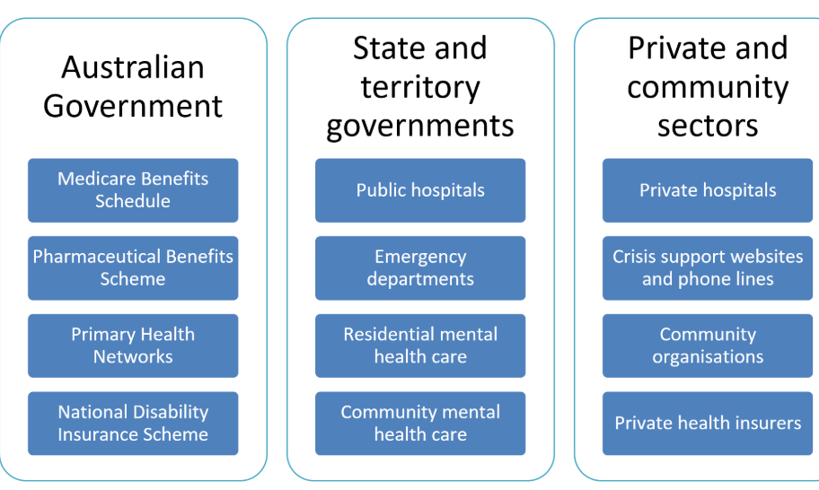
Mental Health in Australia
Notes:
https://www.aph.gov.au/About_Parliament/Parliamentary_departments/Parliamentary_Library/Research/Quick_Guides/2021-22/MentalHealthServices
https://www.aihw.gov.au/mental-health/overview/australias-mental-health-system
Community mental health: https://www.aihw.gov.au/mental-health/topic-areas/community-services#Patient-characteristics

Slide 7
Mental Health in Australia (2)
38.8% of people aged 16–24 years had a 12-month mental disorder
42.9% of people aged 16–85 years had experienced a mental disorder at some time in their life
21.5% of people had a 12-month mental disorder
Gender Distribution
Almost half of females (45.5%) aged 16–24 years and a third of males (32.4%) aged 16–24 years had a 12-month mental disorder.
Australian Child and Adolescent Survey of Mental Health and Wellbeing estimated that 14% of children and adolescents aged 4–17 have a mental illness.
Most commonly:
Attention Deficit Hyperactivity Disorder (7%)
Anxiety disorders (7%)
Major depressive disorder (3%)
Conduct disorder (2%).
About 30% of adolescents with a mental illness experienced 2 or more mental illnesses at some time in the previous 12 months.
Most common illness in the past 12 months :
17% anxiety
8% affective (mood disorder, depression, bipolar)
3% substance use
(of population)
National Survey 2022
Notes:
https://www.abs.gov.au/statistics/health/mental-health/national-study-mental-health-and-wellbeing/latest-release#key-statistics
https://www.aihw.gov.au/mental-health/overview/prevalence-and-impact-of-mental-illness

Slide 8
Research Objectives and Data Foundation
Data Source:
Research Objectives:
8,463
Quantify prevalence, incidence, and persistence of mental disorders across age groups
Examine patterns of co-occurrence between mental and physical conditions
Identify critical intervention points based on age-of-onset analysis
adults aged 18-85 analyzed
15.36M
Australians represented
2007 National Survey of Mental Health and Wellbeing, part of WHO World Mental Health Survey Initiative
Conducted August-December 2007 using validated WMH-CIDI 3.0 diagnostic methodology
Nationally representative with 60% response rate and survey weighting
A Joint Academic–Industry Research Project by UNSW and MNC Actuaries, supported by the UNSW Business Insights Grant

Slide 9
Current Mental Disorder Prevalence
Overall 12-month prevalence stands at 20.5% of the adult population, confirming mental disorders as highly prevalent conditions
Among affected individuals, mild symptoms represent 9.2%, moderate symptoms 6.6%, and severe symptoms 4.1% of the population
Mild-to-moderate conditions labeled as "minor" comprise approximately 80% of current cases, indicating most affected individuals have manageable symptom levels
Standard errors below 1.5 percentage points confirm robust precision in these national estimates

Slide 10
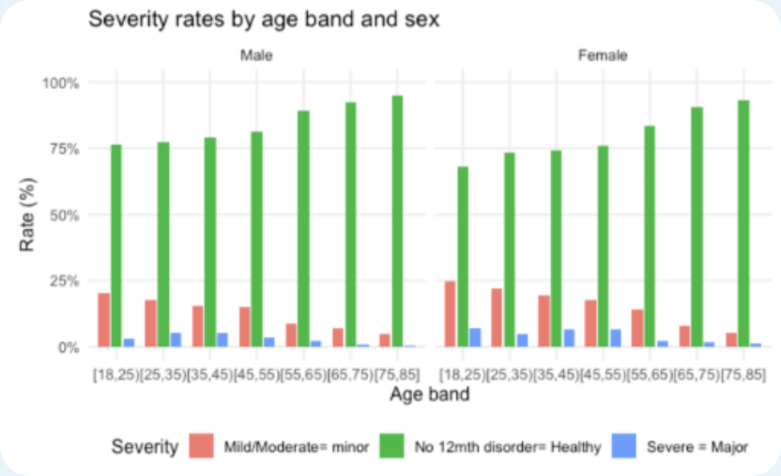
Age Patterns in Mental Disorder Prevalence
25%
prevalence in ages 18-24
Ages 18-24 carry highest burden with approximately 25% experiencing minor disorders and 3-7% experiencing major disorders
This age-related pattern reinforces that mental disorders predominantly emerge early in life and tend to attenuate with increasing age
Recovery-remission from serious mental illness increases steadily after early adulthood, with remission rates rising to nearly 60% by age 65

Slide 11
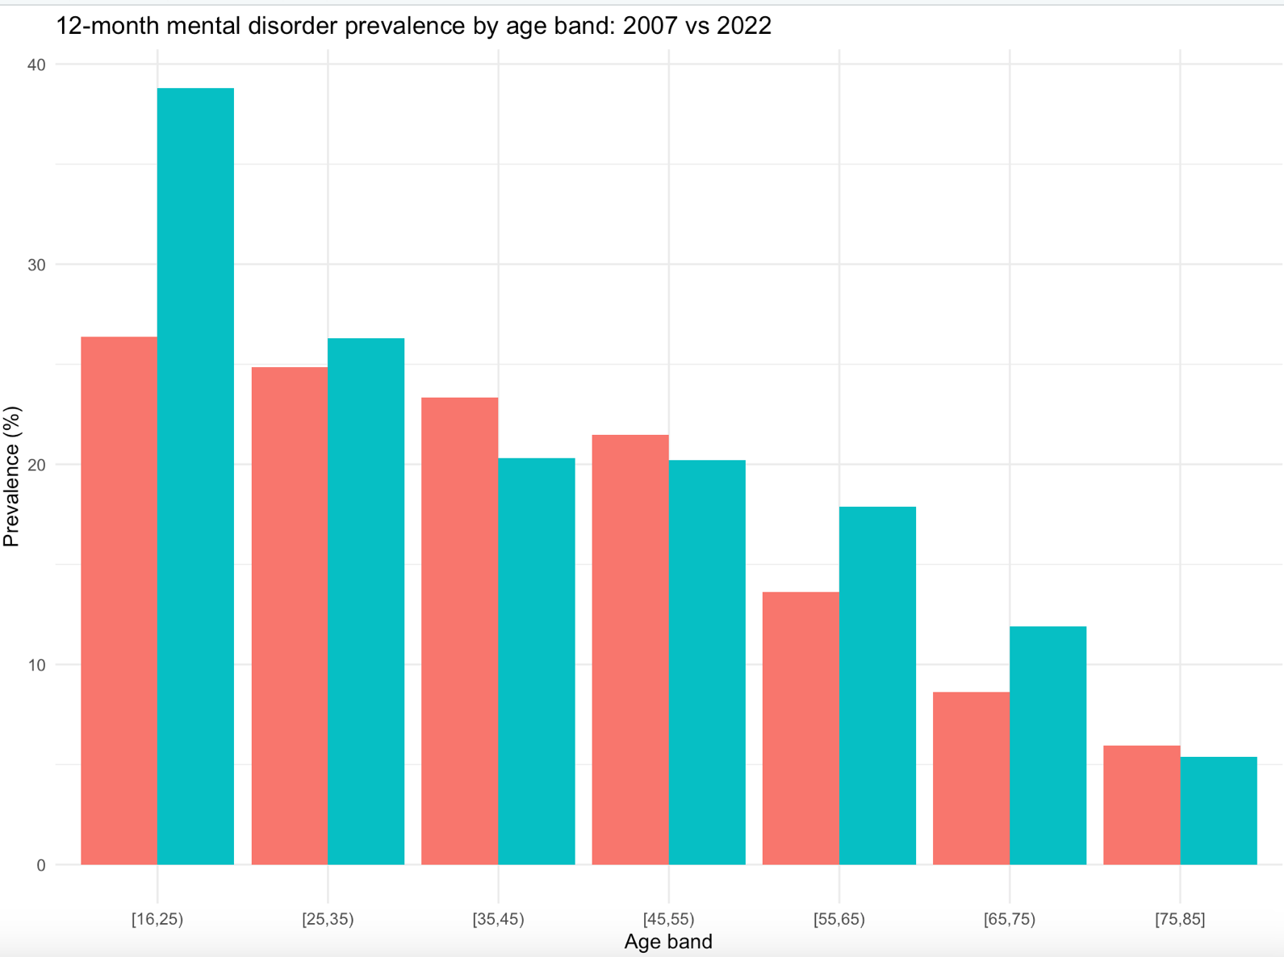
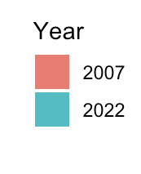
2007 vs 2022 Mental Health Survey Comparison
In 2022:
Lifetime prevalence decreased (45.5% → 42.9%)
12-month prevalence increased (19.9% → 21.5%)
Severity mix shifted:
Severity | 2007 | 2022
Mild | 9.3% | 7%
Moderate | 6.6% | 9%
Severe | 4.1% | 7%
Aggregate prevalence appears stable, but the risk
profile has changed, indicating:
earlier onset concentrated in young adults
higher clinical complexity
greater functional and cognitive impairment
longer expected claim duration and recurrence
potential

Slide 12
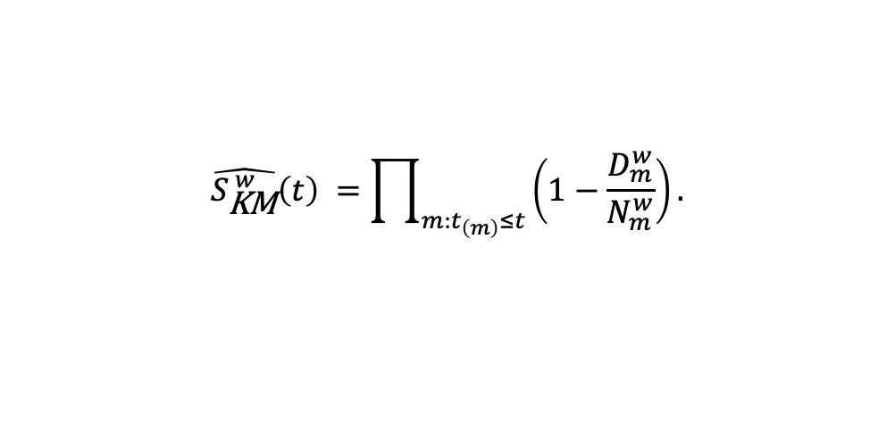
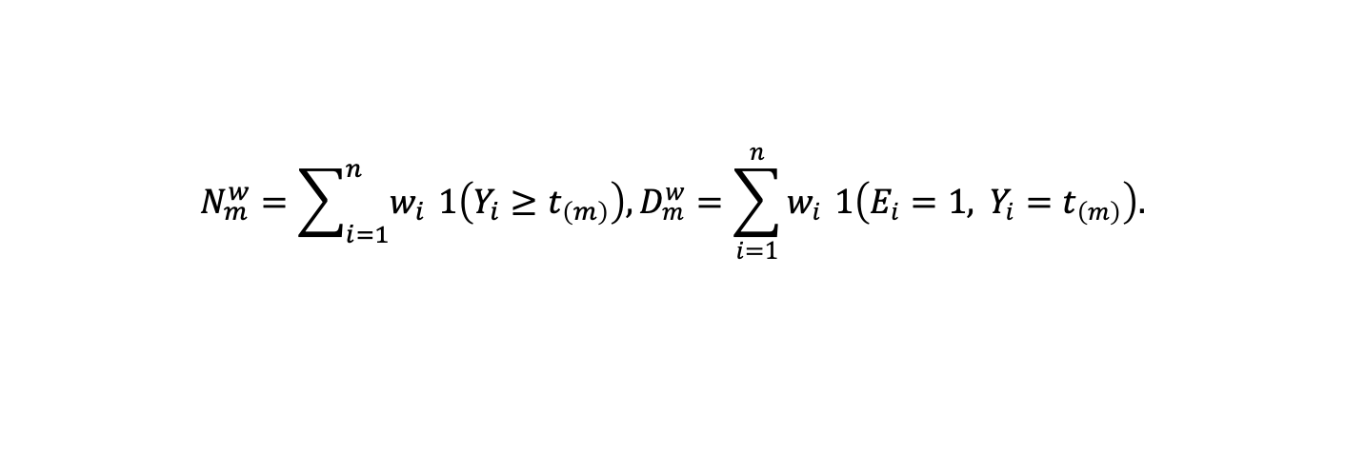

Survival framework: Onset as a Time-to-Event Process
We treat first onset of mental disorder as a survival problem:
$$N_{m}^{w}=\sum_{i=1}^{n}{w_{i}} 1\left(Y_{i}≥t_{\left(m\right)}\right),D_{m}^{w}=\sum_{i=1}^{n}{w_{i}} 1\left(E_{i}=1, Y_{i}=t_{\left(m\right)}\right).$$
Weighted Kaplan–Meier allows valid population-level inference:
$$\hat{S_{\text{KM}}^{ w}}\left(t\right) =\prod_{m:t_{\left(m\right)}≤t}{\left(1−\frac{D_{m}^{w}}{N_{m}^{w}}\right).}$$
The contribution to onset-free person-time for individual $i$ is $Y_{i}=E_{i}T_{i}+\left(1−E_{i}\right)C_{i},$
Cumulative incidence: $\hat{F}\left(t\right)=1−\hat{S_{\text{KM}}^{ w}}\left(t\right).$

Slide 13
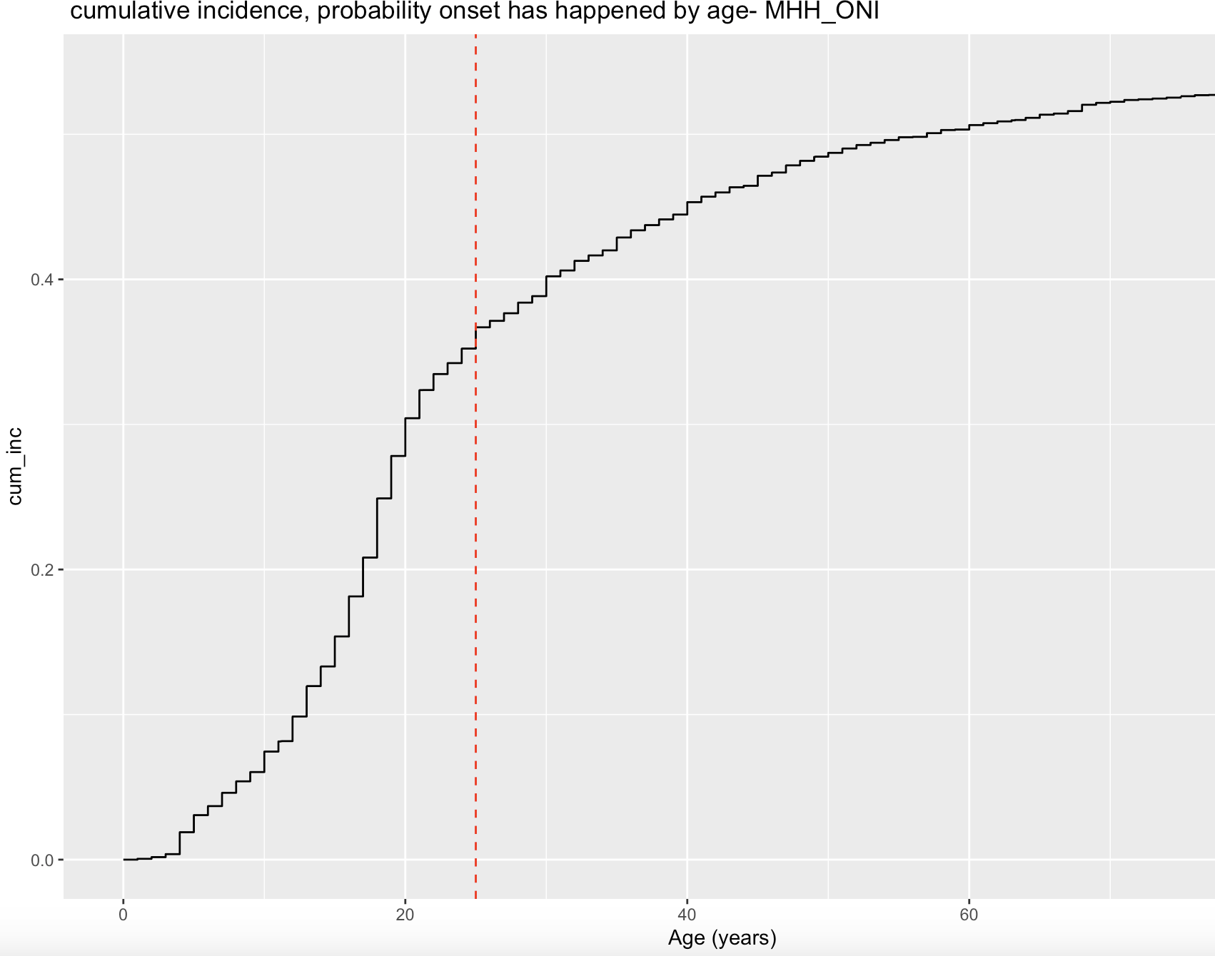
Cumulative Incidence Curve
35.2%
Probability of onset
by age 25
54.2%
Probability of onset
by age 85
70.7%
Chance of remaining
disorder-free to 85,
if onset-free at 25

Slide 14
Age-Specific Hazard Rates
Age Band | Male % | Female % | Overall %
<18 | 1.61 | 1.53 | 1.57
18–24 | 3.14 | 1.74 | 2.41
25–34 | 1.16 | 0.91 | 1.02
35+ | < 1 | < 1 | < 1
Peak Hazard
3.14%
Male 18–24 per year
1.74%
Hazard peaks at 18–24: 2–3% per year
Men show nearly double the onset hazard at peak ages
After age 30, hazard collapses to less than 1%
Late-life hazard is negligible
Female 18–24 per year
2.41%
Overall 18–24 per year
Source: ABS (2008), National Survey of Mental Health and Wellbeing 2007 (CURF). Authors’ KM survival analysis; jackknife replicate weights applied.

Slide 15
Incidence Rates per 1,000 Person per year
40.86
Male 18–24
peak incidence
20.74
Female 18–24
peak incidence
13.2
Overall incidence
per 1,000 p-y
Males higher incidence early; women accumulate more chronic burden over time.
Source: ABS (2008), National Survey of Mental Health and Wellbeing 2007 (CURF). Authors’ KM survival analysis; jackknife replicate weights applied.

Slide 16
Physical Health Follows the Opposite Age Curve
Physical conditions increase monotonically from ~10–15% at 18–24 to 70%+ by 75–85
Women have higher rates of any NHPA condition across most ages
Major physical conditions (NHPA + hospitalisation) are rare before age 45 (< 3%), then surge to ~20% of men and ~16% of women by 75–85
In contrast to mental disorders (which peak early), physical morbidity is a late-life phenomenon
Source: ABS (2008), National Survey of Mental Health and Wellbeing 2007 (CURF). NHPA conditions: arthritis, asthma, cancer, cardiovascular disease, diabetes, kidney disease, osteoporosis. Authors’ analysis.

Slide 17
Mental vs Physical: Two Divergent Risk Curves
Dimension | Mental Health | Physical
Peak age | 18–24 | 65–85
Early life | High onset | Very low
Mid-life | Declining | Rising rapidly
Later life | Low prevalence | Dominant burden
Sex pattern | Higher female lifetime | Female > NHPA
Impairment | Episodic, recurrent, functional | Progressive, chronic, hospital-based
Source: ABS (2008), National Survey of Mental Health and Wellbeing 2007 (CURF). NHPA conditions: arthritis, asthma, cancer, cardiovascular disease, diabetes, kidney disease, osteoporosis. Authors’ analysis.

Slide 18
Why life Insurers are stuck?
Structural forces driving the mental health claims crisis in IP and TPD
01
Subjectivity & Moral Hazard
02
Distribution Channel Constraints
IP and TPD were designed for physical disabilities with objective diagnosis. Mental health claims are inherently more subjective in assessment. TPD in particular creates significant financial incentive for claimants - compounded by growing societal recognition of mental health as a legitimate disability affecting life and work.
Retail insurance is predominantly distributed through financial advisers bound by best-interests duty. An insurer acting alone to exclude or restrict mental health cover becomes unsellable through that channel - creating strong commercial pressure against unilateral action. Reform requires coordinated industry movement.
03
Mispriced Risk Architecture
04
Regulatory & Reputational Pressure
IP and TPD pricing typically pools physical morbidity and mental health incidence at portfolio level, masking very different underlying risk shapes. As this presentation shows, mental health incidence peaks sharply at ages 18–24 - decades before physical morbidity dominates - making blended age curves a systematic mispricing tool.
Broad mental health exclusions and disputed claims are attracting regulator attention and damaging insurer reputation. Blanket exclusions are an increasingly untenable response - both commercially and in terms of the industry's social licence to operate.
These structural forces combined make it impossible for any single insurer to solve the mental health claims crisis - it demands an industry-wide response.

Slide 19
Mental Health Claims Are Reshaping Disability Insurance
+433%
+129%
+732%
79.6%
Mental health
TPD claim costs
(2014–2022)
Mental health
IP/IDII claim costs
(2014–2022)
Mental health
TPD claim rates
(age 30–40)
Of TPD claims
growth attributable
to mental health
Consequences:
Permanent disability onset is shifting earlier in life
Temporary claim incidence declined, but claim duration increased +1.3 years - more than offsetting the reduction
Long-duration liabilities destabilise IP and TPD portfolios
Premium pressure and misaligned underwriting logic
Risk shifts earlier than pricing assumptions reflect
Source: KPMG & Council of Australian Life Insurers (2024), Australia's Mental Health Check-Up

Slide 20
Actuarial Implications
What the epidemiological evidence means for pricing actuaries
01
Separate Mental Health from Physical Morbidity Studies
02
Price Timing of Onset, Not Chronological Age
The age-incidence shape for mental health peaks at 18–24 then declines - the inverse of physical morbidity. Pooling them at portfolio level masks this divergence and produces mispriced age curves. Dedicated mental health studies allow the risk to be quantified on its own terms.
Standard IP and TPD loadings assume later-life risk. Mental health hazard spikes decades earlier. Loadings that ignore onset timing underprice young policyholders - particularly women aged 18–34 - and overprice older cohorts where mental health risk has already largely materialised.
03
Segment Within Mental Health by Condition Type
04
Account for Gendered Risk Trajectories
Mental health is not a homogeneous category. Anxiety, depression, psychotic disorders, and personality disorders carry different incidence trajectories, claim durations, and recurrence patterns. Reviewing condition-type exposure in active lives would help forecast trend and identify concentration risk.
Women carry higher mental health burden across the life course with a pronounced severity gap in young adulthood. Men show higher incidence at peak ages but lower lifetime persistence. Blended pricing that ignores this divergence misstates risk in both directions - more so than in any physical morbidity category.

Slide 21
Limitations & Next Steps
⚠ Limitations
→ Next Steps
Self-reported onset
Apply hazard models to 2022 microdata
Retrospective recall of first episode is susceptible to bias, particularly for disorders with gradual onset.
Replicate incidence and hazard estimates on the most recent wave to capture post-COVID severity shift.
Cross-sectional design
Limits causal inference; cohort effects cannot be fully separated from age effects.
Incorporate recurrence & functional capacity
Model episodic return-to-work patterns rather than assuming discrete claim resolution.
Pre-COVID dataset (2007)
The 2022 data shows a worsening severity trend and earlier onset concentration. These estimates likely understate current risk.
Segment by mental health condition type
Survey vs. insured population
Decompose incidence by diagnostic category to identify which conditions are driving trend in active lives.
Underwriting disclosure requirements mean early-onset individuals - the highest-risk group - are frequently excluded or loaded before cover begins. Insured-population risk cannot be derived from survey data alone.
Link to insured population data
Onset before insurable age
Partner with insurers to compare survey-derived rates against actual claims experience, adjusting for underwriting selection.
Mental health onset peaks at 18–24, often before people enter the insured population. Those who would benefit most from cover may already be uninsurable for the condition most likely to drive their claim.

Slide 22

THANK YOU
  Understanding Mental Health Risk Across the Life Course
  Implications for Actuarial Modelling and Disability Pricing
  UNSW Business School Risk & Actuarial Studies | MNC Actuaries
  Australasian Actuarial Education & Research Symposium 2025

