Slide 1
Towards Fairer Retirement Outcomes: Health-Related Mortality Modelling
Presenter: Fei Huang (UNSW), Pramo Samarasinghe(UNSW)
Co-authors: Francis Hui (ANU) and Andrés Villegas (UNSW)
We thank the Australian Government Actuary for their invaluable support in completing this project.
June 2025

Slide 2
We acknowledge the traditional custodians of the lands and waters where we live and work.
We pay our respects to Elders past and present.

Slide 3
Contents
01 Motivation and Background 02 Medical Variables
03 Model
04 How to use the model
05 Results
06 Future Work and Resources

Slide 4
Motivation and Background
01

Slide 5
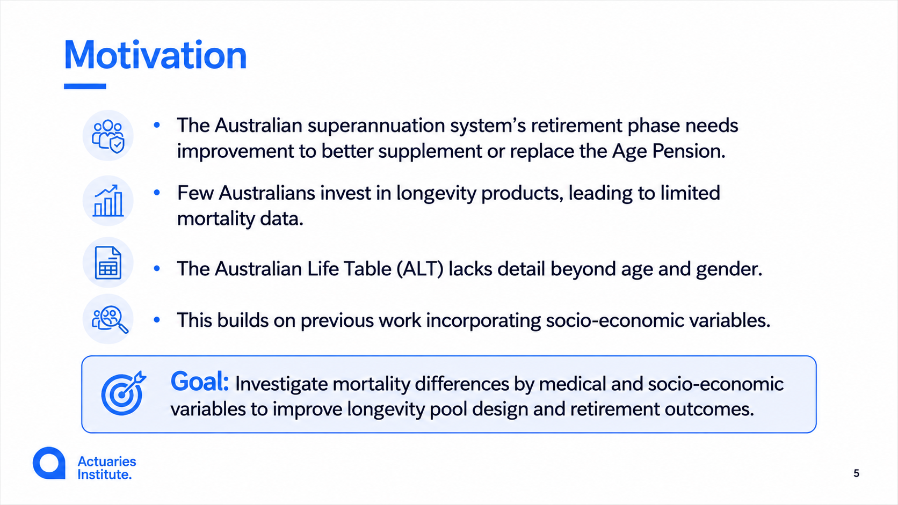

Slide 6
Socio-economic Datasets
Data sourced from Person Level Integrated Data Asset (PLIDA) via ABS DataLab.
Collaborators: ABS, ATO, Department of Education, Health, Human Services, and Social Services.
Datasets for this Research
2016 Census Data: Entire population snapshot as of August 9, 2016.
2009–2016 Social Security Related Information (SSRI): Benefits, payments, marital status, education.
Demographics: For individuals aged 50+ (post-Dec 2007). Includes gender, birth/death dates, indigenous status.

Slide 7
Medical Datasets
In addition to the previous list;
  Medicare Benefits Schedule (MBS): Healthcare services and utilisation
  Pharmaceutical Benefits Scheme (PBS): Prescription medications and dispensing records
  2011-2016
  MBS PBS variables: num (number of services), script (number of scripts dispensed), qty (quantity of units supplied), date: diagnosis date
  No diagnostics data
  Numerous fields with no entries (including chemo, radiation oncology procedures)
  Zero var columns: omitted 76 variables
Notes:
Diagnostic date was available on the dataset but the same for all observations thus was not used in the model
MBS and PBS has no diagnosis information

Slide 8
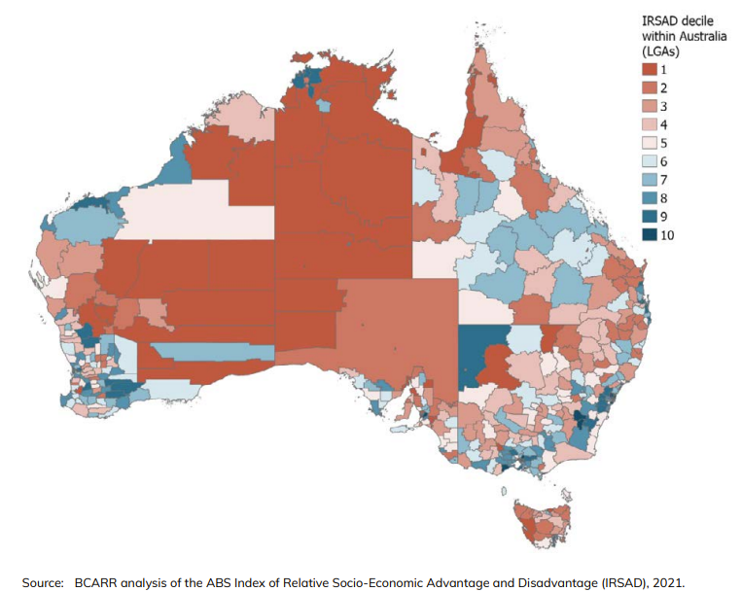
Socio-economic variables
Age
Sex
Index of Relative Socio-economic Advantage and Disadvantage (IRSAD) -- one of the SEIFA variables
Marital Status
Income
Homeownership
Note: Education and Occupation are not considered as they are noisy and contains significant missing data for the retirement age population. SEIFA already contains information about education and employment.

Slide 9
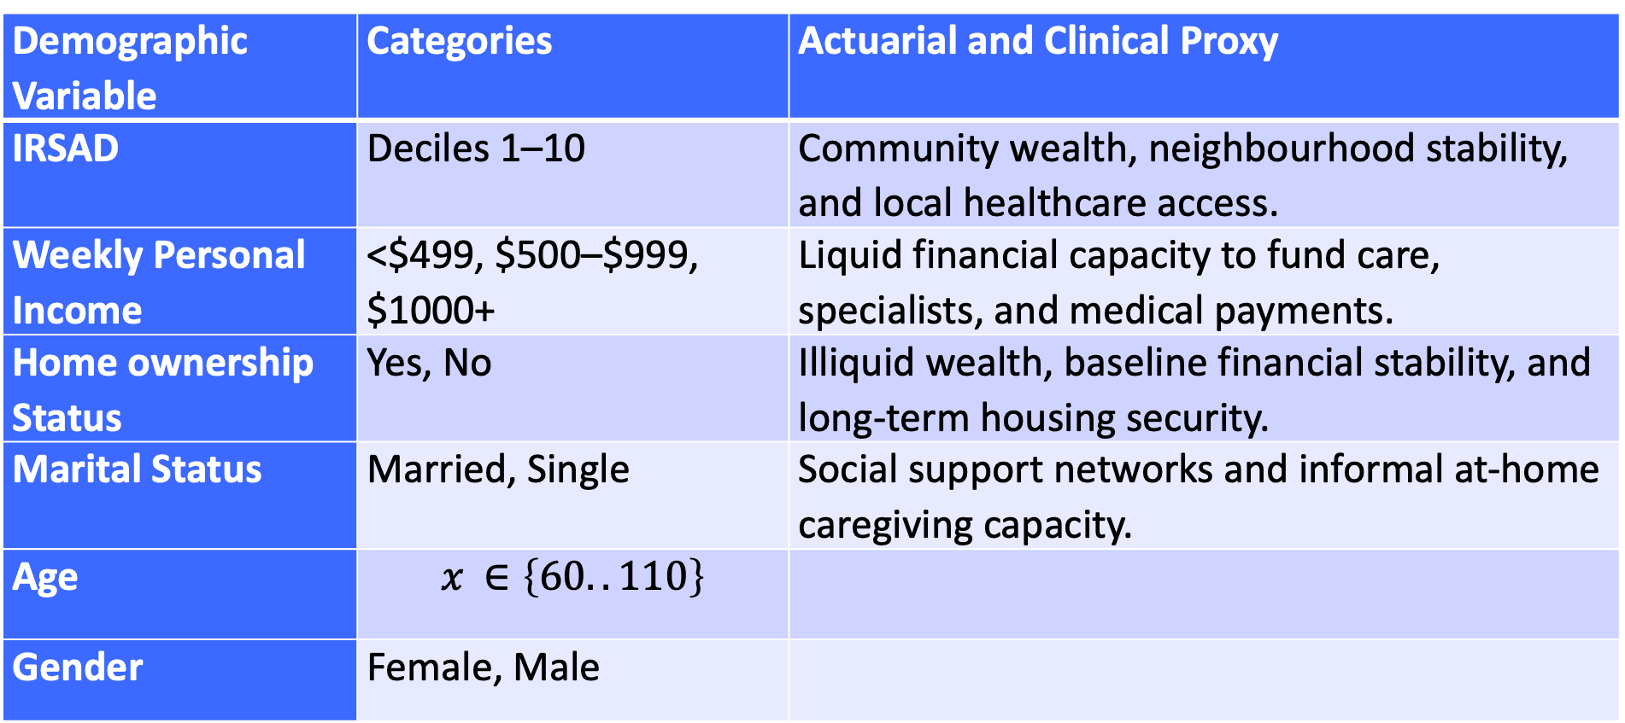
Socio-economic variables
Demographic Variable | Categories | Actuarial and Clinical Proxy
IRSAD | Deciles 1–10 | Community wealth, neighbourhood stability, and local healthcare access.
Weekly Personal Income | <$499, $500–$999, $1000+ | Liquid financial capacity to fund care, specialists, and medical payments.
Home ownership Status | Yes, No | Illiquid wealth, baseline financial stability, and long-term housing security.
Marital Status | Married, Single | Social support networks and informal at-home caregiving capacity.
Age | $$x ∈\left\{60..110\right\}$$
Gender | Female, Male

Slide 10
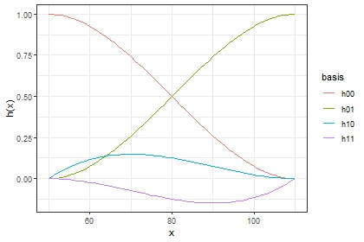

Hermite splines Model (Richards, 2020)
$$\log{μ_{x}}=ah_{00}\left(x\right)+ωh_{01}\left(x\right)+m_{0}h_{10}\left(x\right)+m_{1}h_{11}\left(x\right)$$
$$h_{00}\left(x\right)$$
$$h_{01}\left(x\right)$$
$$h_{10}\left(x\right)$$
$$h_{11}\left(x\right)$$
Note: This is a simplified representation of the model formula. For detailed formulation, please refer to the paper.

Slide 11

Proposed Model for Socio-economic Variables.
$$\log{μ_{x,s,m,i,h}}=ah_{00}\left(x\right)+ωh_{01}\left(x\right)+m_{0}h_{10}\left(x\right)+m_{1}h_{11}\left(x\right)+$$
$$\left(\begin{aligned}\begin{aligned}\begin{aligned}IRSAD (s) \\ +\end{aligned} \\ Marital Status (m)\end{aligned} \\ + \\ Income (i) \\ + \\ Homewonership (h)\end{aligned}\right)×h_{00}\left(x\right)$$

Slide 12
Medical Variables
02

Slide 13
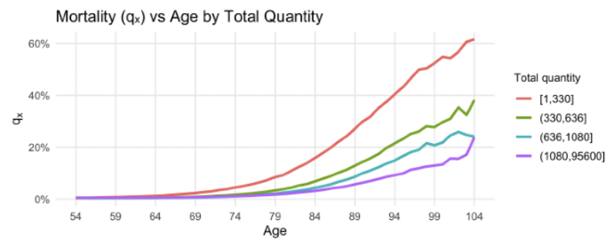
Information Leakage in MBS/PBS Variables
Total number of units supplied
Potential solutions:
1. Use lagged variables
2. Converting to indicator variables

Slide 14
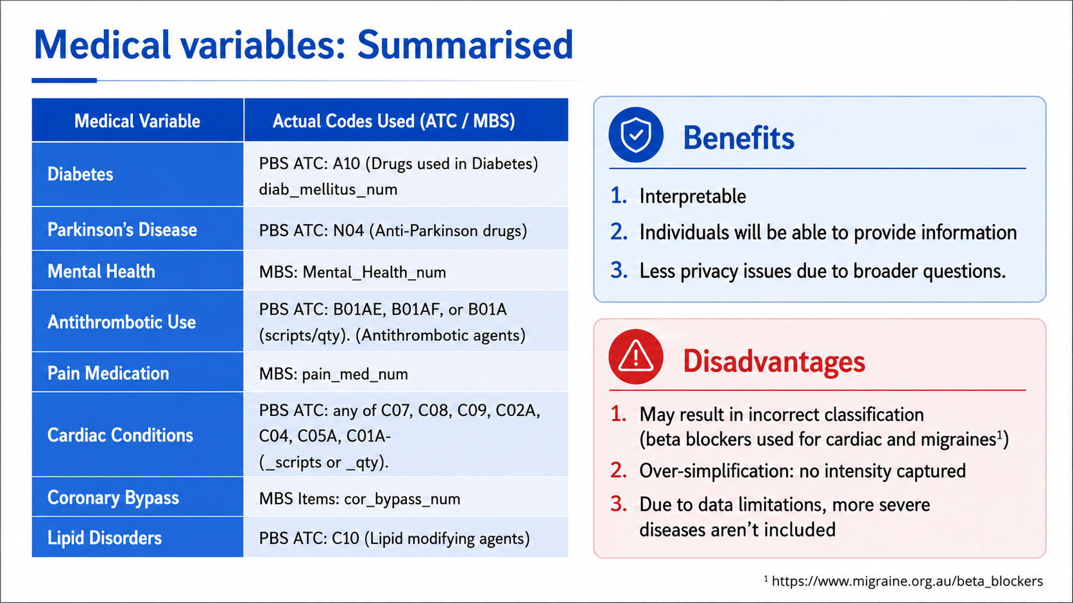
¹https://www.migraine.org.au/beta_blockers

Slide 15
Medical variables: Summarised
Benefits
Interpretable
Individuals will be able to provide information
Less privacy issues due to broader questions.
Medical Variable | Actual Codes Used (ATC / MBS)
Diabetes | PBS ATC: A10 (Drugs used in Diabetes) diab_mellitus_num
Parkinson’s Disease | PBS ATC: N04 (Anti-Parkinson drugs)
Mental Health | MBS: Mental_Health_num
Antithrombotic Use | PBS ATC: B01AE, B01AF, or B01A (scripts/qty). (Antithrombotic agents)
Pain Medication | MBS: pain_med_num
Cardiac Conditions | PBS ATC: any of C07, C08, C09, C02A, C04, C05A, C01A- (_scripts or _qty).
Coronary Bypass | MBS Items: cor_bypass_num
Lipid Disorders | PBS ATC: C10 (Lipid modifying agents)
Disadvantages
May result in incorrect classification (beta blockers used for cardiac and migraines¹)
Over-simplification: no intensity captured
Due to data limitations more severe diseases aren’t included
¹https://www.migraine.org.au/beta_blockers

Slide 16
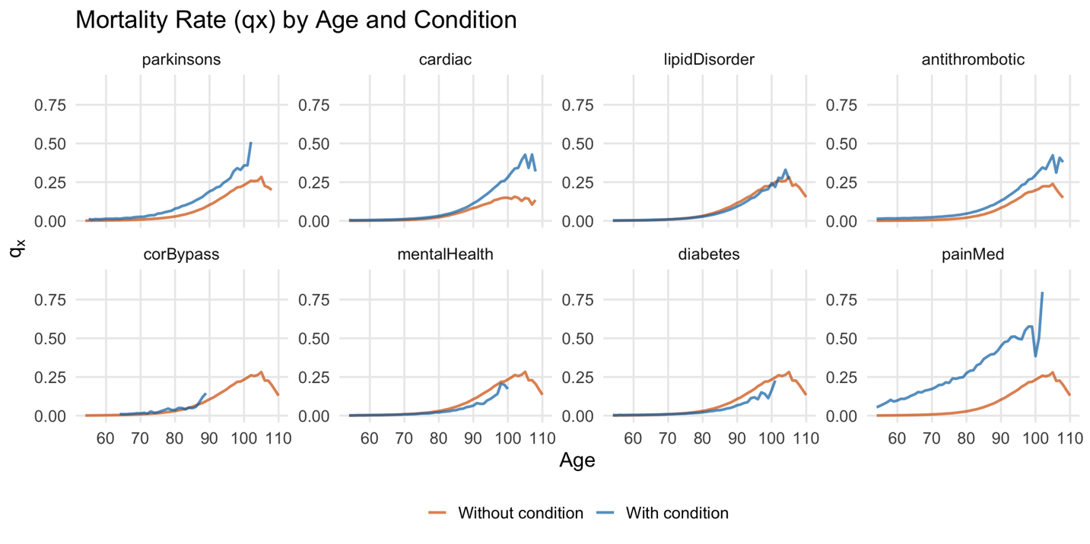

Slide 17
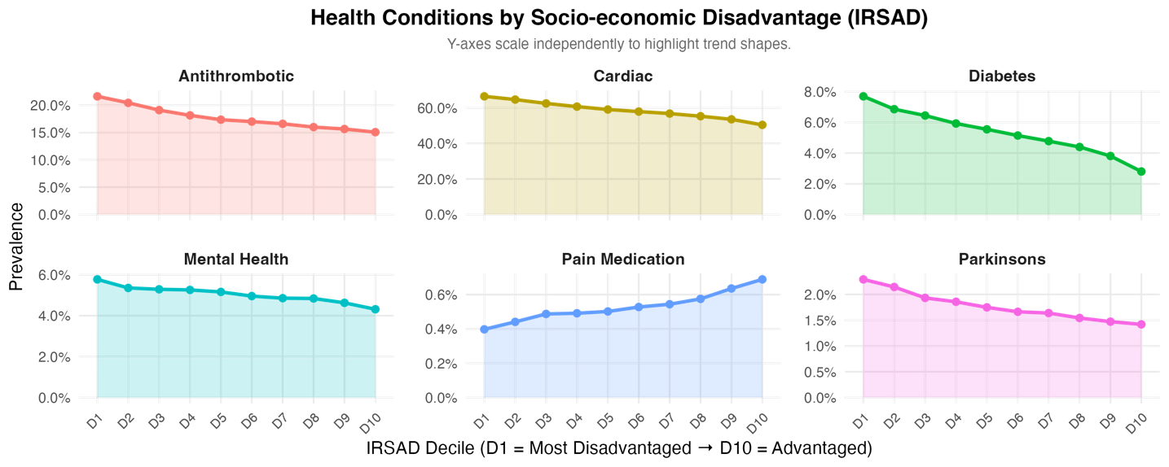
Interaction between Medicare and Socio-economic Variables

Slide 18
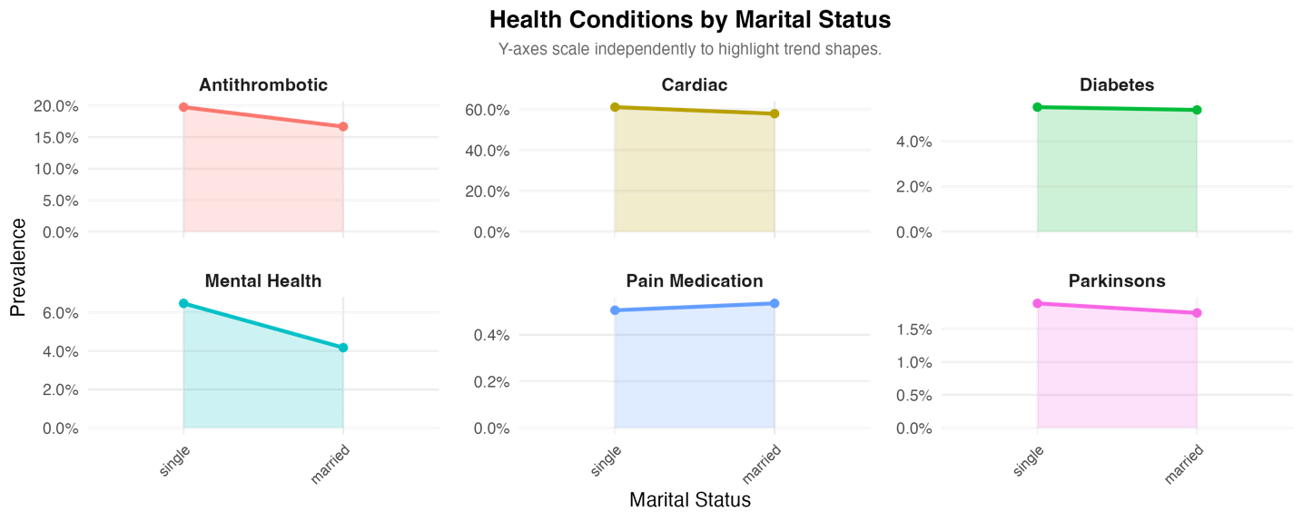
Interaction between Medicare and Socio-economic variables

Slide 19
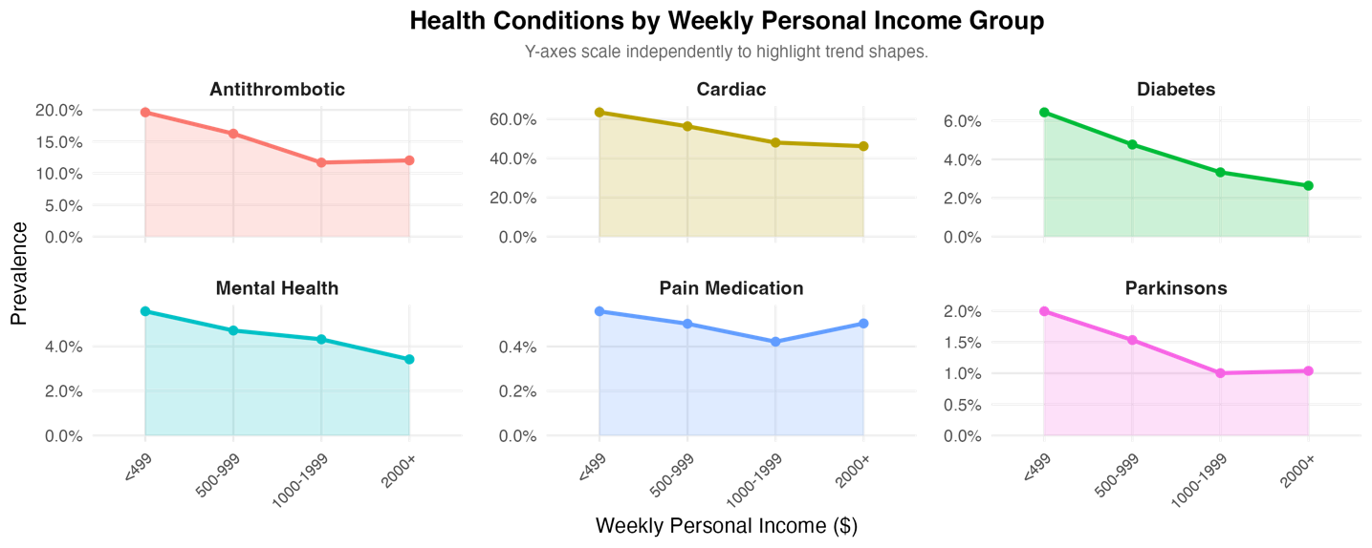
Interaction between Medicare and Socio-economic variables

Slide 20
Model
03

Slide 21
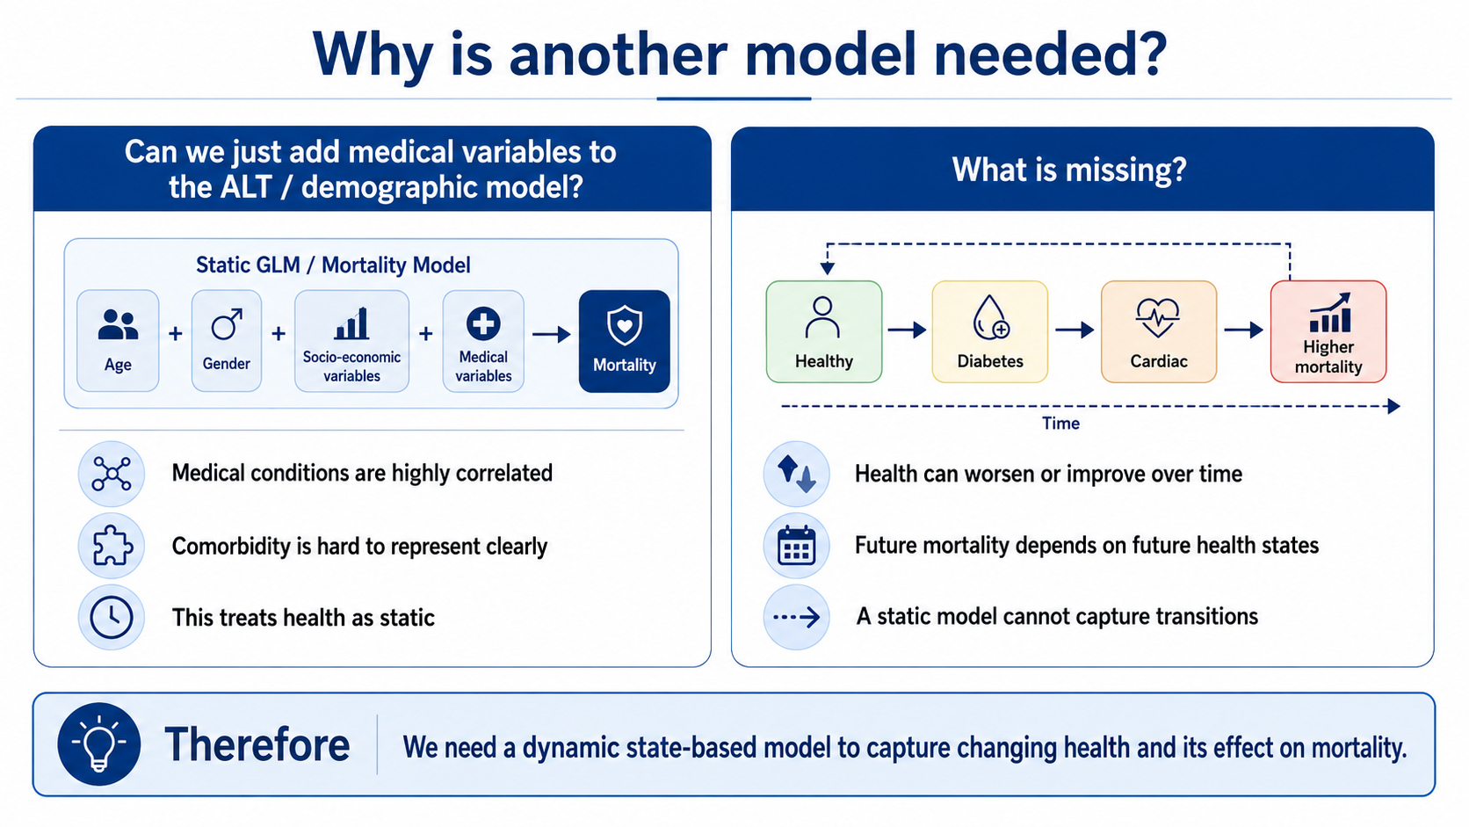
Notes:
Started off medical only
Captures dynamic nature, comobidity

Slide 22
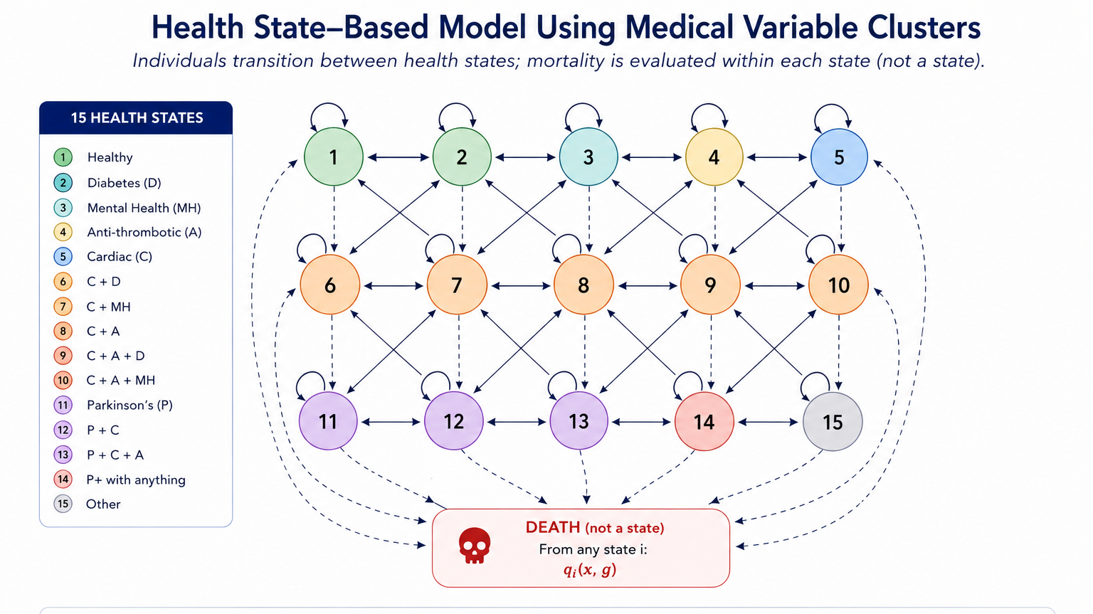

Notes:
Started off medical only
Captures dynamic nature, comobidity

Slide 23
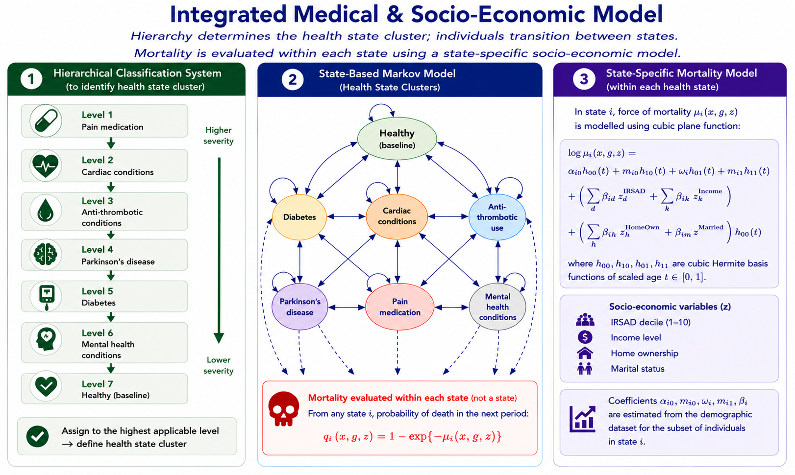
Notes:
Assume death occurs before transition.

Slide 24
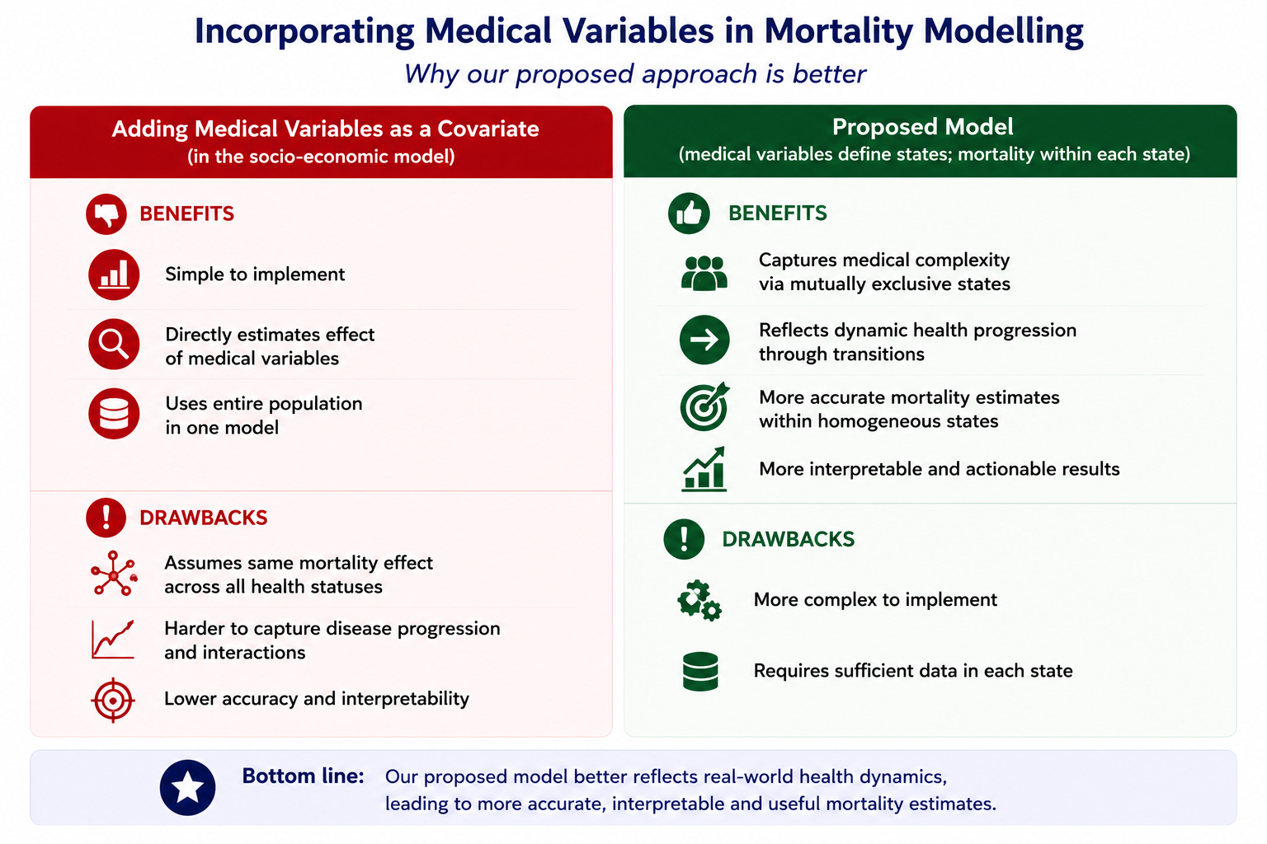
Model Comparison

Slide 25
How To Use the Model
04

Slide 26
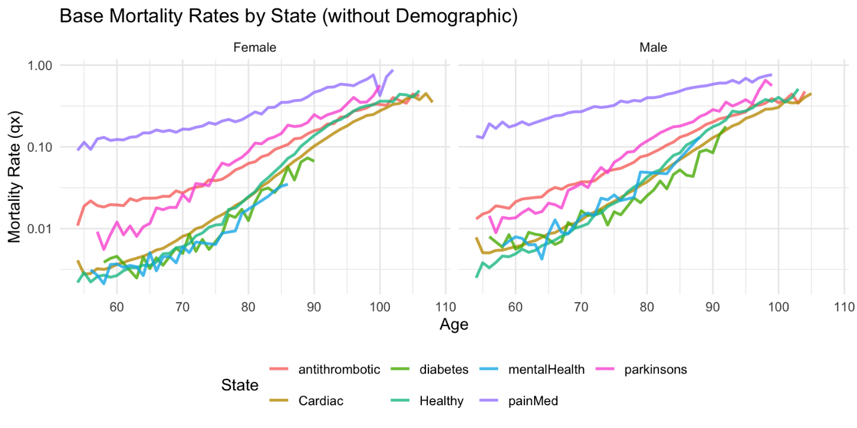
Mortality per State: Hierarchical System

Slide 27
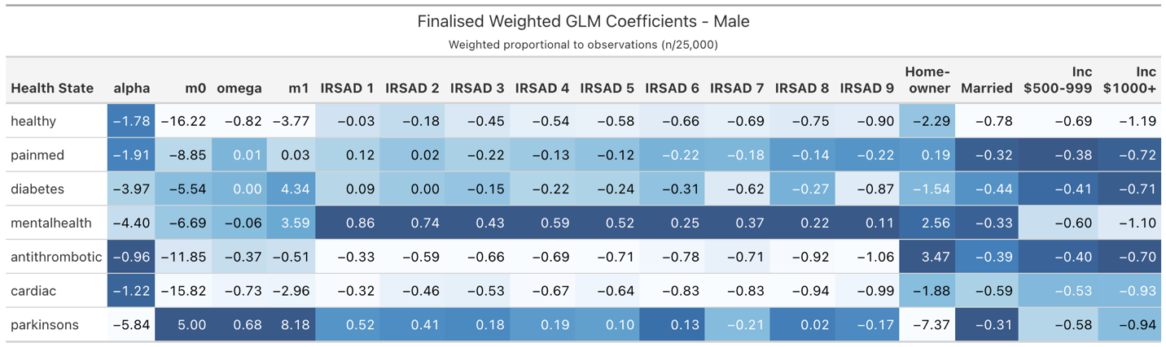
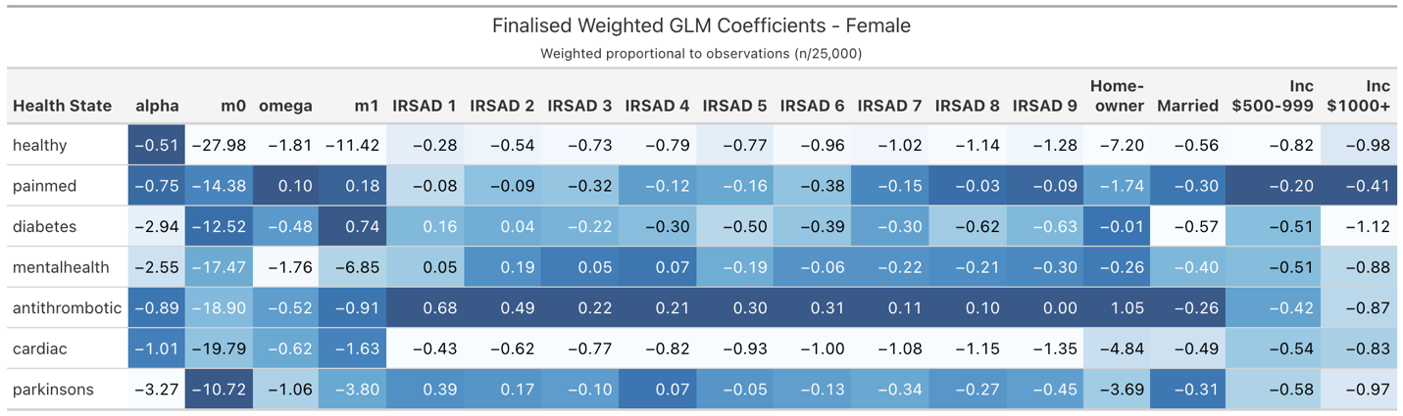
Coefficients Per Cluster

Slide 28
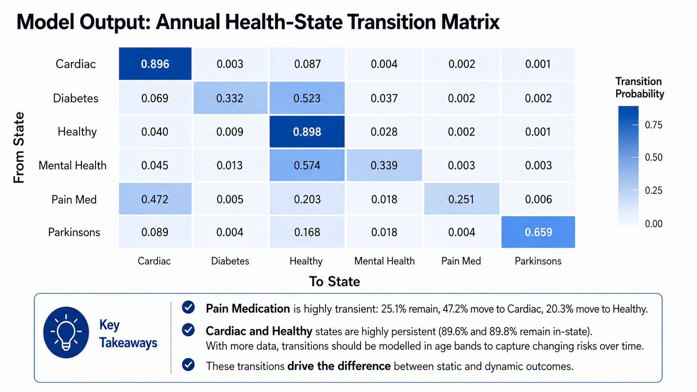

Slide 29
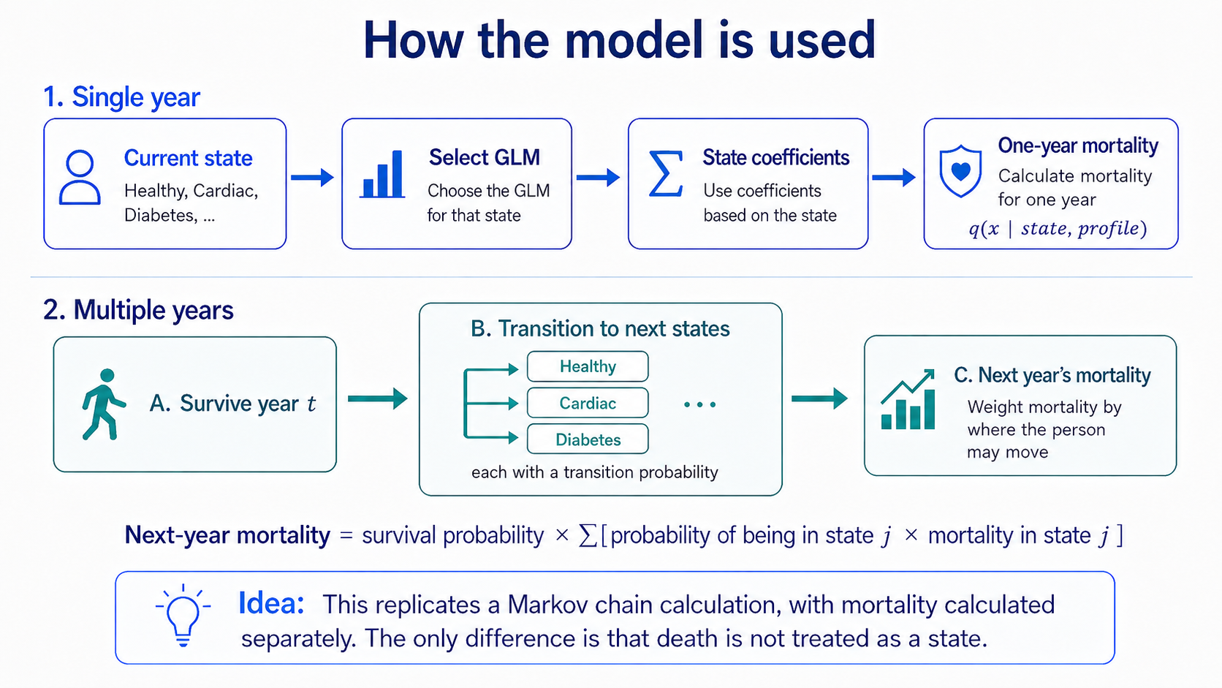

Slide 30
Results
05

Slide 32
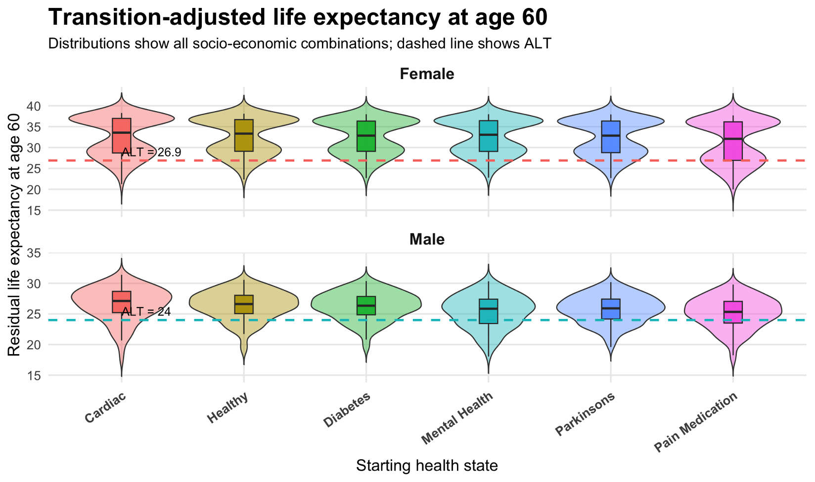

Slide 33
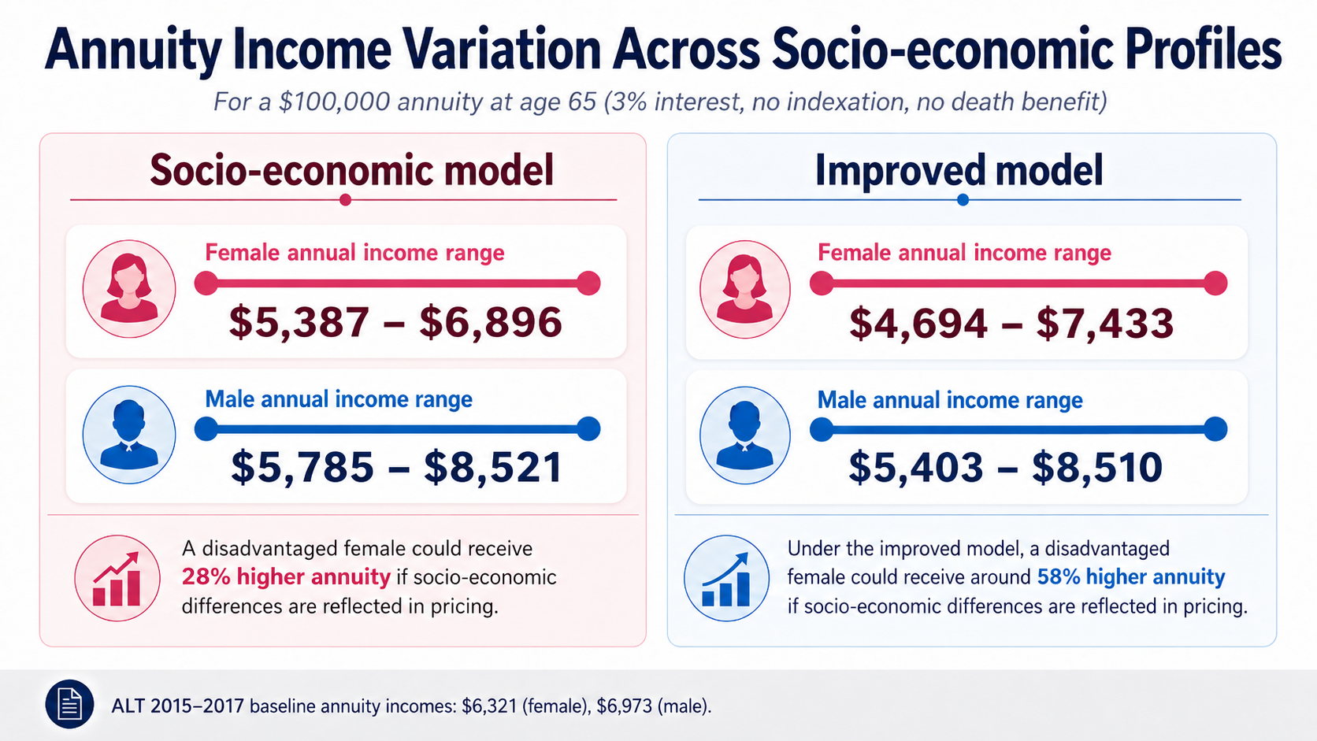
    Annuity design (e.g., death benefit, indexation, guarantee period) can influence the size of these income differentials.

Slide 34
Future work and Resources
05

Slide 35
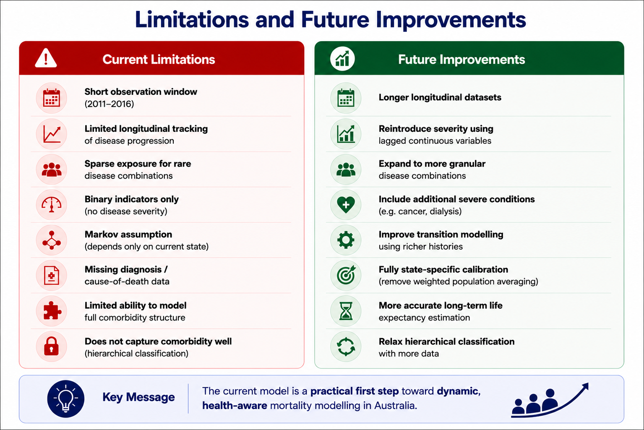

Slide 36


Resources: Paper

Slide 37
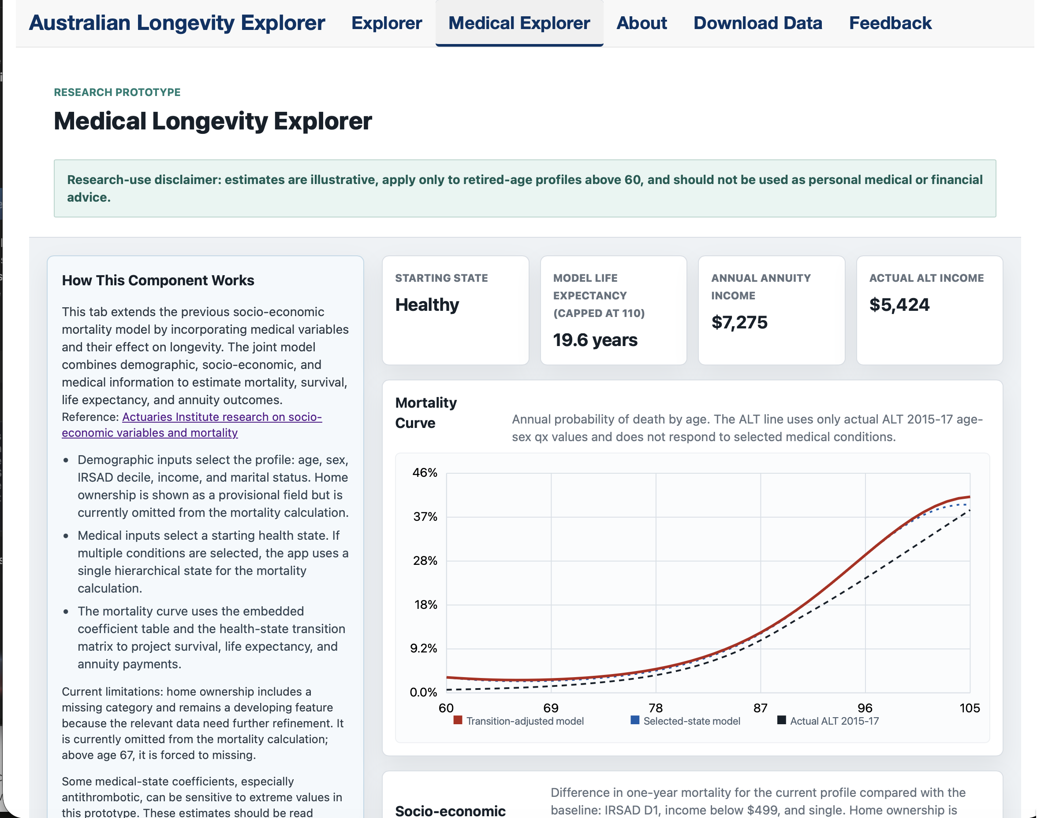

Resources: An Interactive App - “Australian Longevity Explorer”
https://auslongevity.shinyapps.io/explorer/

Slide 38
Thank you
Actuaries Institute
actuaries.asn.au

