Slide 1
The modelling behind successful public policy campaigns
Garvin Tso
27 May 2026

Slide 2
The Actuaries Institute acknowledges the traditional custodians of the lands and waters where we live and work, travel, and trade.
We pay our respect to the members of those communities, Elders past and present, and recognise and celebrate their continuing custodianship and culture.
Notes:
Before I get started…

Slide 3
Introduction
01
Notes:
Welcome all. Today, I would like to share with you some of my personal experiences with public policy. I have been very fortunate to work closely with HESTA on their public policy submissions over the last 5 years, and I’ve been even luckier to have found some success.
I am going to walk you through 3 case studies today and show you what we have found to work for us from a modelling perspective. I’m going to talk about the process, the choices and decisions we had to make, and most importantly the reasoning behind them. My examples are going to be superannuation-focused, but I hope that you can reuse bits and pieces of the principles in your own work.

Slide 4
Three case studies
Superannuation on Paid Parental Leave
LISTO reform
Default system for the retirement phase of super
Passed Parliament 19 September 2024
Effective 1 July 2025
Passed Parliament 10 March 2026
Effective 1 July 2027
WIP
Notes:
The first two campaigns I’m going to touch on are Super on PPL and LISTO reform. We’re incredibly proud to say that they’ve now been passed into law. Because these were the first two I personally worked on, I briefly had a 100% success rate in public policy. Like I said though, it was an incredible amount of luck, which is almost a requirement for success, which I’ll break down later.
The third campaign on the list is still a work in progress. I think it’s important to talk about it so that we can better understand the journey – the challenges that you may face and how to work around them. I would be doing you a huge disservice if I only talked about the happy times we experienced first two, because you should never expect it to be that smooth.
Before I move on to the next slide, I would like to once again acknowledge the team at HESTA for the amazing work that they have done advocating for changes that work towards closing the gender. There was a massive team behind these successes, and really the modelling that I did was but a very part of it.

Slide 5
What is the role of the actuary? What role does modelling do?
  Working forward from the problem
  What is the policy position we are trying to support?
    What is the underlying policy gap you are trying to solve?
    Why should this be the solution?
  Working backwards from the outcome
  What are the key messages the policy team want to be able to present?
  What is the medium of engagement?
Notes:
Right. Let’s start back at the basics. Modelling is not an end in of itself. It is the means to an end.
Modelling needs to serve a purpose. So that’s the first thing we need to do – identify the purpose.
In the case of our first two case studies, HESTA approached us with the purpose. We did not identify the problem or propose the solution. They came to us with an existing policy position, and asked us to provide modelling to support it. That’s not always the case though.
In our third case study, there was no concrete policy position. There was a surface level understanding of the underlying problem we wanted to solve, and a concept of how we would like to solve it, but the details were not there yet, and we needed modelling to inform the policy position.
So let’s summarise and try to answer these questions in our case studies.
1. With Super on PPL, we were trying to enforce one of the core principles of super, which was around the universality of superannuation payments.
2. With LISTO, we were trying to solve the issue of unfair tax outcomes, with low income earners paying more tax within their super than on their take home pay.
3. With Default Retirement, we were trying to solve the issue of retired workers leaving their money in accumulation phase and missing on the tax benefits and retirement income available in pension phase.
And with all three, we had the added bonus of reducing the gender gap in super, because these were all issues that disproportionately affected women.
Along with working forward from the problem, we also work backwards from the outcome. What do we want the modelling to achieve for us? What is our medium of engagement? I’ll expand on both of these questions later, because it’s probably still too abstract right now.
Now it’s important to acknowledge that these are some pretty tough questions. You should not expect to have all of the answers immediately at the start. This is where working iteratively in short cycles is incredibly important. Modelling is not a straight-line process from start to finish.

Slide 6
Modelling output that we always produce
Objective | Example statement
Quantify the size of the problem | [x] Australians have missed out on [$y] since [20xx] due to the lack of policy reform in [topic]
Identify the most affected group of people | Women with low balances are [x%] more likely to be affected by this policy gap
Quantify the impact on example individuals | Mary*, representative of an average Australian, can be expected to miss out of [$x] over her lifetime if no policy change is made in [topic]
Quantify fiscal impact on Federal budget | Reform in [topic] will lead to [$x] in cost savings over the next 5 years.
Notes:
Because we’ve done this a number of times now, we generally have an idea of the modelling output that we want to produce.
These were the sort of statements that we prepared for all three campaigns.
Let’s break them down a bit:
1. The main purpose of the first statement is to draw attention to the problem. Big numbers are important here. These are usually the numbers that make the - newspaper headlines. If you’ve done this part right, even if people disagree with your solution, by engaging you they have acknowledged that the problem is real.
2. The purpose of second statement is to show that the solution is well-targeted. Women, low income – that sort of thing. An adjacent point is, there will always be outliers which critics will always use to attack you. You know like that You can reframe this to show exacting that – that they are outliers.
3. The purpose of the third statement is to humanise the issue and create empathy in the audience. Give the individual a name – Mary, the poor pensioner, single mother, renter for life.
4. The purpose of the final statement is to appeal to government. We don’t always lean into this statement, as you can imagine, but it is important to cost the policy anyway, because an uncosted policy is so easy to attack – something which we can learn from Angus Taylor’s budget reply speech. There are other tricks instead, like bundling a number of cost positive and cost negative policies together, and showing that the bundle of policies together is cost neutral.
Like I said, we prepared these statements for all of our campaigns. That does not mean all of them ended up being released to the public. That is not to say that the ones that don’t get used are not useful. They are still extremely useful in informing a lot of choices. It is very common for commentators to read our proposals and then later ask, did you consider this alternative thing? And we would be able to say yes, and then explain exactly why we didn’t choose the alternative.

Slide 7
What data do we have available?
  Existing research by other industry peak bodies and research houses
  ATO individual tax return 2% sample dataset
  HILDA data
  Government budget papers
  APRA data
  ABS data
Notes:
The second step of modelling involves reviewing what data you have available to you.
I have compiled a list of the resources we often use.
ATO: Policy relates to income
Government: Change to existing policy
APRA: System level data
ABS: Population data
At this point, I should point out the obvious omission here is your own data, and it’s probably the most important one. When we were doing our modelling with HESTA, we had access to their database and all of their member data. APRA and ABS data is extremely useful in helping us scale up our findings from a fund level to the whole of system level or population level.
I’ll give you an example: HESTA has a million members – that’s pretty big dataset. If we limited it to members in the pension phase of super, they represent around 5% of members in the whole system. In our research for the Default Retirement System, we found that there were something like 100,000 members with stranded balances. So 5% of the system
HILDA: Policy at the household level
Look for existing research on adjacent problems. What I find really useful is going through their methodology and footnotes to figure how they answered their questions. Very often we can reuse the same sources they used, but apply them a little bit differently for our purposes.
Key point: The art here really is how you link these datasets together.
For instance, when I was performing modelling for the Default Retirement System, as a starting point I only HESTA’s information. How did I scale it up to the national level. HESTA represented was 5% of all accounts within the system, but I can’t just multiple it by 20. HESTA’s membership is disproportionately female with low balances. And that is the answer really, I had to break up my data, and scale it up proportionately so that I end up with account balance and gender distributions similar to the population level. And in my case, I used APRA data to help inform me how to do that.

Slide 8
Size up the problem
  LISTO reform
  Historical analysis, HESTA only
  "Modelling by [Laneway Analytics] estimates that over the past four financial years, the LISTO misalignment has led to HESTA members missing out on more than 200,000 LISTO payments with a value exceeding $102 million.
  In FY24 [alone]... more than 70,000 HESTA members missed out on more than $35 million in contribution ‘refunds’”₁
  Super on Paid Parental Leave
  Historical analysis, national impact
  “Modelling commissioned by the fund estimates women had missed out on more than $2.8 billion in super savings at retirement from taking time out of the workforce to have children since the Commonwealth Parental Leave Pay scheme was introduced in 2011."₂
₁Financial Standard
₂Sydney Morning Herald
Notes:
Here are some examples of sizing up the problem in our case studies.
There are some choices you can make. You can go backwards looking or forwards looking. You can model the total impact at membership level or the national level. The questions you need to ask yourself are, which one is going to give you the better results? What data do you have available to you?
Example on the left: Historical analysis, HESTA only
This was an example where being forward looking was not advantageous. Because of bracket creep, there were fewer workers whose income fell into the policy gap.
Doing a historical analysis was actually perfect at this moment, because at this exact moment the number of affected people was historically increasing and peaking exactly now.
But you know what there is another way to spin this. Because we don’t want to say that the problem will decrease naturally over time. Instead, we provided a 3-year forward projection of how much this would cost the government, and showed that relative to the size of the problem now, the cost of fixing (in the future) is relatively inexpensive.
Example on the right: Still historical analysis, national level
We went back to 2011 because that was when the policy gap started, and that gave us the biggest number.
--You may then ask me, why did you model at national level for super on PPL but not for LISTO? We did actually, but we had to do this in stages. Public policy modelling is not cheap. We did not walk into this knowing whether the problem was going to be in the millions or billions – that sort of uncertainty is going to be very unsettling to a nervous buyer. So we said, we will do this in stages. We will do the modelling at the fund level first, if the results are promising, we will keep going.--
[1]https://www.smh.com.au/money/planning-and-budgeting/super-on-paid-parental-leave-a-missed-budget-opportunity-20230510-p5d774.html
https://www.9news.com.au/national/scheme-to-pay-mums-and-dads-superannuation-on-top-of-parental-leave-passed/9aa61200-7832-497e-8e00-c267dd3f4e68
[2]https://www.financialstandard.com.au/news/super-tax-debate-suffocates-action-for-low-income-australians-179808647

Slide 9
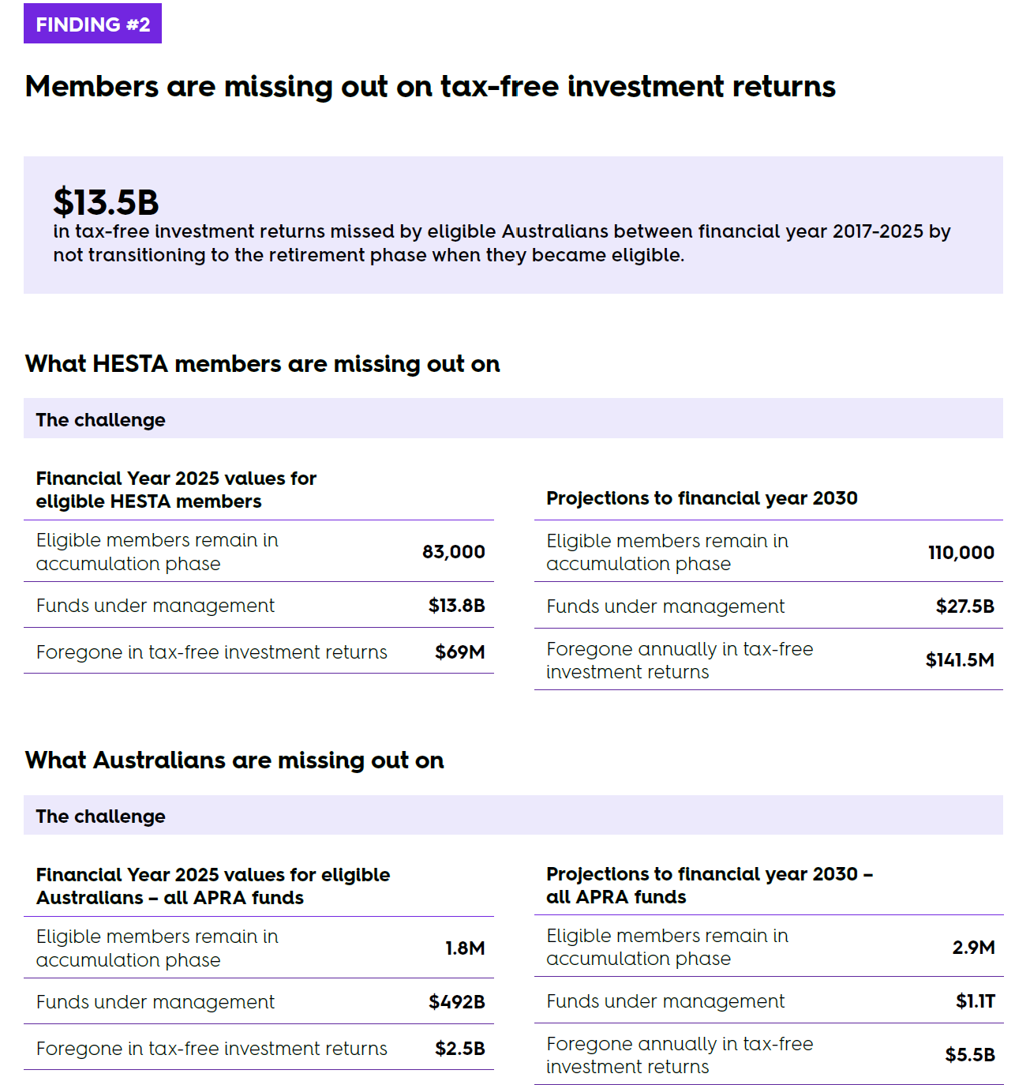
Size up the problem
  Default retirement system
  Forward projection, national level
  “The research from Laneway Analytics, commissioned by HESTA, shows that in the 2025 financial year up to 1.8 million Australians collectively, and often unknowingly, missed out on an estimated $2.46 billion in additional investment earnings.
  Without reform, this figure is projected to rise to more than $5 billion annually by 2030, impacting an estimated 2.9 million Australians.” ₃
₃Financial Standard
Source: HESTA white paper
Notes:
https://www.financialstandard.com.au/news/hesta-urges-government-to-modernise-australian-retirement-system-179811554
https://www.hesta.com.au/about-us/media-centre/hesta-prebudget-submission-202627-default-to-retirement
In this example, being forward looking was excellent because the problem was doubling in size approx. every 5 years. 5 years ago it was $250b, today it was $500b, in 5 years time it’s going to be a trillion.
At the very least, if you’ve done this part right, even if others disagree with your solution, they should agree that there is a problem that needs to be solve. Sometimes that is enough. When I presented my first ever independent paper on a Default Retirement System last year at the summit, I had plenty of pushback, but they were specific to my solution, no one disagreed about the problem. What happened next? They started coming up with their own improved solutions. And isn’t that what public policy should be all about? The industry coming together to improve the system? Shout out to David Knox and Nick Callil, and of course HESTA.

Slide 10
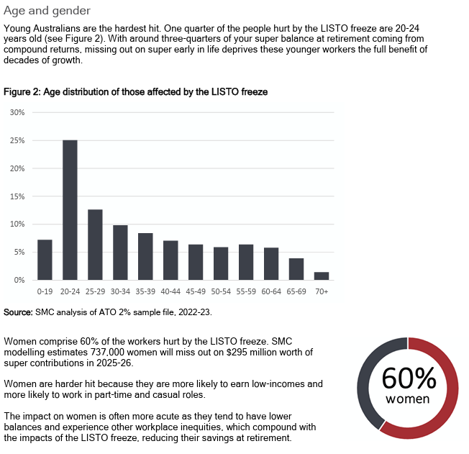
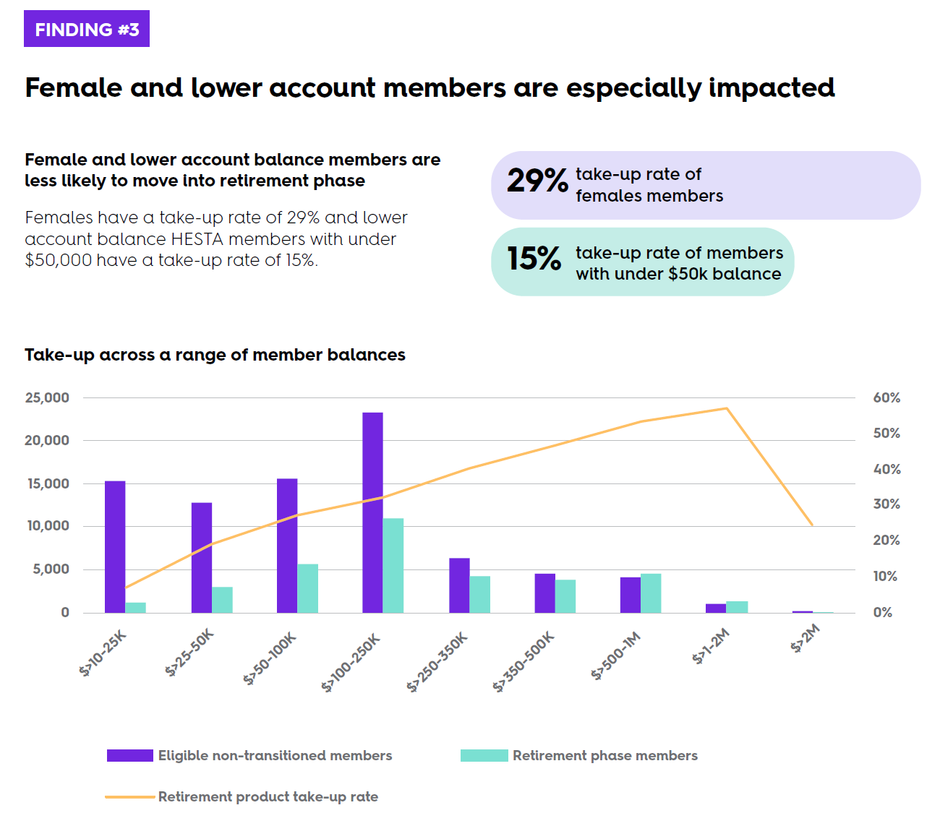
Identify who are the affected people
Notes:
Example on the left is on LISTO. Example of the right is of Default Retirement System.
Purpose is the same, show the affected population as a means of showing that should the government spend money on it, that the money spent will be well targeted.
SMC report - Breaking the deal: why the LISTO needs to be fixed

Slide 11
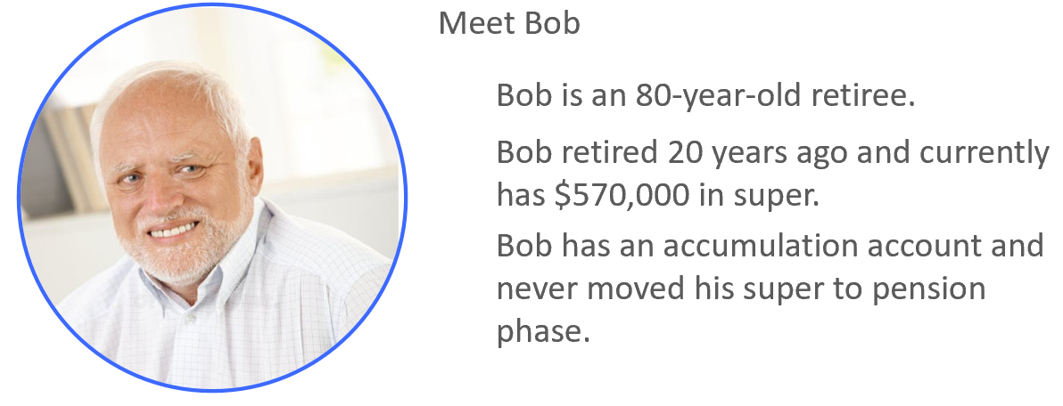
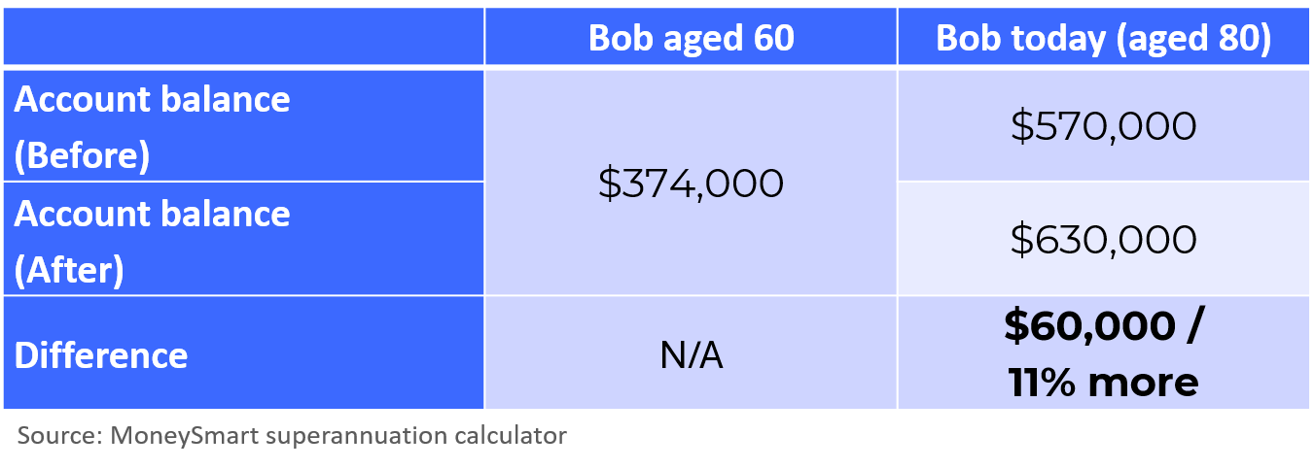
Quantify the impact using example individuals
Notes:
Default Pension Mechanism. 2025 Actuaries Summit presentation.

Slide 12
What is your medium of engagement?
  Pre-budget submission
  Response to industry consultation
  White paper
  Newspapers
  Industry round tables
  Union engagement
  Canberra tour
Notes:
If the output to be used in a public submission to Treasury, or presented behind closed doors in an industry round table, or released as a research white paper? We’re looking at very different level of depth and complexity here.

Slide 13
Policy change is not a straight line – the stars need to line up
  Change of government / timing within election cycle
  Socio-economic / geo-political pressures of the time
  Industry trends
  The power of consensus (peak bodies)
  Favourable media treatment
  The lack of a hyper vocal opposition
Notes:
On this last slide, I want to move on from the modelling. I need to reiterate - modelling is but a small part of our success. We had an incredible team, who knew how to engage with peak bodies, unions, the media, politicians, staffers and the like. And the stars need to line up.
The truth is the whole super on PPL campaign spanned almost 10 years. I managed to come in at the tail end and finish it off just when we experienced a change in government. On reflection, I’ve absolutely done a Steven Bradbury here.
Secondly, I mentioned that the underlying issue of Super of PPL is the universality of superannuation payments. This was actually second in a wave of changes based on the same principle. We had an exemption for superannuation payments for people making less than $450 a month, called the $450 threshold that was just removed before this. Immediately after this, there was a push for the exemption to be removed on domestic workers, and then on under 18s working less than 30 hours a week. It was part of a bigger movement.
Thirdly, all of the successful changes had broad industry support. We had all of the big funds, SMC, ISA, Women in Super – all on board. Our usual opponents, the Financial Services Council, was not actively opposed to it. With the Default Retirement System, this is a box which we have not ticked – and that’s something we’re working on.
Fourthly, we had favourable media treatment. All of the major newspapers picked up on our headlines, and wrote about it for a prolonged period of time. We picked up momentum and there was no other major story at the time to derail it.
Finally, we had no hyper vocal opposition. Just think about all of the noise around the new Division 296 tax even though it’s only going to affect 0.5% of people.
We had all these boxes ticked to find success. This is not to discourage you, but to give you a framework for forming a strategy on your own campaigns.

Slide 14
Thank you
Actuaries Institute
actuaries.asn.au

Slide 15
Introduction
01

Slide 16
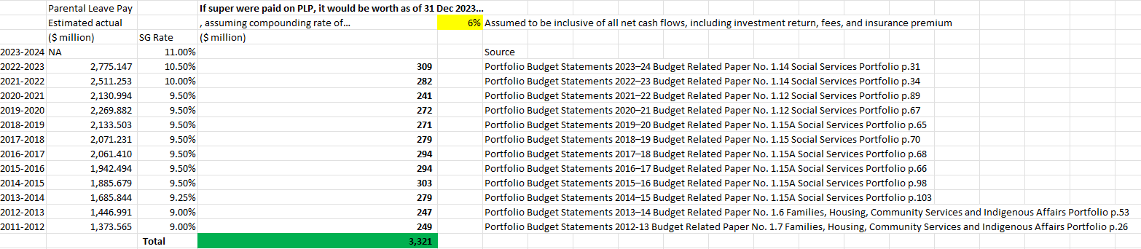
Backward looking figures (Super on PPL example)
We went through government budget papers to find the government own costings and forward projections of the government program

Slide 17
Forward looking figures (LISTO reform example)
FY | Current Policy | Proposed Policy | Additional Cost
2024 | $618,312,303 | $1,194,424,449 | $576,112,147
2025 | $588,457,977 | $1,148,974,115 | $560,516,138
2026 | $559,166,452 | $1,098,054,940 | $538,888,488
2027 | $517,199,184 | $1,017,256,488 | $500,057,304
  We used 2% ATO sample data to estimate how much LISTO members would have received under current policy and the proposed policy
FY | Current Policy | Proposed Policy | Additional People
2024 | 2,262,150 | 3,167,850 | 905,700
2025 | 2,108,550 | 2,968,650 | 860,100
2026 | 1,966,500 | 2,774,550 | 808,050
2027 | 1,830,600 | 2,595,050 | 764,450

Slide 18
Quantify the impact on example individuals (Default Retirement System example)
 | Bob aged 60 | Bob today (aged 80)
Account balance (Before) | $374,000 | $570,000
Account balance (After) |  | $630,000
Difference | N/A | $60,000 / 11% more
Source: MoneySmart superannuation calculator
Notes:
HESTA 2024-2025 Pre-Budget Submission

