Slide 1
Stripping unnecessary complexity from the retirement process
Anthony Asher
May 2026

Slide 2
Contents
The central argument 3
Four major injustices 6
The asset test 7
Commonwealth Rent Assistance (CRA) 10
Effective marginal tax rates (EMTR) 11
Aged care 12
Contributions 14
The radical alternative 15
Discussion 16
With thanks to the Orford Foundation for financial support to the UNSW Innovations in Risk, Insurance and Superannuation Knowledge Hub

Slide 3
The central argument
The retirement system has become unnecessarily complex
Unnecessarily detailed, unreasonable and immaterial from a wider perspective
Complexity distracts and imposes direct and indirect costs on all stakeholders
So, abolish unnecessary and unreasonable provisions

Slide 4
Why this matters
Individuals are disempowered: entirely reliant on financial advisors or Centrelink staff to interpret their entitlements
Providers and regulators continually distracted
Financial advice more expensive than necessary
Australian National Audit Office findings on Centrelink:
“Complex procedures and limited staffing resulted in seniors waiting an average of 48 days for claims to be processed”
Maximum ‘phone wait times exceed one hour on 57% of days
$5bn in incorrect payments over 2 years
Offering lifetime annuities seems too complex

Slide 5

Perspective
Cannot see the wood for the trees
The Problem: AICD: the regulatory burden is a “self-sabotaging drag on productivity and growth” costing 6% of GDP
Income Tax Acts | 1,600,000 words
Corporations Act | 1,000,000 words
War and Peace | 560,000 words
Social Security Act | 500,000 words
Change Perspective: 1. The effects of tax and means tests need to be considered in context.
It is not necessary for each element to be considered on its own
For superannuation, the impact is measured over a lifetime
2. It is difficult to distinguish between different levels of need and “utility”. What should the ratio of single: couple pensions be? Research suggests 0.66 to 0.8. Therefore, arbitrary distinctions of less than (say) 10% are immaterial. E.g. Telephone allowance of $55 per quarter!
Generated by ChatGPT

Slide 6
Four major injustices
• Asset test penalizes saving
• Renters treated worse than homeowners
• EMTRs can exceed 100%
• Long home care waiting lists

Slide 7
The asset test problem
Assumptions of real yield of 3%; AP increases with inflation; standard minimum drawdowns

Slide 8
Combine asset and income tests
Replace separate asset and income tests with unified notional income
Convert assets to income using age & health-based annuity factors
Applies especially to Aged Care - life expectancy is only two years or so

Slide 9
The asset test solution for Age Pension
Persuasive slide for lifetime income streams?

Slide 10
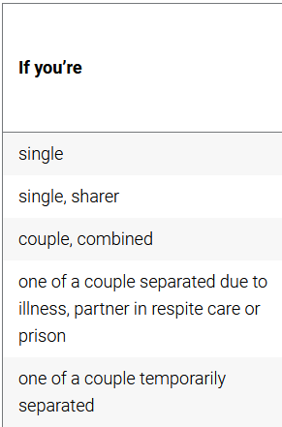
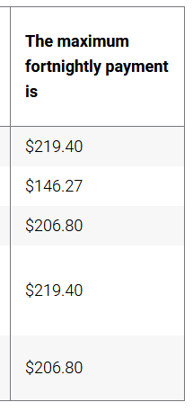
Commonwealth Rent Assistance (CRA) – universally regarded as inadequate
Current position | Proposals
Not means tested but cuts out completely with last $ of Age Pension (AP) | Should be means tested to avoid EMTR > 100%
See table on right – spurious accuracy | One rate for all. Treat single sharer as two singles or as couple
Age Pension differentiates homeowners in asset test but not income test | Inexplicable inconsistency
https://www.servicesaustralia.gov.au/how-much-rent-assistance-you-can-get
=> CRA could be increased to perhaps $10k and means tested for consistency

Slide 11
Effective marginal tax rates (EMTR)
Current position | Proposals
Earnings (except from pension investments) are subject to tax and means tests creating EMTRs of up to 82% | Limit EMTR to 50% by giving credit for PAYG and recover any excess from annual tax refund
Pension, Energy and Education Supplements and Pharmaceutical, Telephone and Remote Area Allowances dependent on last $ of AP, creating EMTRs >> 100% | Abolish all and consolidate in AP so they are means tested
Pensioner Concession Card (worth $1k - $2.6.k depending on state) creates EMTR >> 100% | Abolish – let the states develop their own targets
If an EMTR of 47% disincentivizes, one cannot believe EMTRs of this magnitude are not enervating

Slide 12
Home care packages
Support at Home packages are rationed and some 100,000 people are believed to be on waiting lists.
It would be fairer to reduce the size of the benefits or increase contributions to prevent an inexplicable difference in support for those on the list and others with packages.

Slide 13
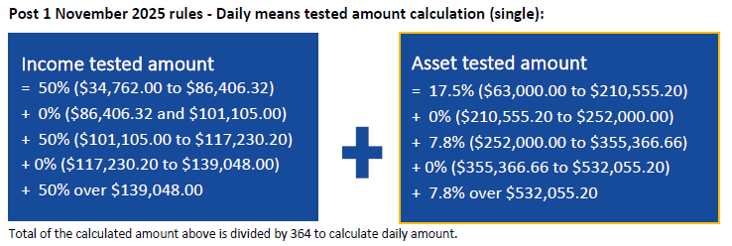
Means tests for home and residential aged care
Use the same definition of means for Age Pension, home care packages, and residential support
Provide financially equal support at home and residential aged care subsidies
Abolish the RAD (lump sum) payments for residential care
Remove grandfathering rules and – only if material – grandfather dollars
Strive for consistency and simplicity
Courtesy Cathy Nance

Slide 14
Simplify contribution rules
Current position | Proposals
$30k cap of deductible contributions and additional tax for those earning over $250k p.a. ($293) | $293 now irrelevant – abolish
If balance < $500k, can carry forward up to 5 years unused concessional contributions | Likely to immaterial except for a small group with volatile taxable income and limited borrowing power - abolish.
Bring forward 3 years of non-concessional contributions | Immaterial (15% of investment income for 1.5 years) – abolish
Up to $500 for Government Co-Contribution for Low Income Earners and $540 Spouse Contribution | Immaterial over a lifetime relative to the value of the Age Pension, and dependent on being informed – abolish
Up to $500 Low Income Superannuation Tax Offset (LISTO) | Also immaterial, but administered by funds automatically so less onerous - ?
Up to $50k into Homesaver for house deposit | Immaterial relative to cost of house - either increase to $300K or abolish

Slide 15
The radical alternative
Abolish both means testing and superannuation tax concessions
New Zealand provides a comparison point
BUT
Requires total reconstruction of institutions of long-term savings distribution and investment
Gives a further free kick to older generations who have benefitted from the tax concessions of the past

Slide 16
Conclusion
The retirement system has become unnecessarily complex
Unnecessarily detailed, unreasonable and immaterial from a wider perspective
Complexity distracts and imposes direct and indirect costs on all stakeholders
So, abolish unnecessary and unreasonable provisions

Slide 17
Discussion
Actuaries should help lead reform?
Can we stand against “good ideas” that fail the materiality test?
  Spouse contribution
  LISTO
  $250 Working Australians Tax Offset (WATO)
  Operational Risk Financial Requirement (ORFR) – 0.0025 * assets
Should materiality be a principle that should be addressed in all our submmissions?

