Slide 1
Always-on Intelligence: Embedding AI in Retirement Guidance
Oscar Chen
Retirement Strategy, Colonial First State
June 2025

Slide 2
Contents
Why Retirement Guidance Needs a New Model
Building the Intelligence Foundation
Always-on Guidance in Practice
Rethinking Retirement: From Product to Journeys
The Role of Actuaries
Q & A

Slide 3
Why Retirement Guidance Needs a New Model
Growing gaps & rising expectations
01

Slide 4

Why Retirement Guidance Needs a New Model
Growing guidance gap
  With more Australians retiring (2.5 million+ in the next decade) and fewer advisers, many retirees risk not getting the help they need. Funds see the need to scale guidance, beyond traditional one-off advice.
  Rising expectations
  Today’s retirees expect personalised, timely support – not just generic brochures. Our members tell us that retirement is a service (engagement, education, advice), not just a product. They want clear, relevant nudges at key moments, in plain language.
  AI as an enabler
  Always-on AI can fill the gap between human interactions, delivering proactive insights (like “future-self” scenario projections) and gentle nudges when it matters. This turns retirement planning from a static “set and forget” into a continuous, adaptive journey that scales across thousands of members.
4

Slide 5
Evolving Regulatory Expectations – Raising the Bar on Retirement Support
Retirement Income Covenant (2022)
From savings to retirement outcomes
Shifts from accumulation to sustainable retirement income, requiring trustees to design strategies aligned to member needs and outcomes.
Best Practice Principles (2026)
Urge data-driven and timely engagement
Promotes deeper understanding of member needs and targeted, timely communications (e.g. using behavioural insights).
APRA Letter on AI (2026)
Innovation is encouraged, but robust risk management is non-negotiable
Acknowledges AI’s benefits but warns on governance gaps. Boards must oversee AI use with robust risk management, and ensure human oversight for high-impact decisions.
APRA Retirement Reporting Framework (Consultation, 2026)
Measuring what matters
Introduces structured reporting on retirement outcomes and member experience, enabling transparency, benchmarking, and accountability.
DBFO Tranche 2 (TBC, 2026+)
Potential step-change in advice delivery
Uncertainty on scope and timing delays scalable, fund-led advice models – risking further expansion of the advice gap …
5

Slide 6
Building the Intelligence Foundation
From fragmented data to real-time insights and responsible AI
02

Slide 7
Customer 360: The Foundation for Personalised Guidance
Multiple data signals converge to form a dynamic member profile
Unified member data
  Customer 360 platforms integrate balances, transactions, demographics and interactions into a single, up-to-date view.
  This holistic picture enables richer analytics.
  Data sources
  Beyond structured data (account balances, contributions, retirement dates), leading funds incorporate behavioural signals (online activity, engagement patterns), household context, and selected unstructured insights (from surveys or calls) to better anticipate needs.
  Current limitations
  In practice, data gaps (incomplete external assets, poor data quality) persist, while privacy and consent requirements constrain use. Robust governance is critical so that AI uses data ethically and with member permissions. (e.g. a fund may not use detailed health info unless explicitly allowed.)
Transactions
Behaviours
Sentiments
7

Slide 8


Predictive Analytics – Right Nudge, Right Time
Member Segmentation How much do we know about our members?
Triggers & Nudges
Preferences→ Engagement → Outcome
Smart segmentation
  Always-on analytics segment members by basic characteristics (age, balance, advice status) and preferences & needs to enable targeted and relevant interventions, moving beyond one-size-fits-all communications.
  For example, identify “late retirees with high balances” vs. “new retirees drawing minimum pension” to tailor interventions.
  Event-driven triggers
  AI algorithms monitor for life events or behaviors that signal a need for guidance (e.g. approaching Age Pension; a sudden large withdrawal; or only taking minimum drawdowns (low balance utilisation). Instead of generic newsletters, the system can send a personalized “check-in” prompt at those moments (e.g. a birthday retirement health-check, or a drawdown alert ahead of year-end).
  Higher engagement
  When communication aligns to member context and timing, engagement increases materially. An internal survey found 70% of members are interested in receiving help from their fund to stay “on track” towards retirement goals.
18-50
Young &
Established
Track performance
Consolidate super
Uplift financial literacy
50 - 60
Pre-Retirees
Increase contributions
Manage investment risk
Establish retirement strategy
60 - 75
Retirees
Age pension optimisation
investment/market/longevity risks
Income goals vs. Drawdown strategy
75+
Later
Retirement
Aged care
Estate planning
Intergenerational wealth transfer
8

Slide 9
Making AI Work Responsibly at Scale
AI Guardrails
Technology readiness
  An always-on system needs robust tech infrastructure. Funds must have real-time data pipelines (often cloud-based) to feed AI models continuously. Legacy systems and data silos limit effectiveness. Investment in data engineering is a pre-requisite for true “always-on” intelligence.
  Privacy & consent
  Embedding AI must respect data privacy laws and member permissions at every step. Sensitive personal data (health, spending patterns, etc.) can enhance predictions, but only if used with consent and transparency – Members should know and trust how their data drives nudges.
  Human oversight remains essential
  AI outputs must be tested for fairness and supported by clear governance. Human judgement remains critical for high-stakes decisions to maintain trust and accountability.
  Ultimately, maintaining member trust is paramount, so guardrails like explainability, opt-outs, and fallback to humans should be built in.
Privacy & Data Protection
Customer data is secure, managed and used appropriately
Human + AI Oversight
Critical decisions involve human judgement
Fairness & Bias Monitoring
Outcomes are equitable and regularly tested for bias
Explainability & Transparency
Recommendations are clear, auditable and understandable
9

Slide 10
Always-on Guidance in Practice
What an AI-enabled retirement experience looks like?
03

Slide 11
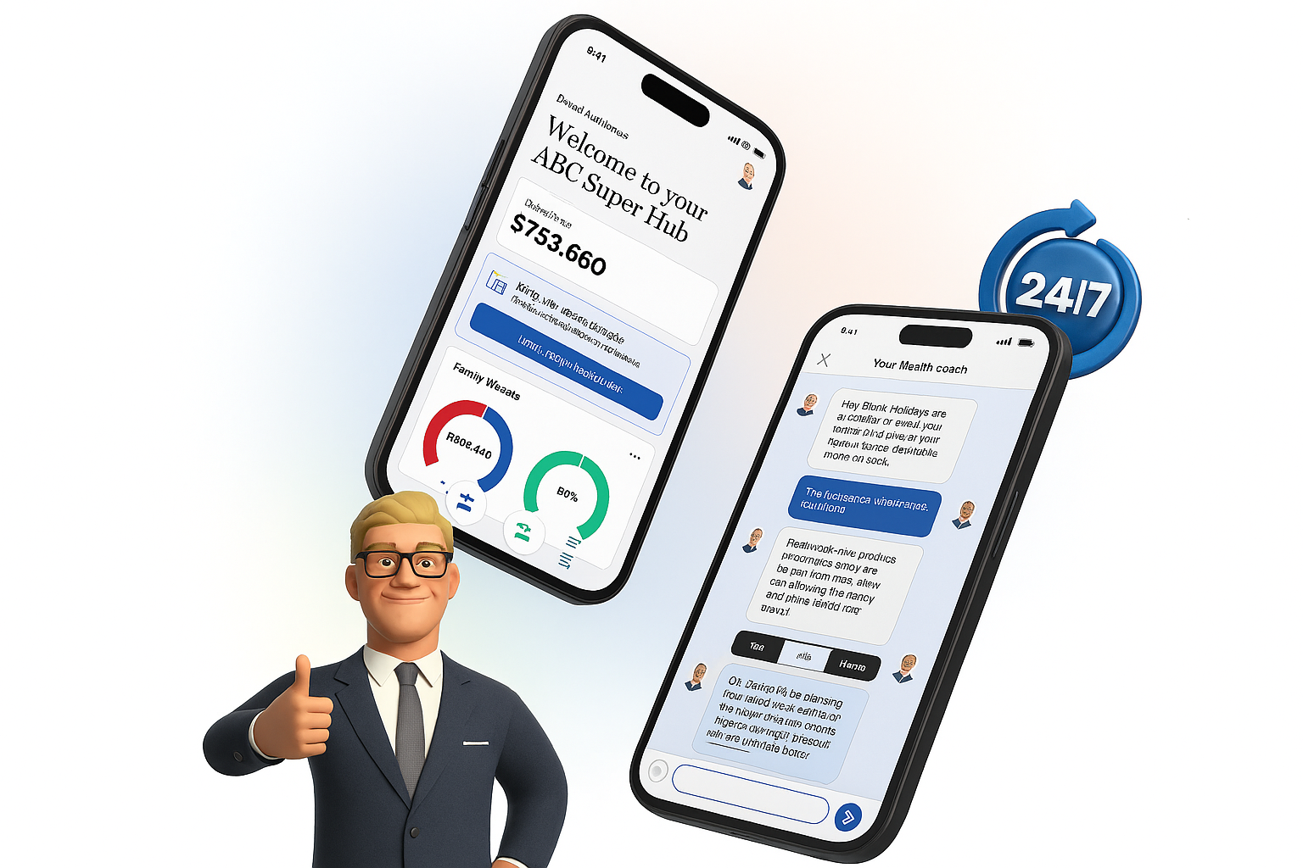
Always-on Retirement Guidance: AI at Scale, Human Where it Matters
24/7 “digital coach”
  Embedding AI creates an always-available retirement coach that can answer common questions, run scenario models, and send nudges anytime. For example, an AI chatbot might show “future self” income projections if a member considers retiring a year early. This constant support helps members feel guided even when advisers aren’t present.
  Clear advice boundaries
  AI can help provide education (e.g., explain account-based pension vs annuity), and general guidance (“your projected income covers ~80% of comfortable standard”). When a situation gets complex or personal, the system hands over to a human adviser. This ensures compliance (no unlicensed advice) and builds trust – members know a qualified person is behind major decisions.
  Seamless human handover
  A well-designed AI-human hybrid makes transitions smooth – continuous member support rather than siloed interactions.
  For instance, if the AI identifies a member at high risk of outliving their savings, it can notify an adviser with the context. The adviser then proactively reaches out, informed by the AI’s analysis.
11

Slide 12
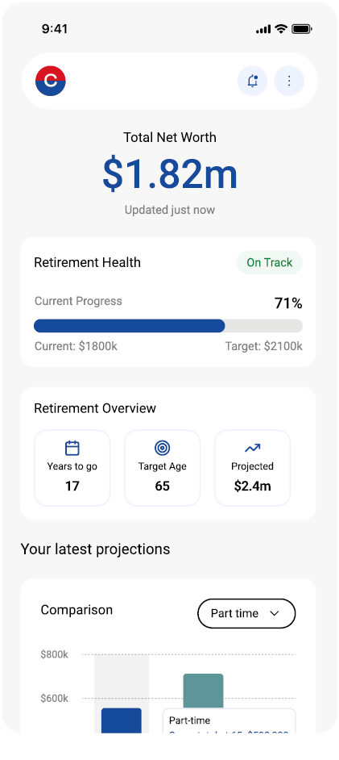
What Members Value Most in Always-on Guidance
Scenario modelling with personalized data is the highest value feature
  Members are highly motivated by the ability to explore their own “what-if” scenarios using real data – making guidance feel relevant and actionable vs. generic tools.
“I’d be really curious to keep trying different scenarios—what if I worked two days a week instead, or picked up an extra casual job?” – Victoria
The “always-on coach” is an exploration tool with human oversight
  Customers use AI to explore scenarios and clarify questions, then prefer to seek human guidance for complex planning or reassurance. They are however happy for AI to surface opportunities and actionable insights.
A whole-of-wealth view (incl. partner) is now expected baseline, not a differentiator
  Members expect a consolidated view, including partner assets. This is no longer differentiating, but a prerequisite for meaningful guidance.
12

Slide 13
From Predictive Analytics to Targeted Engagement
Example: member attrition propensity model
Data
Attrition Model
Key Predictors
Member Segmentation
Targeted Engagement
High Risk
Medium Risk
Low Risk
Average
13

Slide 14
Rethinking Retirement: From Product to Journeys
How AI reshapes retirement solutions and member engagement
04

Slide 15
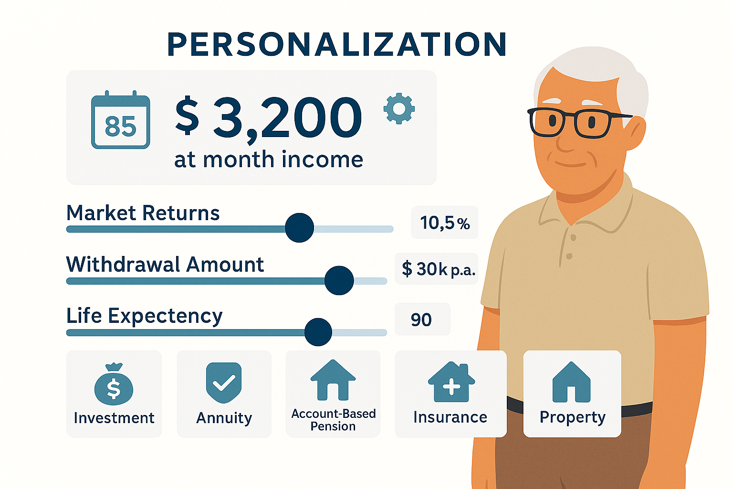
From Products to Journeys
– Redefining Retirement Strategy & Solutions
From products to journeys
  Always-on intelligence pushes funds to treat retirement as a lifelong journey rather than a one-off product sale. The focus shifts from, say, offering an account-based pension alone, to supporting decisions across retirement (when to retire, how much to draw down, whether to annuitize, how to invest, etc.). AI-driven engagement can personalize these decisions at scale.
  Dynamic “what-if” modelling
  Expect to see more interactive tools that let members play with scenarios (market returns, withdrawal rates, lifespan). These future-self visualizations make planning tangible. Members better understand trade-offs, leading to more confident choices.
  Personalised product blending
  Richer data enables tailored product mix – one member might get nudged towards a combo of an account-based pension + longevity insurance; another might stick with a flexible pension and cash reserve.
  Actuaries are critical here – designing algorithms that balance income, risk, and flexibility for different cohorts, and ensuring they deliver the optimal member outcomes.
15

Slide 16
The Role of Actuaries
From modellers to strategic enablers of AI-driven decisions
05

Slide 17

The Road Ahead: Strategic Enablers of AI-Driven Decisions
Actuaries as guardians
  Actuaries have a pivotal role in this future model. We bring strengths in long-term risk modeling, product design, and ethical governance. We can ensure the predictive algorithms are sound (technically and financially), and that nudges truly aim to improve member outcomes.
  We also define success metrics (e.g. income sustainability, engagement rates) and monitor that the AI-human system deliver them responsibly.
  Responsible innovation
  The message for the profession: We can embrace AI as a strategic enabler, while championing the safeguards that protect members.
  Done right, always-on intelligence – guided by actuarial insight – could make retirement guidance more accessible, timely, and member-centric.
17

Slide 18
Q & A
Actuaries Institute
actuaries.asn.au

