Slide 1
Modelling the Financial Impact of Provider Insolvency on the Tuition Protection Service
Rohan John
June 2026

Slide 2
Contents
1 | Context & Motivation
2 | Conceptual Framework
3 | Data Integration & Time Alignment
4 | Risk Parameterisation
5 | Portfolio Results & Loss Distribution
6 | Risk Concentration & Policy Insights
7 | Conclusion & Key Takeaways

Slide 3
Contents
1 | Context & Motivation
2 | Conceptual Framework
3 | Data Integration & Time Alignment
4 | Risk Parameterisation
5 | Portfolio Results & Loss Distribution
6 | Risk Concentration & Policy Insights
7 | Conclusion & Key Takeaways
01

Slide 4
Context & Motivation
Why Insolvency Risk Matters in the Tuition Protection Service
The Tuition Protection Service (TPS) is a Government-backed framework designed to protect students when education Providers fail, either by placing students into alternative courses or providing refunds. While modelling has previously been undertaken (e.g. by AGA for the Department of Education), insolvency risk is still typically observed through realised events rather than embedded as a forward-looking distribution of outcomes.
Provider failure can arise through a range of mechanisms, including sudden insolvency, course cancellations due to low enrolment, loss of regulatory registration (e.g. ASQA/TEQSA), visa sponsorship breaches, or campus closures. These events differ operationally but are financially equivalent, as they trigger student displacement and TPS intervention.
When a Provider defaults, the TPS must coordinate placements or refunds, with costs driven by both the number of students affected and the success of placement activity. This creates a financial exposure linked to prepaid tuition fees held by Providers, where losses emerge through operational responses (placements and refunds) rather than a traditional claims process.
These risks are amplified in segments such as VET and ELICOS, which are characterised by smaller Providers, dependence on international demand, and greater sensitivity to regulatory and cashflow pressures. As a result, insolvency risk is systematic within certain parts of the sector, rather than evenly distributed.
The objective of this work is to quantify both the expected cost of Provider failure and the distribution of potential losses, providing a clearer understanding of how this risk behaves under both normal and adverse conditions.

Slide 5
Contents
1 | Context & Motivation
2 | Conceptual Framework
3 | Data Integration & Time Alignment
4 | Risk Parameterisation
5 | Portfolio Results & Loss Distribution
6 | Risk Concentration & Policy Insights
7 | Conclusion & Key Takeaways
02

Slide 6
Conceptual Framework
PD
Reframing the TPS as a Credit Risk Portfolio
The TPS can be viewed as a large, diversified credit portfolio, where each education Provider represents an obligor with a probability of default over a defined horizon. Losses arise when Providers fail and prepaid tuition fees cannot be fully recovered through student placements.
This allows insolvency risk to be expressed using the standard framework, enabling a structured risk quantification, rather than relying on observed payouts alone.
Each component captures a distinct driver of risk:
    PD (Probability of Default): likelihood a Provider becomes insolvent
    LGD (Loss Given Default): proportion of fees not recoverable
    EAD (Exposure at Default): prepaid tuition fees at risk
  This framing separates frequency, severity, and exposure, enabling a structured quantification of risk rather than relying on observed payout outcomes.
  Monte Carlo simulation is then used to generate a distribution of portfolio losses, allowing both expected outcomes and tail risk under adverse conditions to be assessed. In effect, TPS behaves like a credit portfolio, even though it is not explicitly managed as one.
LGD
EAD
PORTFOLIO LOSS

Slide 7
Contents
1 | Context & Motivation
2 | Conceptual Framework
3 | Data Integration & Time Alignment
4 | Risk Parameterisation
5 | Portfolio Results & Loss Distribution
6 | Risk Concentration & Policy Insights
7 | Conclusion & Key Takeaways
03

Slide 8

Data Integration &
Time Alignment
Linking External Data to Financial Risk
We integrate multiple external datasets – including PRISMS enrolments, TPS operational data (placements and refunds), and ASIC insolvency statistics – each contributing a specific dimension of risk. Unlike internal scheme data, these sources are not naturally aligned, so additional judgement is required to create a consistent framework.
A key step is translating enrolment data into financial exposure, by combining student counts with average tuition fees. This provides a point-in-time estimate of prepaid fees at risk, which acts as the analogue of exposure in a credit portfolio. Given differences in course duration and fee structures, this is necessarily approximate but captures the economic scale of the liability.
Insolvency data is available at an aggregate industry level, so it is mapped to TPS sectors (Higher Education, VET, ELICOS) using relative risk characteristics. This ensures that observed failure rates are reflected, while still aligning to the structure of the model.
As this is a less familiar product, outputs are validated through cross-checks against known system behaviour (e.g. TPS payouts, sector volatility), ensuring that the resulting dataset is directionally consistent with real-world outcomes.

Slide 9
Contents
1 | Context & Motivation
2 | Conceptual Framework
3 | Data Integration & Time Alignment
4 | Risk Parameterisation
5 | Portfolio Results & Loss Distribution
6 | Risk Concentration & Policy Insights
7 | Conclusion & Key Takeaways
04

Slide 10
Risk Parameterisation
PROBABILITY OF DEFAULT
LOSS GIVEN DEFAULT
EXPOSURE AT DEFAULT
Baseline derived from ASIC insolvency statistics, providing an observed measure of education-sector failures.
These are blended with sector-specific judgemental adjustments to reflect differences in Provider composition and regulatory environment.
This results in a PD structure where Higher Education exhibits low default rates (~1-1.5%), while VET (~3-4%) and ELICOS (~5-6%) reflect higher exposure to smaller, private Providers with more volatile operating conditions.
Direct recovery data is not observed, so LGD is inferred from TPS operational outcomes, using placement activity as a proxy for mitigation.
LGD is defined as 1 - placement rate, where placements reduce loss and refunds represent realised losses.
This produces an average LGD of ~64%, reflecting a mix of historical outcomes, including stressed environments post-COVID and placement variability, and should therefore be interpreted as a conservative estimate of severity.
Exposure is constructed from student enrolments multiplied by average tuition fees, producing an estimate of prepaid fees at risk in the event of Provider failure.
This results in ~$12-13bn of total exposure, heavily concentrated in Higher Education due to its scale, despite lower underlying risk.
While simplified, this provides a coherent and comparable exposure measure across sectors, which is sufficient for modelling relative risk contribution.
Taken together, these inputs create a model that reflects both financial characteristics and operational behaviour, enhancing predictive relevance and interpretability.

Slide 11
Contents
1 | Context & Motivation
2 | Conceptual Framework
3 | Data Integration & Time Alignment
4 | Risk Parameterisation
5 | Portfolio Results & Loss Distribution
6 | Risk Concentration & Policy Insights
7 | Conclusion & Key Takeaways
05

Slide 12
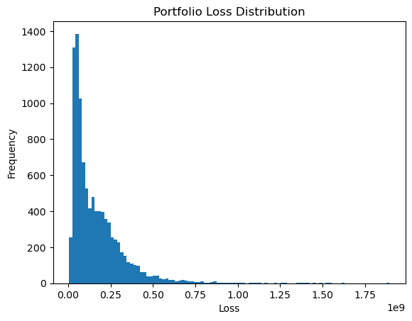
Portfolio Results &
Loss Distribution
Reference points:
Metric | EAD | Expected Loss | VaR (99%)
Value | ~$12-13B | ~$163M | ~$720M
The model simulates losses over a 1-year horizon, aligning with the annual nature of Provider financial performance and the relatively short duration of most courses.
The model captures approximately $12-13B in prepaid fee exposure, representing the stock of prepaid fees at risk across the international education sector.
Expected losses are approximately $163M (~1.3% of exposure), consistent with the combined effect of modest default rates and elevated loss severity on a portfolio of this scale. This implies a steady level of Provider defaults each year, consistent with observed ASIC insolvency activity, ensuring losses arise from ongoing sector churn rather than rare extreme events.
Under stress (e.g. reduced visa demand), expected losses increase to ~$189M, indicating a ~15-20% uplift, which is consistent with a moderate deterioration in sector conditions rather than a systemic shock.
The loss distribution is right-skewed, with most outcomes clustered at lower loss levels and a gradual tail extending to higher losses. At the 95th percentile, losses reach ~$442M, increasing to ~$720M at the 99th percentile. This reflects the impact of clusters of Provider failures, rather than individual large institutions, with tail risk driven by deterioration in higher-risk segments.
Unlike a sector-level model, losses are driven by the accumulation of many smaller defaults, rather than isolated large events. This produces a smooth distribution and avoids unrealistic step-changes in outcomes.
Footnote: Loss distribution is smooth due to Provider-level simulation, with tail outcomes driven by multiple concurrent defaults rather than discrete sector-wide failures.
Notes:
Observed TPS payouts provide a useful external benchmark, with annual payments varying depending on Provider failures and placement outcomes.
The model outputs are directionally consistent with these observations, allowing for differences between realised outcomes and forward-looking estimates.
This reflects the simplified structure of the model, which captures core risk drivers but does not fully replicate operational timing or recovery dynamics.

Slide 13
Contents
1 | Context & Motivation
2 | Conceptual Framework
3 | Data Integration & Time Alignment
4 | Risk Parameterisation
5 | Portfolio Results & Loss Distribution
6 | Risk Concentration & Policy Insights
7 | Conclusion & Key Takeaways
06

Slide 14
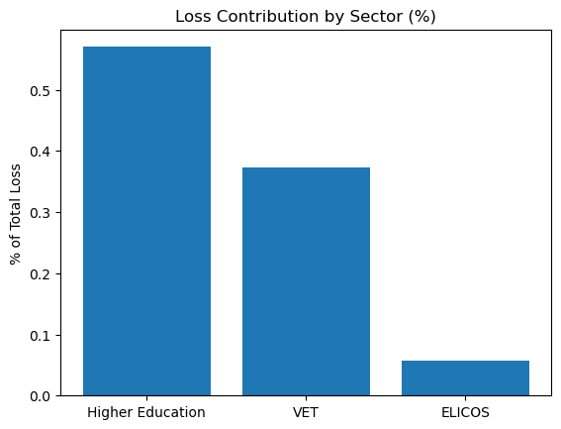
Risk Concentration &
Policy Insights
Where Risk Sits and Why It Matters
Risk is not evenly distributed, with Higher Education dominating exposure while VET and ELICOS contribute disproportionately to loss, reflecting higher default rates despite smaller size.
This creates a portfolio with a stable core and higher-risk fringe, where large institutions anchor exposure but incremental losses are driven by smaller, higher-risk Providers with elevated default rates.
The model shows that losses arise from many smaller defaults rather than single large failures, consistent with a diversified but structurally uneven market.
Sensitivity to demand conditions is significant, with relatively small shocks (e.g. visa reductions) leading to material increases in expected loss, highlighting the sector’s dependence on international student flows.
Overall, risk is driven by the interaction of scale, Provider structure, and external demand conditions, rather than any single dominant factor. This reinforces that portfolio risk is shaped more by the distribution of risk characteristics than by aggregate exposure alone.
Footnote: Loss contribution reflects the interaction between exposure and default rates, with higher-risk sectors contributing disproportionately to total losses despite smaller exposure.
Sector | Exposure Share | Avg PD | Loss Contribution
Higher Education | ~80% | ~1.5% | ~45-50%
VET | ~15-20% | ~3% | ~30-35%
ELICOS | ~2-3% | ~5% | ~5-10%
Footnote: Average PDs reflect sector-level differences in Provider composition, with Higher Education dominated by large institutions and VET/ELICOS characterised by smaller, higher-risk Providers.

Slide 15
Contents
1 | Context & Motivation
2 | Conceptual Framework
3 | Data Integration & Time Alignment
4 | Risk Parameterisation
5 | Portfolio Results & Loss Distribution
6 | Risk Concentration & Policy Insights
7 | Conclusion & Key Takeaways
07

Slide 16
Conclusion & Key Takeaways
1
INSOLVENCY RISK EMERGES FROM NORMAL OPERATIONS, NOT JUST EXTREME EVENTS
The model indicates ~$160M p.a. in losses (~1.3% of exposure), showing that even in stable conditions, Provider failure creates a persistent funding requirement.
This highlights that systems with embedded credit exposure should treat losses as structural rather than exceptional, incorporating into baseline assumptions.
2
RISK SITS IN DIFFERENT PLACES TO EXPOSURE
While exposure is concentrated in lower-risk segments, losses are driven by higher-risk, smaller entities, reflecting differences in default behaviour.
This reinforces the need to assess risk using segmentation and relative risk contribution, rather than aggregate exposure alone.
3
TAIL RISK IS DRIVEN BY CORRELATED DETERIORATION
Losses at the tail (e.g. ~$720M at the 99th percentile) arise from multiple concurrent failures, rather than isolated large events.
This demonstrates how portfolios that appear diversified can still exhibit meaningful tail risk when underlying drivers are shared (e.g. demand shocks).
4
SYSTEM OUTCOMES ARE HIGHLY SENSITIVE TO EXTERNAL CONDITIONS
A moderate shock results in ~15-20% increase in expected loss, demonstrating how outcomes can shift materially even without extreme stress.
This highlights the importance of incorporating forward-looking and scenario-based analysis, particularly where revenue depends on external demand.
5
MODEL STRUCTURE MATERIALLY CHANGES RISK OUTCOMES
Moving from sector- to Provider-level simulation significantly reduces extreme tail outcomes, with VaR (99%) falling to ~$720M and more realistic distribution.
This highlights that how risk is modelled (granularity, diversification assumptions) can be just as important as the input parameters themselves.

Slide 17
Thank you
Actuaries Institute
actuaries.asn.au

