Slide 1
Modelling of Retirement Systems:
A Comparative Study of Australia and Singapore
Chair: Francis Burgess, Head of Pricing
Presented by
Simon Kong, Chief Examiner
Iris Deng, Senior Pricing Manager (Apologies)
Yean Tat Yong, Group Risk Pricing Manager

Slide 2
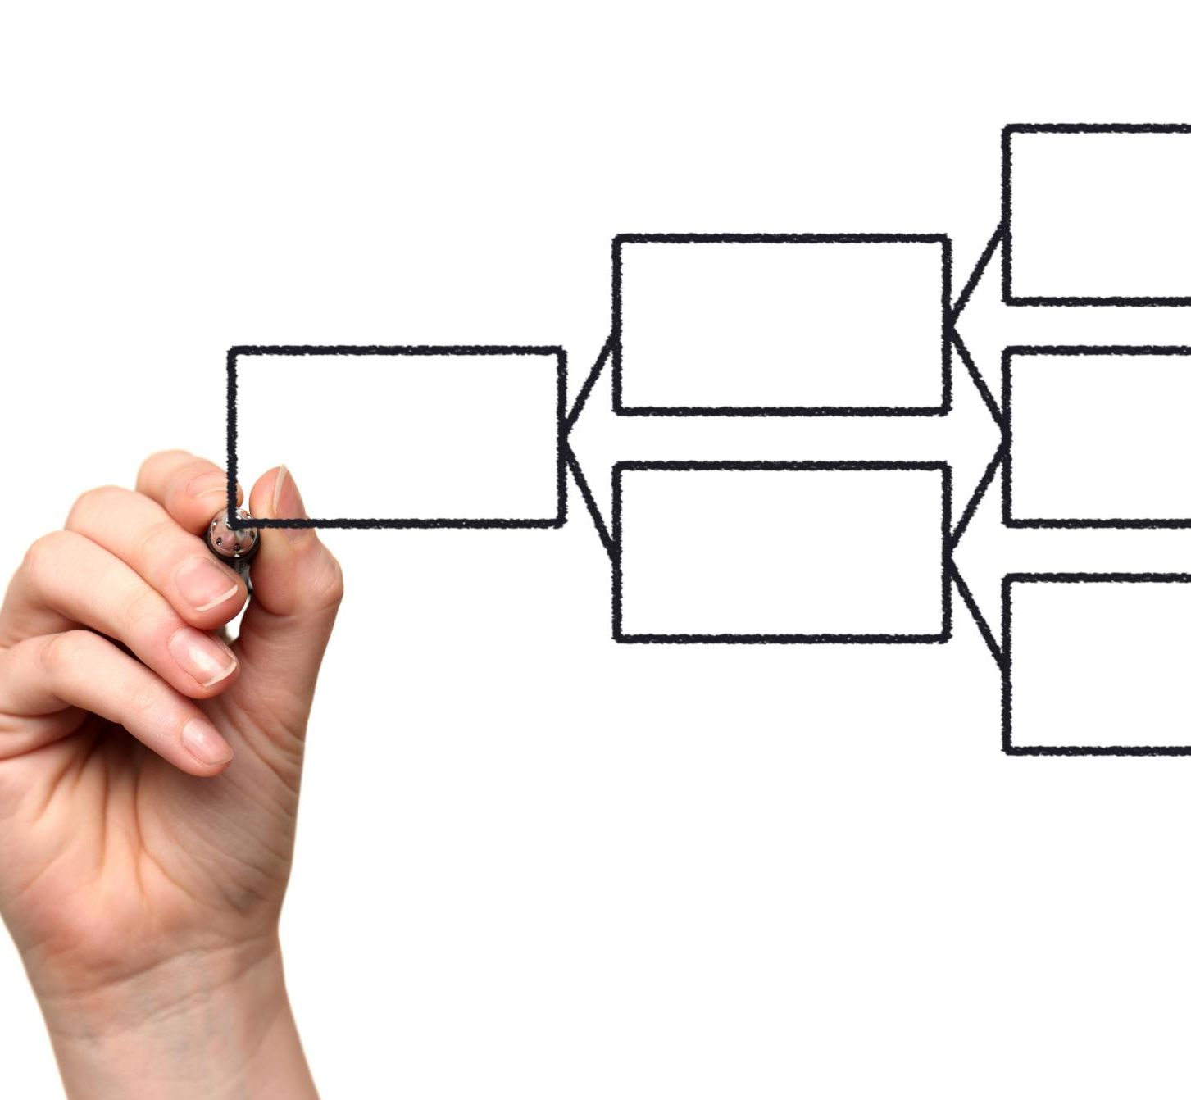
Contents
Introduction
Comparison between Singapore and Australia
Methodology, Data and Assumptions
Comparison of Results
Key Learnings

Slide 3
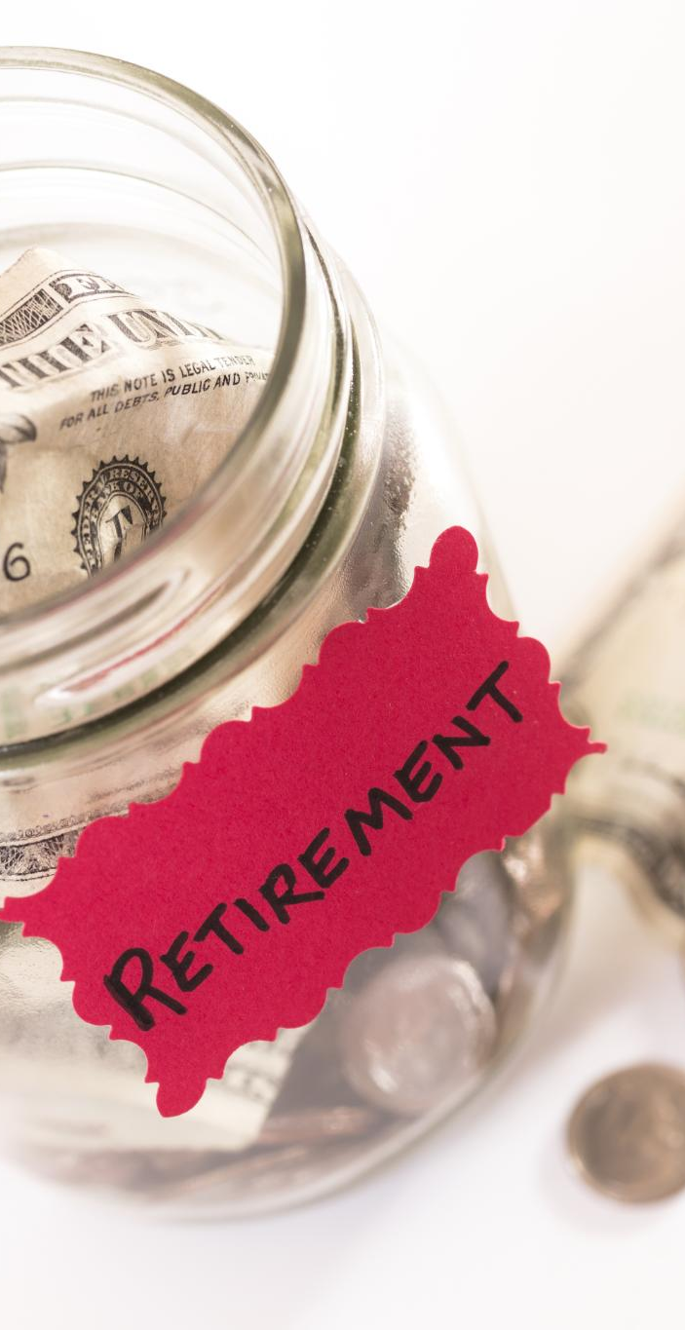
Introduction
2 out of 3 Australians are concern
Why Singapore?
What are we trying to achieve?

Slide 4
Singapore vs Australia
01

Slide 5
Singapore CPF vs Australia Superannuation
 | Australia | Singapore
System Design | Decentralised Individual investment control | Centralised Government-managed
Provider | Superannuation Fund | Central Provident Fund (CPF)
Account Structure | Single Account | Multi Account OA (Ordinary) MA (MediSave) SA/RA (Special/Retirement)
Housing Usage | Limited | HDB Flat purchase Mortgage servicing
Contribution Structure | Default 12% with voluntary top up | Mandatory combined up to 37%
Investment Approaches | Market linked investment -potential growth with volatility | Limited individual control Government guaranteed interest –stability
Retirement Benefits | Flexible drawdown Safety net –age pension | Compulsory CPF life annuity pooling longevity risk
Tax | Taxed-taxed-exempt | exempt–exempt–exempt

Slide 6
Contribution Allocation Comparison

Slide 7
Stages of Australia Superannuation
Below 60
60 - 65
Above 65
Accumulation phase
Transition to Retirement (TTR)
Limited withdrawal capacity if unretired.
Full access to account balance if retired.
Full access to account balance

Slide 8
Stages of Singapore CPF
Up to 55
55
Main Accumulation phase
Total of 37% of salary is contributed towards the 3 CPF accounts
Higher proportion of contribution will the shift towards SA and MA as the individual age.
Creation of RA and closure of SA
If there is gap required, CPF balance from OA is transferred to RA up to the Full Retirement Sum (FRS) by default.
If FRS is fully funded, OA becomes a liquid account.

Slide 9
Stages of Singapore CPF
55 - 65
65-70
Above 70
Contribution goes below 37%
Contribution goes into OA and MA if the FRS is fully met.
Optional retirement deferral window
Deferring CPF Life payout would increase monthly payouts.
If choose to retire, individual could elect CPF Life payout structure.
Monthly payout from CPF Life.
Account balance are payout out to nominees upon death

Slide 10
Methodology, Data, Model
02

Slide 11
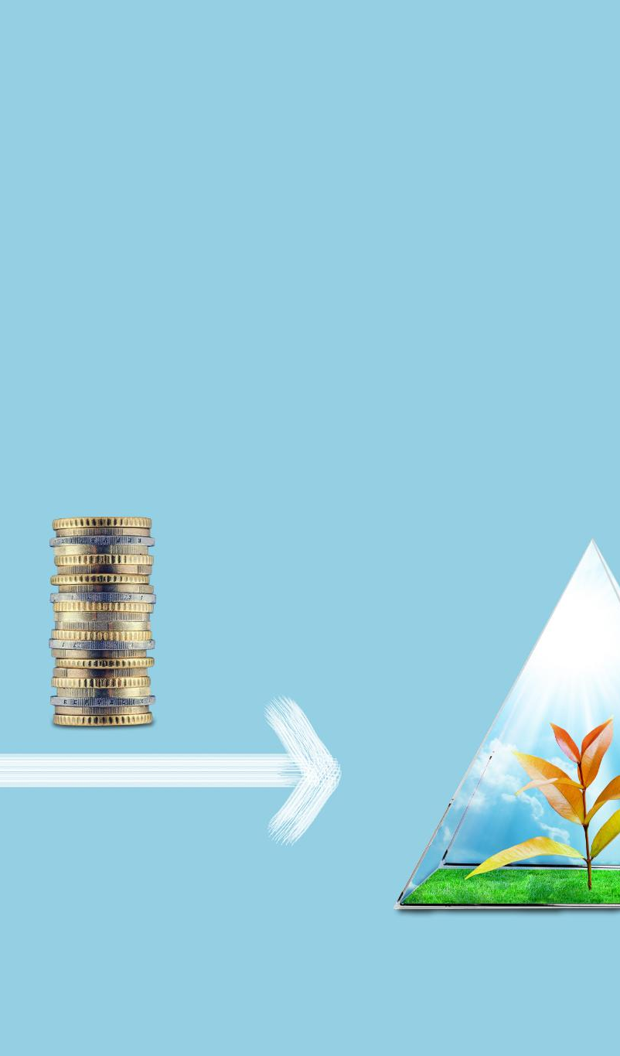
Retirement System Modelling Framework
Lifecycle Savings Projection
Housing Influence on Retirement
Retirement Income Projection
Stochastics Modelling

Slide 12


Data
📈
💰
Retirement System
Economic
Investment
Insurance
Investment return for equity/bond/cash
Mortality
Annuity
Life Insurance
Mortality improvement
Superannuation
Age Pension
CPF
Inflation
Housing price
Salary

Slide 13
Comparison and Results
03

Slide 14
Tales of Two Cities: Superannuation vs CPF
Jack and his spouse in Melbourne
Age 25, happily married
Nil saving and superannuation balance
Aspiring future homeowners
Salary AUD$80K @ 3.5% pa
12% super contribution
CPI 2.5% pa
Asset allocation
  High growth (70/30) pre-50
  Defensive (30/70) thereafter
Mike and his spouse in Singapore
Age 25, happily married
Nil saving and CPF balance
Aspiring future homeowners
Salary SGD$60K @ 4.4% pa
37% CPF contribution up to 55 (including for housing and medical expenses), reducing to 25% above age 60
CPI 1.9% pa
CPF Life (lifetime annuity from age 65, non indexed)

Slide 15
Australian Retirement Projection
- Jack, age 25, retiring at 65 in 40 years
Target retirement income $48K per person i.e. 60% of salary indexed at CPI
Key assumptions:
In today’s dollar value
Homeowner, still married at retirement
Investment allocation
  High growth (70/30) pre-50
  Defensive (30/70) thereafter
Projected Life Expectancy at Retirement

Slide 16
Singapore Retirement Projection
- Mike, age 25, retiring at 65 in 40 years
Target retirement income $38K per person i.e. 80% of Australia
Key assumptions:
In today’s dollar value
Homeowner, still married at retirement
CPF Life (lifetime annuity from age 65, non indexed)
CPFIS (Investment Linked)
Projected Life Expectancy at Retirement
Two investment scenarios:
CPFIS (investment linked): same as Australia
CPF Account: fixed crediting rates (2.5% for OA and 4% for SA).
However, majority of CPF FUMs are invested in the CPF Account.
CPF Account (Guaranteed Rates)
Projected Life Expectancy at Retirement

Slide 17
Probability of Adequacy- Australia vs Singapore
Australia
Singapore

Slide 18
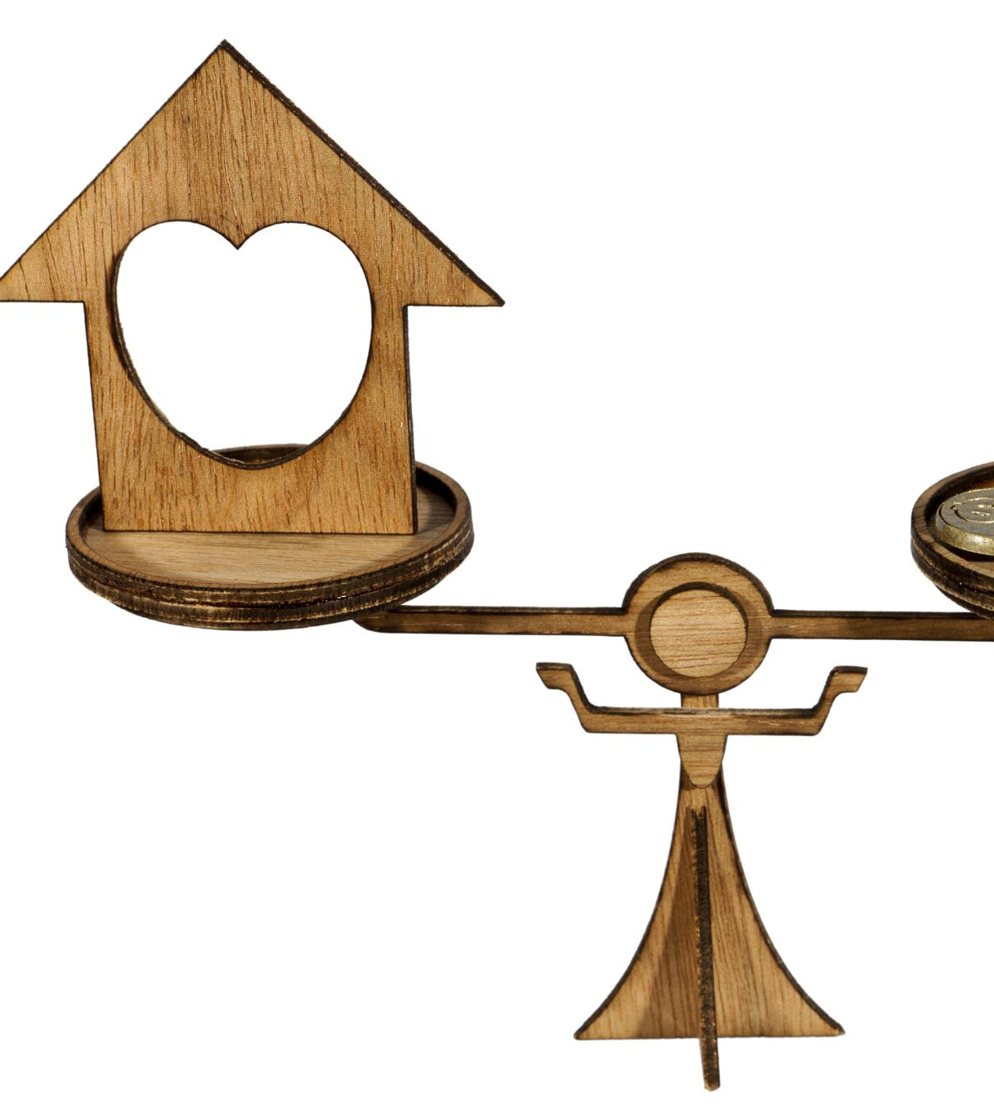
What can Australia learn from Singapore?
🏠
Housing via Superannuation
Housing Cost Challenges
Targeted Super Contributions
Policy Governance and Safeguards
New Housing Supply

Slide 19
Housing via Superannuation
Policy Details
Additional 17% contribution to the special housing account within superannuation.
Taxed at 15%.
Assumptions
Starting house price 908k
House price appreciation 7% pa
Rental cost $650 pw for a couple
Modelling Outcome
Housing via superannuation accelerate home ownership by 3 years, from 7 years to 4 years.
It means an average purchase price of 1.20m instead of 1.46m.
Superannuation balance can last 5 years longer in retirement with the housing via superannuation scheme.

Slide 20

What can Australia learn from Singapore?
♾️
Lifetime Annuities
Longevity Risk Protection
Investment Risk Protection
Age Pension Treatment

Slide 21
Lifetime Annuity
Assumed a 30% annuity allocation at retirement
Higher safety net after retirement saving is depleted
Australia
Australia with annuity

Slide 22
Probability of Adequacy
- Lifetime Annuity
Lifetime annuity improves the probability of adequacy, particularly at advanced ages.

Slide 23

Learnings from Singapore and Australia
Trade-off Between Adequacy and Stability
Investment Strategy
Compulsory Savings Importance
Housing’s Role in Security
Managing Longevity Risk

Slide 24
Thank you
Q & A

