Slide 1
Shaping the Future of Aged Care:
Insights and Priorities for Reform
Aged Care Thought Leadership Working Group
September 2026
Georgina Hemmings, Alfie Qiang, Candice Ming, Qiao Zhou, Kim Cossart, Anthony Asher, Geoff Keen, Alice Chau, Margaret Kerr, Nirosana Maheswaran, Cecilia Li, Catherine Nance

Slide 2
The Actuaries Institute acknowledges the traditional custodians of the lands and waters where we live and work, travel, and trade.
We pay our respect to the members of those communities, Elders past and present, and recognise and celebrate their continuing custodianship and culture.
Acknowledgement of Country

Slide 3
Important notice for all participants
This meeting is being conducted in accordance with Institute’s Code of Conduct and attended by members in their professional capacity.
It is acknowledged that professional members in their employed capacity, may be active market participants in their respective industries who may compete with each other as defined by competition law.
Participants are, therefore, reminded that in accordance with their competition law compliance obligations they should not:
discuss any matter that may be perceived as being cooperation by competitors in a market to influence that market;
discuss any matters that could be regarded as fixing, maintaining or controlling prices, allocation of customers or territories, coordinating bids and/or restricting output or acquisitions in any circumstances;
share commercially sensitive information relating to their employer; or
share information for an anti-competitive purpose.

Slide 4
Contents
Introduction
01 Consumer Navigation Guide
02 Consumer MyAgedCare website
03 Consumer Service providers
04 Consumer Cost Comparison
05 Means testing
06 Solvency
Q&A

Slide 5
Consumer – Navigation Guide
01 Georgina Hemmings

Slide 6

What do I do next?

Slide 7
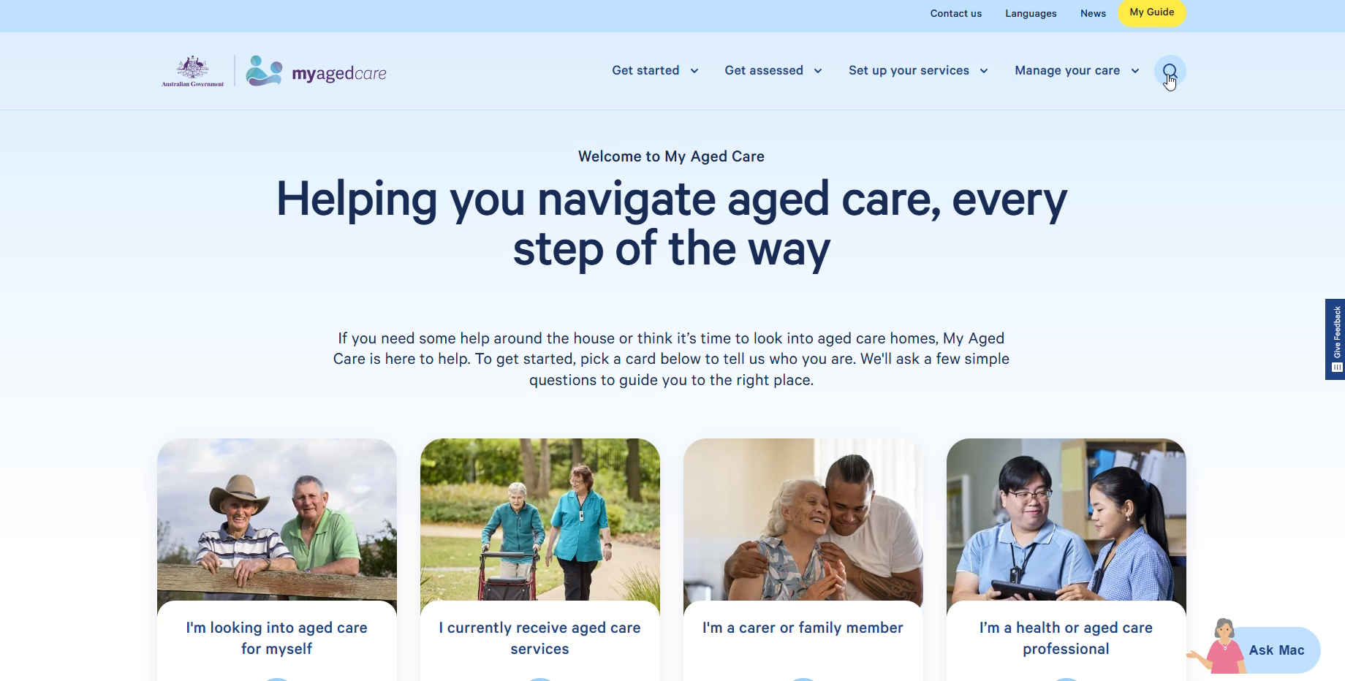
MyAgedCare – current webpage

Slide 8
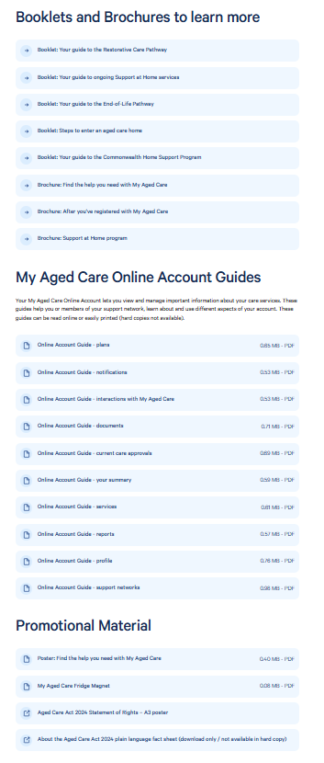
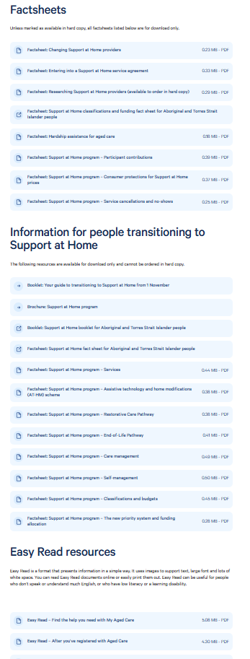
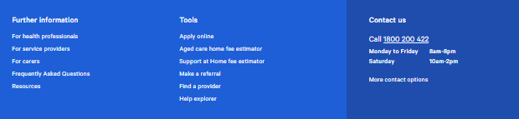
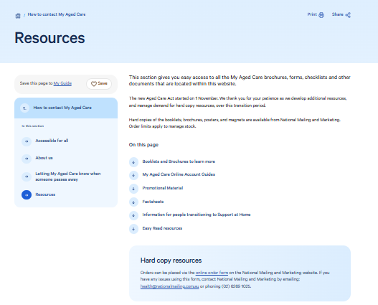
Resources - current

Slide 9
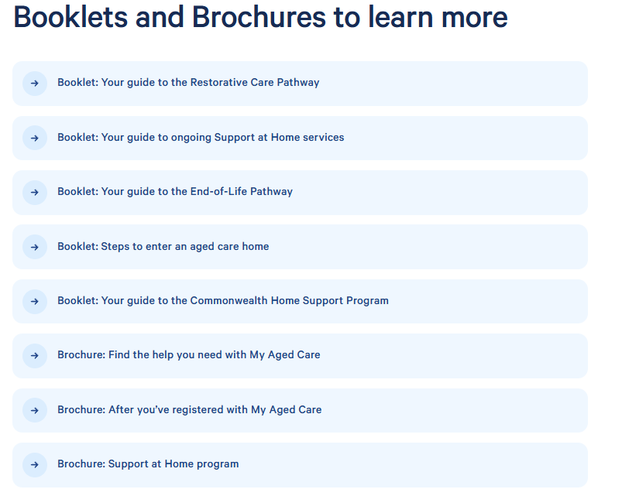
What problem are we solving?
Current
Proposed
1. How do I get started?
4. What options are available while I decide?
3. How do I enter residential aged care?
5. What other resource might help me?
2. How do I get help to live independently at home?

Slide 10


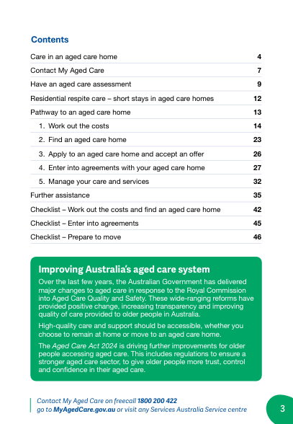
3. How do I enter residential aged care?
These documents are for individuals who are unable to live independently in their own home and need to enter a residential aged care facility.
This Key Steps Guide is a high-level view of key considerations to help you get started on this journey. | This Detailed Guide provides more comprehensive information about residential aged care.

Slide 11
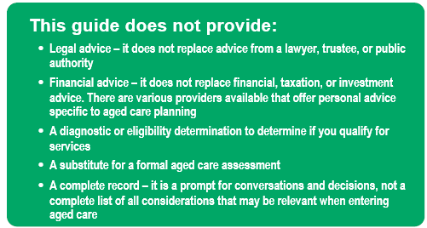
Key Steps Guide
Contents
How do I get assessed for aged care services..……………………... 1
How much will residential aged care cost me……………………….. 2
How can I find a residential aged care facility....….……………….... 3

Slide 12
1. How do I get assessed for aged care services?
How do I apply? | Online via myagedcare.gov.au By phone: My Aged Care 1800 200 422 In person: Aged Care Specialist Officer at Services Australia – phone 1800 227 475 If you are in hospital, hospital staff can arrange an assessment for you. | how-get-assessed
What is involved? | The process involves two separate assessments Service needs and severity assessment (“Needs Assessment”) Financial assessment (“Means Assessment”) The Needs Assessment focuses on your medical needs, wishes and preferences. A trained assessor will arrange a time to meet with you to discuss your circumstances. The Means Assessment determines how much you will pay for aged care services based on your personal financial circumstances, as assessed by Services Australia. This is covered in more detail in Section 2 of this Key Steps Guide. You may wish to obtain financial, tax, and/or legal advice to help with preparing for completing this assessment. | preparing-your-assessment
What does the assessment decide? | You will receive a Notice of Decision covering your eligibility for each of the following: Support at Home (with your level 1–8 and priority (standard to urgent)) Residential aged care Respite or short-term care Transition Care Program (if in hospital) Your Notice of Decision will include referral codes you will need to give to aged care providers. | receiving-your-assessment-outcome

Slide 13
2. How much will residential aged care cost me?
What the types of fees I might pay? | Basic Daily Fee – not means tested, everyone pays Hotelling Contribution – means tested Non-clinical care contribution – means tested Accommodation costs – Refundable Accommodation Deposit (RAD) or Daily Accommodation Payment (DAP) You may also be asked to pay Higher Everyday Living Fees (HELF) for optional additional services. Your provider sets the RAD amount, which may be negotiable.
Are there any daily, annual and lifetime caps for fees? | The Australian Government publishes fee schedules twice yearly (March and September). As at 1 July 2026 the maximum fees are: Basic Daily Fee: $66.80 Hotelling Contribution: $22.15 Non-clinical care contribution (NCCC): $107.32 (daily cap), payable for a maximum of 4 years. Also subject to a lifetime cap $137,917.01. If paying a RAD, 2% p.a. is deducted from your deposit for 5 years. If paying a DAP, the conversion factor is 8.43% p.a. (indexed to inflation every 6 months). | Fee Schedule
Where can I find a tool to estimate my fees? | My Aged Care has a tool to estimate your fees based on your financial circumstances. You will need your total annual income, asset values (including your home), and an estimate of your daily accommodation payment (DAP). My Aged Care has a similar tool for the cost of Support at Home packages. These tools are high-level guides. Depending on your circumstances, you may wish to seek personal advice from an aged care specialist. | Aged care home fee estimator Support at Home fee estimator

Slide 14
3. How can I find a residential aged care facility?
How do I find and compare providers? | My Aged Care has a tool to view aged care providers near your postcode. It includes 5-star ratings and estimated accommodation costs (RAD or DAP) to help you develop a shortlist. | How to choose a provider
How do I choose a provider? | Once you have a shortlist, arrange a tour of each facility. You may want to prepare questions and consider your priorities, such as: Proximity to family and friends Access to your current social connections and routine The ‘feel’ of the facility and quality of care Cultural, religious, cognitive, physical, or other specific needs | Find-a-provider
Can I try before I commit? | If the facility offers respite, you may be able to trial it before committing as a permanent resident. You may be eligible for up to 9 weeks respite per year, with a further 3 weeks available in some circumstances.

Slide 15
Who is the project manager?
Public
Private

Slide 16
Conclusions
MyAgedCare has a wealth of information, but it is hard to navigate
Technology versus printable materials for the target market
Organise information around the decisions customers are facing and meeting their needs
Develop Key Steps Guides to sit beside Detailed Guides
Opportunity for both public and private sectors to offer concierge services to manage E2E

Slide 17
Consumer – MyAgedCare Website Navigation
02 Alfie Qiang

Slide 18
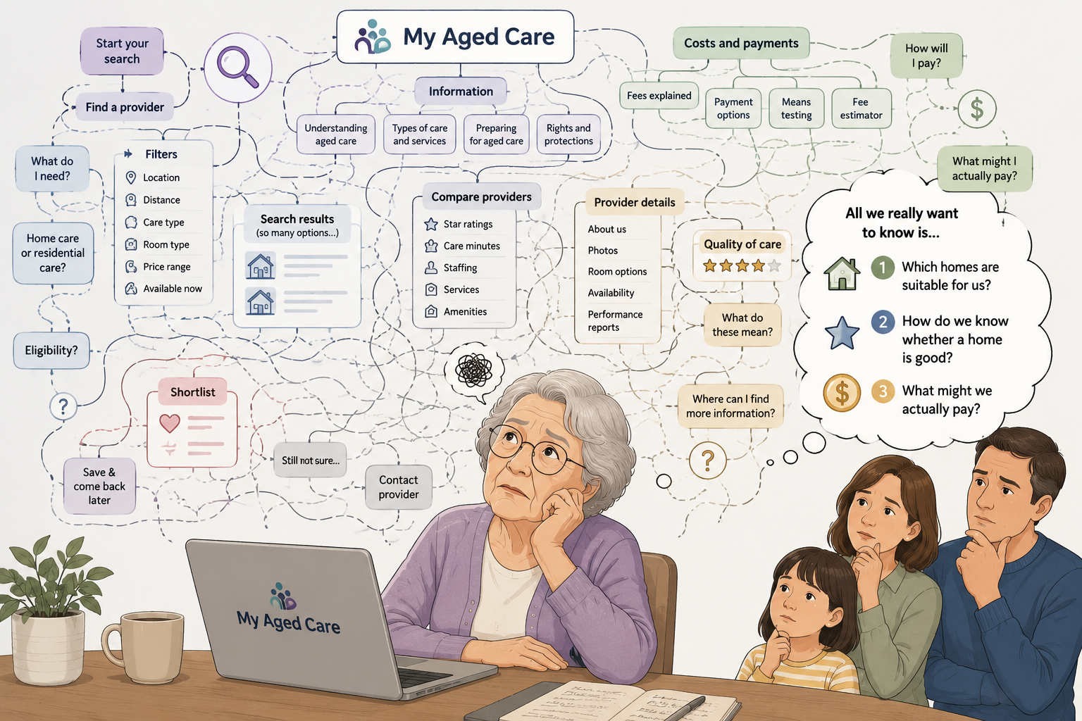
Mum needs a residential aged care home...

Slide 19
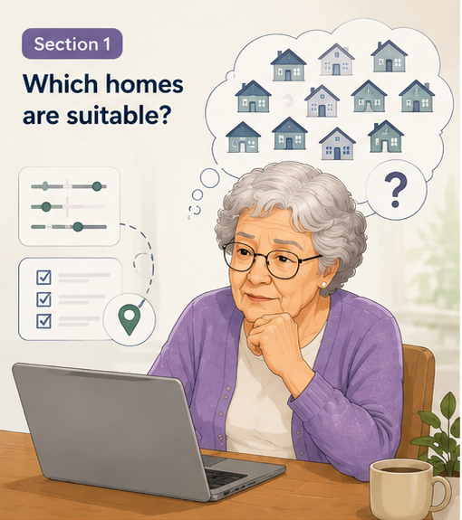
From many options to a practical shortlist
Mum’s family may start with a simple provider search, but the current journey can quickly become fragmented: moving between search, shortlist and comparison, with key information appearing late.
Our proposed uplift:
Create one connected pathway that helps families narrow options confidently, keep track of shortlisted homes, and move smoothly into comparison.

Slide 20
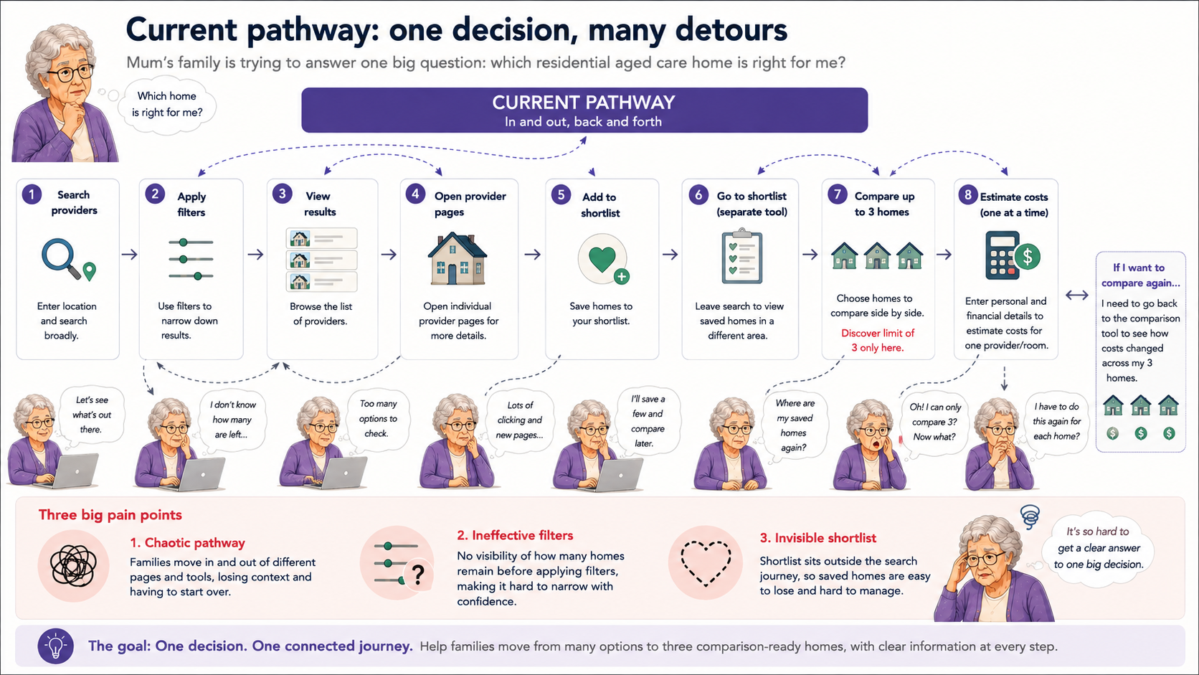
Current pathway: one decision, many detours
Mum’s family is trying to answer one big question: which residential aged care home is right for me?

Slide 21
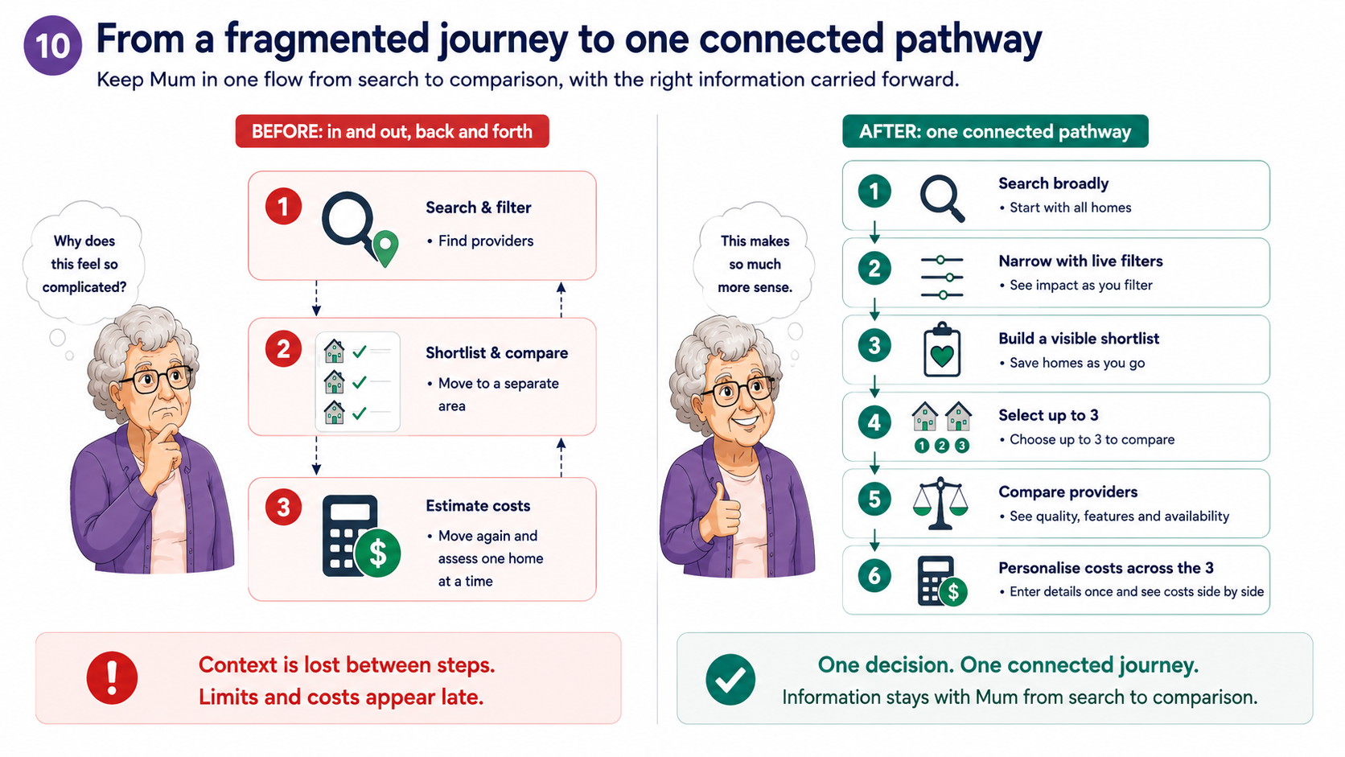
From a fragmented journey to one connected pathway
Keep Mum in one flow from search to comparison , with the right information carried forward

Slide 22
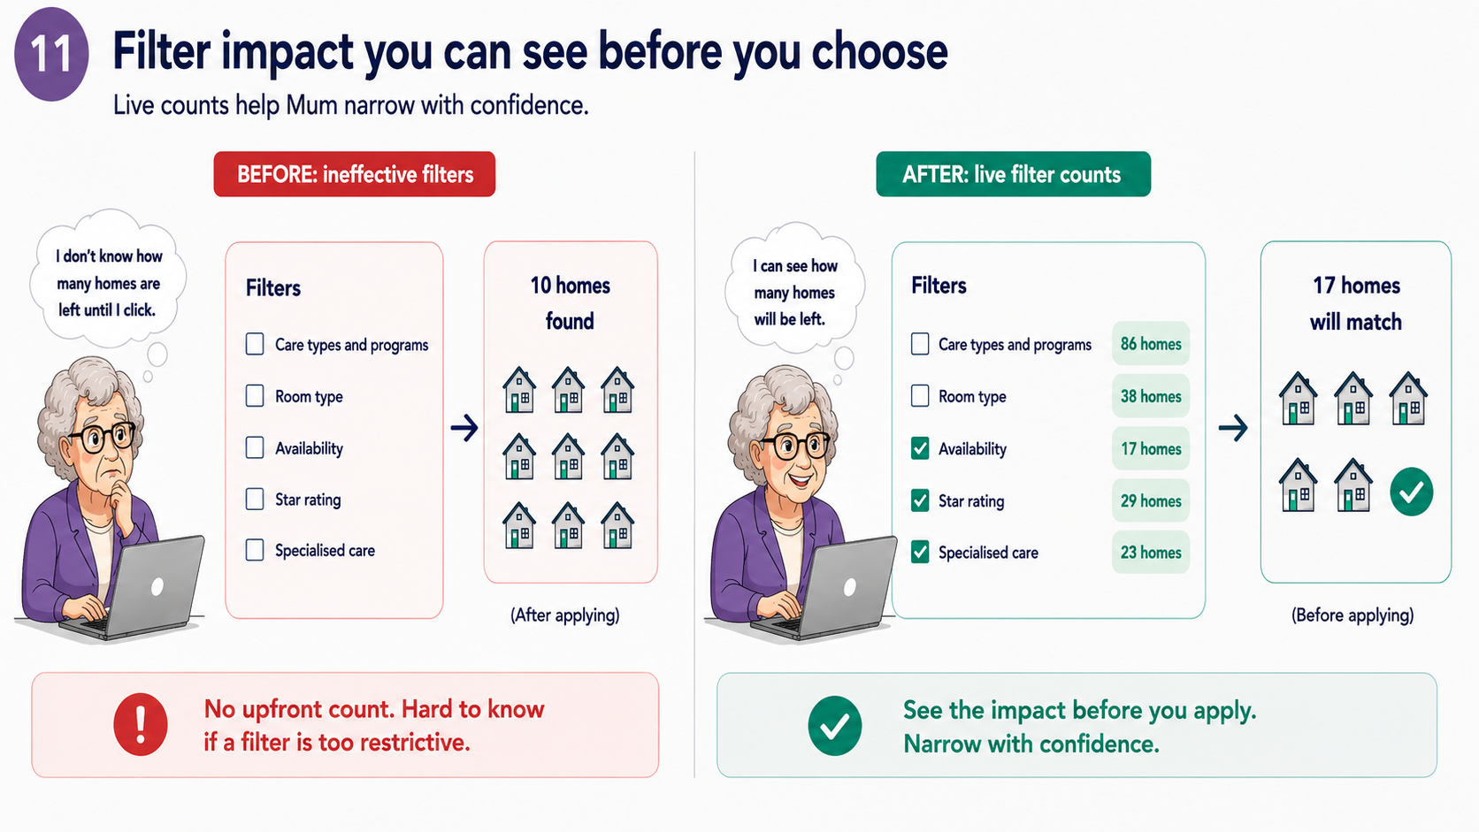
Filter impact you can see before you choose
Live counts help Mum narrow with confidence

Slide 23
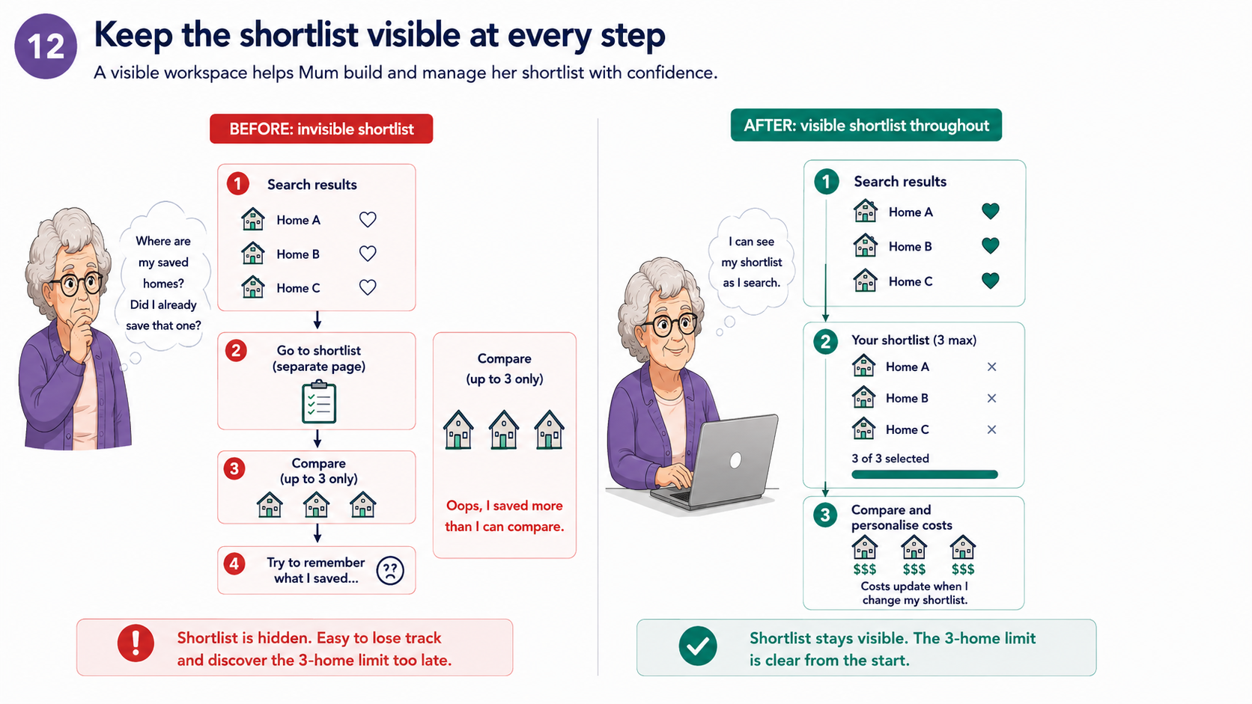
Keep the shortlist visible at every step
A visible workspace helps Mum build and manage her shortlist with confidence

Slide 24
Consumer – Service providers
03 Candice Ming

Slide 25
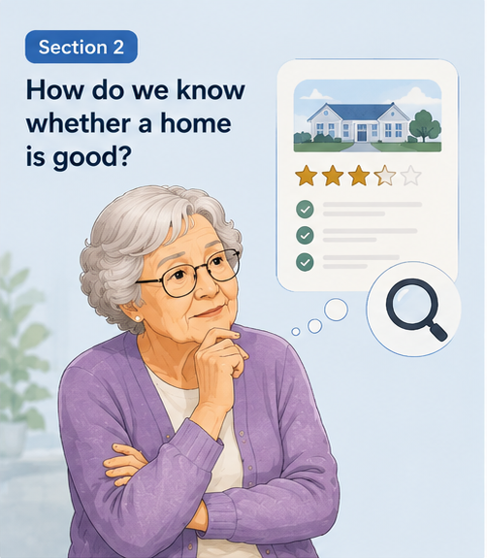

Slide 26
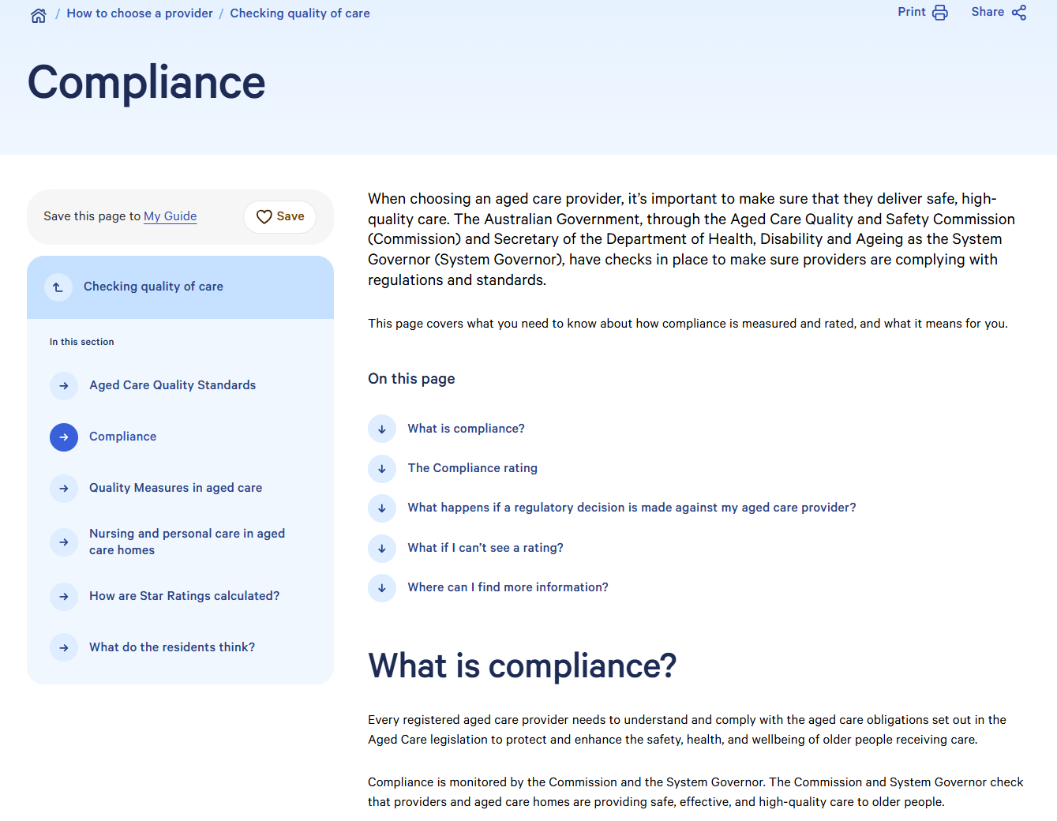
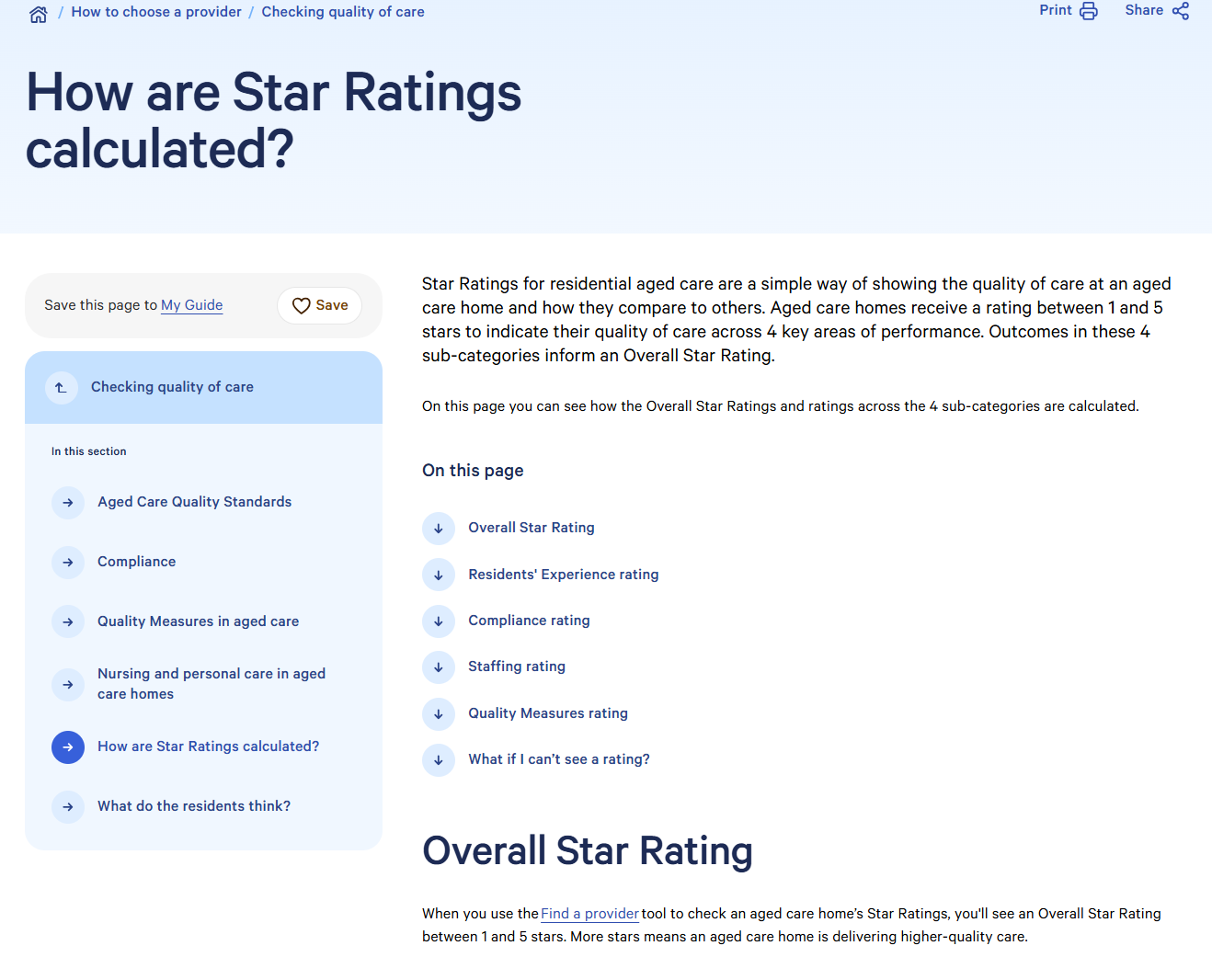
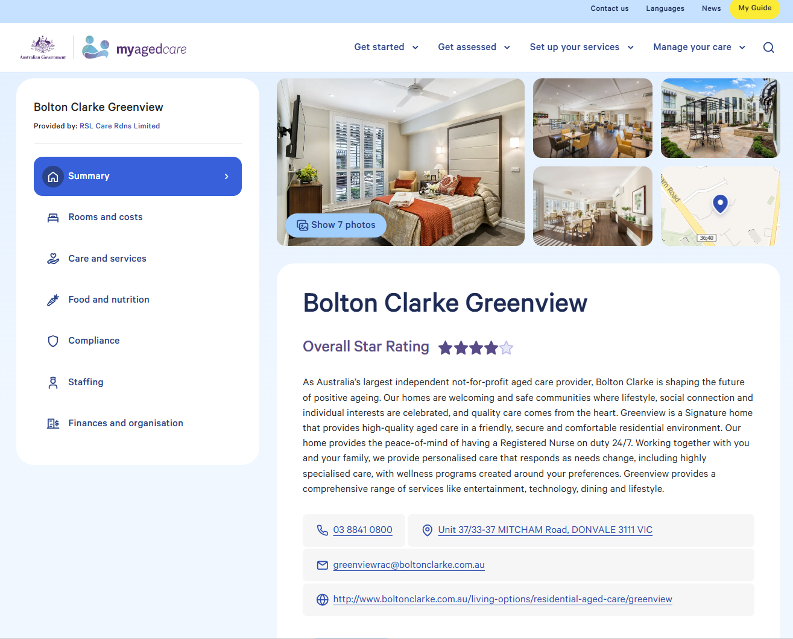
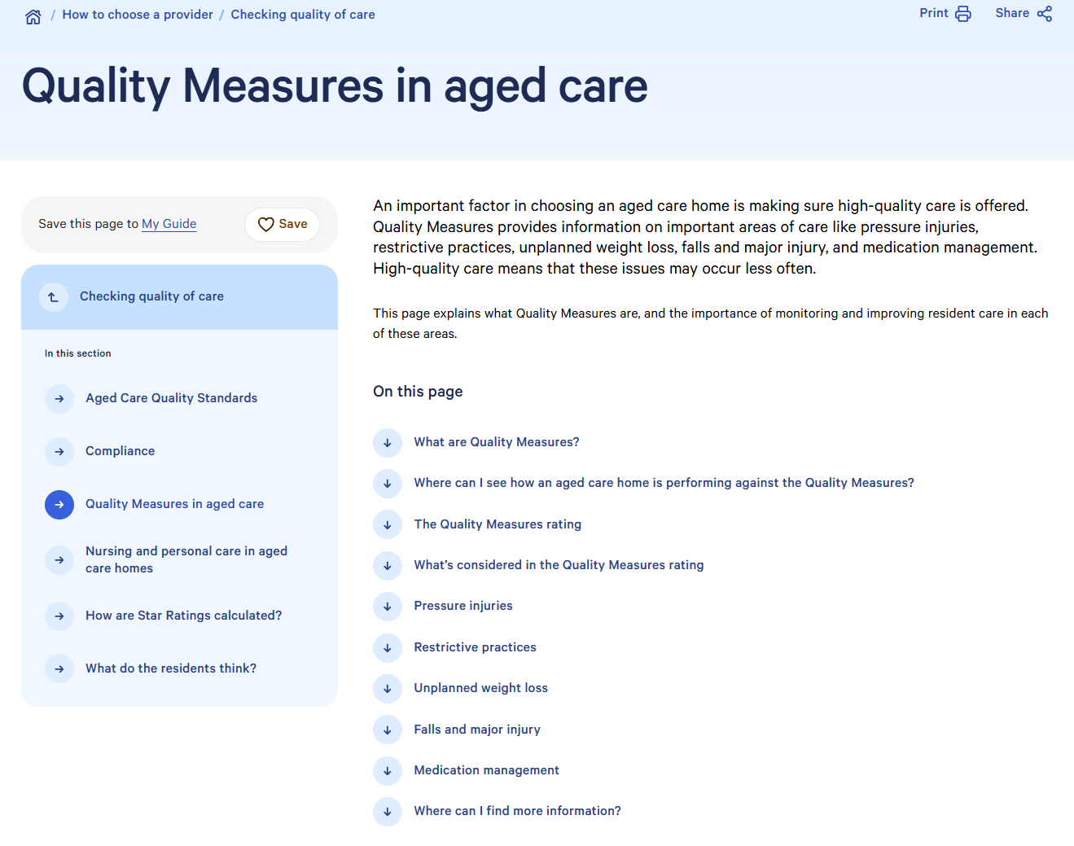
Source: https://www.myagedcare.gov.au (accessed 31 July 2026)

Slide 27
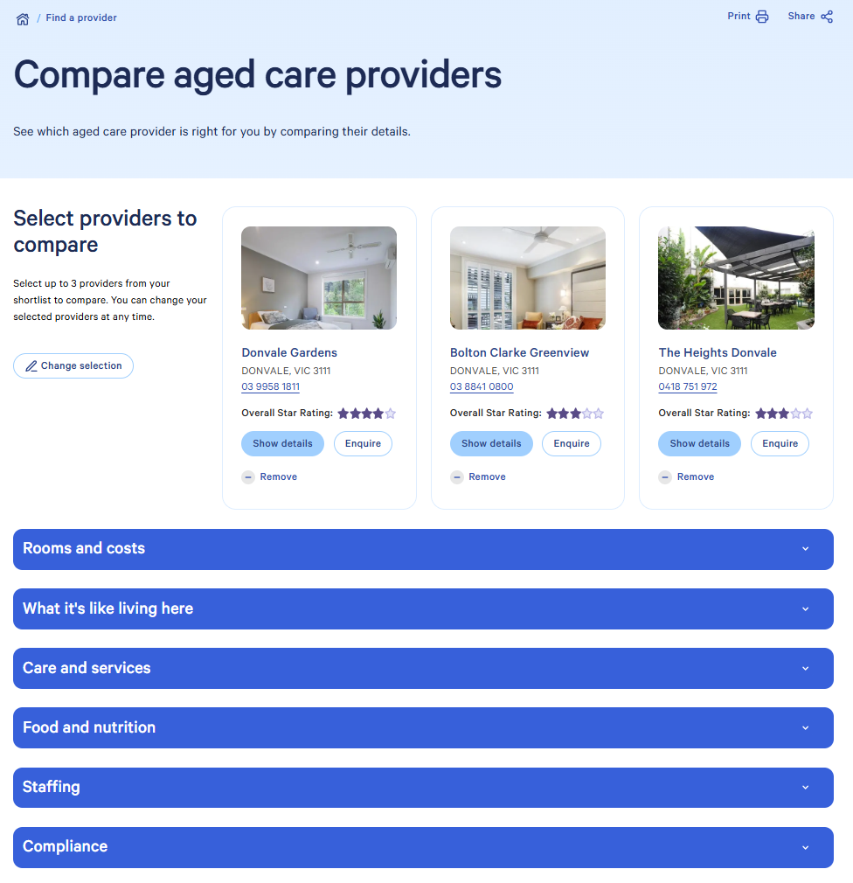

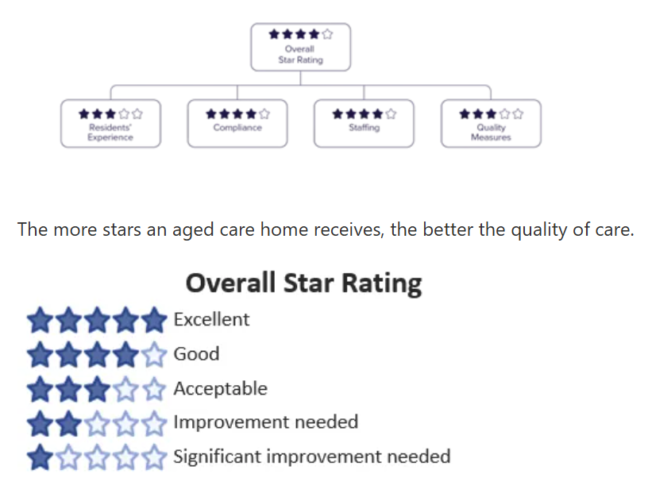
Current
Source: https://www.myagedcare.gov.au (accessed 31 July 2026)

Slide 28
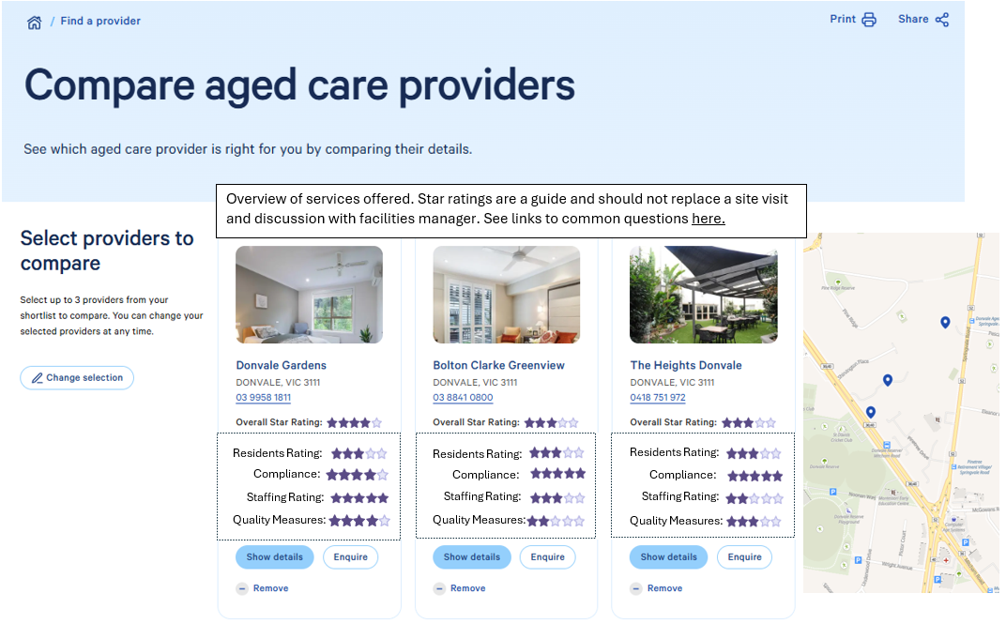
Enhanced
1
2

Slide 29
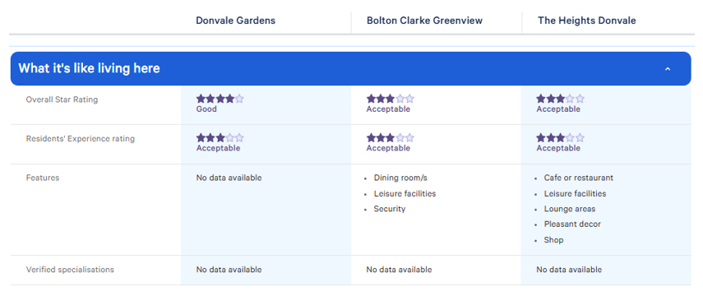
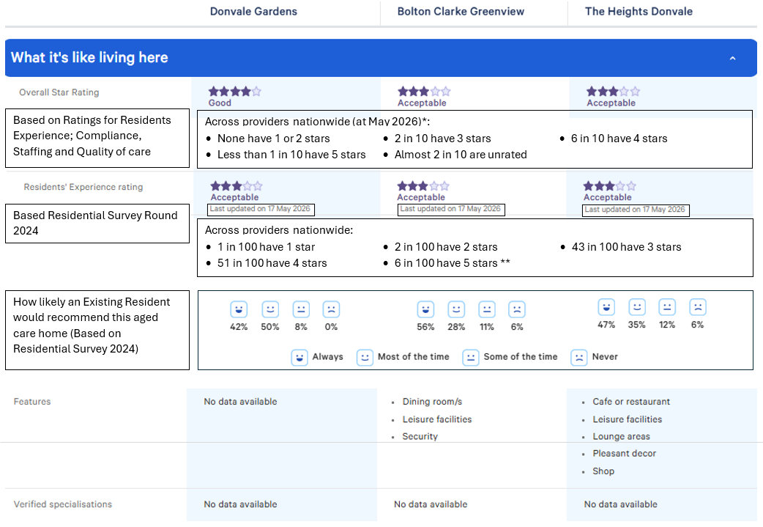
What’s it like living here? (i.e. Residents' Experience)
Current
Enhanced
3
4
Source: https://www.myagedcare.gov.au

Slide 30
What’s it like living here? (i.e. Residents' Experience)
Enhanced
3
4
* Star rating May 2026 Extract
** https://www.myagedcare.gov.au/how-are-star-ratings-calculated

Slide 31
Consumer – Cost comparisons
04 Qiao Zhou

Slide 32
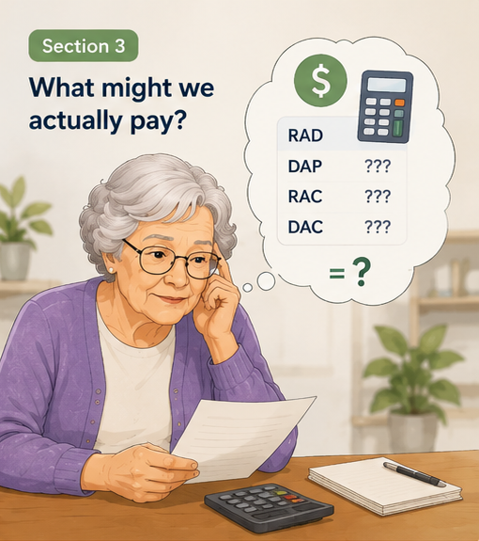
From suitable homes to costs Mum can compare
Mum has shortlisted three homes that meet her care, location and quality needs.
Her next question is:
What would each of these options actually cost me?

Slide 33
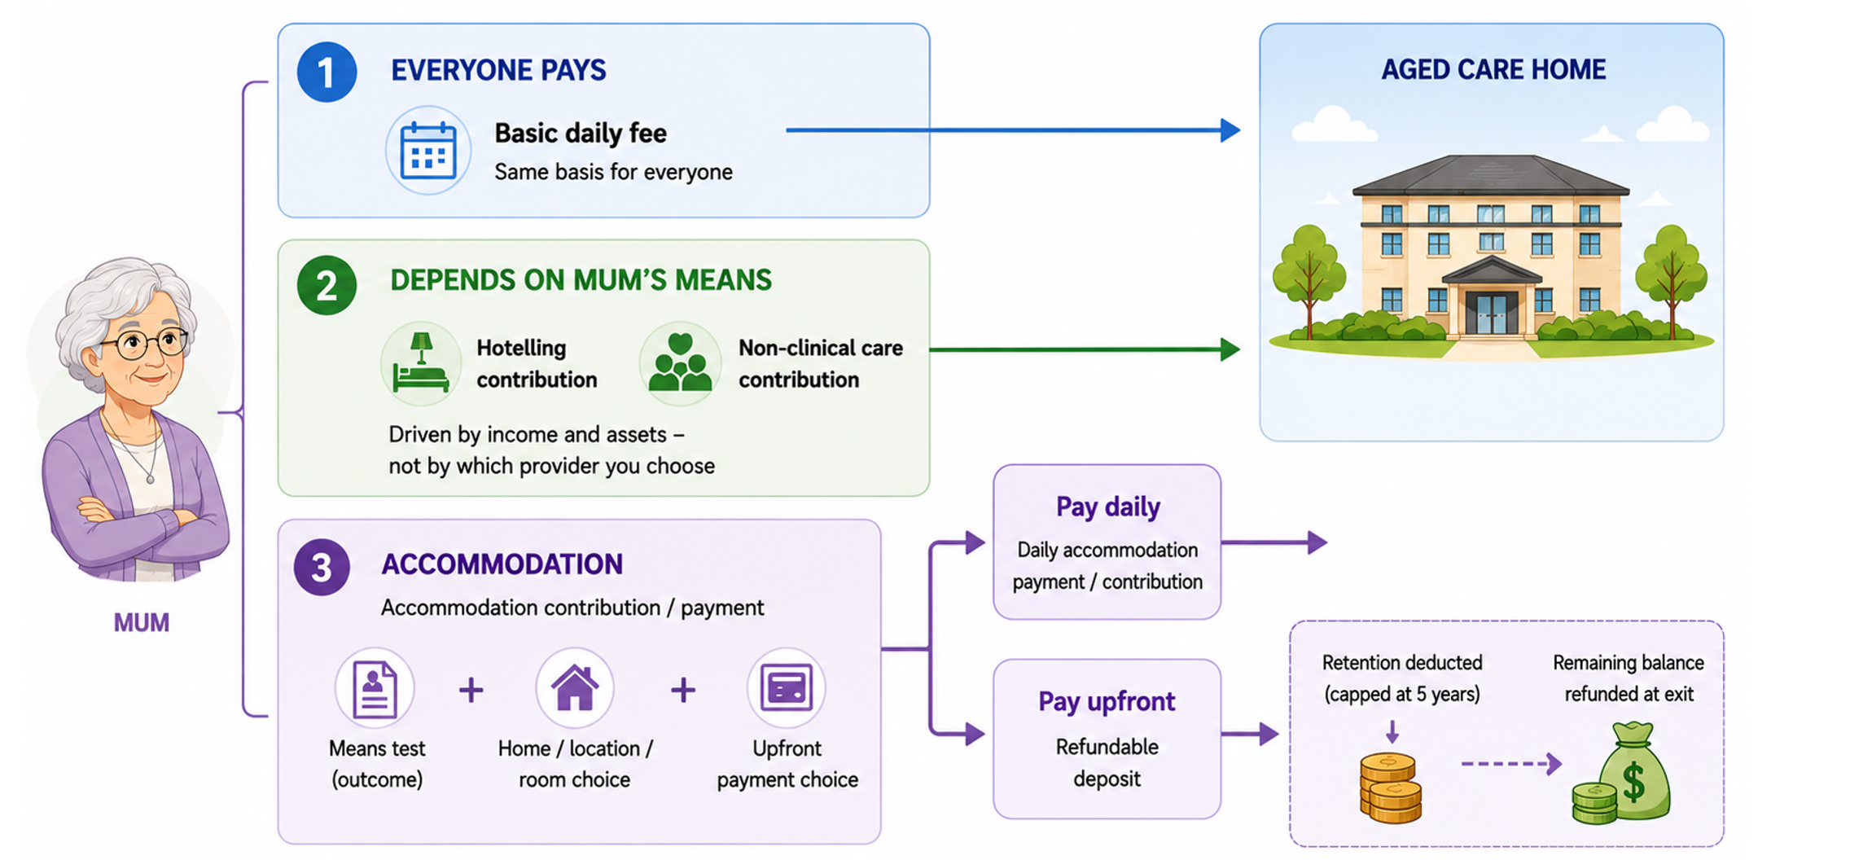
What actually drives Mum’s residential aged care costs?

Slide 34
Scenario 1 — Mum qualifies for accommodation support
The published room price may not be the relevant answer
Mum’s position: Eligible for accommodation support | Plans to pay: $200k upfront

Slide 35
Scenario 2 — Mum does not receive accommodation support
Room price and upfront payment now matter
Mum’s position: Not eligible for accommodation support | Plans to pay: $500k upfront
Same $500k upfront → different daily payments because room prices differ

Slide 36
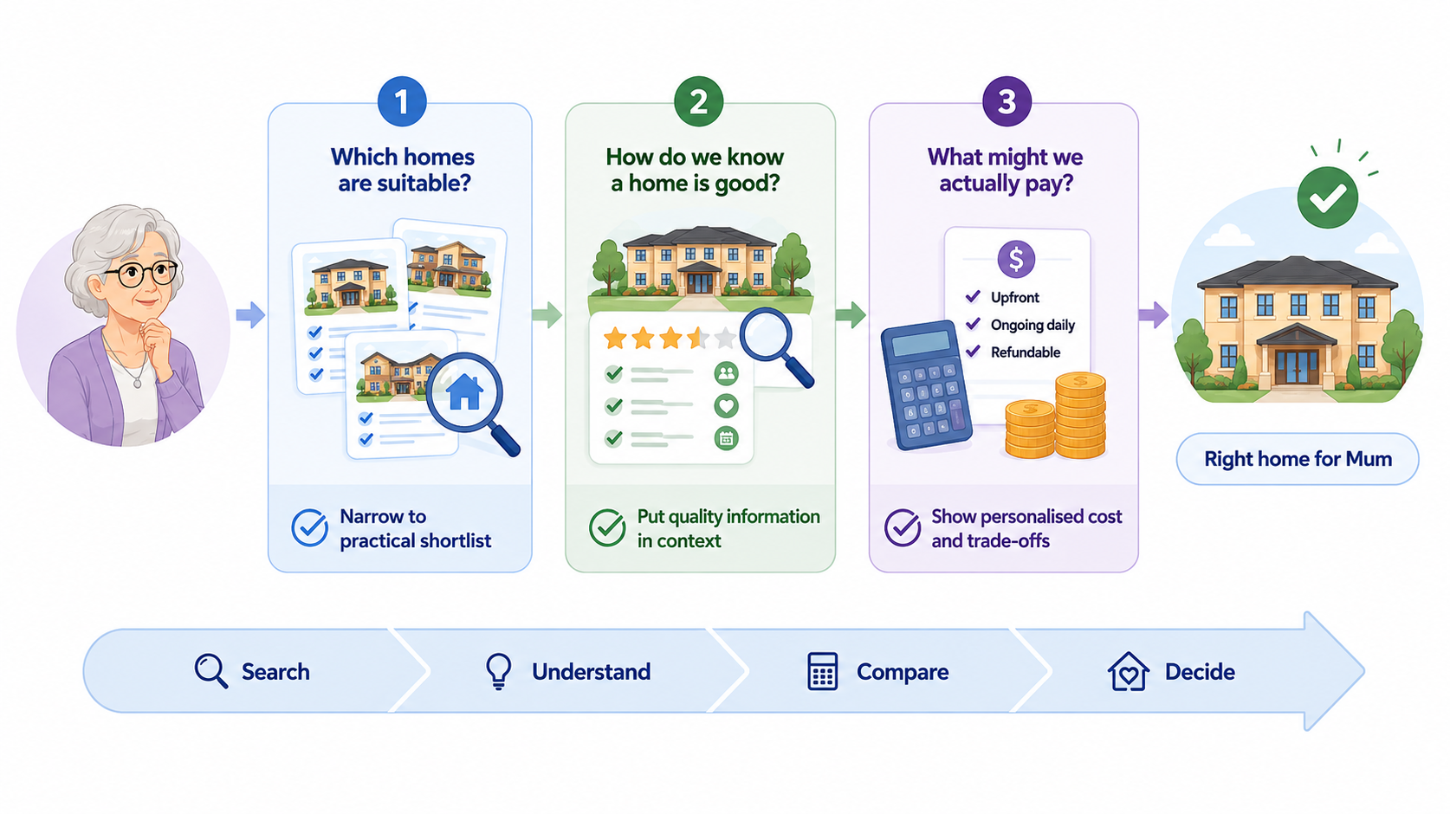
One decision, one connected journey

Slide 37
Residential aged care costs
05 Catherine Nance
The means test, the numbers, and what needs to change

Slide 38
Residential aged care costs – single person
Maximum annual cost
Approximate assets
Basic daily fee
$24,382 pa
Not means tested
HSC maximum
$8,085 pa
Assets range
$263,000 – $362,000
NCC maximum
$39,172 pa
Lifetime limit $137,917 (3.5 yrs)
Assets range
$548,000 – $1,049,000
Accommodation – provider dependent
RADs ~ $400,000 – $900,000 (Median <$600,000)
Eg: For a $600,000 RAD:
  2% pa retention (5 yrs) = $12,000 pa ($60,000)
  + lost earnings
  $50,580 pa DAP
Higher everyday living fees (HELF)~ $7,000 – $25,000 pa
* All amounts at 1 July 2026

Slide 39
Cost outcomes under different scenarios
 | MyAgedCare Published RAD | Actual RAD pay DAP | Actual RAD pay RAD
House | $500,000 | $500,000 | Sold
Super / savings | $250,000 | $250,000 | $250,000
Basic daily fee pa | $24,000 | $24,000 | $24,000
Hotelling pa | $8,000 | $8,000 | $8,000
Non-Clinical Care pa | $0 | $0 | $15,808
Accommodation | DAP $46,000 pa (RAD $550,000) | DAP $42,000 pa (RAD $500,000) | RAD $500,000
Age Pension | $31,000 pa | $31,000 pa | $31,000 pa
* All amounts rounded to $,000

Slide 40
Cost outcomes under different scenarios
 | MyAgedCare Published RAD | Actual RAD pay DAP | Actual RAD pay RAD | Higher Investment assets | Higher RAD
House | $500,000 | $500,000 | Sold | Sold | Sold
Super / savings | $250,000 | $250,000 | $250,000 | $500,000 | $250,000
Basic daily fee pa | $24,000 | $24,000 | $24,000 | $24,000 | $24,000
Hotelling pa | $8,000 | $8,000 | $8,000 | $8,000 | $8,000
Non-Clinical Care pa | $0 | $0 | $16,000 | $37,000 | $35,000
Accommodation | DAP $46,000 pa (RAD $550,000) | DAP $42,000 pa (RAD $500,000) | RAD $500,000 | RAD $500,000 | RAD $750,000
Age Pension | $31,000 pa | $31,000 pa | $31,000 pa | $27,000 pa | $31,000 pa
* All amounts rounded to $,000

Slide 41
Age Pension means test vs aged care means test
Age Pension | Thresholds | Calculation | Final Age Pension
Income test | 1 Income Threshold | Pension = Max pension less 50% of income > threshold | Lower of the two
Assets test | 1 Assets Threshold | Pension = Max pension less 7.8% of assets > threshold
Aged care HSC & NCC costs | Thresholds | Calculation | Final cost
Combined Income test Assets test | 18 Thresholds for income, assets and testing amounts All indexed twice a year | ~20 Calculations required | HSC max of $8,085 NCC max of $39,172
2 thresholds and 2 calculations for the Age Pension vs 18 thresholds and 20 calculations for aged care

Slide 42
Two key problems
Means testing is complex
Barrier to informed decision making
No ability to pre-plan or test “what ifs”
Impacts important decisions: RAD vs DAP, sell or keep the home, Age Pension
No choice but to seek professional financial advice
MyAgedCare site is inflexible
One option only using a DAP at the published room price

Slide 43
Administration complexity of the aged care means test
Requires simultaneous navigation of 5 legislative instruments and over 150 pages
Instrument | Role in Means Testing | Approx. Relevant Pages
Aged Care Act 2024 (Cth) | Establishes the framework; defines contribution types (HSC, NCC, accommodation) | ~40–60
Aged Care Rules 2025 | Specifies thresholds, formulas, caps, contribution rates and calculation methodology | ~80–120
Social Security Act 1991 (Cth) | Defines “ordinary income” and assessable assets cross-referenced by the Rules | ~150–200 (aged care-relevant)
Veterans’ Entitlements Act 1986 (Cth) | Parallel framework for DVA clients | ~80–120
Aged Care (Consequential and Transitional Provisions) Act 2024 | Governs grandfathered pre-1 Nov 2025 residents under legacy rules | ~20–40

Slide 44
Two solutions
Simplify means testing
Convert to a 2-stage test like the Age Pension
Grandfather all existing fees with CPI indexation
Simplify legislation
Provide a calculator
Publicly available calculator, like ASIC MoneySmart for the Age Pension
Includes aged care costs and Age Pension

Slide 45
Consumer – Solvency
06 Anthony Asher

Slide 46
Recap: Financing of residential aged care accommodation
Means tested contributions from the wealthier
Refundable Accommodation Deposit (RAD)
Is intended to cover the cost of the room and other facilities but 50% or more bigger
Needs approval for over $750,000
Now subject to annual charge of 2%, which is still not enough to cover maintenance and depreciation
Exempt from Aged Pension means tests and from tax
OR
Daily Accommodation Payment (DAP)
Is usually the Maximum Permissible Interest Rate (MPIR) times the RAD
MPIR is based on current interest rates and is currently 8.43% and increased by inflation
Too low when interest rates are low so contributing to RAD "inflation"
Government subsidies for those who cannot afford much

Slide 47
Average Balance Sheet* of Aged Care Providers
Cash to cover liquidity requirements of 35% of quarter’s expenses + 10% of RADs and 2% of ICs.
Assets ($m)
Cash | 50
Property | 180
Other | 20
Total | 250
Liabilities ($m)
RADs | 85
ICs (RVs)** | 60
Other | 35
Total | 180
Equity | 70
Properties valued at adjusted book value – useless information for solvency purposes.
43% of providers operate just one home – 17% market share.* Vulnerable to lower occupancy.
90% of providers are not-for-profit – 57% market share.* Much higher than comparable countries.
No solvency requirement

Slide 48
Why a solvency standard?
Government guarantees the RADs - but can levy the industry for losses
Some providers are under financial strain
Too small to be viable
Regional demand may be inadequate
Management struggles to contain costs or maintain buildings
Industry pushback on liquidity and solvency
Financial management can be limited?
Opportunists taking profits?

Slide 49
Determining solvency
Solvency requirements should be a percentage of assets
Alternatives for valuation of the properties:
1. Value of RADs – but favourable means tests mean they are overstated
2. Capitalise EBITDAR (Earnings before interest, tax, depreciation & rent)
Assumes that interest, depreciation and rent can be allocated to property
But earnings include DAPs which vary with MPIR
Value RADs at face value or DAP equivalent?
Industry apparently uses a capitalisation rate of 15% - very high depreciation?
EBITDAR not relevant for some not-for-profit providers
Business could be worth more than properties for commercial providers
3. Land plus depreciated replacement value (standardized $ per sq m?)
Needs to be impaired if occupancy is likely to be low

Slide 50
Q&A – Cecilia Li
Where to next?
Thank you
Actuaries Institute
actuaries.asn.au

