Slide 1
The Fair Pricing Playbook:
Responsible AI for Algorithmic Insurance Pricing
Fei Huang
Associate Professor
UNSW Business School

Slide 2
Important Notice for all Participants
This meeting is being conducted in accordance with Institute’s Code of Conduct and attended by members in their professional capacity.
It is acknowledged that professional members in their employed capacity, may be active market participants in their respective industries who may compete with each other as defined by competition law.
Participants are, therefore, reminded that in accordance with their competition law compliance obligations they should not:
  discuss any matter that may be perceived as being cooperation by competitors in a market to influence that market;
  discuss any matters that could be regarded as fixing, maintaining or controlling prices, allocation of customers or territories, coordinating bids and/or restricting output or acquisitions in any circumstances;
  share any confidential information or commercially sensitive information obtained through their employment, professional engagements or industry roles; or
  share information for an anti-competitive purpose.

Slide 3
When AI identifies a predictive signal, can we trust it?

Slide 4


Wolf or Husky?

Slide 5
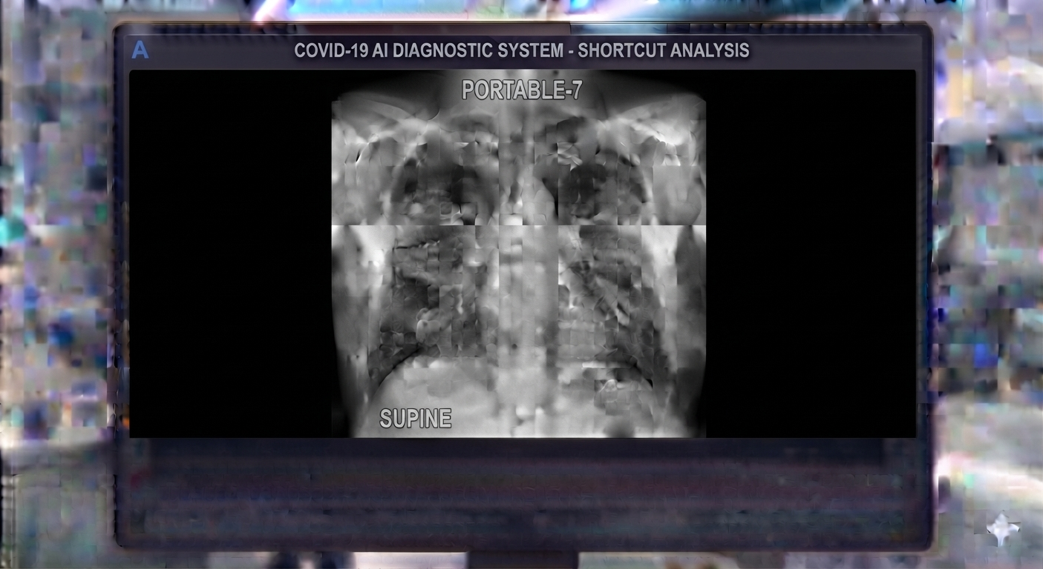
AI Systems for COVID-19 Detection: Which X-Ray Features Matter?
Illustration generated using AI.

Slide 6
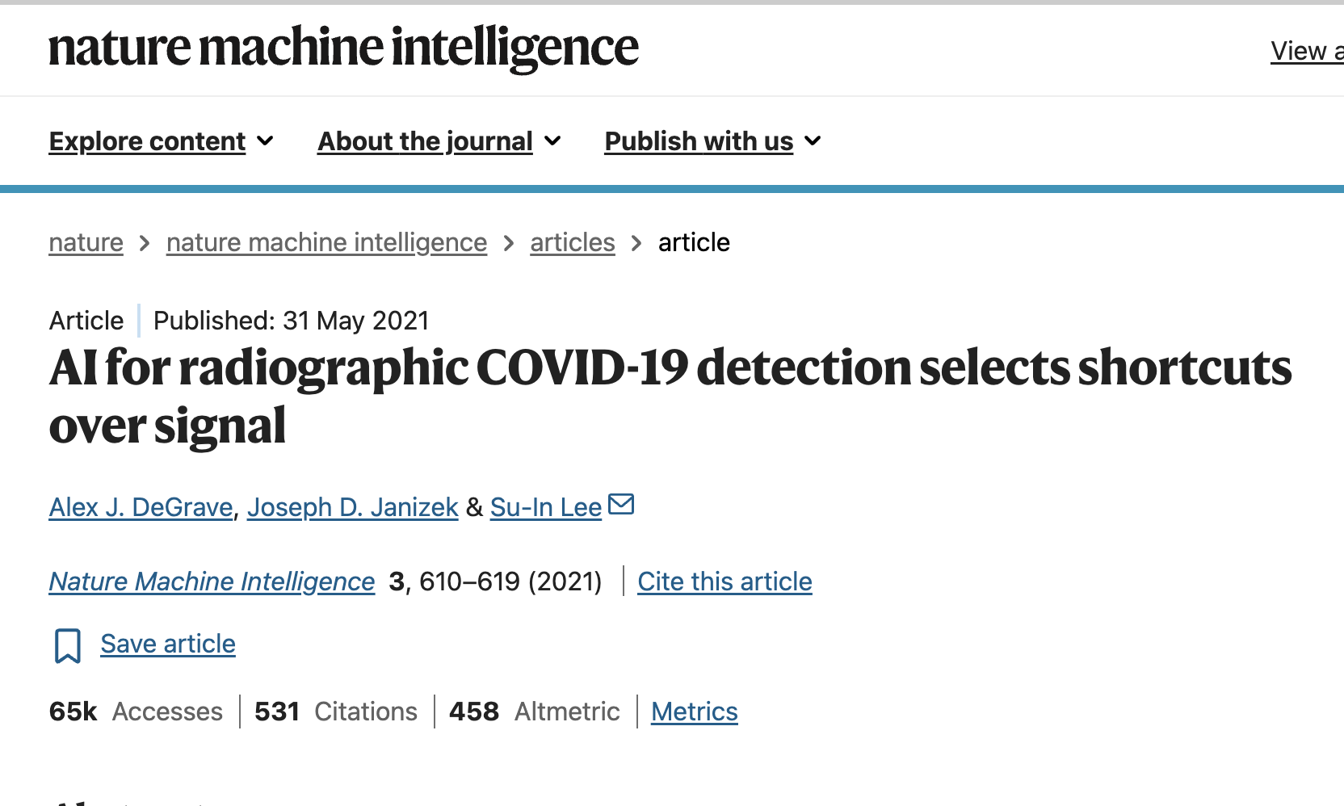
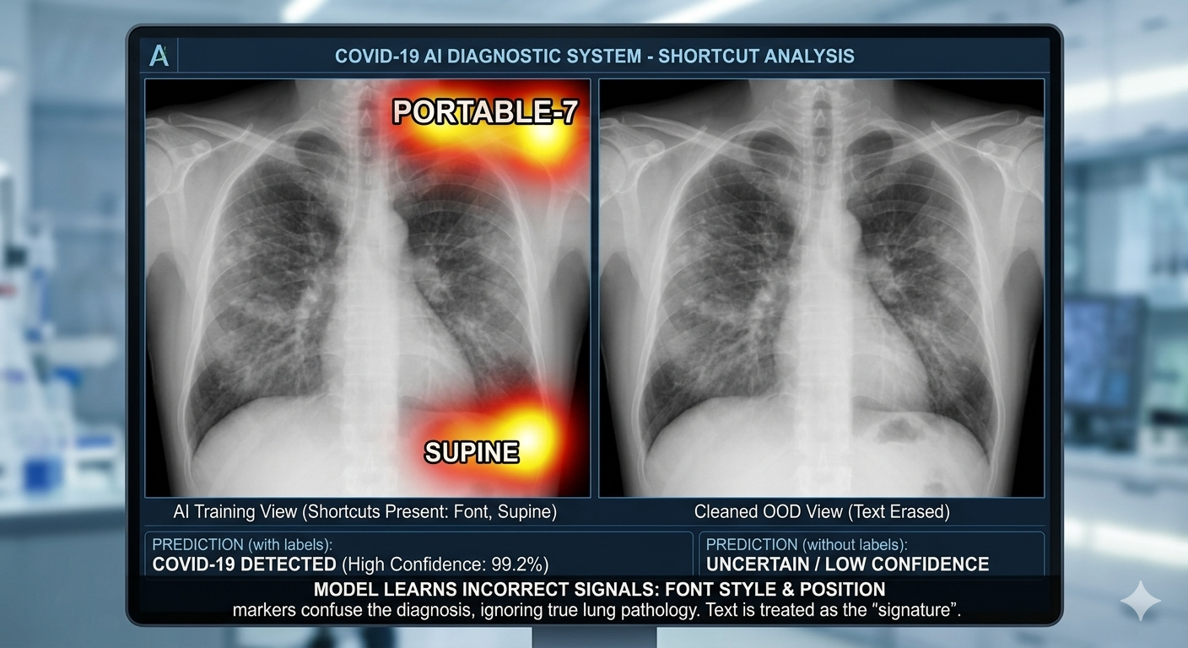
Illustration generated using AI.​
AI systems trained to detect COVID-19 from chest X-rays often learn hospital- or dataset-specific shortcuts, such as image artifacts and acquisition differences, instead of genuine signs of disease.
Consequently, although they may perform well on familiar or even some external datasets, their ability to generalize reliably to new hospitals is limited.

Slide 7
What do we mean by “Fair”?
---- “Fairness” is an overloaded concept.
1
2
3
Consumer trust & promises
Anti-discrimination
Competing notions of fairness
Legal obligation
Contested ethical terrain
Contractual commitment
Direct discrimination
Actuarial fairness
Codes of practice
Indirect discrimination
Social justice
Consumer promises
The legal standard
Choice-sensitive fairness
Product disclosure

Slide 8
How Australian Law Regulates Insurance Discrimination?
Insurance exemptions: Insurers may charge different prices based on age, disability or sex when supported by reasonable actuarial or statistical evidence.
Evidence standard: Data should be current, complete, credible, sufficiently large and relevant to the individual risk.
No racial exemption: Race, colour, descent, ethnicity and immigrant status are protected under the Racial Discrimination Act.
Broader protections: State and territory laws may also protect attributes, such as religious belief.
Guidance from the Human Rights Commission and Actuaries Institute warns removing a protected attribute from a dataset is not sufficient, as other data may still act as a proxy.

Slide 9
Transparency
2026 ASIC review of five motor vehicle insurance providers found none had explained in their quote and renewal documents:
  the key factors that affected the calculation of the premium, or why the premium had changed from the previous year.

Slide 10
Privacy
Implications of the Newly Proposed Australian Privacy Reforms “Privacy Amendment (Personal Data Protection) Bill 2026”
  New “fair and reasonable” test: Personal-data collection, use and disclosure will be assessed holistically against factors such as reasonable expectations, transparency, data minimisation, genuine choice, proportionality and individual impact.
  Expect stronger justification and documentation for using third-party, inferred or sensitive data in underwriting, pricing and claims.
  Expect greater transparency and explanation on customer notices, consent processes, data requests, and usage.
  The consultation closes on 18 September 2026.

Slide 11
AI Doesn't Create a New Problem.
It amplifies an existing one.

Slide 12
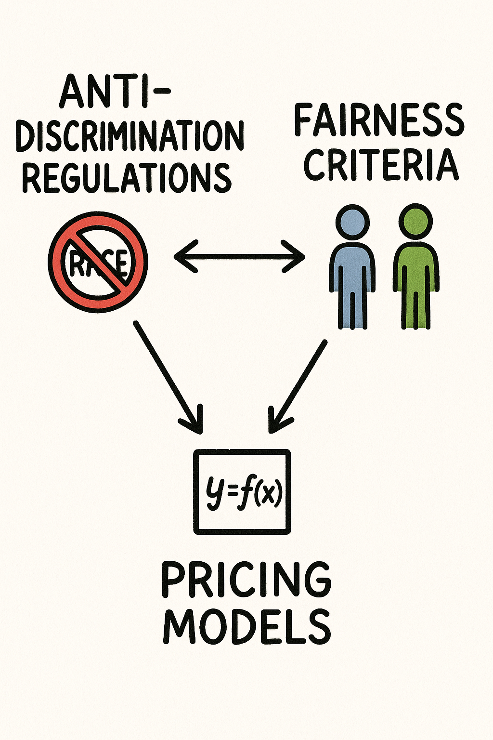
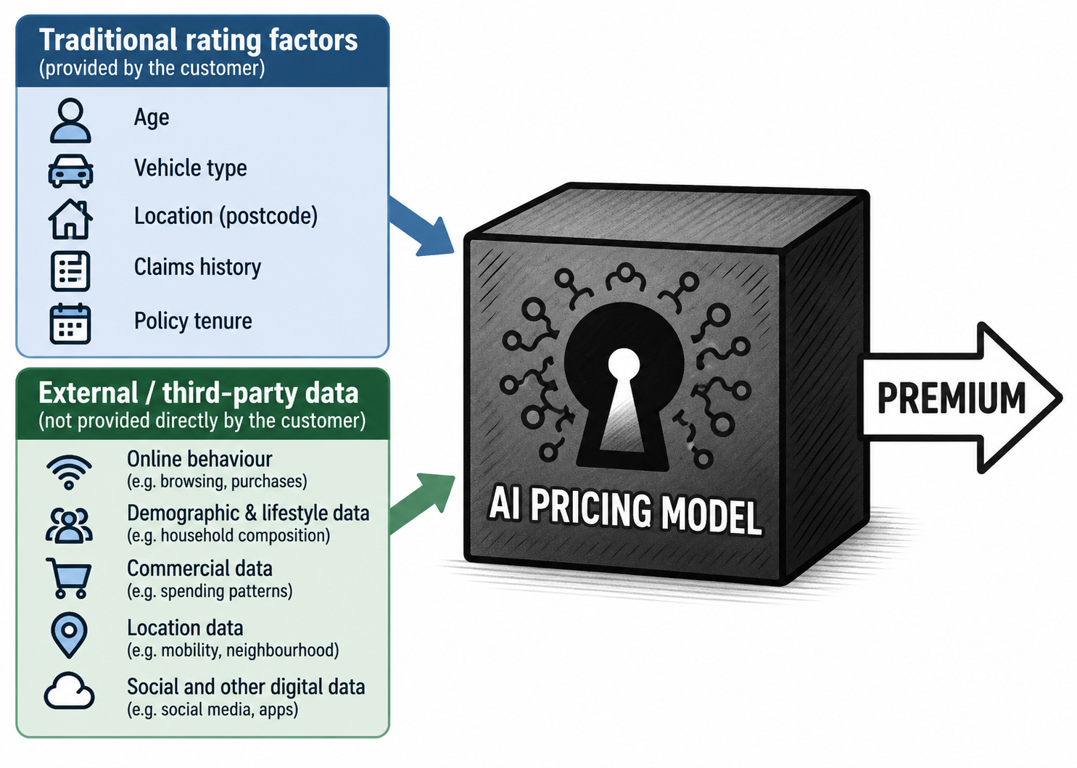
Algorithmic Pricing
Illustration generated using AI.​

Slide 13
Four Big Questions to Tackle
What is fair?
Fairness criteria can conflict.
How do we achieve it?
Fair prices and fair markups can conflict.
Who gains and who loses?
Fairness can redistribute welfare and profit.
How do we know it works?
We need an appropriate audit protocol.
Notes:
13

Slide 14

The Fair Pricing Playbook
A practical framework for developing, evaluating, and auditing fair algorithmic pricing systems.
Step 1: Define Fairness | Step 2: Design Fair Pricing | Step 3: Assess Impact | Step 4: Audit the System
Fairness Metrics | Fair Models | Welfare Implications | Fairness Testing
What is fair? | How to achieve fairness? | Who gains and loses? | How to audit fairness?
https://fair.feihuang.org

Slide 15
Step 1: Define Fairness

Slide 16
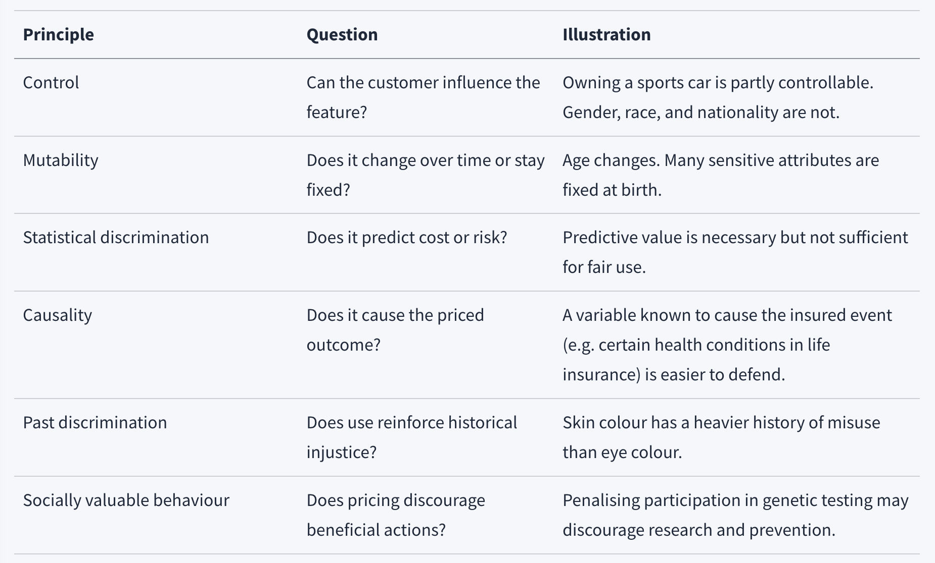
Is it fair to use that rating factor?

Slide 17
Indirect Discrimination
-- a grey area in regulation
  Direct discrimination is prohibited, but indirect discrimination using proxies or more complex and opaque algorithms are not clearly regulated or assessed.

Slide 18
Fairness Metrics
Input-based approach: restricting the use of certain rating factors or pricing procedures
  protected or proxy variables (fairness through unawareness)
  non-risk-based price optimization/price walking
Output-based approach: quantitative fairness metrics

Slide 19
Case Study: When “Accurate” Algorithms Are Not Seen as Fair
Example: U.S. car insurers used credit-based insurance scores to predict claims and set premiums.
The tension:
Although the scores were statistically effective (confirmed via a series of statistical studies), policymakers questioned whether people with low scores genuinely deserved to pay more—especially when scores reflected circumstances outside their control.
The finding triggered sustained regulatory pushback, investigations in more than 17 US states and five congressional hearings
What regulators questioned:
  Does credit genuinely measure insurance risk?
  Why does credit predict claims?
  Are consumers being improperly penalized (for circumstances beyond their control)?
  Should states ban or restrict the use of credit scores?
Source: Kiviat (2019), “The Moral Limits of Predictive Practices: The Case of Credit-Based Insurance Scores,” American Sociological Review, 84(6), 1134–1158.

Slide 20
Insurance risk pricing is not a pure predictive task.
AI can help us predict risk better, but it can’t tell us what is fair.

Slide 21
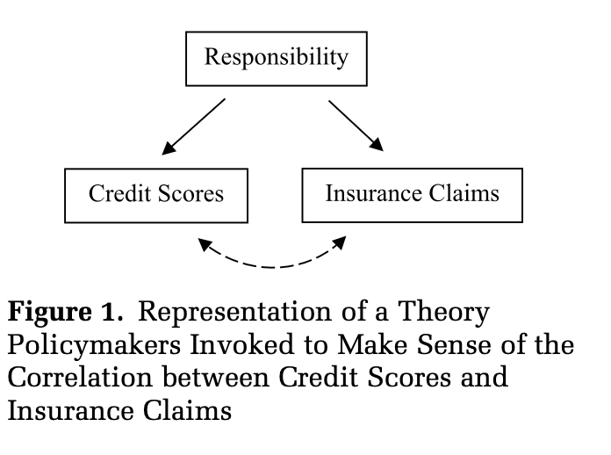
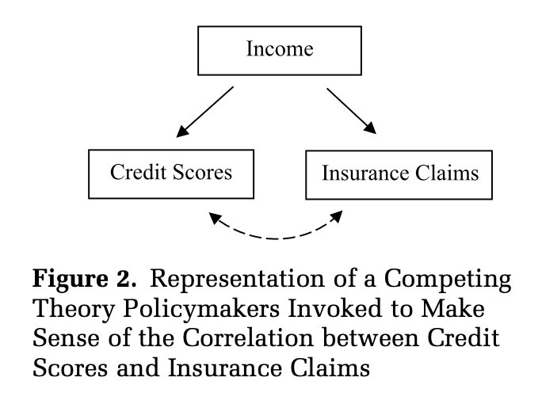
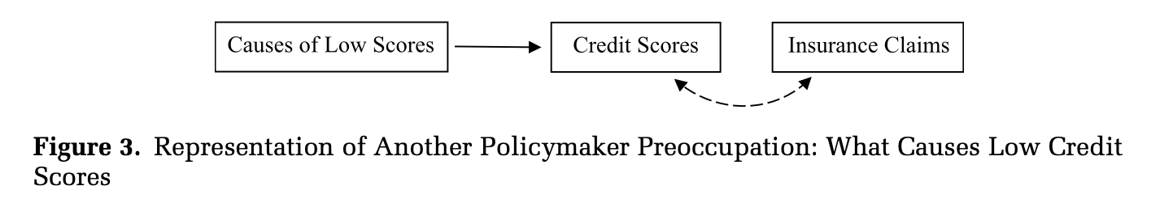
Causal Theorizing as Moral Adjudication: Asking the "WHY"
Why does the prediction work?
2. Why people have low credit scores?
Loan delinquencies, bankruptcies, missing data, catastrophic event, serious illness, death of spouse etc.
Source: Kiviat (2019), “The Moral Limits of Predictive Practices: The Case of Credit-Based Insurance Scores,” American Sociological Review, 84(6), 1134–1158.

Slide 22
Outcome
All states responded by:
Banning credit-based insurance scoring entirely, or
Restricting its use—for example, limiting how much it could affect premiums, requiring transparency, or prohibiting certain adverse actions.
.

Slide 23
Predictive accuracy is not enough.
Algorithmic predictions are more likely to be accepted when:
2. Their causal logic is morally understandable.
3. Their categories align with shared ideas of responsibility and deservingness.
Takeaway:

Slide 24
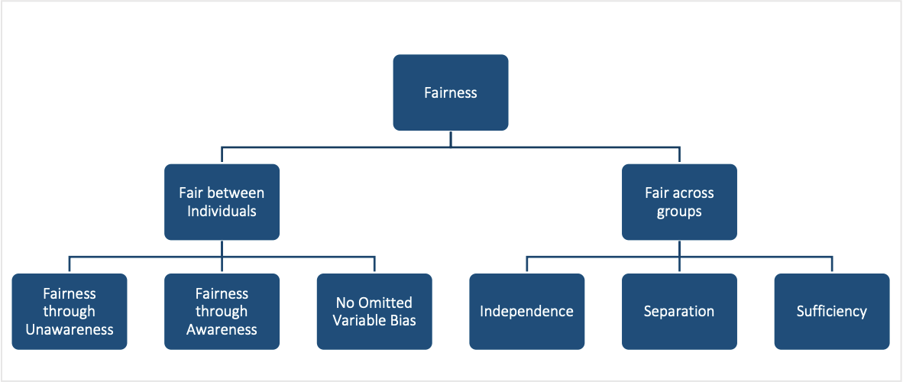
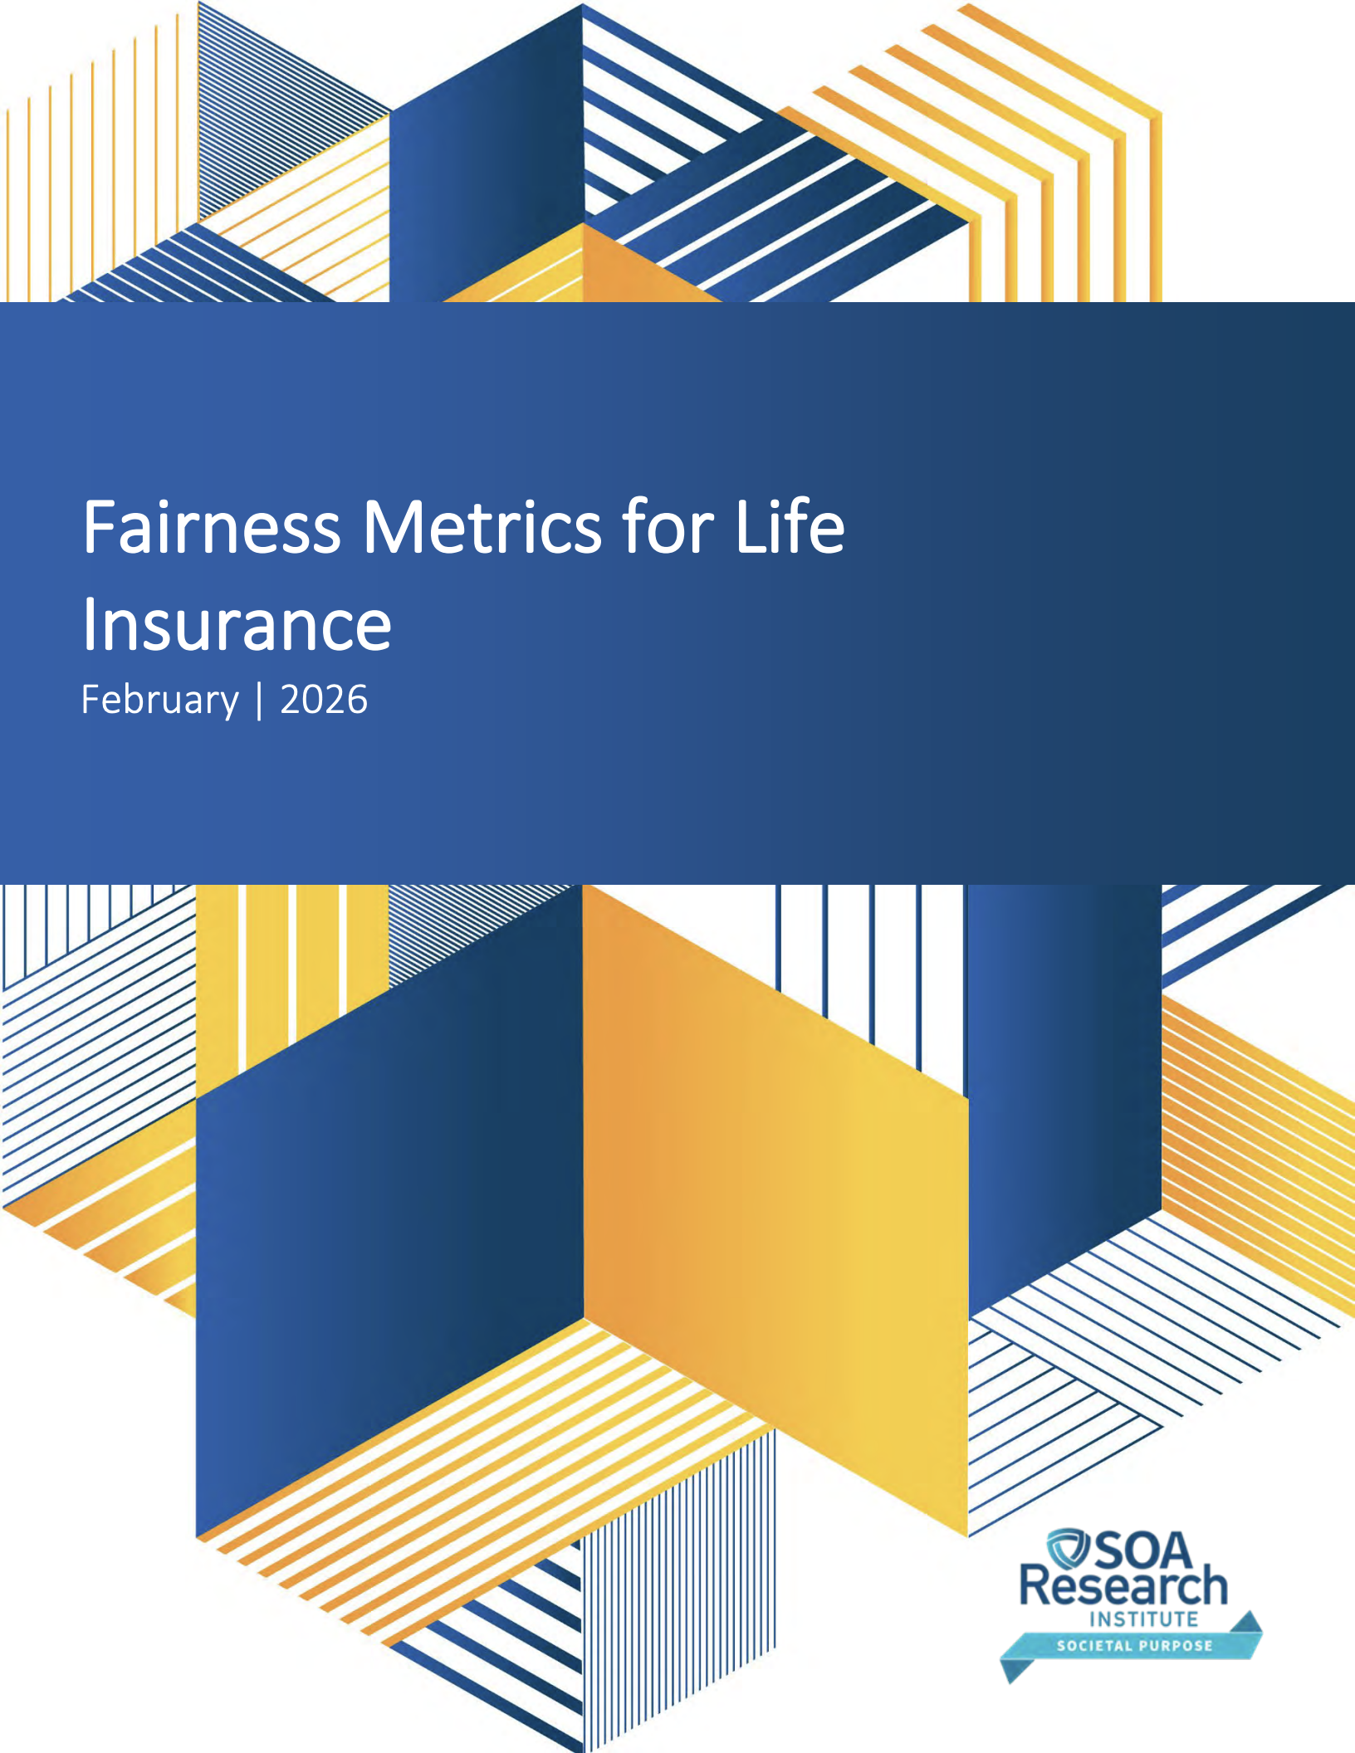
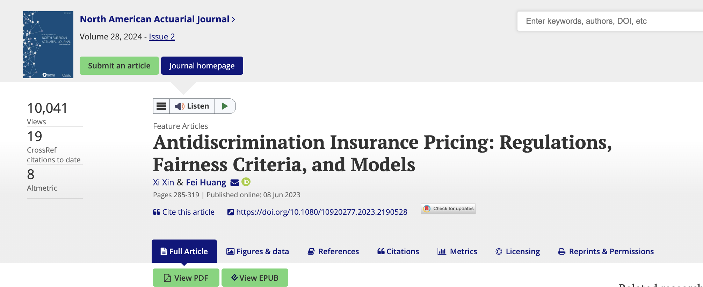
Fairness Metrics: From Input- to Output-Based Approaches
Context matters – There is no one-size-fits-all answer!

Slide 25
Step 2: Design Fair Pricing

Slide 26
Insurance Pricing Process
Data Collection
Machine Learning Tasks
Cost Modelling
Demand Modelling
This is where Machine Learning Fairness comes in.
Price Optimisation
Strategic pricing decisions
Price Output
This is what we care!

Slide 27
Step 3: Assess the Impact

Slide 28
Impact of Fairness Policies on Stakeholders
Fairness-accuracy tradeoff
Fairness-welfare tradeoff???
Accuracy
Algorithm 1
Algorithm 2
Algorithm 3
Algorithm 4
Consumer Welfare
Fairness metric
Fairness
Who pays the cost of fairness???
Does fairness benefit the disadvantaged???
Consumer Welfare
Welfare of Group 2
Profit
Welfare of Group 1

Slide 29
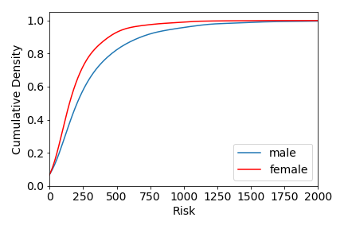
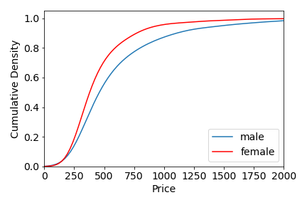
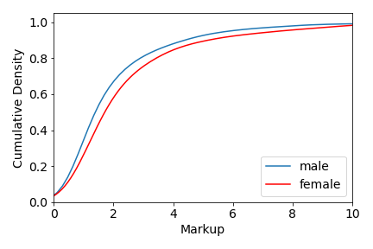
Discrepancy between Male and Female
Female consumers are:
  safer drivers
  charged less price
  charged more markup
Which group is the "disadvantaged"?

Slide 30
Finding
Is fair insurance pricing a fair machine learning problem?
Fairness in machine learning (cost prediction) ≠ Fairness in outcome (pricing)
Price equalization removes price gaps but widens markup gaps
Effects of price optimization bans depend on market conditions
Notes:
30

Slide 31
Step 4: Audit the System

Slide 32
Existing Testing Proposals: What Regulators Require
Colorado SB21-169 (2023)
NY DFS Circular Letter (Jan 2024)
Colorado Division of Insurance · Life insurance underwriting
New York Department of Financial Services · All lines
Instrument
Draft Proposed Regulation 10-1-1 under SB21-169; first US law requiring algorithmic fairness testing
Instrument
Proposed Insurance Circular Letter; applies to all insurers authorised in New York State
Criterion tested
Proxy discrimination + Conditional demographic parity (CDP)
Criterion tested
Proxy discrimination ('drivers of disparity') + Independence / CDP
Proxy discrimination
Fit two regressions: (a) with non-traditional variables + protected attribute; (b) without protected attribute. Flag any non-traditional variable whose coefficient shifts between models
Proxy test
Identify variables that 'cause differences in outcomes for protected classes' or 'serve as a proxy for any protected class'. Operationalised via coefficient-shift analysis across two regressions
Conditional demographic parity
Regress outcome on race/ethnicity indicators ± approved controls. Test significance at 5%. If significant, check whether effect exceeds 5 percentage points (approvals) or 5% of mean premium
Disparity metrics
Adverse Impact Ratio, Denials Odds Ratio, Standardised Mean Difference, z/t-tests — applicable to observed outcomes (demographic parity) or regression residuals (CDP)
Race inference
BIFSG (Bayesian Improved First Name Surname Geocoding) where race not directly observed
Race inference
BIFSG or any approved method with demonstrably greater accuracy
Model type
Logistic regression for binary approval outcomes; linear regression for premium rates
Governance
Requires documented risk management framework, board oversight, and ongoing monitoring of AI systems
Scope
External consumer data, algorithms, and predictive models used in life insurance underwriting
Scope
All AI systems and external consumer data used in underwriting, rating, and pricing across all insurance lines

Slide 33
Core problem
Pricing outputs are deterministic. Standard audit statistics assume random residuals.
1
2
3
No Fairness Standard
Wrong test
No protocol

Slide 34
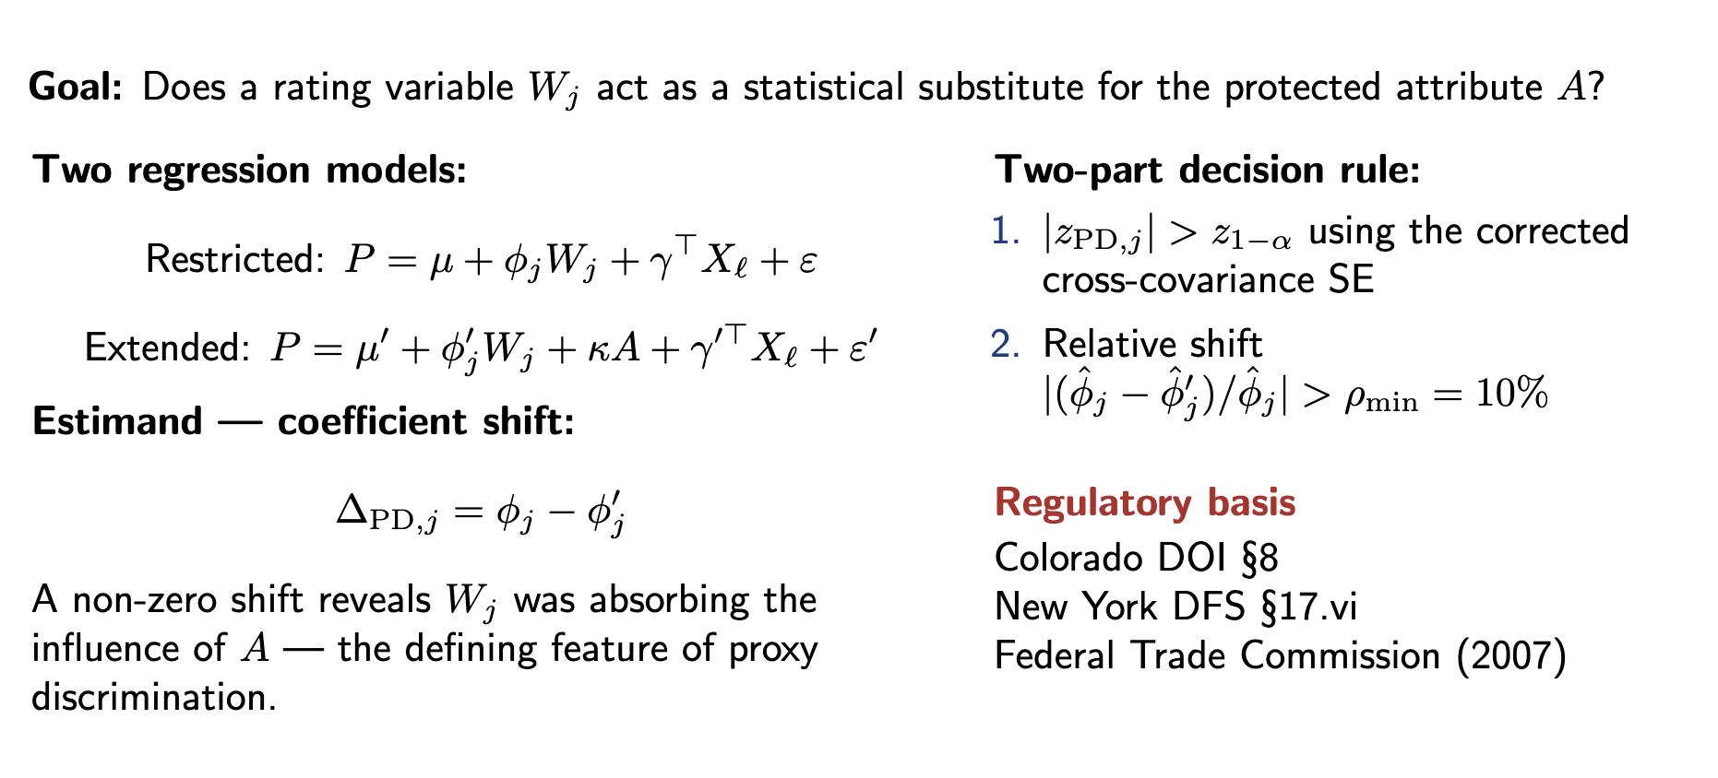
Fairness Criterion: Proxy Discrimination

Slide 35


A solution
Classical formula — invalid for deterministic outputs
HC3 sandwich estimator — more appropriate for this setting
$$Var(\hat{β}) = σ² × (XᵀX)⁻¹$$
$$Var(\hat{β}) = (XᵀX)⁻¹ × Σ × (XᵀX)⁻¹$$
Assumes residuals are random i.i.d. draws from a distribution
Where Σ is built from the actual squared residuals of each observation

Slide 36
TOST shifts the statistical question from ‘Can we detect a violation?’ to ‘Do we have sufficient evidence that the disparity is within the tolerance?
From Significance Testing to Equivalence testing (TOST)
Significance testing
TOST equivalence testing
Null
Gap = 0
Null
Gap ≥ tolerance
Pass means
Failed to detect violation (not necessarily fair)
Pass means
Positive evidence gap is small enough
Large samples
Flags trivial gaps as violations
vs.
Large samples
Help — tighter CI confirms fairness
Small samples
Misses genuine gaps
Small samples
Return 'Insufficient information'
Verdict
'Not significant' ≠ 'fair'
Verdict
Pass means gap is within tolerance

Slide 37
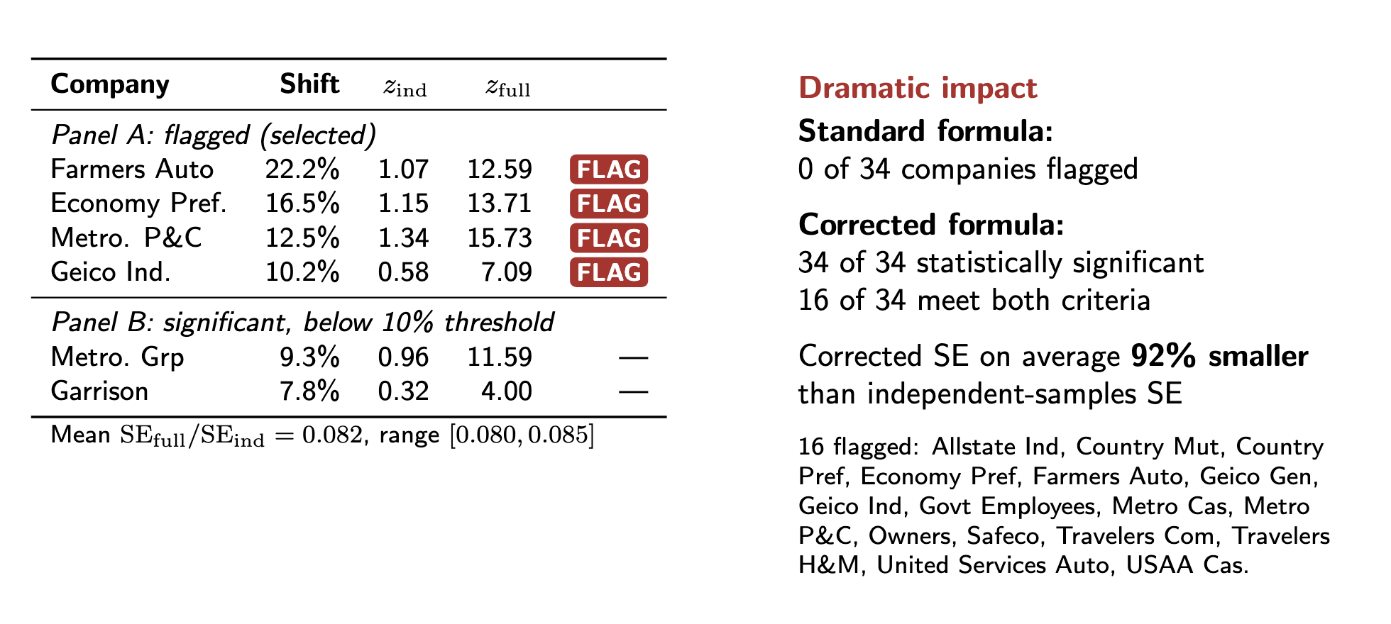
Proxy Discrimination: Before and After Correction

Slide 38
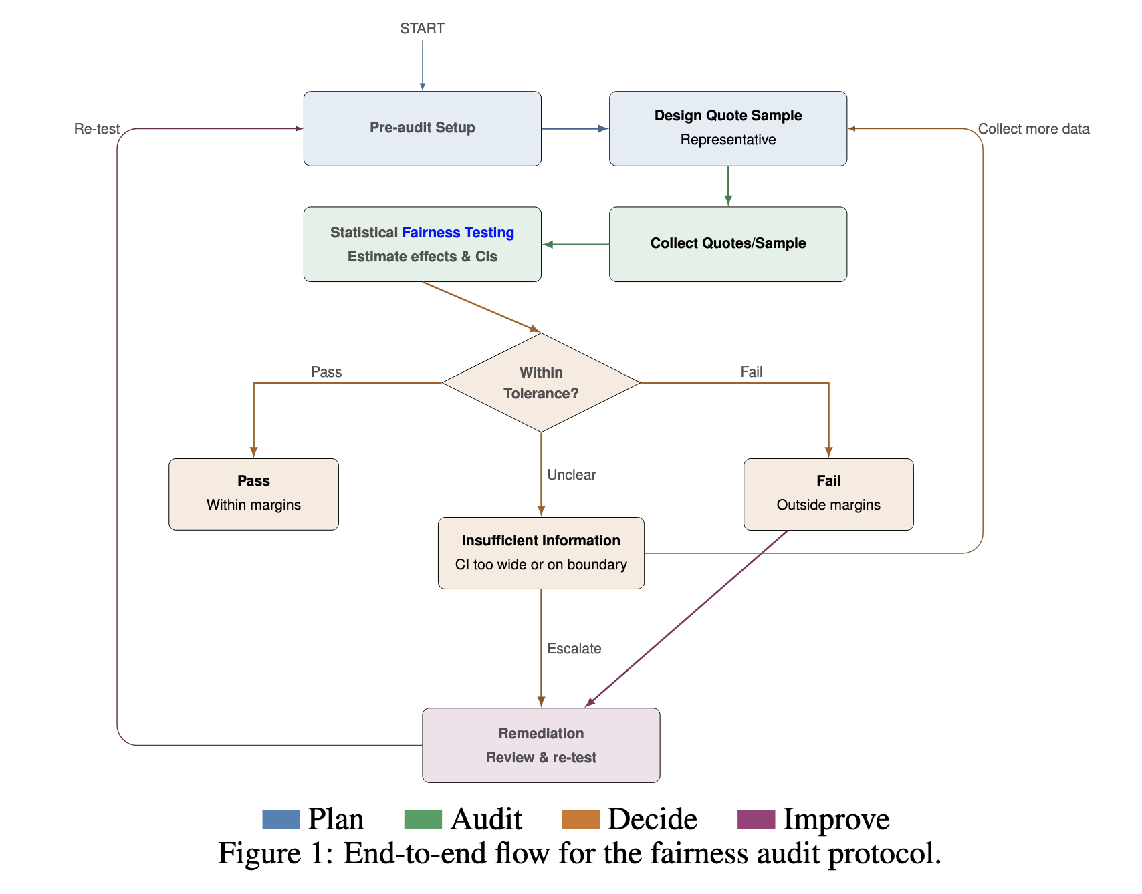
A Proposed Fairness Auditing framework

Slide 39
The Fair Pricing Playbook
Visit: fair.feihuang.org
Step 1: Define Fairness | Step 2: Design Fair Pricing | Step 3: Assess Impact | Step 4: Audit the System
Fairness Metrics | Fair Models | Welfare Implications | Fairness Testing
What is fair? | How to achieve fairness? | Who gains and loses? | Does it work?
Thank you!

Slide 40
About the Actuaries Institute
The Actuaries Institute is the peak professional body for Actuaries in Australia. The Institute provides expert comment on public policy issues where there is uncertainty of future financial outcomes.
Actuaries have a reputation for a high level of technical financial expertise and integrity. They apply their analytical and risk management expertise to allocate resources efficiently, identify and mitigate emerging risks and to help maintain system integrity across multiple segments of the financial and other sectors. This unrivalled expertise enables the profession to comment on a wide range of issues including life, general and health insurance, climate change, superannuation and retirement income policy, enterprise risk management and prudential regulation, the digital economy, finance and investment and wider health issues.
© Institute of Actuaries of Australia 2023.​ All rights reserved.

Slide 41
Thank you
Actuaries Institute
actuaries.asn.au

