Slide 1
Australian mortality update 2025
Matt Ralph
Mortality Subcommittee

Slide 2
Important notice for all participants
This meeting is being conducted in accordance with Institute’s Code of Conduct and attended by members in their professional capacity.
It is acknowledged that professional members in their employed capacity, may be active market participants in their respective industries who may compete with each other as defined by competition law.
Participants are, therefore, reminded that in accordance with their competition law compliance obligations they should not:
  discuss any matter that may be perceived as being cooperation by competitors in a market to influence that market;
  discuss any matters that could be regarded as fixing, maintaining or controlling prices, allocation of customers or territories, coordinating bids and/or restricting output or acquisitions in any circumstances;
  share commercially sensitive information relating to their employer; or
  share information for an anti-competitive purpose.

Slide 3

Q&A
Join at Slido.com
#2803677

Slide 4
Australian Mortality update 2025
Setting the 2025 Baseline
What did 2025 look like in Australia?
2025 experience in context
Discussion/Questions
Notes:
[NEXT]

Slide 5
Australian Mortality update 2025
Setting the 2025 Baseline
What did 2025 look like in Australia?
Australian 2025 experience in context
Discussion/Questions
Notes:
[NEXT]

Slide 6
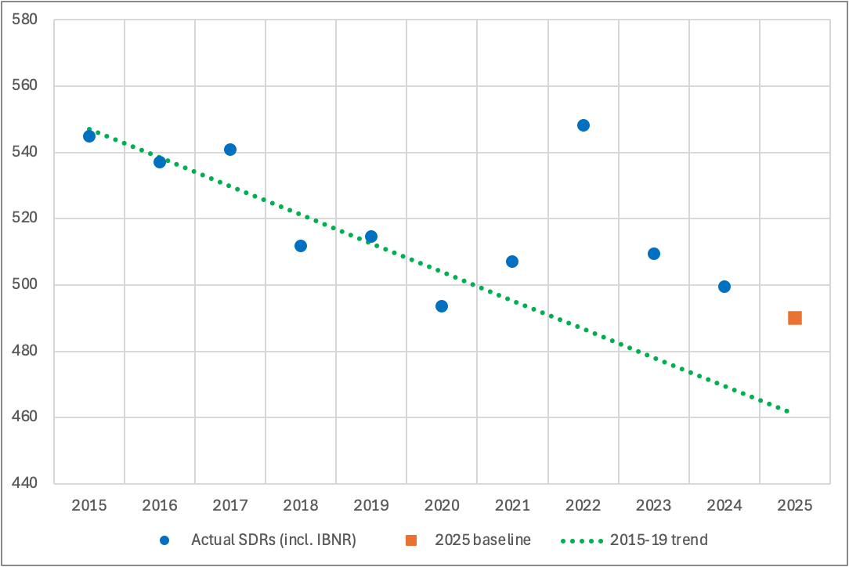
Benchmarking 2025
Method gradually leans on post-pandemic data as it accumulates.
Starting point: weighted mix of the two years of post-pandemic experience (2023 and 2024).
Apply one year of mortality improvement, based on both pre- and post-pandemic trends.
Implement this credibility-based blend of pre- and post-pandemic trends for the three main categories of causes of death: non-respiratory, COVID and non-COVID respiratory.
Since 2024, we have moved to using standard trend analysis.

Slide 7
Australian Mortality update 2025
Setting the Baseline
What did 2025 look like in Australia?
Australian 2025 experience in context
Discussion/Questions
Notes:
[NEXT]

Slide 8
2025 in headline numbers
OVERALL MORTALITY EXPERIENCE
188,300
actual deaths
187,400
predicted (baseline) deaths
+900 / +0.5%
excess deaths vs baseline
No statistically significant excess mortality in Australia in 2025
Source: Actuaries Institute Mortality Working Group, 2025 Mortality Report

Slide 9
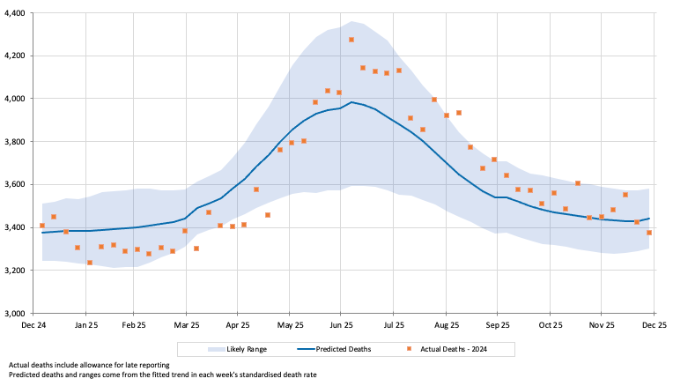
Actual mortality tracked below, then above, prediction
WEEKLY DEATHS, ALL CAUSES
A tale of two halves
Mortality tracked below prediction in H1, then above prediction for the rest of the year.
This is despite a smaller-than-expected COVID-19 winter wave
H2 deterioration was driven by cancer, dementia and a large influenza spike.
Across the full year, weekly mortality mostly stayed within the 95% likely range – but the consistent first-half/second-half pattern is a notable feature of 2025.
Figure 6 – Weekly actual and predicted deaths, 2025, all causes
Source: Actuaries Institute Mortality Working Group, 2025 Mortality Report

Slide 10
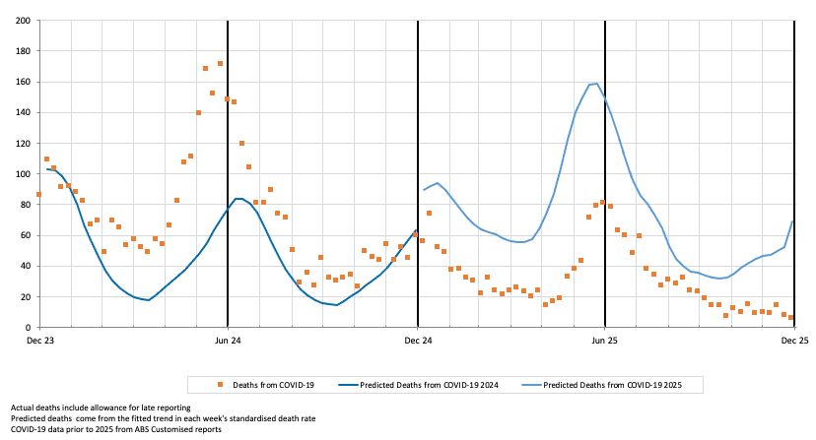
COVID-19: a materially better year than expected
COVID-19 MORTALITY
-55%
vs prediction: 1,745 actual vs 3,882 predicted deaths
0.9%
of all 2025 deaths were from COVID-19 (2024: 2.1%)
Baseline assumed two waves similar to 2024; the winter wave peaked well below prediction.
The expected summer wave did not eventuate – first time since 2021–22.
Drops out of the top 20 leading causes of death for the first time since 2021.
Figure 7 – Weekly COVID-19 deaths, actual vs predicted, 2024–25
Source: Actuaries Institute Mortality Working Group, 2025 Mortality Report – Section 2

Slide 11
Excess deaths by cause, 2025
VS BASELINE EXPECTATION
Cause of death | Excess deaths | % vs baseline
All non-COVID-19 respiratory causes | +1,200 | –
of which: Influenza | +630 | +87%
COVID-19 | –2,137 | –55%
Subtotal – all respiratory (incl. COVID-19) | –900 | –
Ischaemic heart disease | +430 | +4%
Cerebrovascular disease | +420 | +5%
Cancer | –600 | –1%
Other unspecified | +810 | +2%
Subtotal – non-respiratory (doctor-certified) | +600 | –
Coroner-referred (ex-COVID-19, estimated) | +1,220 | +5%
TOTAL – all causes | +900 | +0.5%
Source: Actuaries Institute Mortality Working Group, 2025 Mortality Report

Slide 12
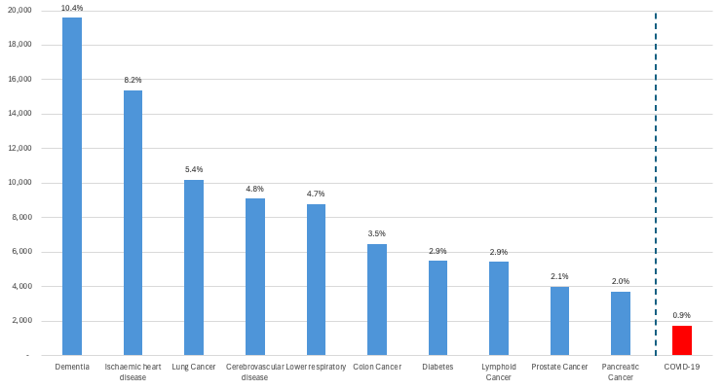
Dementia remains the leading cause of death
ESTIMATED LEADING CAUSES OF DEATH, AUSTRALIA 2025
Figure 9 – Estimated leading causes of death, Australia 2025 (% of total deaths)
COVID-19 (0.9% of deaths) falls outside the top 20 leading causes for the first time since 2021 – it ranked 10th in 2024 and 3rd in 2022.
Dementia's continued position as the #1 cause reflects Australia's ageing population and the rising mortality impact of neurodegenerative disease.
Source: Actuaries Institute Mortality Working Group, 2025 Mortality Report

Slide 13
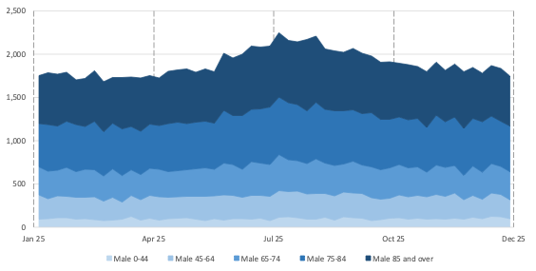
Mortality by age and gender
SUPPLEMENTARY ANALYSIS
Source: Actuaries Institute Mortality Working Group, 2025 Mortality Report – Table 2 (excess deaths by age/gender)
Notes:
SPEAKER NOTE / TO VERIFY: the source report's narrative text around Table 2 refers to ‘the analysis by age band and gender in 2024’ and cites 2024 COVID-19 figures, even though it sits within the 2025 experience section. This looks like a carried-over label from last year's report that wasn't updated. Recommend confirming with the report author (Josh Corrigan) whether Table 2 and these percentages are actually 2025 data before presenting this slide.

Slide 14
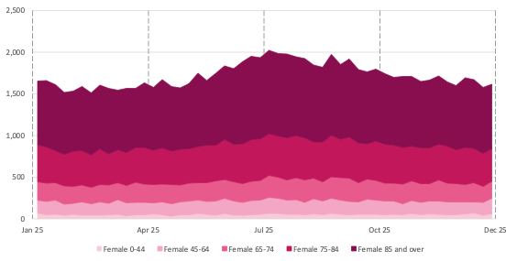
Mortality by age and gender
SUPPLEMENTARY ANALYSIS
Source: Actuaries Institute Mortality Working Group, 2025 Mortality Report – Table 2 (excess deaths by age/gender)
Notes:
SPEAKER NOTE / TO VERIFY: the source report's narrative text around Table 2 refers to ‘the analysis by age band and gender in 2024’ and cites 2024 COVID-19 figures, even though it sits within the 2025 experience section. This looks like a carried-over label from last year's report that wasn't updated. Recommend confirming with the report author (Josh Corrigan) whether Table 2 and these percentages are actually 2025 data before presenting this slide.

Slide 15
Australian Mortality update 2025
Setting the Baseline
What did 2025 look like in Australia?
Australian 2025 experience in context
Discussion/Questions
Notes:
[NEXT]

Slide 16
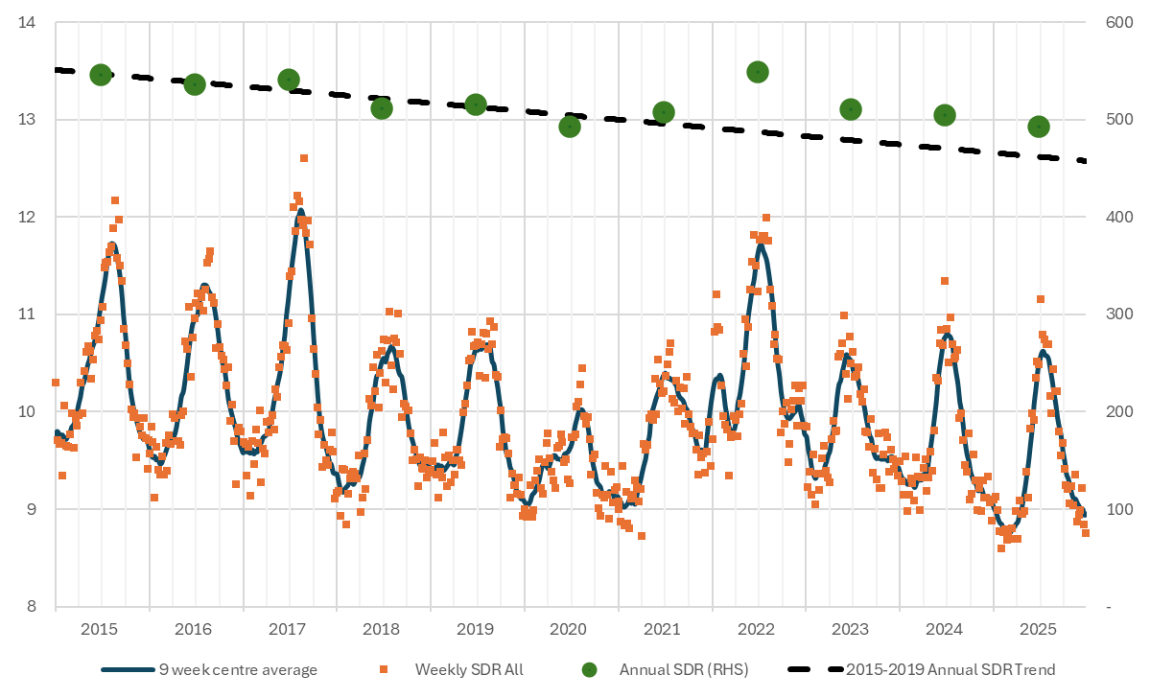
Mortality remains above trend, but the gap is closing
STANDARDISED DEATH RATES, ALL CAUSES, 2015–2025
2022
highest mortality of any year since 2015 – COVID-19 peak
2023–25
materially lower than 2022; similar levels to 2018–19
Downward trend evident since the 2022 peak.
No summer COVID-19 wave in 2025 – seasonal pattern may be returning to the single-winter-peak pre-pandemic norm.
Figure 10 – Weekly and annual SDRs, 9-week moving average and 2015–19 trend, all causes
Source: Actuaries Institute Mortality Working Group, 2025 Mortality Report

Slide 17
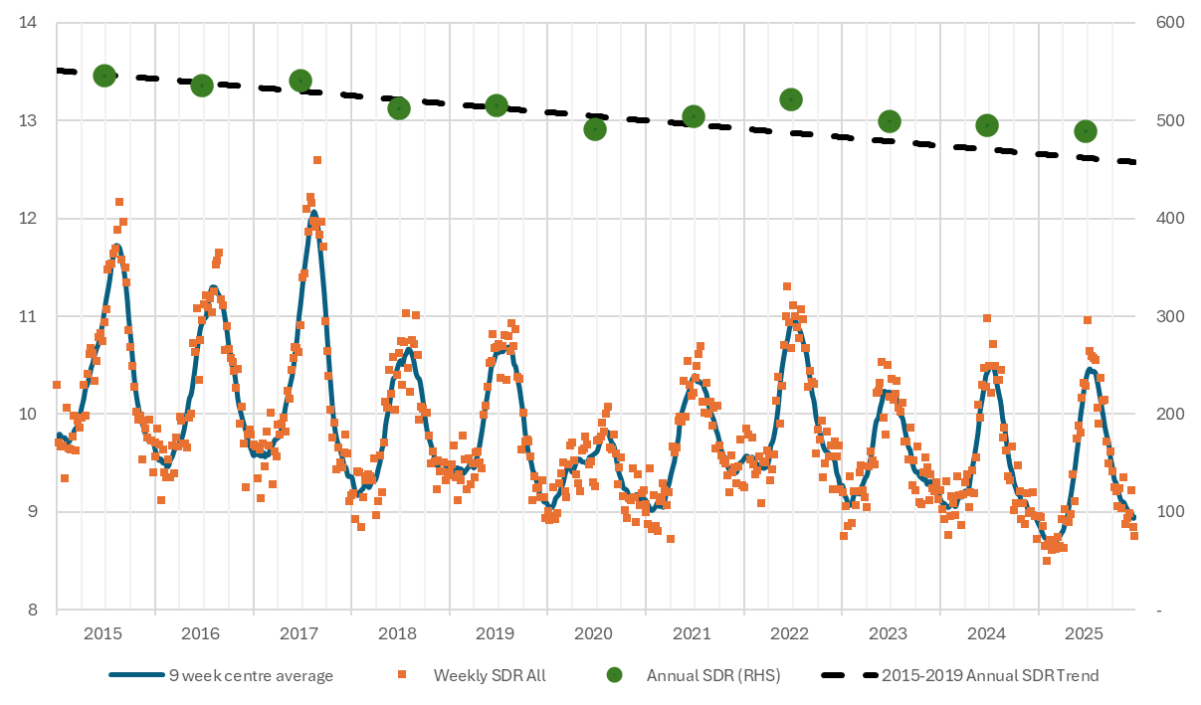
Even excluding COVID-19, mortality still sits above trend
STANDARDISED DEATH RATES EXCLUDING COVID-19, 2015–2025
Figure 11 – Weekly and annual SDRs, 9-week moving average and 2015–19 trend, excluding COVID-19 deaths
2022 remains significantly above the 2015–19 trend even after fully removing COVID-19 deaths.
2023, 2024 and 2025 also sit above trend – arguably within the typical range, but seemingly indicating a parallel upward shift in underlying mortality.
Source: Actuaries Institute Mortality Working Group, 2025 Mortality Report

Slide 18
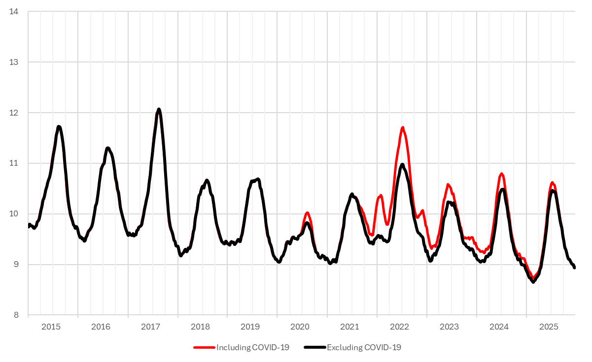
COVID-19's footprint on overall mortality has become small
WEEKLY SDRS INCLUDING VS EXCLUDING COVID-19, 2015–2025
Figure 12 – Weekly SDRs 2015–2025, including and excluding COVID-19
Until 2024, COVID-19 produced a winter and a summer wave each year, with winter the more deadly of the two.
Each wave since the 2022 peak has been smaller than the last – and 2025 had no summer wave at all, leaving the red and black lines almost overlapping.
Source: Actuaries Institute Mortality Working Group, 2025 Mortality Report

Slide 19
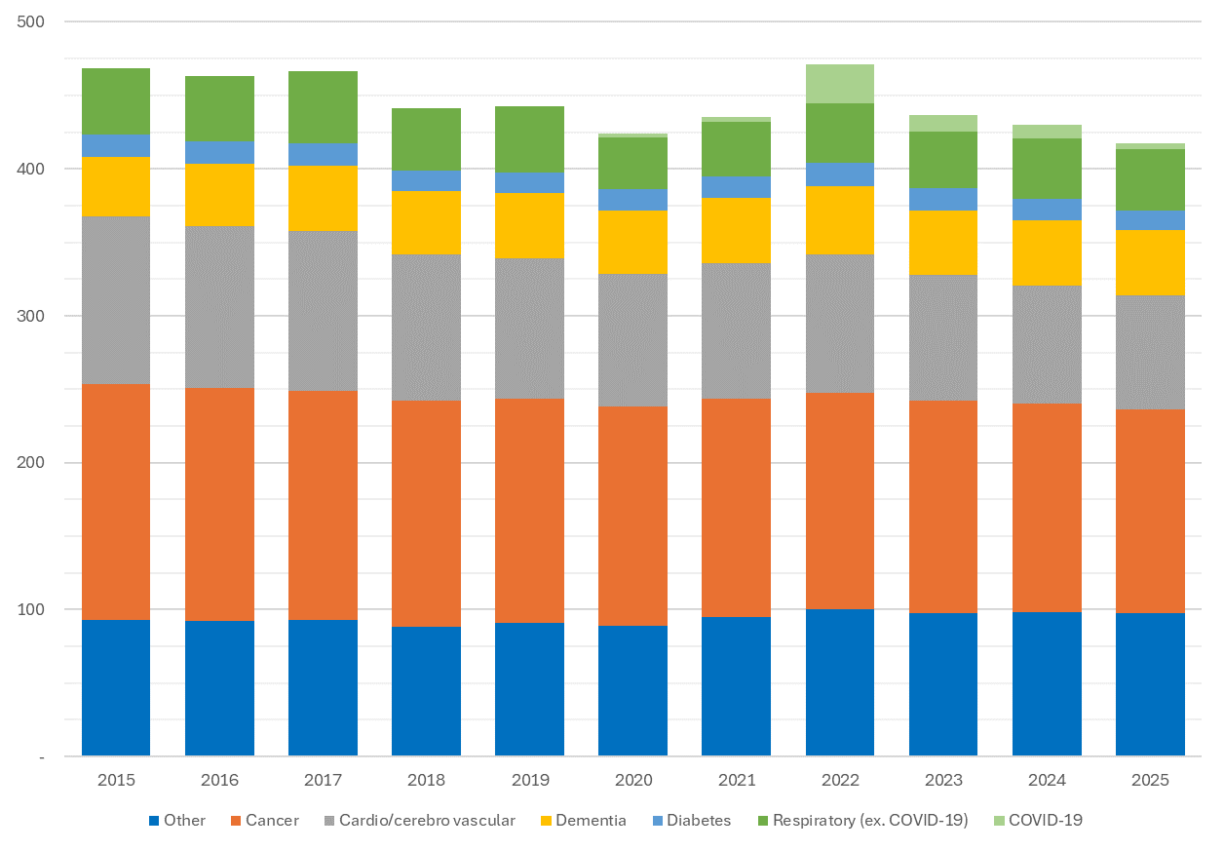
Cancer and cardiovascular gains offset by dementia, ‘Other’
ANNUAL SDRS BY CAUSE, 2015–2025
Figure 13 – Annual SDRs 2015–2025 by cause
Reductions in cancer and cardio/cerebrovascular mortality have been the primary drivers of long-run improvement, offset by steady increases in dementia and “Other” deaths.
Source: Actuaries Institute Mortality Working Group, 2025 Mortality Report

Slide 20
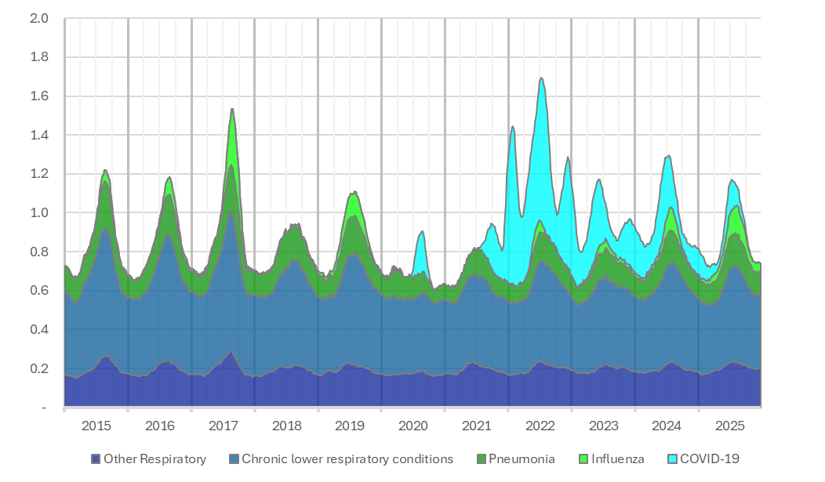
Flu deaths substituting for COVID in 2025?
Weekly SDRs for respiratory causes, 2015-25
Strong correlations between many of the main causal groups continues to be observed.
Reduction in COVID-19 mortality was offset by higher influenza mortality

Slide 21
Australian Mortality update 2025
Setting the Baseline
What did 2025 look like in Australia?
Australian 2025 experience in context
Discussion/Questions
Notes:
[NEXT]

Slide 22
Q&A
Join at Slido.com
#2803677

Slide 23
Feedback Poll
Join at Slido.com
#2803677

Slide 24
Thank you
Actuaries Institute
actuaries.asn.au

Slide 25
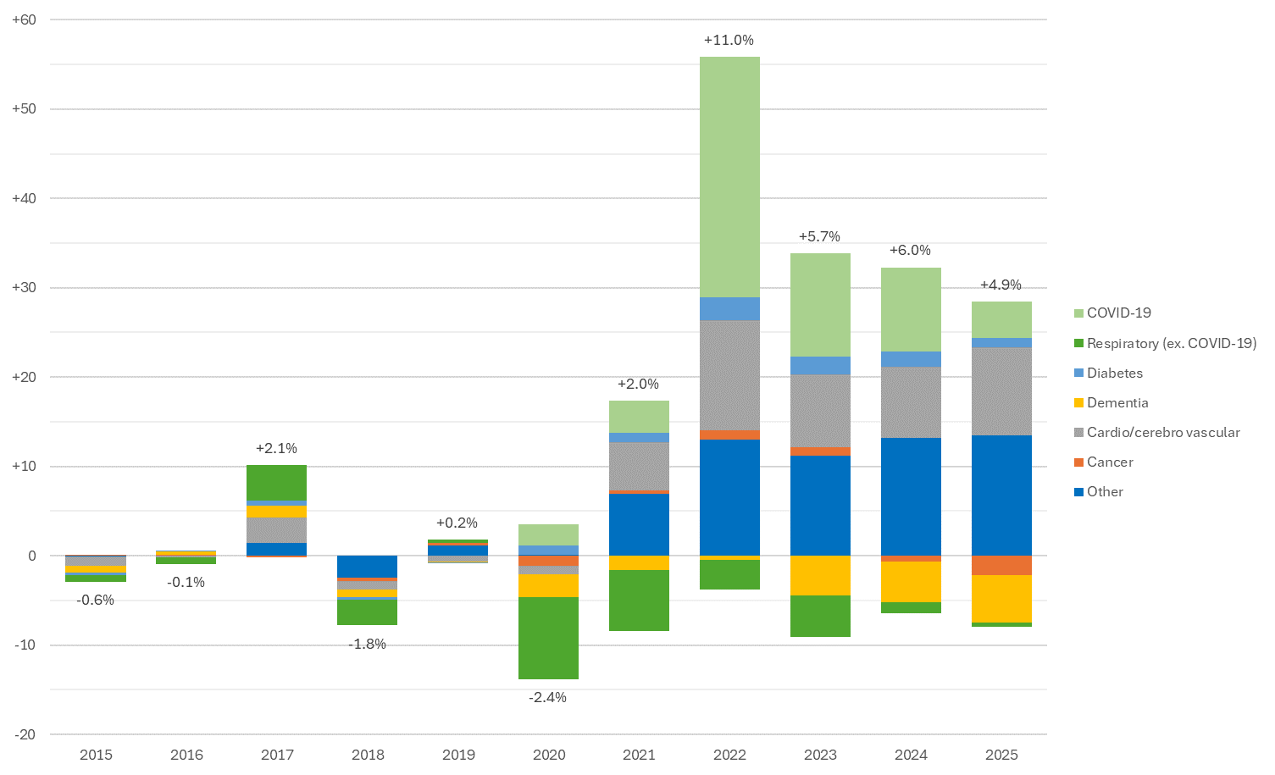
2025 remains above trend, but the gap continues to narrow
CONTRIBUTION OF EACH CAUSE TO DEVIATION FROM THE 2015–19 TREND
+4.9%
2025 mortality vs the 2015–19 trend – down from +6.0% in 2024 and +11.0% at the 2022 peak
Dementia, then cancer, were 2025's most favourable contributors – both improving since 2021.
Cardio/cerebrovascular disease and “other” causes remain the main drags on the trend, consistent with recent years.
Respiratory disease's favourable contribution has shrunk to almost nil in 2025, due to an adverse flu season.
Note: this compares 2025 to the fixed 2015–19 trend – a different baseline to the ‘+0.5% excess’ figure discussed earlier, which uses a 2025-specific baseline.
Figure 14 – Contribution of each cause to overall deviation from the 2015–19 trend (doctor-certified deaths only)
Source: Actuaries Institute Mortality Working Group, 2025 Mortality Report

