Slide 1

ACTUARIES INSTITUTE · DIALOGUE PAPER
Bridging the
Longevity Divide
SOCIOECONOMIC MORTALITY · LIFETIME INCOME · MEMBER OUTCOMES
Presentation · 8 October 2026
PRESENTED BY
Fei Huang + Philip Clark
Co-authors Francis Hui · Andrés Villegas
READ THE PAPER
ACKNOWLEDGEMENT
We thank the Australian Government Actuary for supporting this project.

Slide 2
Disclaimer
This presentation discusses the authors’ interpretation of the research. Like the Dialogue Paper, this presentation is intended to stimulate discussion.

Slide 3
Important notice for all participants
This meeting is being conducted in accordance with Institute’s Code of Conduct and attended by members in their professional capacity.
It is acknowledged that professional members in their employed capacity, may be active market participants in their respective industries who may compete with each other as defined by competition law.
Participants are, therefore, reminded that in accordance with their competition law compliance obligations they should not:
  discuss any matter that may be perceived as being cooperation by competitors in a market to influence that market;
  discuss any matters that could be regarded as fixing, maintaining or controlling prices, allocation of customers or territories, coordinating bids and/or restricting output or acquisitions in any circumstances;
  share any confidential information or commercially sensitive information obtained through their employment, professional engagements or industry roles; or
  share information for an anti-competitive purpose.

Slide 4

Q&A
Join at Slido.com
#4064733

Slide 5




01
02
MEET THE CO-AUTHORS
Dr Fei Huang
Dr Francis KC Hui
Associate Professor
UNSW Business School
Associate Professor of Statistics
Australian National University
EXPERTISE
EXPERTISE
Responsible AI · fairness in insurance · mortality modelling
Statistical inference · spatio-temporal analysis · mortality modelling
03
04
Dr Andrés Villegas
Philip Clark · FIA, FIAA
Associate Professor
UNSW Business School
Senior Consultant · Azuria Partners
Actuaries Institute Retirement Income sub-committee
04
EXPERTISE
EXPERTISE
Mortality modelling · longevity analytics · retirement income products
Lifetime income pricing · longevity analytics · retirement income strategy

Slide 6
WHY SEGMENTATION MATTERS
Socioeconomic context expands the life table from 2 factors to 6
STANDARD LIFE TABLE
SOCIOECONOMIC LIFE TABLE
2
6
FACTORS
FACTORS
Age
01
Age
02
Gender
01
ADD 4
SOCIOECONOMIC
FACTORS
03
IRSAD
04
Marital status
02
Gender
05
Income
06
Homeownership
2 demographic inputs + 4 socioeconomic factors = 6-factor life table
Socio-economic mortality modelling using PLIDA data

Slide 7
DATA FOUNDATION
PLIDA links census, social security and demographic records
Person Level Integrated Data Asset (PLIDA), accessed through the ABS DataLab.
2016
2009–16
60+
Census snapshot
Social Security Related
Information (SSRI)
Demographic coverage
Entire population snapshot
9 August 2016
Individuals aged 60+
Gender · birth/death dates
Benefits · payments
Marital status · education
PLIDA COLLABORATORS
ABS · ATO · Department of Education · Health · Human Services · Social Services

Slide 8
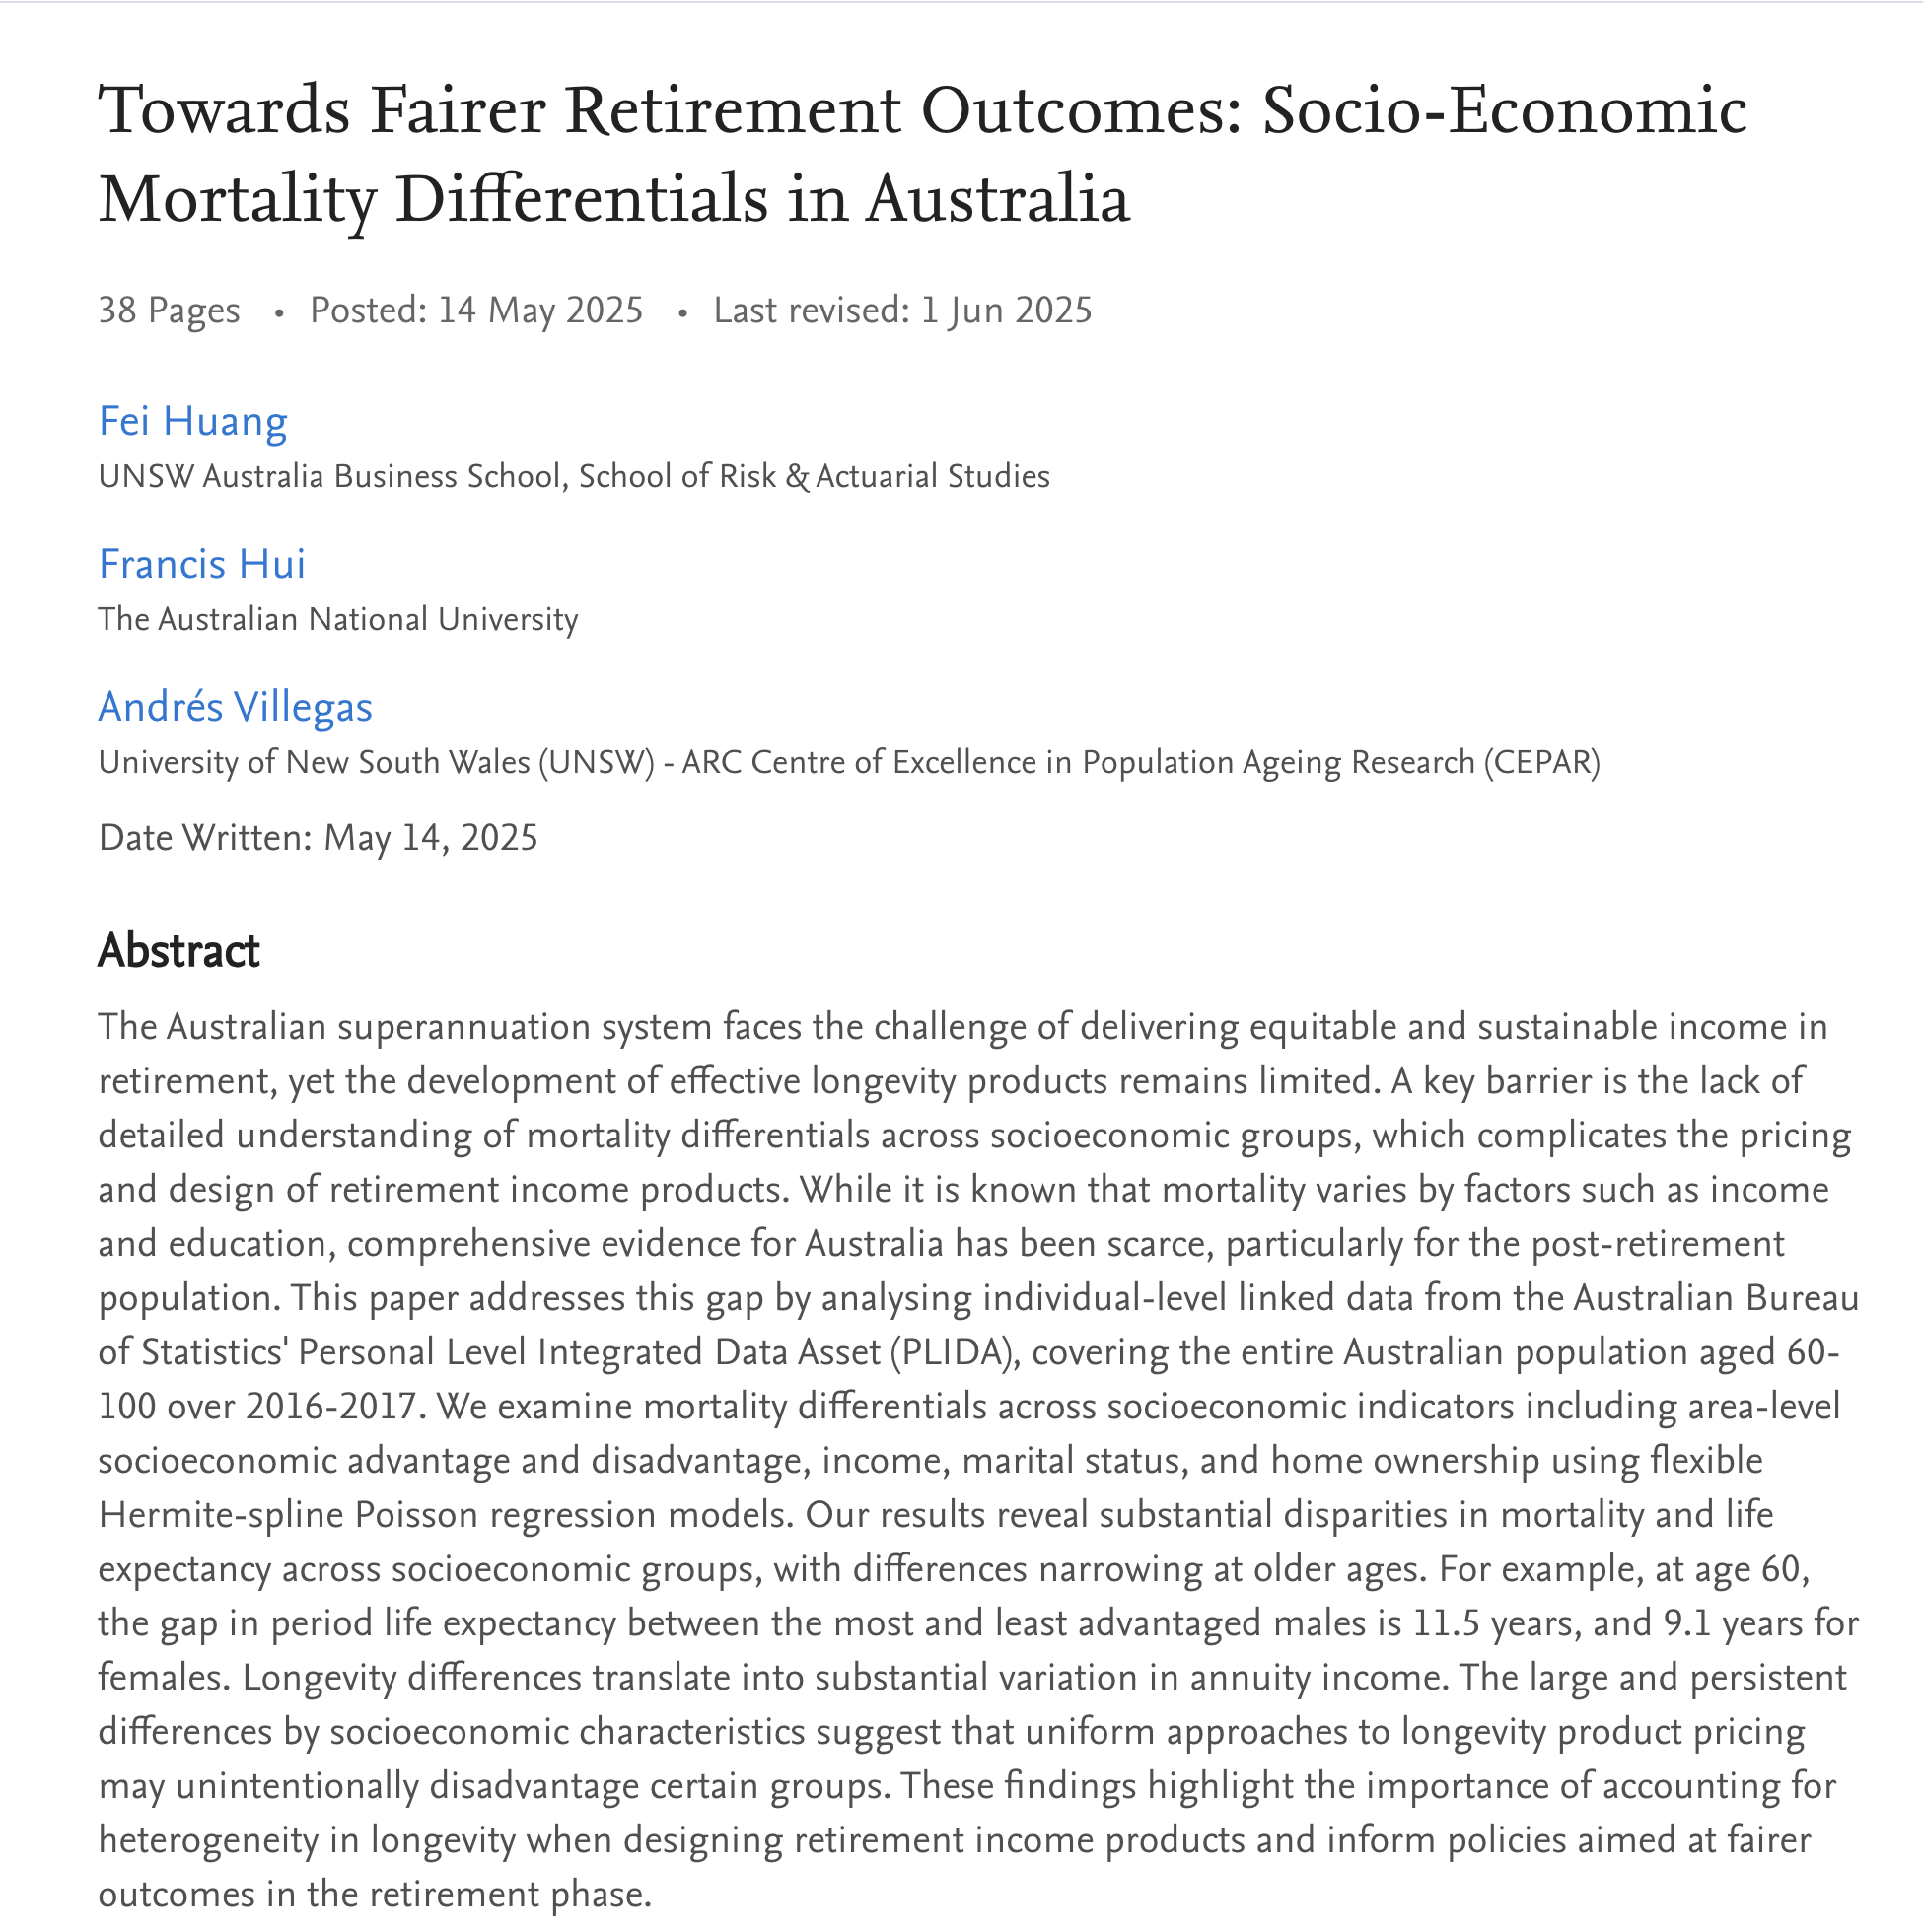

MODELLING APPROACH
One model generates 480 differentiated life tables
Hermite splines model (Richards, 2020) combine multiple predictors of mortality experience.
480
life tables
Simultaneously account for:
Age
Gender
IRSAD
Marital status
Income
Homeownership
SCAN TO READ
Parsimonious enough to use; granular enough to distinguish member profiles.
RESEARCH PAPER

Slide 9
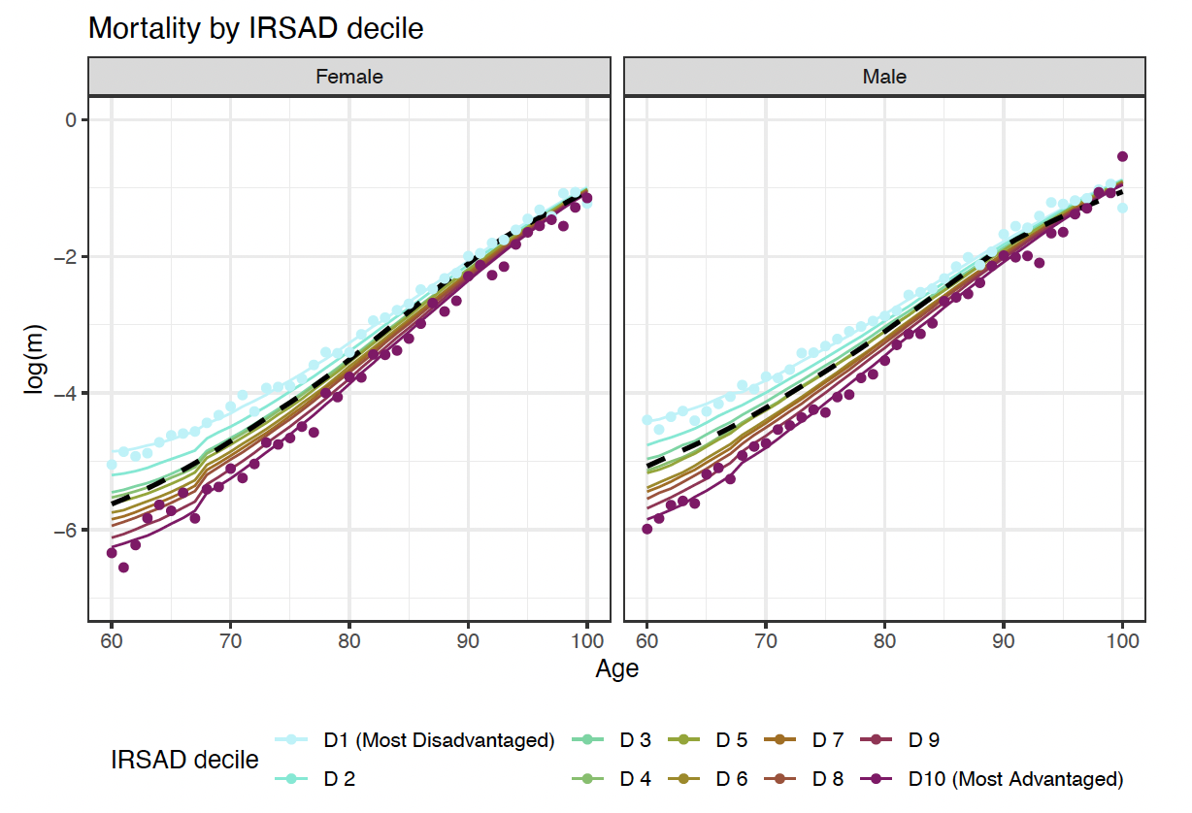
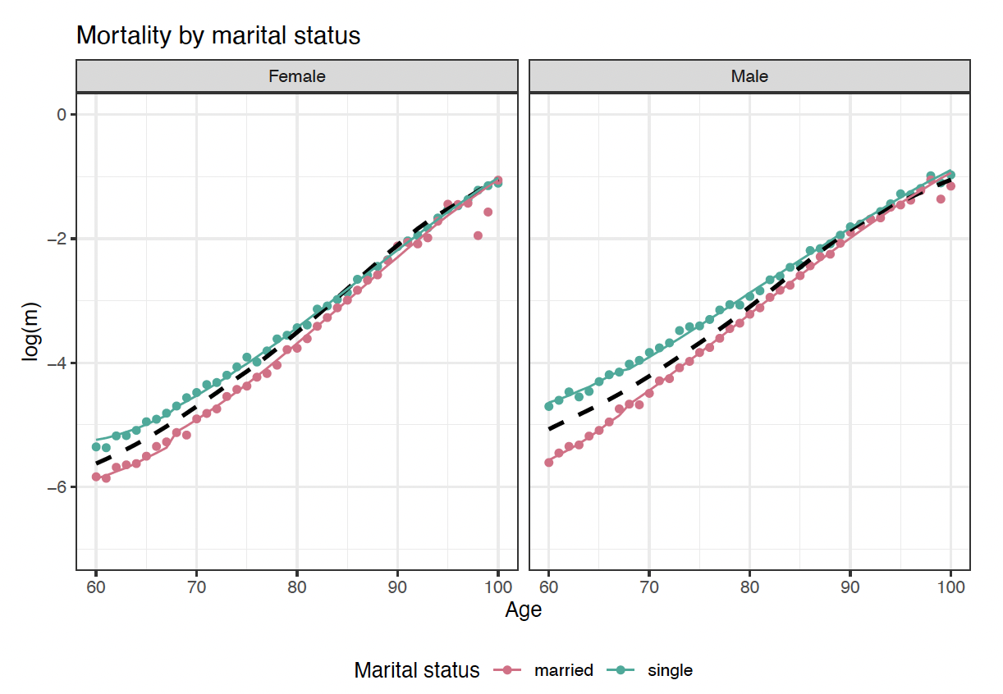
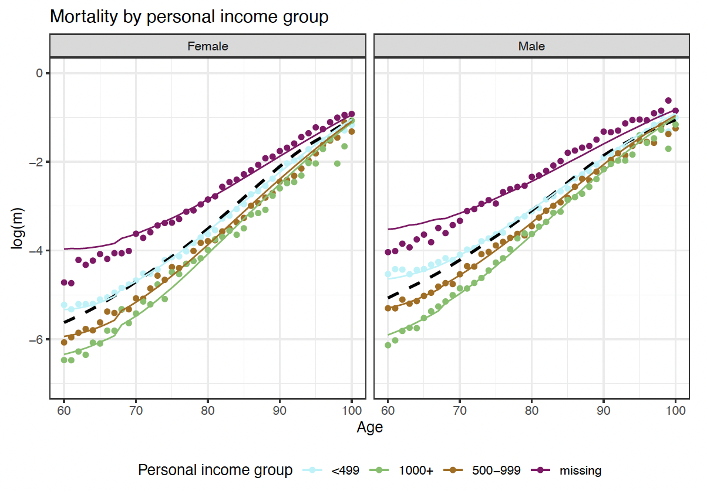
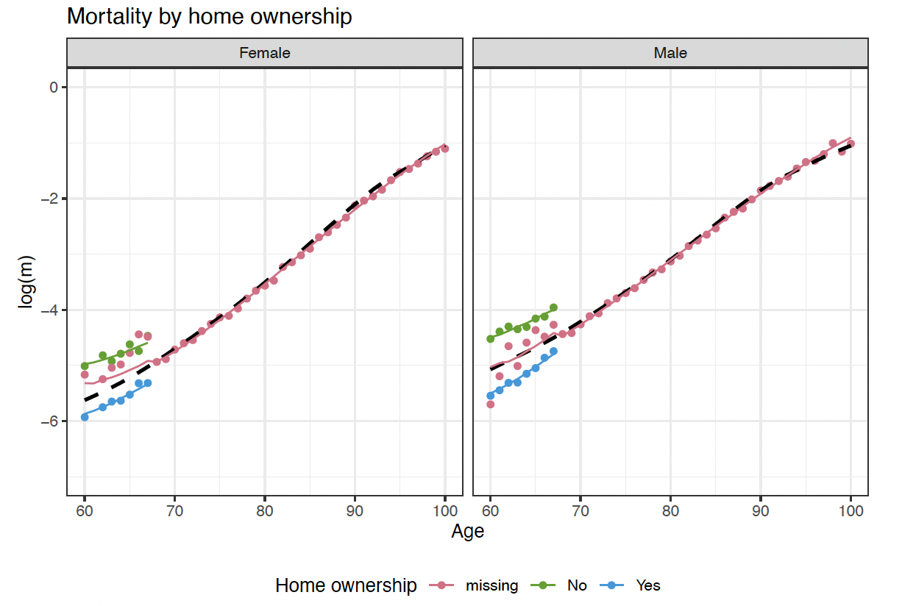
MODEL OUTPUT
Observed rates track fitted mortality patterns
Four views
IRSAD
Marital status
Personal income
Home ownership

Slide 10
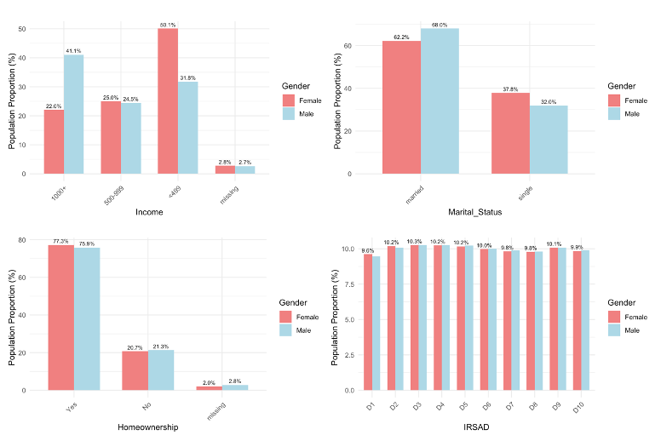
POPULATION PROFILE
Socioeconomic factors reshape the population mix
Demographic breakdowns across income, marital status, home ownership and IRSAD for the 60-65 age group.

Slide 11
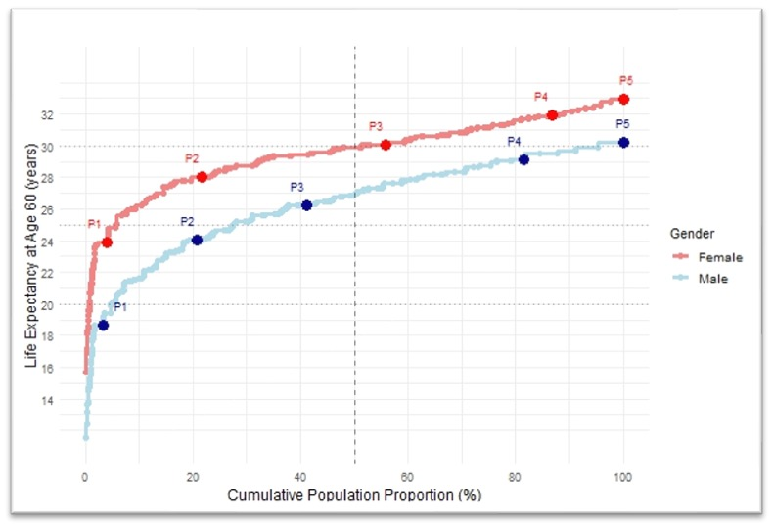
MODEL OUTPUT
Life expectancy is a distribution—not a single point estimate
Five illustrative profiles show the cumulative distribution at age 60.
CUMULATIVE DISTRIBUTION
ILLUSTRATIVE PROFILES
P1. Single, Non-homeowner, <$499 weekly income, D1
P2. Married, Homeowner, <$499 weekly income, D1
P3. Married, Homeowner, <$499 weekly income, D7
P4. Married, Homeowner, $1000+ weekly income, D4
P5. Married, Homeowner, $1000+ weekly income, D10
Profile assumptions span marital status, homeownership, weekly income and IRSAD decile.

Slide 12
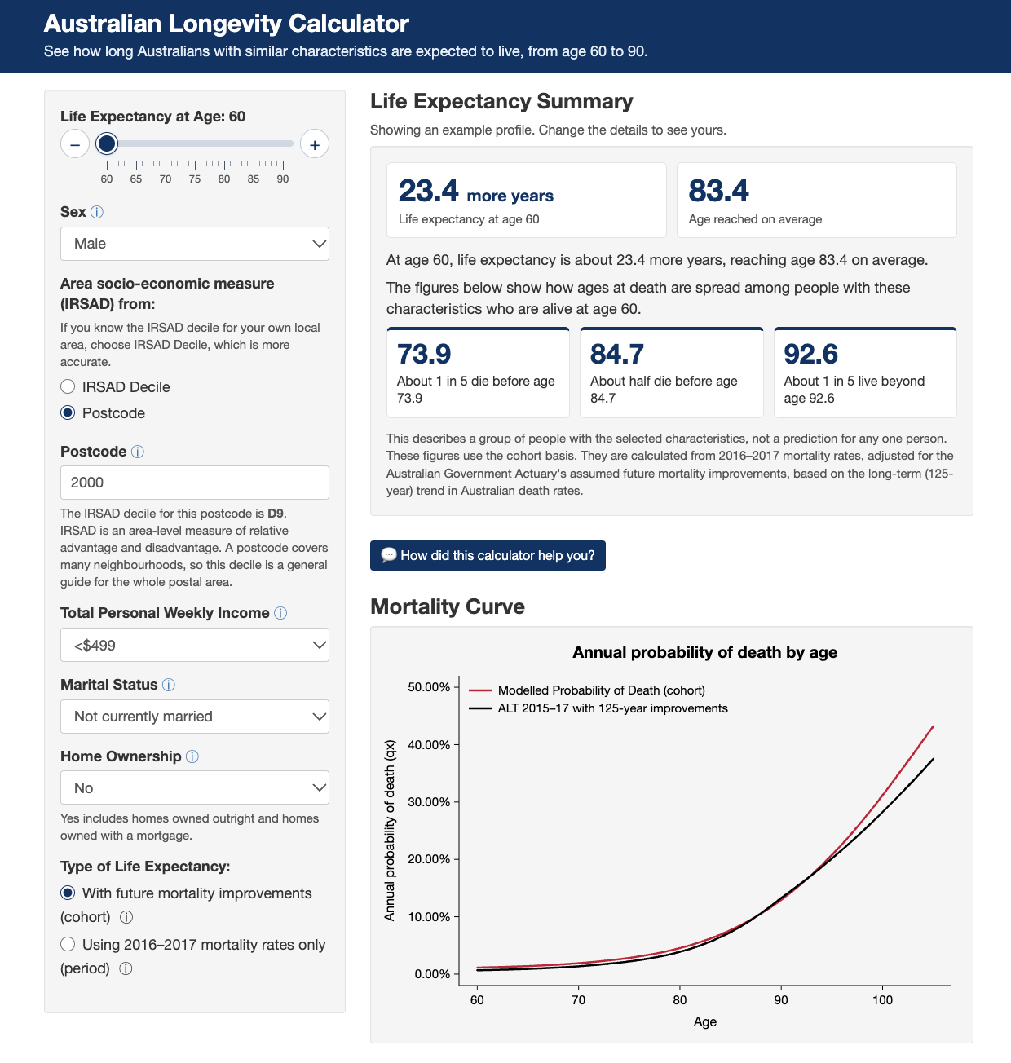

INTERACTIVE TOOL
The Australian Longevity Calculator
Explore how life expectancy shifts as socioeconomic assumptions change.
SCAN TO EXPLORE
auslongevity.org
Open Data Available for Industry Use

Slide 13
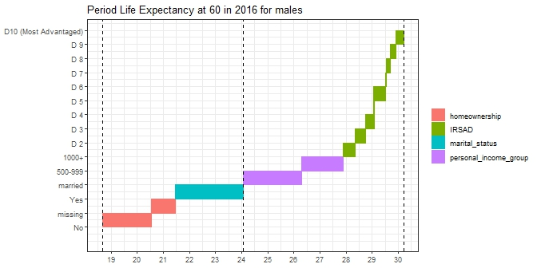
MALE PROFILES
Male life expectancy spans 11.5 years across illustrated profiles
Period life expectancy at age 60 in 2016.
11.5
YEAR SPAN
ILLUSTRATED ENDPOINTS
18.67
shortest profile
24.05
ALT 2015–17
30.20
longest profile
Income · marital status · homeownership · IRSAD

Slide 14
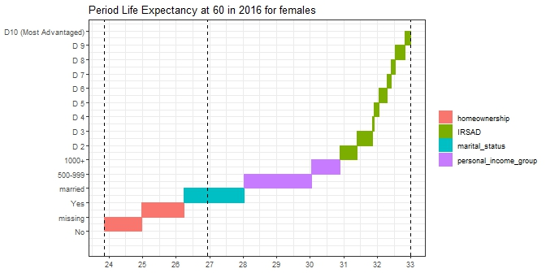
FEMALE PROFILES
Female life expectancy spans 9.1 years across illustrated profiles
Period life expectancy at age 60 in 2016.
9.1
YEAR SPAN
ILLUSTRATED ENDPOINTS
23.86
shortest profile
26.93
ALT 2015–17
32.98
longest profile
Income · marital status · homeownership · IRSAD

Slide 15
FROM EVIDENCE TO RETIREMENT INCOME STRATEGY: 3 PRACTICAL MESSAGES
Longevity differences in practice
The model is not only an actuarial refinement, it changes how lifetime income is assessed, positioned and trusted.
01
02
03
Prove Value for Money
Reach the Many
Build Trust
Assess member outcomes and value for money of a retirement income proposition.
Expand longevity protection for members who most fear running out of savings, not only the financially confident.
Safeguard disadvantaged members from pathways or nudges that trustees might design and implement
ONE EVIDENCE BASE · THREE STRATEGIC IMPLICATIONS

Slide 16
MESSAGE 1 · MEMBER OUTCOME AND VALUE FOR MONEY
01 / 06
Can a fund demonstrate Value for Money of a Lifetime income offering?
Generic life expectancies cannot evidence who benefits—and who does not.
VALUE FOR MONEY
1
MEMBERS WITH ACCESS
Does the offer deliver value for members who have access to a Lifetime income stream?
What members
receive
2
TARGET MEMBERS
Does the offer deliver value for members who are the natural socioeconomic targets?
vs
What members
invest
3
MEMBERS WHO TAKE UP
Does the offer deliver value for members who take up the Lifetime income on offer?
The balance changes for each socioeconomic cohort.
Member outcome calculation requires differentiated life expectancies
Notes:
Set up the contrast: group insurance cost is a single well-known average. The longevity guarantee cost is not one number but three, depending on which cohort you mean — offered, should take up, and do take up.

Slide 17
MESSAGE 1 · MEMBER OUTCOME AND VALUE FOR MONEY
02 / 06
Value for Money, as one possible approach for member value, depends on the chance of outliving break-even age of the Lifetime income stream
Some lifetime income participants will get less than they put in, some will get more.
THE BREAK-EVEN TEST
Break-even age
DIE BEFORE BREAK-EVEN
OUTLIVE BREAK-EVEN
Receive less than invested assuming same asset
Receive more than invested assuming same asset
80 | 20
? | ?
20 | 80
POOR VALUE
FAIR VALUE
GREAT VALUE
80% chance of dying before break-even age
What is a fair chance of outliving break-even age?
80% chance of outliving break-even age
Without differentiated mortality assumptions, the value for money question is only guesswork.
Notes:
Reframe value-for-money as: what share of members outlive the breakeven age and get more than they put in, versus the share who get less? The split is unknown until you use differentiated life expectancies for the offered, should-take-up, and do-take-up cohorts.

Slide 18
MESSAGE 2 · REACHING THE MANY
03 / 06
We underwrite life cover, but not lifetime income
Same person. Same insurer. Same mortality risk. Two very different processes.
RETAIL LIFE INSURANCE
LIFETIME INCOME
UNDERWRITTEN
UNCHECKED
Harry, aged 65
Same Harry, via super fund
01
Long underwriting process
SAME
PERSON
✓
No medical history
02
Medical history required
✓
No health questionnaire
SAME RISK
03
Doctor follow-up available
✓
No doctor contact
04
Health can load the premium—or decline cover
✓
$300,000 invested at the standard rate
Risk examined before the promise.
Risk assumed before the promise.
The risk is individualised in one product and not the other.
Could optional enhanced rates improve outcomes for some cohorts?
Notes:
Tell the underwriting story: applying for retail life insurance at 66 requires medical history and doctor details, and can lead to loaded premiums or decline. Buying a lifetime income from the same insurer through the super fund requires none of that — no underwriting at all, just the standard rate.

Slide 19


MESSAGE 2 · REACHING THE MANY
04 / 06
A message built around optimising income may not speak to every member’s motivations and circumstances
Harry and Sam are hypothetical members who have both worked hard for their super. Their circumstances and goals differ, so one message may not resonate with both.
HUMBLE HARRY
SELF-FUNDED SAM
$400k
$1.2m
Motivated by lasting income
Motivated by optimising income
Single and in average health
May want to avoid outliving savings
Married and in good health
More self-funded than Harry
“Is this product designed for someone in my position?”
“This product has allowed me to boost my Age Pension.”
Are we talking to the many, whatever their circumstances and motivations?
Notes:
Key message: members come to lifetime income with different circumstances and motivations, so a message built around one motivation (optimising income) may not speak to all of them. Harry ($400k, single, average health) may be motivated by income that lasts, for example avoiding outliving his savings; Karl ($1.2m, married, good health) is more self-funded and may be motivated by optimising income. Neither is more deserving, every Australian has worked hard for their super, and we do not have enough information to assess suitability for either. Close on the question: are we talking to the many? Differentiated life expectancies are one way to make the offer relevant to more members.

Slide 20
MESSAGE 3 · TRUST AND ENGAGEMENT
05 / 06
Uniform pricing on default offering can erode trust
When a member trusts their fund enough to accept a default or follow a nudge towards lifetime income, they are also trusting the fund to make sure it is good value for money.
01
MORE MONEY
02
MORE DUTY
03
MORE INFLUENCE
Compulsory contributions rise
Retirement Income Covenant
Defaults steer members into products
THE MEMBERS TRUST THE FUND’S NUDGE IF:
A NUDGE WITH NO SAFEGUARD CAN BACKFIRE:
— They believe the fund is working for their best interest
— They believe the fund considers their circumstances
— Members with shorter life expectancies can be caught in the net
— Value shifts toward members expected to live longer
How can actuaries help trustees design longevity-informed retirement solution pathways so that there is better value for members with shorter life expectancies?
Notes:
Trace the policy trajectory: compulsory contributions up, the Retirement Income Covenant, and potentially a nudge or soft default into lifetime income next. A default is built for the disengaged member who trusts the fund, not the financially literate one who shops around. But pricing today isn't individually differentiated, and funds have no mechanism to flag when a default is poor value for a member with a shorter life expectancy — which becomes a cross-subsidy problem.

Slide 21
MESSAGE 3 · TRUST AND ENGAGEMENT
06 / 06
Voluntary participation raises a different question from compulsory pooling
Group insurance and DB can rely on broad mortality pooling because participation is largely predetermined. DC lifetime income is different: members choose, so the composition of the purchaser pool matters.
COMPULSORY POOLS: GROUP INSURANCE AND DB ARRANGEMENTS.
VOLUNTARY POOLS: MEMBERS DECIDE WHETHER, WHEN, HOW MUCH AND POTENTIALLY WHICH PROVIDER.
PARTICIPATION IS
PARTICIPATION IS
COMPULSORY
VOLUNTARY
broad pooling works
selection risk matters
Members cannot opt into the longevity pool selectively, so one mortality basis can be defended.
Existing providers already price on the expected longevity of likely purchasers, not the average member.
As the market develops, how can providers gain sufficient confidence that the mortality of different profiles of purchasers remains close enough to pricing assumptions?
DISCUSSION QUESTION
What forms of underwriting, health declarations, segmentation or evidence gathering could be used in voluntary lifetime income products that are reliable, practical, equitable and improve member outcomes?
Notes:
Voluntary participation changes the pooling question. Compulsory pools (group insurance, DB) rely on broad pooling because participation is largely predetermined; members cannot opt in selectively. Voluntary DC lifetime income is different: members choose whether, when, how much and potentially which provider, and existing providers already price on the expected longevity of likely purchasers rather than the average member. The real issue is selection: how confident can providers be that the mortality of actual purchasers will keep matching pricing assumptions as the market broadens? If longevity differs materially across socio-economic groups and participation is voluntary, purchaser-pool composition matters (longevity-divide research). Close on the discussion question. Spectrum of responses to canvass: no underwriting; socio-economic segmentation; simplified health declarations; enhanced-annuity-style underwriting; optional underwriting for better rates; medical underwriting for particular conditions; experience monitoring and repricing rather than underwriting. Frame the discussion around practicality, member outcomes, fairness, anti-selection and market development.

Slide 22
CONCLUSION
A 9.1–11.5-year span is too material to ignore
Differentiated life expectancies improve modelling, member outcomes and trust.
01
02
03
Measure the difference
Use it in decisions
Design for trust
PLIDA-based modelling identifies a 9.1–11.5-year span between illustrated profiles at age 60.
Differentiate Value for Money, target-market and break-even assessments by member cohort.
Price, defaults and nudges should recognise that some members have shorter lives and DC lifetime income remains an individual risk.
Differentiated life expectancies are essential to building and measuring better member outcomes.

Slide 23
Q&A
Join at Slido.com
#4064733

Slide 24
Feedback Poll
Join at Slido.com
#4064733

