Slide 1
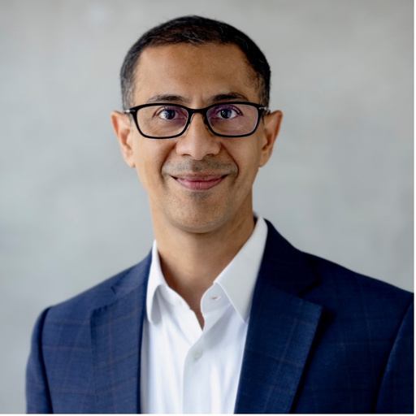

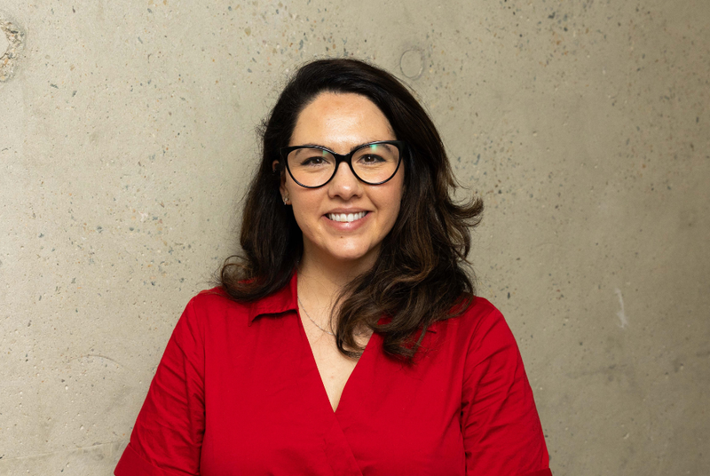





Ethics and Professionalism APAC Seminar 2026

Slide 2
The Actuaries Institute acknowledges the traditional custodians of the lands and waters where we live and work, travel, and trade.
We pay our respect to the members of those communities, Elders past and present, and recognise and celebrate their continuing custodianship and culture.

Slide 3









Thank you
to our supporting
association
partners

Slide 4




Major Sponsor
Thank you
to our partners
Community partners

Slide 5
What will we cover today?
Responsible AI, learning from social sector evaluation, navigating responsibility and social good, building ethical cultures and an interactive workshop

Slide 6
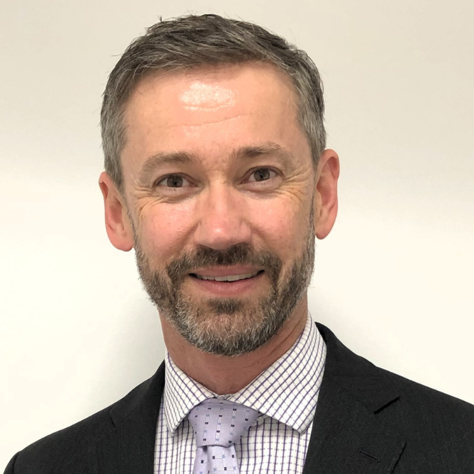
Stuart Turner FIAA
Chair of the Actuaries Institute's Professionalism Committee and is Senior Actuary – Projects at Zurich Australia
Chair of this Seminar and Workshop Facilitator

Slide 7

Housekeeping reminders
Breakout Rooms will follow the lightning talks
We will place you into a room for the workshop. Please do not leave breakout rooms as you may exit the who webinar. We will close rooms and bring everyone back together.
Cameras off and Audio muted
Leave your camera and audio off until breakout rooms please.
We want to hear from you in the Q&A and in polls
Please use the Zoom Q&A at the bottom of your screen for your questions to speakers. We will answer your questions at the end of the Interactive Workshop time.
Some speakers have polls; we’d love to have you interact with these.

Slide 8

Nicolette Rubinsztein AM, FIAA, FAID
Chair, CBHS Health Fund
NED, Zurich Australia
Chair, Greenpeace Australia Pacific
Presenter of The Ethical Use of AI – A Leadership Perspective
Note: AI was used in preparing this presentation.

Slide 9
The Ethical Use of AI
A Leadership Perspective
Nicolette Rubinsztein AM | July 2026
Chair, CBHS Health Fund | NED, Zurich Australia | Chair, Greenpeace Australia Pacific
FIAA, FAID
Note: AI was used in preparing this presentation.

Slide 10

At a macro level, there are massive far-reaching risks in AI
YUVAL NOAH HARARI
“
“
…if we continue releasing these powerful tools into our public sphere without safety measures — they destroy the foundations of our society and of democracy.
AI could amplify existing power imbalances, as its immense potential often lies in the hands of a select few — governments or corporations — risking global inequality and reinforcing systemic dominance.
Fox News interview, April 2023
Nexus, 2024
“
“
Technological advancements and automation are likely to create ‘immense power and wealth’ in tech hubs such as Silicon Valley and parts of China, while many countries might completely collapse.
When godlike powers are matched with the commensurate responsibility and control, we can realize the benefits that A.I. promises.
Fast Company Innovation Festival
Fortune, March 2023

Slide 11
How can it go wrong? Real-world case studies
BROADER CASE STUDIES
📱
🚁
🤖
Facebook & the Rohingya Genocide
Autonomous Weapons & Drone Targeting
Mobley v. Workday — AI Hiring Discrimination
The UN Fact-Finding Mission found Facebook played a determining role in spreading hate speech during the 2016–17 military crackdown in Myanmar, which the UN concluded warranted prosecution for genocide against the Rohingya.
AI-enabled autonomous weapons systems, including drone targeting, have raised serious ethical questions about accountability when decisions to use lethal force are delegated to algorithms without meaningful human oversight.
Derek Mobley sued Workday in 2023 after being rejected for 100+ positions via its AI screening tools, alleging race, age and disability discrimination. A California court allowed the case to proceed in July 2024.
UN Fact-Finding Mission on Myanmar, 2018
UN Secretary-General; International humanitarian law debate
US District Court, N. California, July 2024

Slide 12
How can it go wrong? Real-world case studies
INSURANCE CASE STUDIES
🚗
❌
Car Insurance & Racial Bias
AI-Driven Denial of Insurance Claims
UK Citizens Advice (2022) found people of colour pay on average £250 more than white people for car insurance — driven partly by algorithmic pricing and proxy discrimination in AI underwriting models.
AI systems used to automatically deny health and other insurance claims have been found to apply blanket rules without adequate individual assessment — raising fairness, regulatory and reputational risk.
Citizens Advice, March 2022
Emerging regulatory concern; APRA/ASIC guidance
ABILITY TO DESTROY BUSINESSES AND INSURANCE COMPANIES
“AI does not fail the way humans fail. A human gets it wrong once — AI could get the same thing wrong every time, across thousands of patients, often invisibly for months.”
Eric Lowenstein, CEO of Tego

Slide 13
There are many risks relating to AI…
1
2
3
4
Conduct and
fairness risk
Model and
performance risk
Commercial and
strategic risk
Data risk
5
6
7
8
Cyber and
security risk
Regulatory and
compliance risk
Third-party and
vendor risk
Operational risk
But they are not new risks!

Slide 14
The current situation — mainstream financial services
Low-risk use cases to date
Huge variability in AI strategy
AI deployment in financial services has so far focused on internal efficiency, copilot tools and decisioning support — relatively contained risk profiles.
From simple copilot rollout to customer-facing automated decision-making — governance must be fit for purpose at every point on that spectrum.
Exponential pace of change
The biggest risk is doing too little
The pace is not linear. Most scientists did not predict how rapidly AI capabilities would advance — and agents change everything.
Failing to embrace AI may put businesses at a strategic disadvantage. The challenge is governing it well, not avoiding it.

Slide 15
But it’s going to get a lot harder
Agents are difficult to govern
Skills needed are rapidly evolving
⚠
⚠
Output increasingly hard to interrogate
The people building it may not understand it
⚠
⚠
Governance rarely keeps pace with deployment
Concentration risk with single AI providers
⚠
⚠

Slide 16
And there is already a governance gap
“
APRA
“
APRA
Governance has not matured at the same pace. APRA observed a tendency to treat AI risk as ‘just another technology’ — resulting in gaps including weak post-deployment monitoring and change management.
Boards have strong interest in AI’s potential benefits but many lack the technical literacy required to provide effective challenge to management on AI-related risks and oversight.
APRA Letter to Industry on AI, 30 April 2026
APRA Media Release, 30 April 2026
“
APRA
“
ASIC — Beware the Gap (REP 798)
While AI is being actively adopted by all the entities we engaged with, there are differing levels of maturity across governance, risk management and operational resilience.
Licensees are implementing AI more quickly than they are adjusting their risk and compliance frameworks to manage the heightened risks and challenges.
APRA Member Therese McCarthy Hockey, April 2026
Review of 624 AI use cases, 23 licensees, Oct 2024

Slide 17

So where to from here?
How can we properly govern AI?

Slide 18
There are plenty of resources
SINGAPORE GOVERNMENT
GRADIENT INSTITUTE
🇸🇬
Model AI Governance Framework for Agentic AI
🧠
Risk Analysis Techniques for Multi-Agent Systems
Practical framework addressing agentic AI systems — highly relevant as agents become mainstream in financial services.
Technical guidance on analysing and managing risk in LLM-based multi-agent systems.
AUSTRALIAN GOVERNMENT / GRADIENT INSTITUTE
GRADIENT INSTITUTE
🇦🇺
Guidance for AI Adoption — Foundation Document
📋
AI Governance Cheatsheet
Practical foundation for Australian organisations adopting AI responsibly.
A concise summary of the Foundation Document — useful for board and executive briefings.
INTERNATIONAL AI SAFETY INSTITUTE
EZRA KLEIN SHOW (PODCAST)
🌐
International AI Safety Report 2026
🎧
How Fast Will A.I. Agents Rip Through the Economy?
The latest global assessment of AI safety risk — essential reading for board members.
Jack Clark (Anthropic co-founder) interviewed by Ezra Klein — highly recommended.
Source: Gradient Institute, Singapore IMDA, Australian Government National AI Centre, Ezra Klein Show

Slide 19
Let’s start with the basics — the EU’s 7 requirements for trustworthy AI
1
2
3
4
Human Agency & Oversight
Technical Robustness & Safety
Privacy & Data Governance
Transparency
AI systems should empower human beings, allowing them to make informed decisions and supporting meaningful human oversight.
AI systems must be developed with a preventative approach to risk, ensuring they are reliable, safe and resilient.
AI systems must guarantee privacy and data protection, with quality data governance throughout the system's lifecycle.
The data, system and AI business models should be transparent, with AI-driven decisions explainable to those affected.
5
6
7
Diversity, Non-discrimination & Fairness
Societal & Environmental Well-being
Accountability
Unfair bias must be avoided — AI systems should be accessible and involve stakeholders throughout their life cycle.
AI systems should benefit all human beings, including future generations, and be sustainable and environmentally friendly.
Mechanisms must be in place to ensure responsibility and accountability for AI systems and their outcomes, including auditability.
Source: European Commission High-Level Expert Group on Artificial Intelligence (AI HLEG), Ethics Guidelines for Trustworthy AI, 8 April 2019

Slide 20
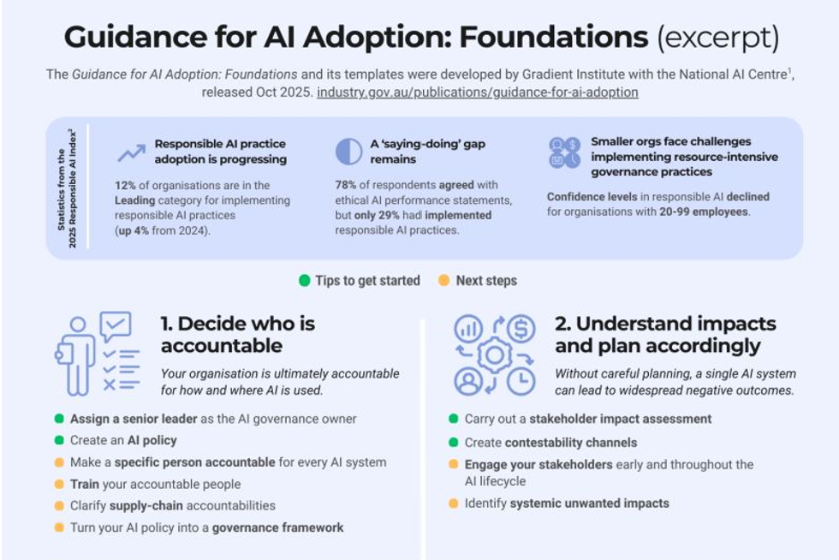
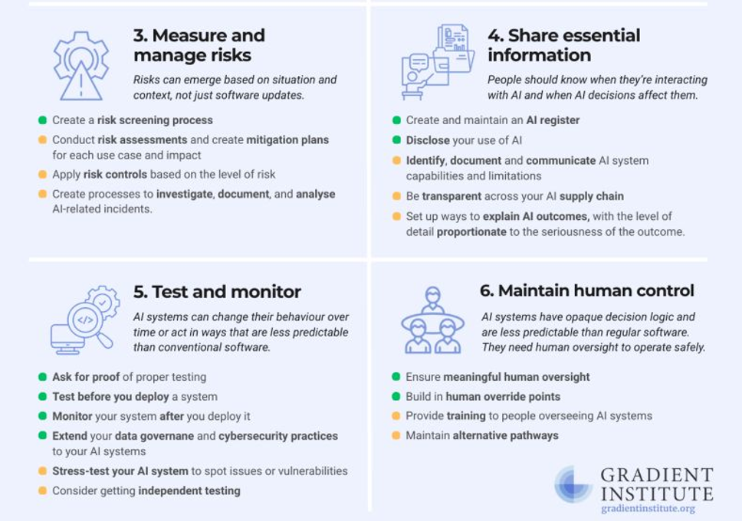
And these are useful foundations…

Slide 21
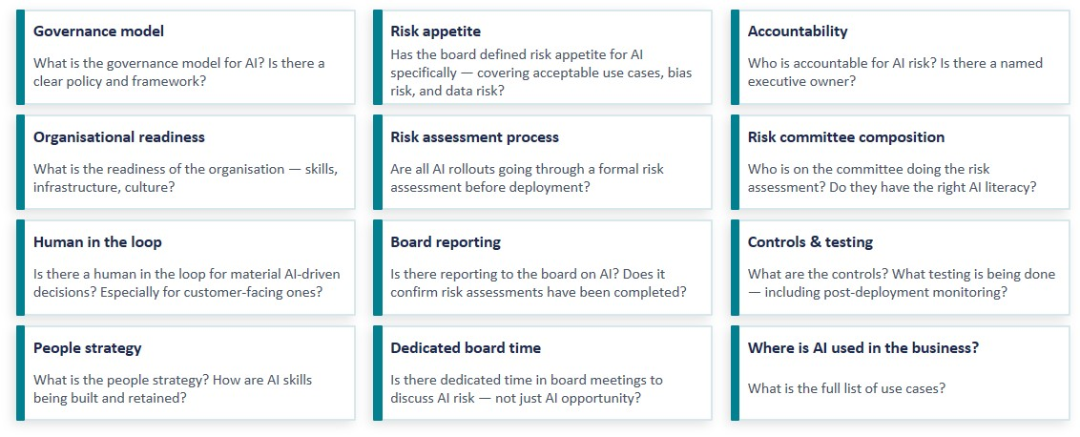
What questions should boards ask?

Slide 22
What should a governance model look like?
BOARD
Set AI risk appetite • Receive AI governance reporting • Challenge management on AI risk • Build AI literacy at board level
MANAGEMENT
AI strategy & policy • AI risk committee • Accountable executive • Risk assessment for all deployments • Three lines of defence • Vendor/concentration risk
OPERATIONS
AI inventory & classification • Model risk management • Bias & fairness testing • Post-deployment monitoring • Escalation triggers • Human-in-the-loop controls
Framework aligned to APRA Letter to Industry on AI (April 2026) and ASIC REP 798 (October 2024)

Slide 23
In other words…
✓
Not that different from “normal” governance
✓
New tools and mechanisms
✓
New forum (temporarily?)
✓
New way of assessing size of risk (modular approach?)
✓
New skills

Slide 24
But in the end… it comes down to Leadership, Culture and Training
LEADERSHIP
CULTURE
TRAINING
Safe to Speak Up
Vision & Strategy
Safe to Speak Up
People Strategy
Safe to Speak Up
The primary goal of leadership is to set vision and strategy for responsible AI adoption — not just chase capability.
Create cultures where people feel safe raising AI-related concerns — about bias, risk, or ethical misuse — without fear.
Create cultures where people feel safe raising AI-related concerns — about bias, risk, or ethical misuse — without fear.
The most important component of your AI strategy is your people strategy
Tone from the Top
Safe to Make Mistakes
Training
Boards and executives must model the behaviours they expect. Ethics in AI starts with the tone leadership sets.
Responsible experimentation requires psychological safety. Learning from AI failures is how organisations improve governance.
All levels need training – from board to line one.

Slide 25
Governing AI might be easier than governing humans!
AND REMEMBER…

Slide 26

Jon Shen FIAA, CERA
AI Practice Executive, Strategy and Governance, Suncorp Group.
Presenter of AI is here. Can you govern it?

Slide 27


AI is here. Can you govern it?
Jon Shen | July 2026
AI Practice Executive – Strategy and Governance
Suncorp
A PROPHECY
Security rolls out rapid security fixes to manage cyber risk. They're doing the right thing, but there are unforeseen consequences: the patches cause AI agents in production to break, customers can't get their claims serviced, and the finger-pointing begins.
How do you move forward from here?
Will your board ask the right questions?
Will your organisation absorb the pace of change?

Slide 28



Two regulators. Eight days apart.
APRA · PRUDENTIAL REGULATOR
ASIC · CORPORATE & FINANCIAL SERVICES REGULATOR
30 April 2026
8 May 2026
Governance, risk and resilience aren't keeping pace with AI.
Boards must be literate enough to provide effective challenge.
Cyber and third-party reliance are among the biggest gaps.
Strengthen cyber resilience against frontier-AI threats.
Don’t wait for perfect clarity; act now.
Boards must prove, not assume, that cyber controls are effective.
AI and cyber risk are merging. Responsible AI means developing, governing and running these systems ethically.

Slide 29


AI literacy is everyone's job.
Everyone will use AI
How will you ensure it is safe?
Every role will use AI to augment and accelerate their work.
Therefore everyone needs to understand its capabilities and limitations, the risks and controls to match.
What frameworks and processes have you implemented?
Take inspiration from e.g.
Australia’s AI Ethics Principles
Guidance for AI Adoption (AU NAIC)
Model AI Governance Framework for Agentic AI (SG IMDA)
Not just the board. Everyone.

Slide 30


Be intentional, wherever you sit.
In a technology or data team
In a pure actuarial team
Partner with security up front; don't bolt on controls after something breaks.
Test for poor customer outcomes, not just accuracy.
Know where AI sits across your systems and your vendors’.
Example: Customer-facing AI system to address common queries
Use AI to augment your work, never to replace your judgment.
Consider who a model's decisions could disadvantage.
Don't sign off on a model you can't explain; ask until you can.
Example: Streamlining claims activities and decisions
Responsible AI is a shared responsibility, across business, regulators and our profession.

Slide 31
We are living in unprecedented times.
The actuarial skillset equips us to shape the uncertain future ahead.
A MOMENT YOU'LL RECOGNISE

Slide 32
Resources (coming August 2026):
Technical Paper: Considerations for AI Adoption
Publication: AI Risk Management in the Financial Services Sector (with UTS HTI)

Slide 33

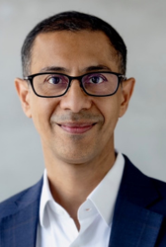
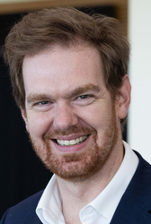

Lightning Talks with practitioners from Australia, Hong Kong and Singapore
Louis Lee, FIAA
Group Head of Agency Digital and AI at Prudential plc
Sanchit Maini, FIAA, FIAI, FSAS
Group Chief Product Officer, Prudential
Hugh Miller, FIAA
Principal at Taylor Fry
Bianka Grange, AIAA
Executive Manager, VERO SME Packages

Slide 34
Ethics & Professionalism
Actuaries and AI
Louis Lee

Slide 35
To Adopt or Not Adopt
RECKLESS ADOPTION
The risk we discuss
DEFENSIVE PARALYSIS
The risk we live with
⬇ SHADOW AI
Happens already everywhere | Ungoverned. Undocumented. Unauditable.
Using AI badly is a professional failure. So is not using it at all.

Slide 36

Example: AI Claims End-to-End
01
Conversational Claims Submission
02
Intelligent Data Processing
03
Matching with Underwriting Conditions, Exclusions
04
Adjudication, Decisioning & Explainability
05
Fraud Detection

Slide 37
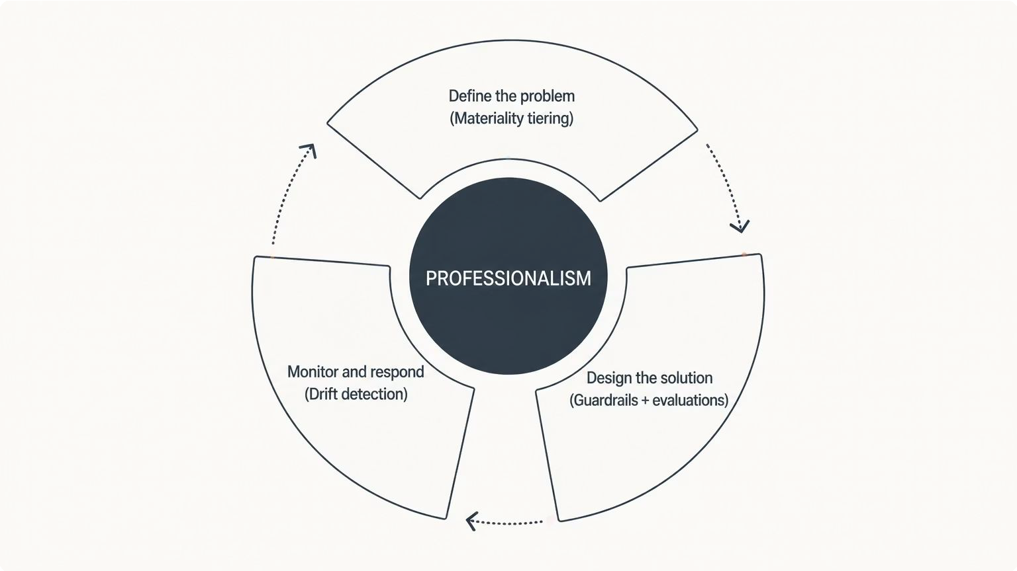
1 | AI Professionalism is just Control Cycle
What breaks if this is wrong?
How would I know if it were wrong?
How will I know when it stops being right?
Would I put my name on this?

Slide 38

2 | Things to check before signing off AI applications
Hallucinations
Model Bias
Adversarial
Groundedness
Toxicity
Explainability
↓ addressed by ↓
Guardrails
Real-time safety filters that block harmful inputs and outputs while enforcing usage policies.
Model Evaluations
Continuous testing of AI behavior for accuracy, bias, and safety before and after deployment.
Testing with Synthetic Data
Using artificial data to safely test AI systems for edge cases and biases without risking real user data.
Red Teaming
Simulating adversarial attacks to proactively find and fix vulnerabilities before bad actors do.

Slide 39




3 | The model can change after you approve it
1
The vendor changes the model
2
The Model can drift
3
The agent drifts
4
The adversary adapts
Monitor the Behaviour, not just the model. Feedback loop

Slide 40

4 | Automate the testing. Keep the judgment.
Automate
Evals on every build Guardrails on every request Adversarial testing
Drift monitoring
Cannot automate
What "acceptable" means The materiality tier Owning the residual risk Putting your name on it
Every actuary is can be an AI expert. Apply your Professional Standards and judgement.

Slide 41
Professional and Ethical Challenges in Product Development Across Asia and Africa
Sanchit Maini
22 July 2026

Slide 42
Contents
Setting the Scene 01
Framing the Problem 03
Framework to Progress 10
Concluding Remarks 12

Slide 43
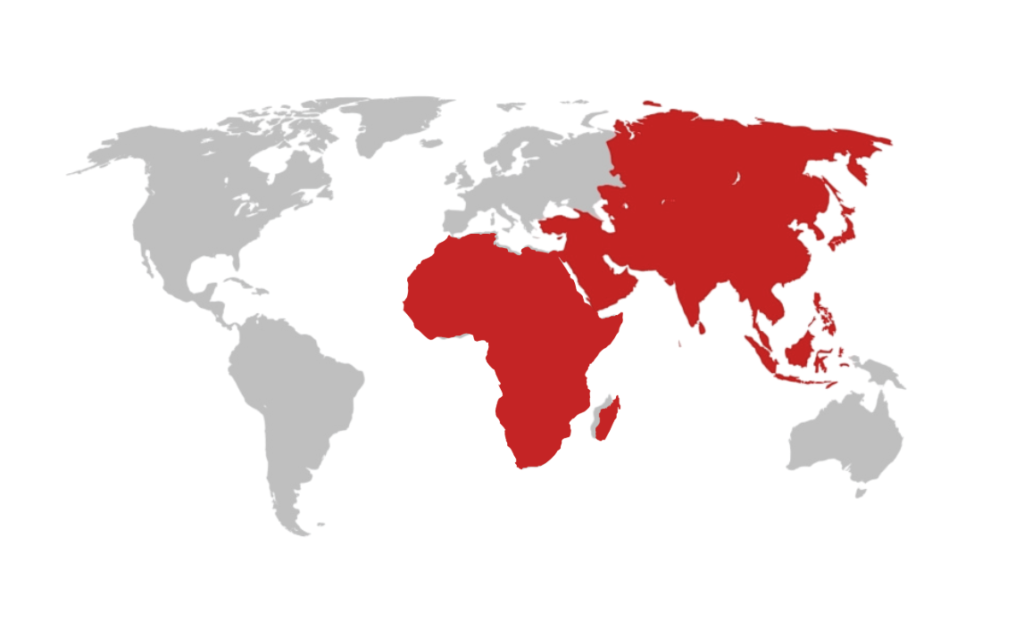
Setting the Scene
01

Slide 44
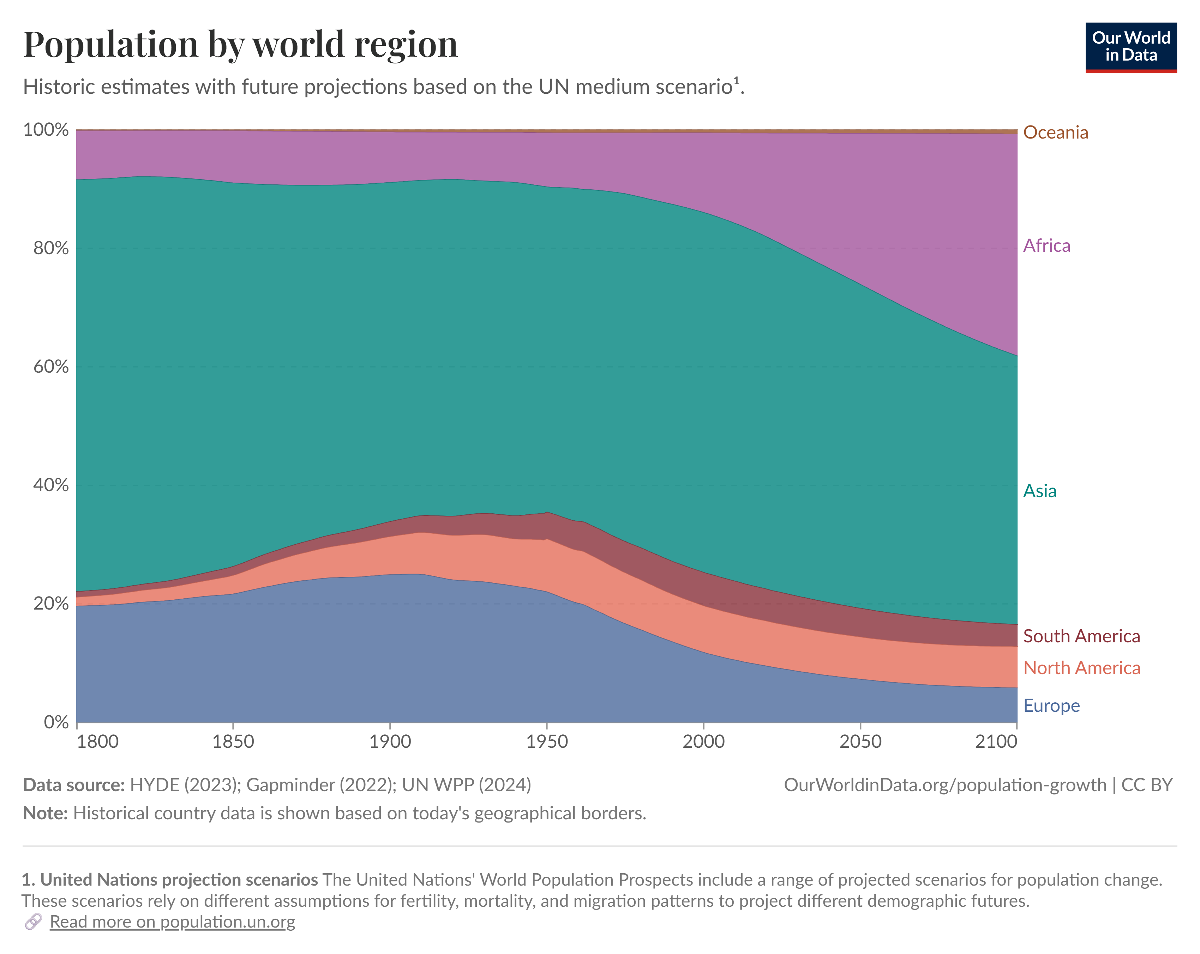
Asia and Africa
  Asia and Africa represent 78% of global population, and projected to increase to 83% by 2100.
  Africa will drive most of the population growth to 2100
  Asia and Africa represent ca. 37% of global GDP on a nominal basis, and ca. 55% on PPP basis
01

Slide 45


Asia and Africa
  These regions cover a wide variety of markets from Hong Kong and Singapore – well developed, internationally connected wealth hubs, emerging markets in ASEAN and Africa and many frontier markets such as Cambodia and Laos
  Regulatory, capital markets, technology adoption, consumer attitudes, access and affordability vary significantly
01

Slide 46
Framing the Problem
02

Slide 47
Key Considerations
  Access and Affordability
    Double digit medical inflation in many parts of Asia
    Medical coverage both a regulatory and policy issue
    Affordability issues straining household budgets
    Parts of Asia esp Greater China experiencing savings glut leading to higher demand for savings products
  Information Asymmetry
    Consumer information against: Regulatory, policy makers, insurers, reinsurers, distributors
  Sustainability and Inclusive Insurance
    Manage conflict within ESG, especially ‘E’ and ‘S’
    Inclusive insurance lens – beyond income to consider demographic and underwriting factors
    Transition over exclusion
02

Slide 48
Archetype for Progress
03

Slide 49
[Foundational elements]
  Holistic considerations across:
    Risk – policyholder, shareholder, conduct, compliance
    Stakeholders – consumers, community, shareholders, distributors, investors, rating agencies, regulators, policy makers,
    Time horizons – importance varies by stakeholder, and competing priorities based on short and the long view require decision trade-offs
  Reasonable expectations of:
    Policyholders: shaped by several factors eg point of sale disclosures, management actions, competitor behaviour, regulatory and policy guidance
    Regulators: fair disclosures, understanding of policy benefits, features, coverage, fairness of management actions over policy lifetime; level playing field; sustainability
    Society: the ‘S’ of ESG; acknowledge and address negative externalities, issues emerging over longer horizon; inclusivity, sustainability, fairness, access & affordability
  Design Principles
    Clear customer segment
    Establish customer needs – features to address needs
    Less is more
    Greater flexibility over longer coverage periods – both policyholder and shareholder
    Clear disclosures – especially on management discretion and how it is exercised
    Consistent principles across policy term and cohorts
    Risk buffers – to ensure sustainability, while balancing policyholder fairness
03

Slide 50
Concluding remarks
  Holistic stakeholder considerations
  Product design to reflect: clear, simple, easy to sell, easy to understand
  Consumer at the heart of everything
  Tragedy of horizons
  Corporate memory – learnings from past failures
04

Slide 51
Thank you
Actuaries Institute
actuaries.asn.au

Slide 52
Working in the social sector – professionalism and ethics
Hugh Miller
APAC Professionalism & Ethics, July 2026

Slide 53
An example
You are the quantitative lead for an evaluation of a new mental health program, which has been operating for nine months. It is a relatively expensive/intensive program compared to existing services.
Qualitative research shows very high rates of satisfaction among participants. Staff interviewed also view the program as effective.
You have looked at self-rated psychological distress over time as well as administrative outcomes (mental-health related presentations to emergency departments). There is no evidence of improved outcomes:
    Distress improves, but no faster than for similar people not accessing the program
    No impact visible on emergency department visits
  How do you position the advice?

Slide 54
An example
Trust the numbers
The data shows an expensive program with little impact, so make clear the program has a lack of efficacy
You are the quantitative lead for an evaluation of a new mental health program, which has been operating for nine months. It is a relatively expensive/intensive program compared to existing services.
Qualitative research shows very high rates of satisfaction among participants. Staff interviewed also view the program as effective.
You have looked at self-rated psychological distress over time as well as administrative outcomes (mental-health related presentations to emergency departments)
    Distress improves, but no faster than for similar people not accessing the program
    No impact visible on emergency department visits
  How do you position the advice?
Downplay the numbers
Make the strong qualitative findings the key observations, noting lots of potential limitations in the quantitative work
Reframe the numbers
Point to the strong decreases in distress scores as good evidence that the program is helpful
Something else?
I don’t know

Slide 55
An example – some thoughts
The importance of strong subject matter expertise
What are the client’s key choices and decision points?
What does the broader evidence base say?
How real are the uncertainties of impact?
What’s the quality of survey and qualitative work?
How do we get to a stronger evidence base?
Notes:
SME - helps enormously – For example, there are many reasons why the ED metric would not generate a positive result (people finding other services, short time frame, lowish rates anyway). Likewise, significant evidence that distress scores will improve across different programs
Qual - Have surveys and qualitative work been asking the right questions (e.g. ‘has this helped’ is always pretty strong)? If yes, we cannot ignore completely
What are the main decisions being made (e.g. to what extent is trial extension an option, vs shutting down or widespread rollout)
How real are the uncertainties of impact (e.g. perhaps evidence for alternative is similarly weak)

Slide 56
Broader comments
Public service ethos & professionalism
Don’t hide the limitations
Understand impacts on vulnerable populations
Work with experts
There is a responsibility to call out programs that are not working
How much do my priors affect my conclusion?
Notes:
Public service professionalism – ‘frank and fearless advice’. Self-censorship is unhelpful
Always need an appropriately clear presentation of limitations alongside numbers (otherwise people will trust the numbers too much).
Need to be aware of the limitations of our subject matter expertise
Cohorts and vulnerable populations – will some people disproportionately suffer based on particular advice/decisions
We want to help those who need it, but there is also a duty to use taxpayer funds effectively.
Self-reflection – to what extent do my personal beliefs/priors affect my interpretation of results

Slide 57
Thank you
Actuaries Institute
actuaries.asn.au

Slide 58
Ethics and Leadership
Bianka Grange
2026 APAC Ethics and Professional Seminar

Slide 59


I’m not a philosopher...
  My curiosity about ethics started in 2021, with an MBA course in critical thinking. A course in how we reason and engage honestly with views that aren’t our own.
    Primary Ethics: volunteer ethics teacher in NSW primary schools, every Tuesday morning
    The Good Place and Mike Schur’s How to Be Perfect: moral philosophy made relatable
    Co-chair of the Institute’s Diversity & Inclusion working group: applied ethics in practice
  The idea: ethical behaviour is not a trait you have or don’t. It is a muscle — it grows with deliberate use.
01

Slide 60

Why ethics matters?
What must we do? vs What we should do?
Meeting the standard and ticking the box tells you the minimum. It sets the floor, not the goal.
Leaders operate in grey areas. The decisions we make, the behaviours we reward or ignore, shape the culture around us.
Ethical leadership builds trust
Your role: create the conditions where everyone’s ethical muscle gets used

Slide 61
Poll
When making a decision, what do you instinctively prioritise?
A. Rules and obligations
B. Best overall outcome
C. Personal values or character
D. What will be perceived as fair

Slide 62
Building your ethical compass
Deontology
Kant
Some actions are right or wrong in themselves, regardless of outcome.
Underpins law, professional codes and regulation. Its strength is clarity; its weakness is rigidity.
Consequentialism
Bentham & Mill
The right action produces the greatest good for the greatest number.
How actuaries often think: optimise the outcome. Without constraints, it can justify almost anything.
Virtue ethics
Aristotle
What kind of person should I be? Character is built through habit.
But virtues can go too far. Courage becomes recklessness. The virtuous path is the balance, applied with judgement.
Your compass
Not about picking one framework. It is recognising which one is doing the work, and which one others are using.
Disagreement is often not about the decision, but about which question is being answered.

Slide 63
Ethics, Critical Thinking, and Diverse Perspectives
  Ethics and critical thinking: the same practice
  We rarely notice our own biases
  Disagreement ≠ bad faith
  Maybe they see what we don't
  Diversity reveals blind spots, not just "other opinions"
01

Slide 64
Poll
What makes people least likely to question a situation to raise a concern?
A. Fear of being wrong
B. Fear of consequences
C. Belief nothing will change
D. Not realising there is something to be concerned about

Slide 65

Psychological Safety
  Silence grows where people fear judgement, blame or punishment
  Unraised concerns resurface bigger, later
  Perfection isn't the goal; reflection and learning are
  Leaders who own mistakes give others permission to do the same
  Nobody wakes up trying to be bad. The work is getting better at it
  Ethical practice lives in the reckoning, not just the good calls
01

Slide 66
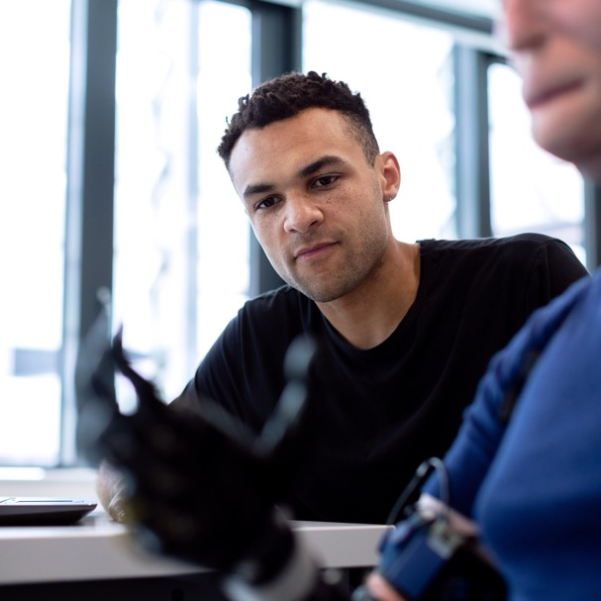
Final Thoughts
    Four things to take away
    Know your compass.
    Be curious about other people’s compasses.
    Create a culture where people can speak: through what you say AND do.
    Treat mistakes as moments for ethical learning.

Slide 67
Thank you
Actuaries Institute
actuaries.asn.au

Slide 68

Sim Ng
Chief Controller, Prudential Group
Workshop Facilitator

Slide 69
Case Study and Interactive Workshop
Stuart Turner & Sim Ng

Slide 70
Agenda
The importance of practicing ethical thinking
Case study discussion groups – Part 1
Discussion
Case study discussion groups – Part 2
Discussion
Ethics and Professionalism

Slide 71
The Importance of Practicing Ethical Thinking
Reminding ourselves of our obligations drives better outcomes
Hearing and considering other perspectives
Acting ethically is hard in the real world

Slide 72
Case Study – Part 1
You’re an actuary working in a pricing role, for a small company that has a reputation for strong environmental and social focus, with the objective to improve the lives of those in developing nations. The Board and investors support the social mission but also look for investments that generate acceptable return on investments (ROI). The business has invested heavily in AI technology to reduce the cost of distribution, reach communities and help low-income households obtain insurance that traditional agency and bancassurance distribution models have struggled to provide. To achieve this objective, the AI model has been designed and trained primarily to maximise take-up rates and reduce distribution costs.
In a few of the target markets, the traditional agency model has been providing employment and financial education within the local communities. Similar products are offered, which is a life coverage plus additional optional coverages such as personal accident, 10 critical illnesses or hospital income. However, the product distributed by the AI model is significantly cheaper for the same coverage.

Slide 73
Case Study – Part 1
The initial trials are producing complicated results. Early reporting has focused primarily on sales volumes, take-up rates and distribution costs. Whilst the AI-enabled distribution model is materially cheaper to operate and appears capable of scaling sales rapidly, the take-up varies significantly across regions for reasons that are not yet fully understood.
The project team has assessed success mainly through cost reduction, conversion rates and expected profitability.
The leadership team is also grappling with how to govern the AI implementation responsibly. The model is complex, the pace of development is fast, and there is no clear accountability on who should approve changes, monitor take-up rates and customer outcomes, challenge model assumptions or decide when the product is ready to scale. Everyone is under pressure to move quickly due to funding constraints.

Slide 74
Discussion Questions:
As an actuary, what areas are you responsible for in this initiative?
What governance structure, expertise and challenge mechanisms should be put in place to manage the financial, governance, social and ethical risks before the product is significantly scaled up?
With funding for the development about to dry up and stakeholders nervous about over-investing in AI, what considerations and assessments are required before further investments are made?

Slide 75
Discussion groups
You will be moved to a Zoom break-out room
Nominate a person to provide some short, written feedback in response to the questions
You have 10 minutes to discuss the questions
When we return, we will ask the nominated person to enter your key points into the Zoom chat.

Slide 76
We are currently in Breakout Rooms
You're in the main session while breakout rooms are underway. Don’t be alarmed, your system or login may not be compatible with Breakouts. Please stay with us, we'll be back together shortly.
In the meantime, feel free to think through the case study questions yourself.

Slide 77
Discussion:
Enter your group’s feedback via the Zoom chat
As an actuary, what areas are you responsible for in this initiative?
What governance structure, expertise and challenge mechanisms should be put in place to manage the financial, governance, social and ethical risks before the product is significantly scaled up?
With funding for the development about to dry up and stakeholders nervous about over-investing in AI, what considerations and assessments are required before further investments are made?

Slide 78
Case Study – Part 2
The pressure to launch quickly is high, but some judicious risk mitigants are put in place. Following the full launch, volumes increase significantly. Insurance coverage in the markets with high response rates increase greatly (with some other markets remaining underserved), and your offering is seen as a market leader, with some competitors soon following. Many low-income households now have access to insurance protection that they would otherwise never have obtained.
Twelve months down the track, the business begins to receive some media queries about the massive decline in the old distribution market, with many small businesses, sales and education roles not being needed with the advent of your simpler, automated AI solution. As first entrant in the market, criticism is being laid at you for the social impact of your changes.
Complaints are also being received from customers who feel that the benefits of the product were overstated, and the complaints are concentrated in the markets with high take-up rates. Investigation indicates that this may have unintentionally been the result of the AI seeking to optimise the financial outcomes for the business by selling more to lower risk customers. Internal reviews find no evidence that the AI model was deliberately designed to mislead customers or disadvantage particular groups.
Periodic reviews are in place for financial and operational KPIs, but did not assess customer understanding, community impacts or boarder social outcomes.

Slide 79
Discussion Questions:
What responsibility does the company have for the broader consequences of a successful innovation? What role do you play in this discussion as an actuary in the company? How should organisations balance improved customer outcomes, financial returns and wider social impacts when evaluating new technologies?
Who is accountable when unintended consequences occur? What governance approaches might have reduced the risk of AI misstatement of the benefits? What other metrics could have been tracked to identify issues earlier?

Slide 80
Discussion groups
You will be moved to a Zoom break-out room
Nominate a person to provide some short, written feedback in response to the questions
You have 10 minutes to discuss the questions
When we return, we will ask the nominated person to enter your key points into the Zoom chat.

Slide 81
We are currently in Breakout Rooms
You're in the main session while breakout rooms are underway. Don’t be alarmed, your system or login may not be compatible with Breakouts. Please stay with us, we'll be back together shortly.
In the meantime, feel free to think through the case study questions yourself.

Slide 82
Discussion:
Enter your group’s feedback via the Zoom chat
What responsibility does the company have for the broader consequences of a successful innovation? What role do you play in this discussion as an actuary in the company? How should organisations balance improved customer outcomes, financial returns and wider social impacts when evaluating new technologies?
Who is accountable when unintended consequences occur? What governance approaches might have reduced the risk of AI misstatement of the benefits? What other metrics could have been tracked to identify issues earlier?

Slide 83
Q&A with all our presenters
Please use Zoom Q&A for your questions.
The presenters will get through as many as they can.

Slide 84
Major Sponsor
Thank you
to our partners
Community partners

Slide 85
Thank you
to our supporting
association
partners

Slide 86
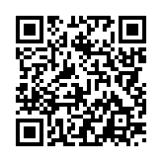
Please take a moment to complete our survey
This is important for us when planning this event in the future. Scan the QR code to be taken to a short 5 question survey

Slide 87



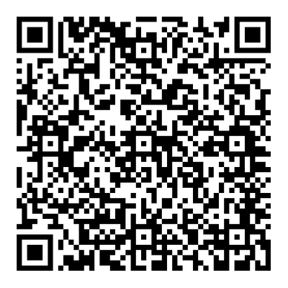
Subscribe to
research and analysis that shapes tomorrow's
decisions.
Subscribe now

Slide 88
Thank you for joining us

